Slide 1
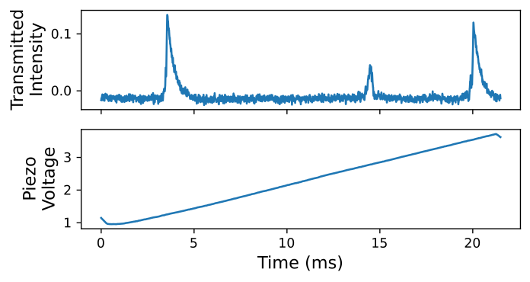
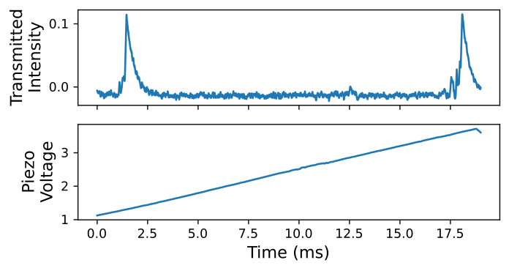
Misaligned Cavity
Aligned Cavity
Higher order mode

