Slide 1
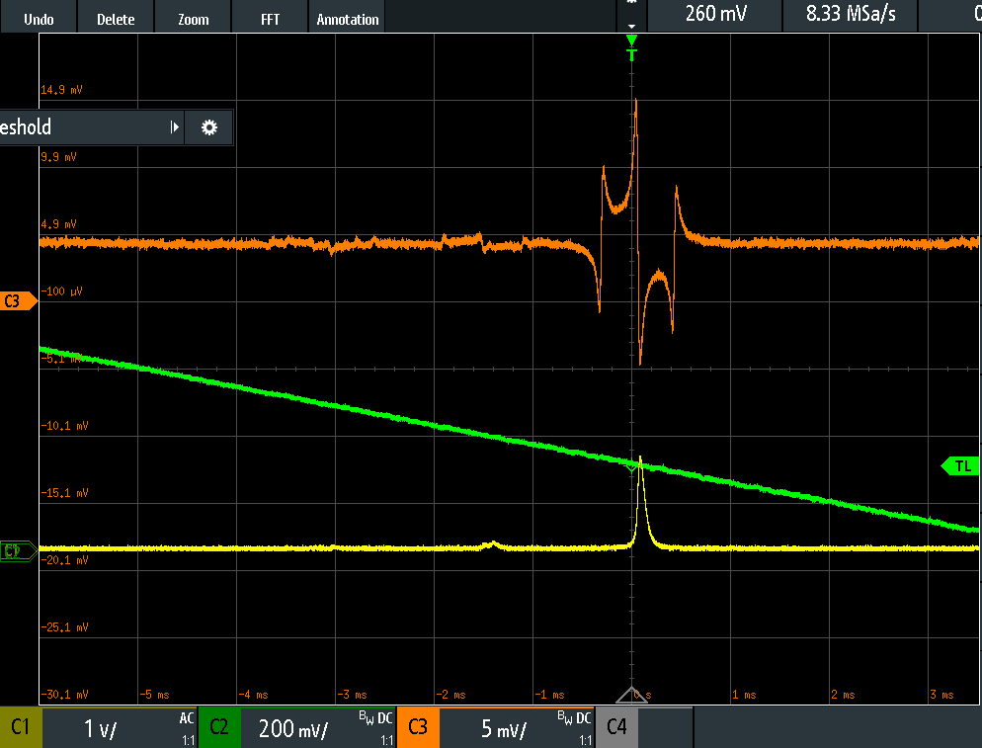
LPF
Error Signal
RF Generator
Error Signal
Servo Loop
Piezo Drive
φ
Mixer
Transmission
Monitor
PD
EOM
AOM
PZT
RF Generator
Modulation Signal

