Slide 1



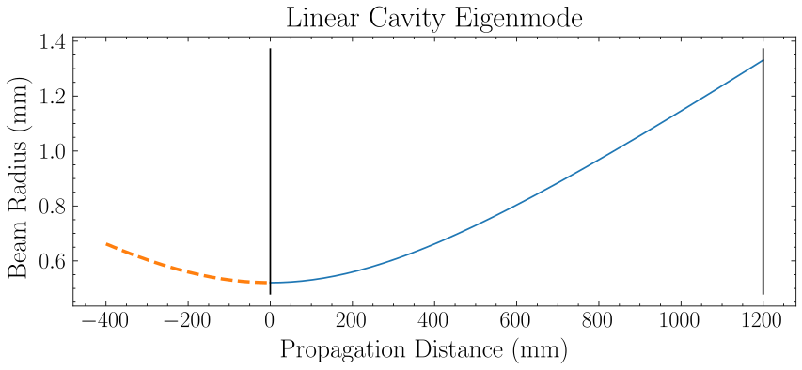
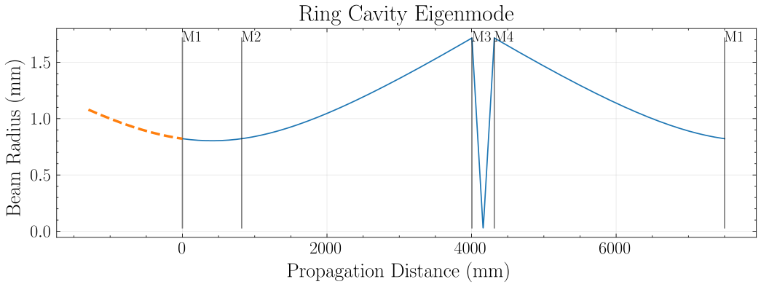
(a)
(b)
M3
M4
Input Beam
Output Beam
Input Beam
Output Beam
M1
M2

