Slide 1
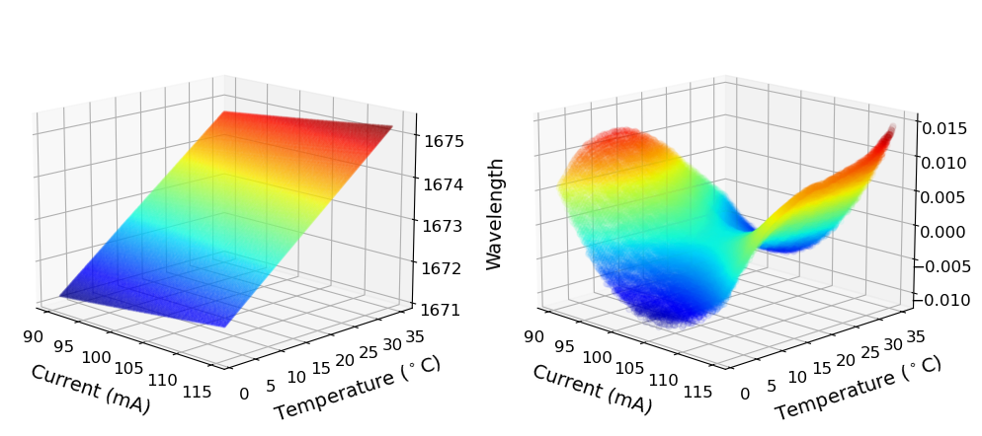
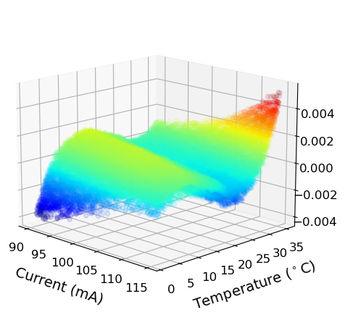
(a)
(b)
(c)
Fit Error
Fit Error

