Slide 1
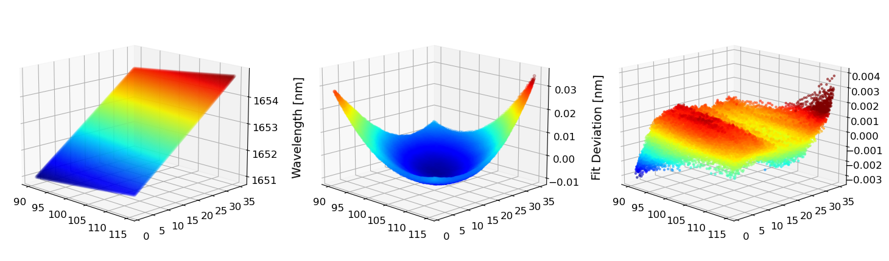
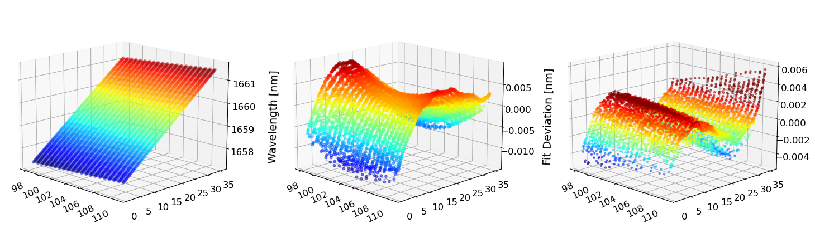
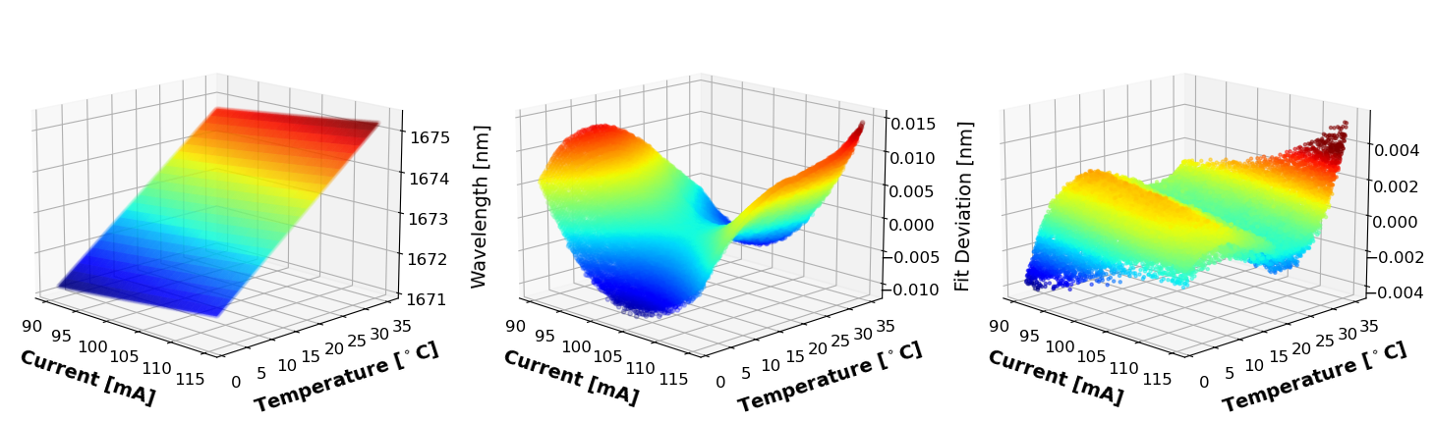
Wavelength Data
Plane Subtracted
Paraboloid Subtracted
Laser 1
Laser 2
Laser 3

