Slide 1
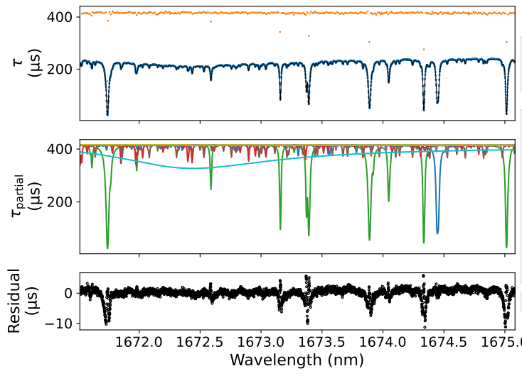
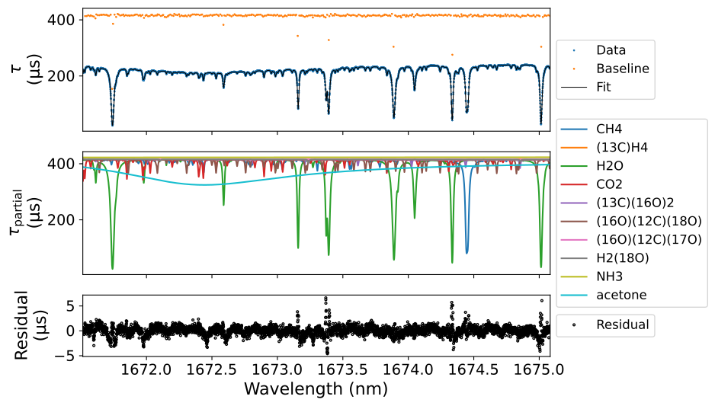
Non-Interacting Gas Approximation
Self-Broadening Iteration

