Slide 1
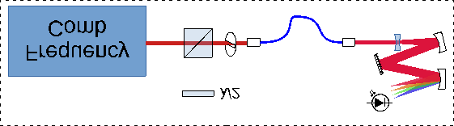
Saturated Absorption Spectroscopy
Measurement
Ti:Sapphire
CW Laser
PD1
PD3
Stabilized
He-Ne Laser
PD2
Scanning
Michelson Interferometer
Optical Detuning Measurement

