Slide 1
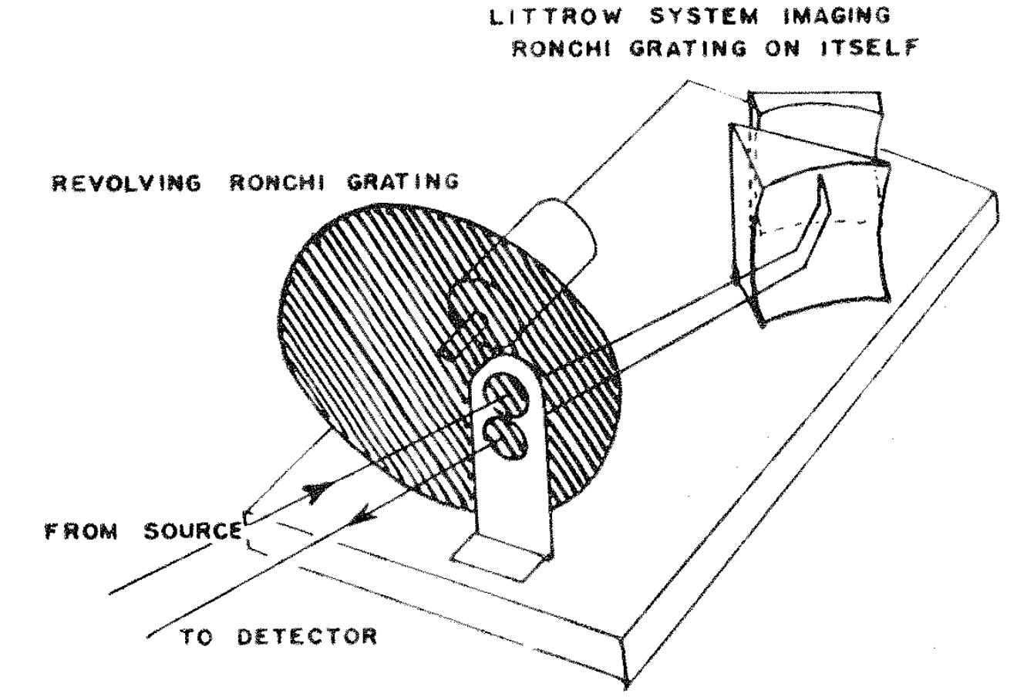

a)
b)
Littrow
Prism
Rotating Grid
Lens

