Slide 1

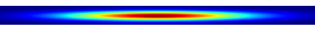
Focusing Optics
PD
Output From Spectrometer

