Slide 1

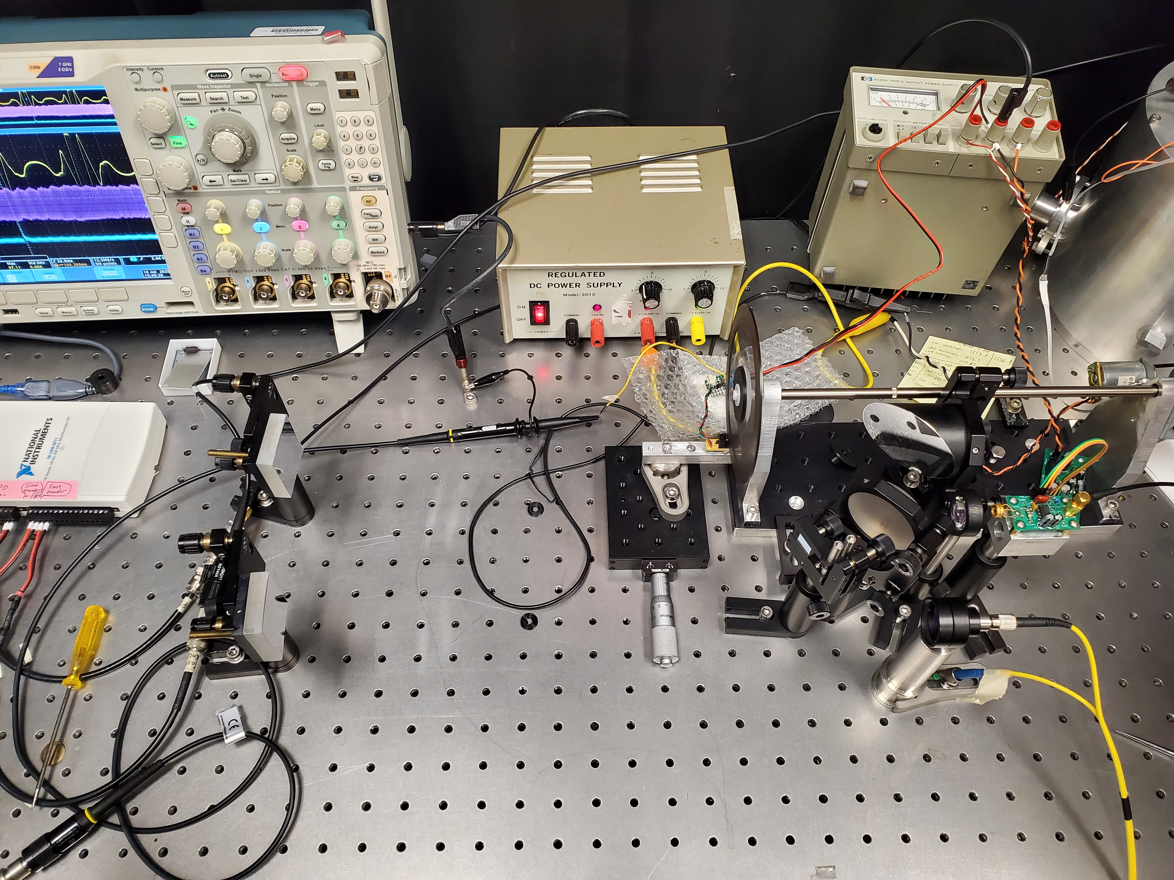
Focusing Optics
Amplified
Photodiode
Input Light

