Slide 1
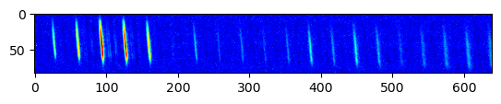
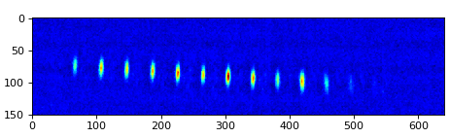
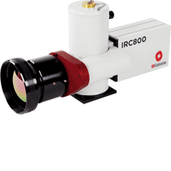
Czerny-Turner Configuration
NIR Recording
Vernier Filtered Comb Light
MIR Recording

