Slide 1
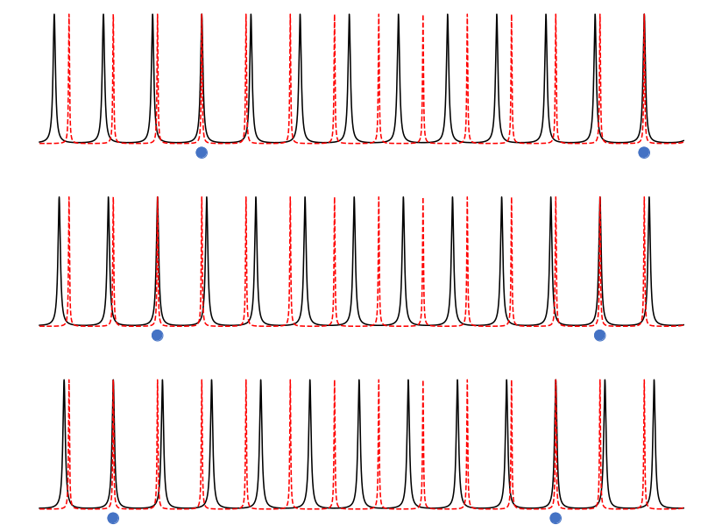
Detector Signal
Repeating Absorption Feature
Time
Time
Grating Dispersion Direction
Grating Dispersion Direction

