Slide 1
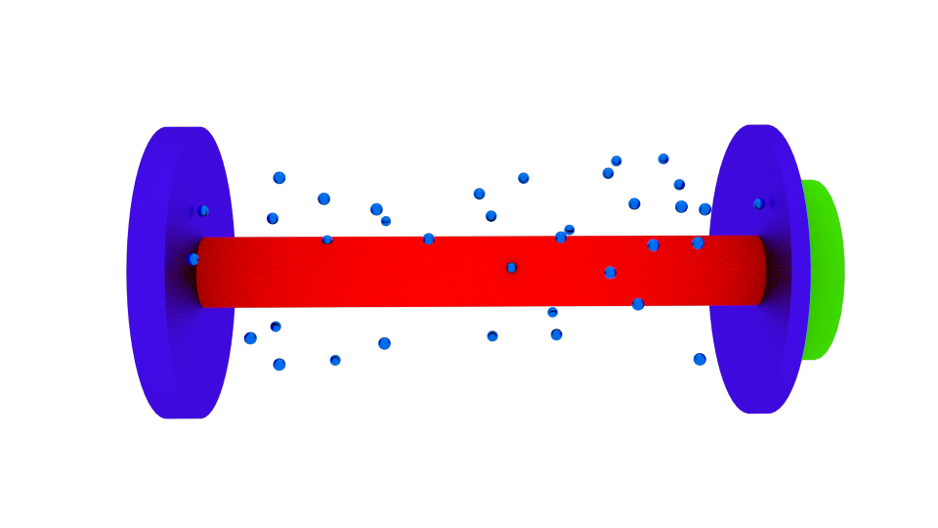
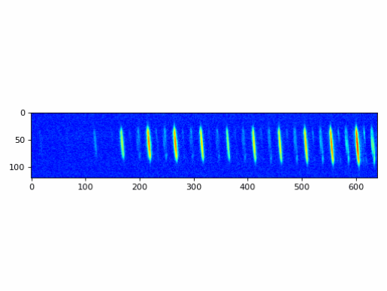
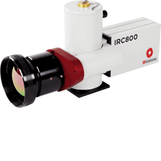
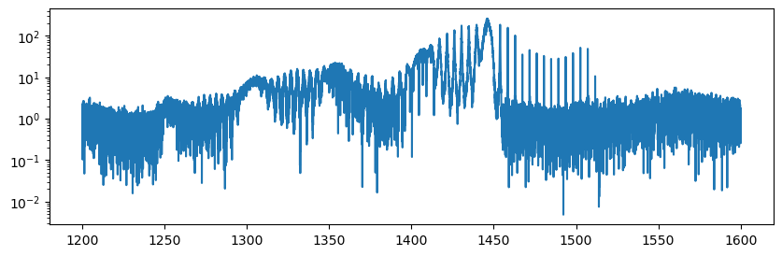
FTS
Mode-Matching
Telescope
Optical Cavity FSR = 250MHz
Czerny-Turner Configuration
ELMO fs-laser module
125MHz rep. rate
PZT
Pressure Controlled Chamber
Camera Data
Position Sensitive Detector
Vernier Filtering observed with FTS
Infrared Camera LN2 Cooled
Wavelength [nm]

