Slide 1
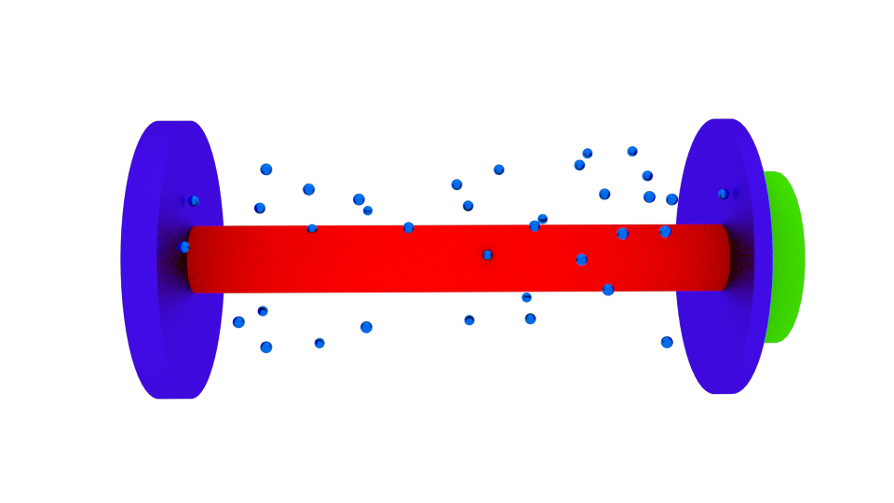
Piezo Ramp
Output Pulses
Comb
Laser
Spectrometer

