Slide 1
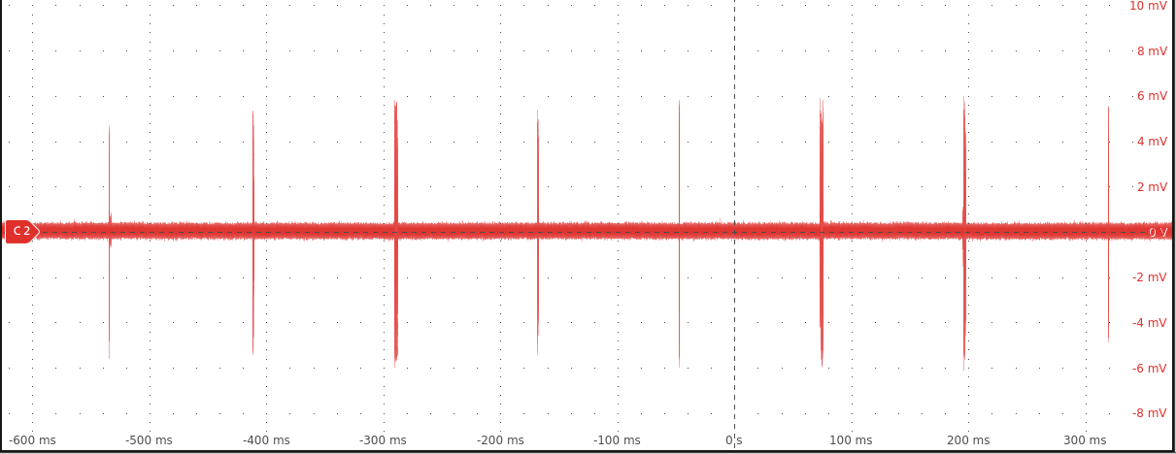
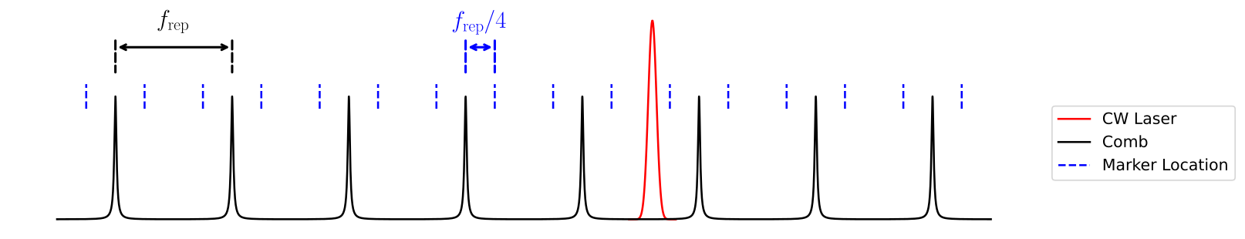
Beat Note
Mixer
LPF
Frequency
Generator
Scanning
Optical Frequency

