Slide 1

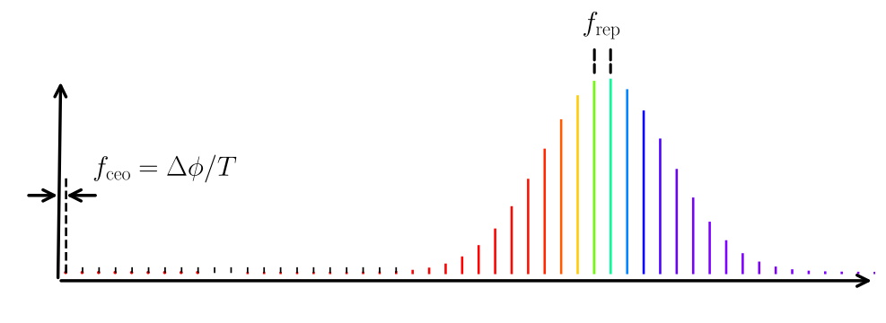
Time Representation
Frequency Representation

