Slide 1
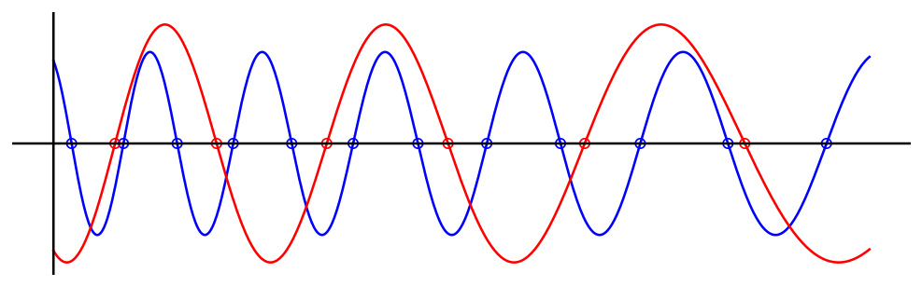
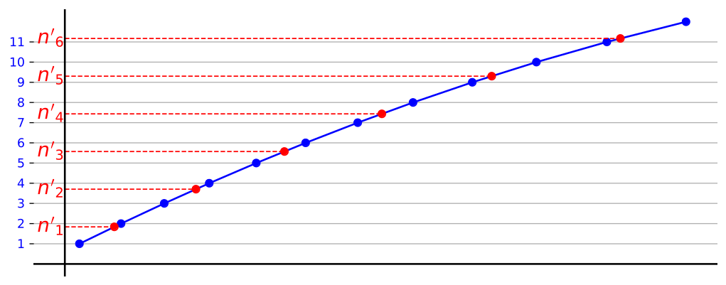
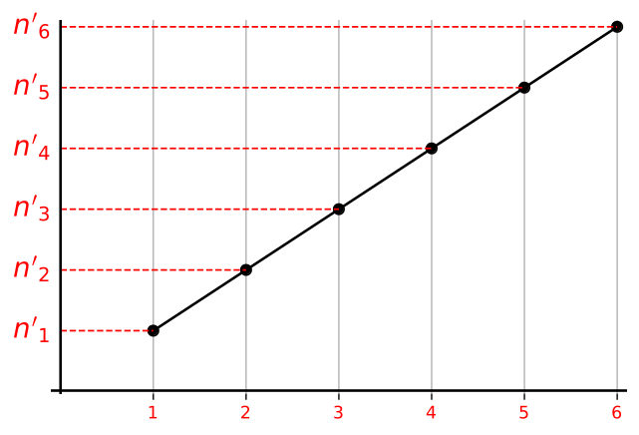
Filtered
Interferograms
Reference Laser
Time
Test Laser
Ref Phase / π
Interpolated Ref Phase / π
Time
Test Phase / π

