Slide 1
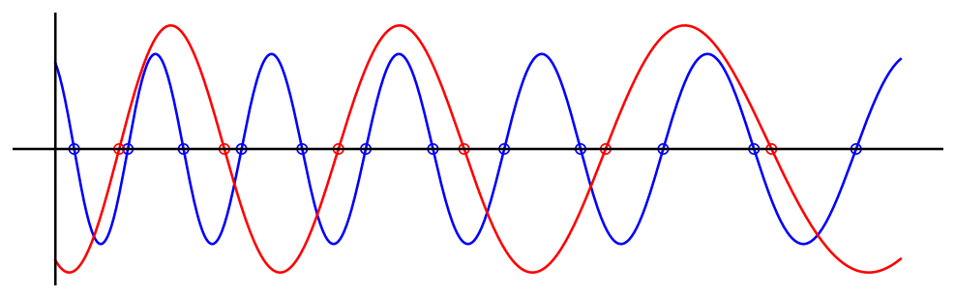
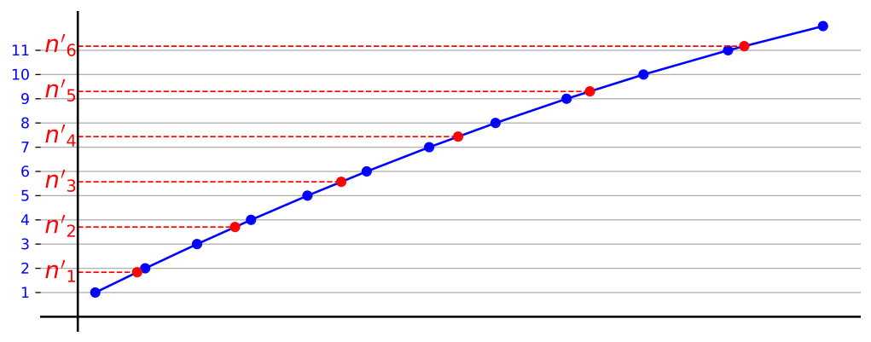
Filtered
Interferograms
Reference Laser
Time
Test Laser
Ref Phase / π
Time

