Slide 1
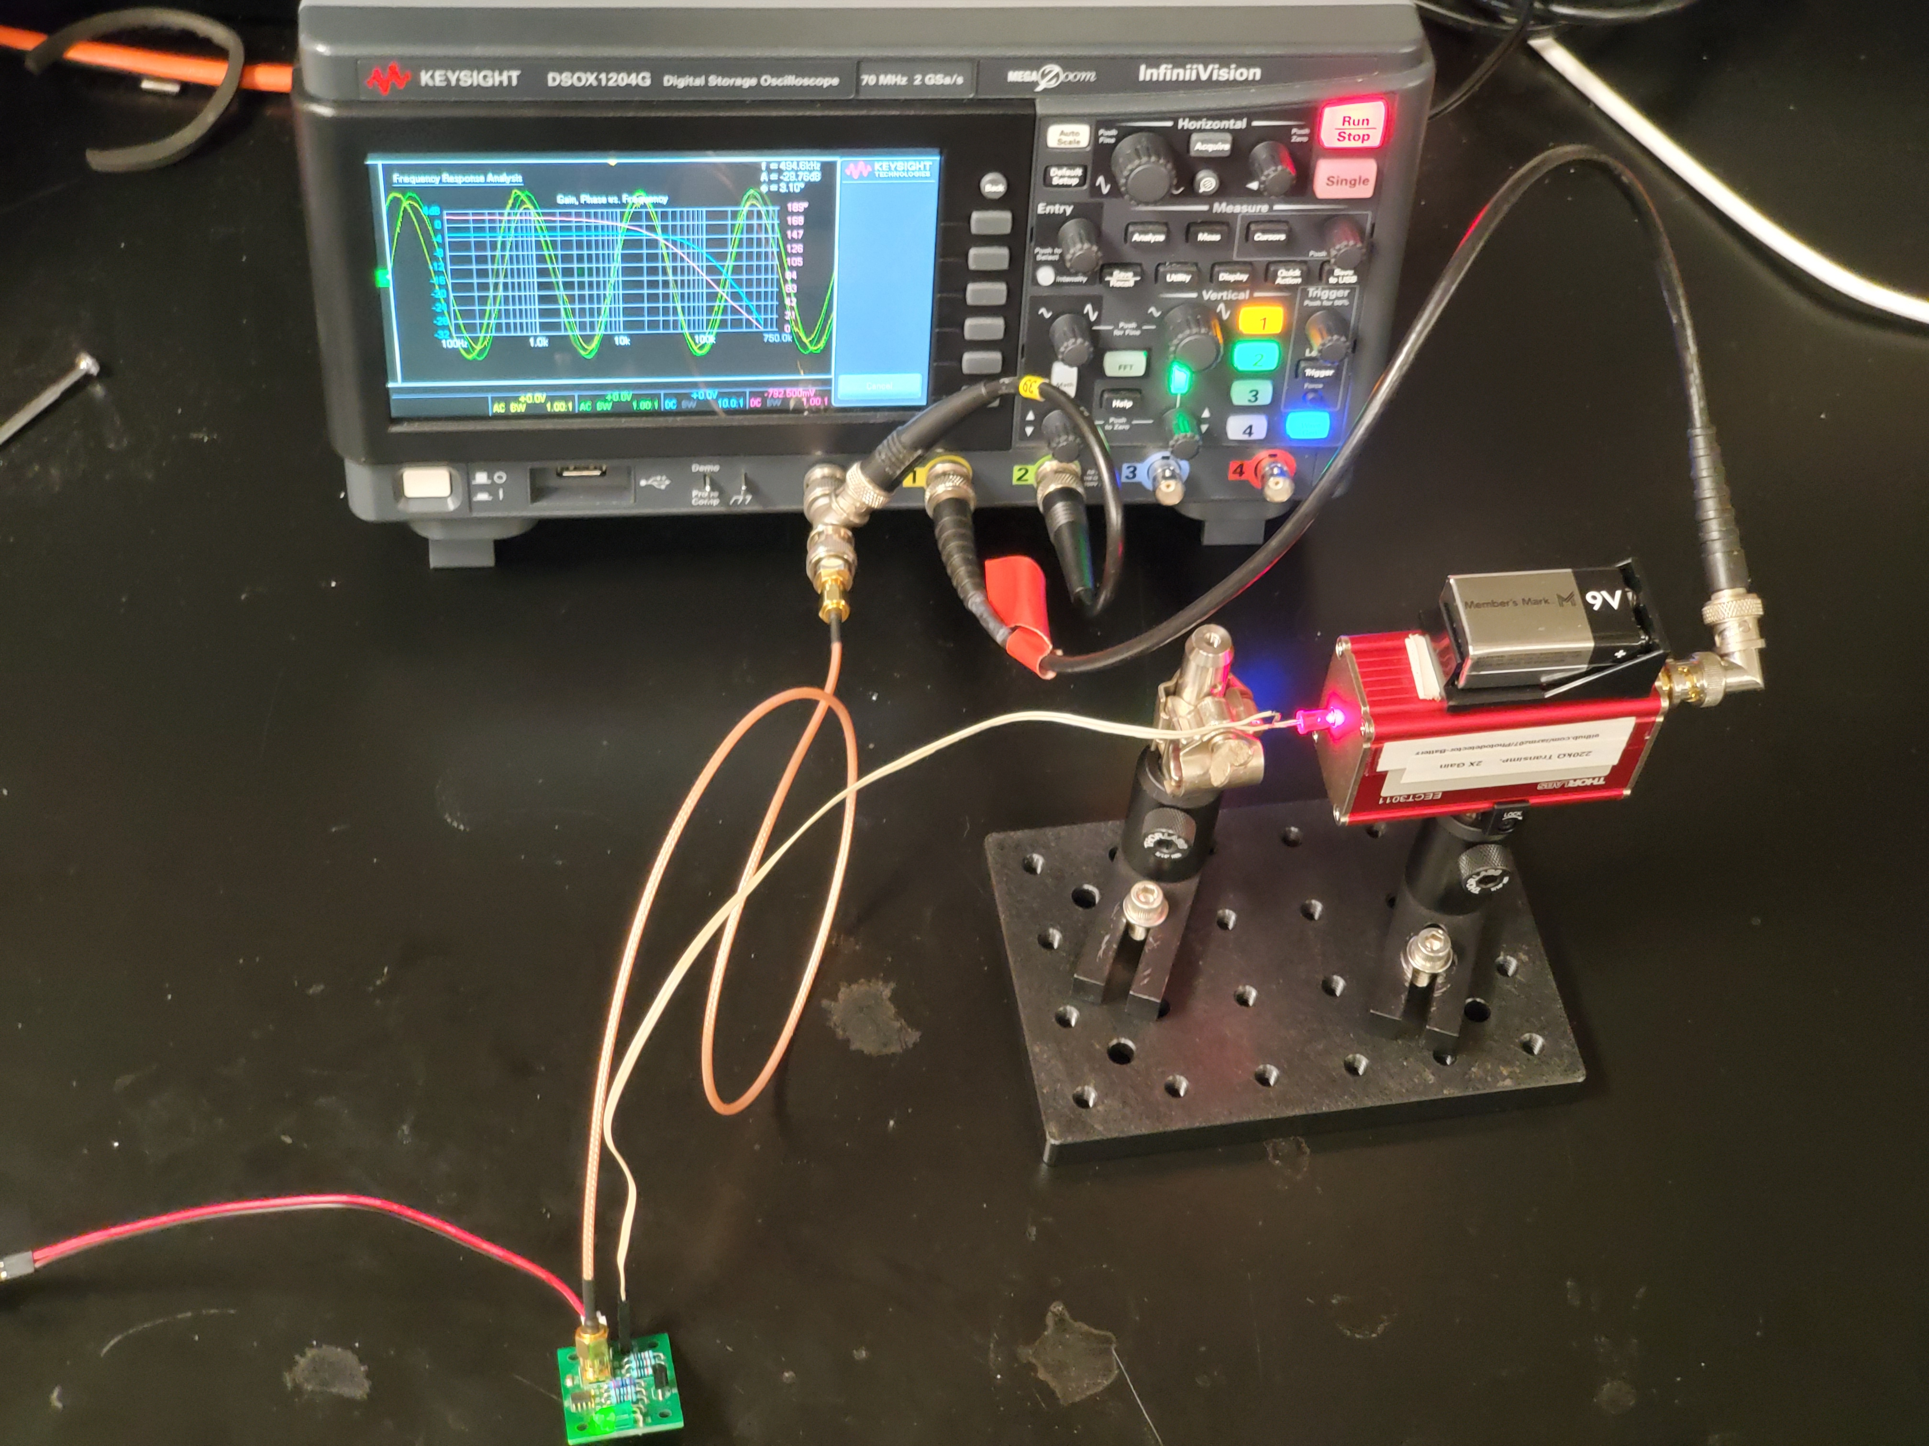
Scope
Func.
Gen
Ch2
Ch1
Function Generator
Input
Const.
Current
Driver
LED
PD
InGaAs Photodiode
LED
Constant Current Source w/ Modulation In

