Slide 1
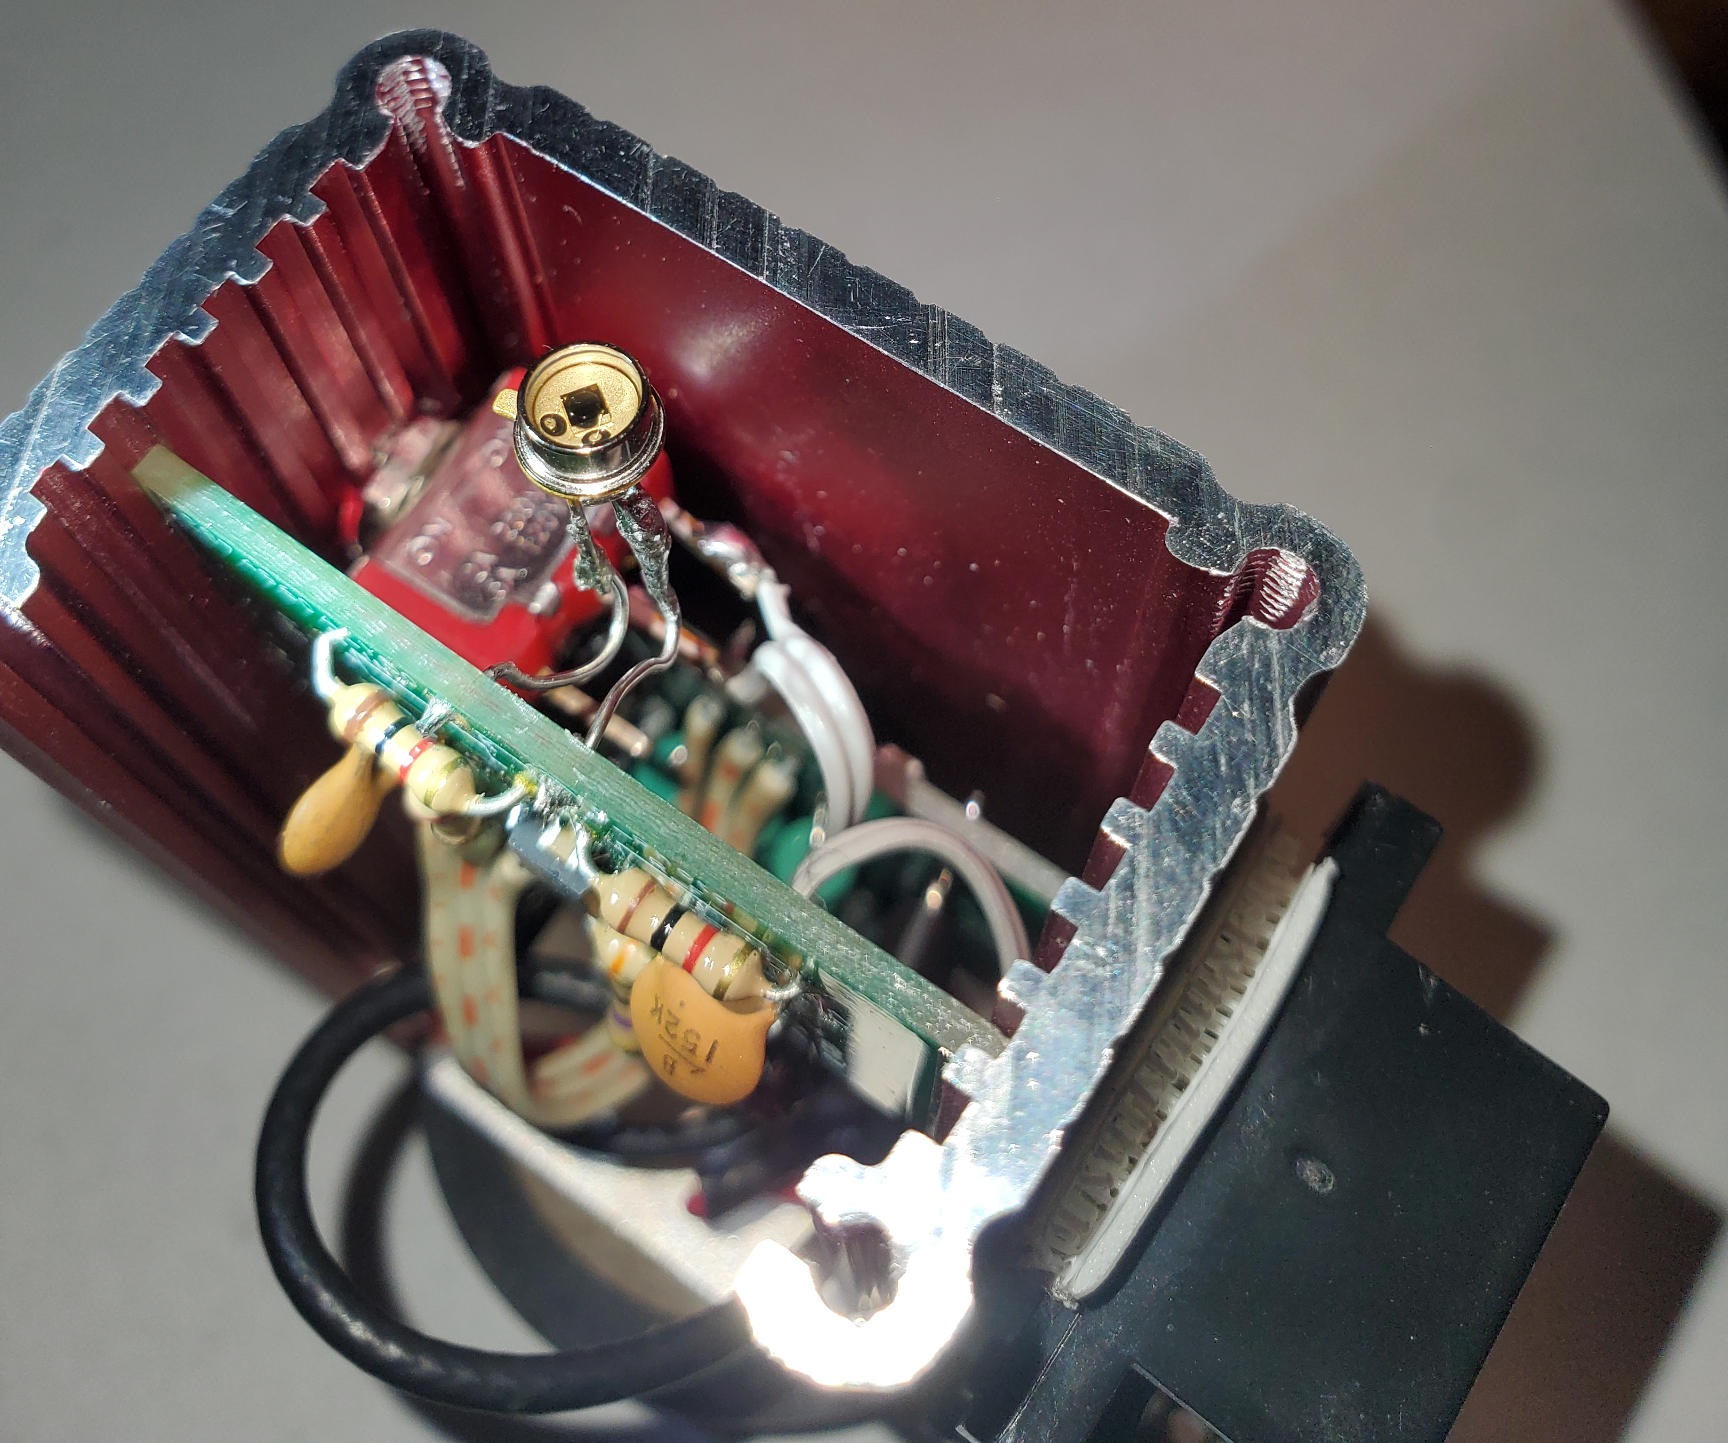
Photodiode
Break Point

