Slide 1
Statistics for Public Health Research
Center for Data Research and Analytics

Slide 2
Session-1 Table of Content
Population and parameters
Research question
Quantification of a research question
Measuring the outcome
Collecting data for the study parameters
The other factors
Sample and Estimators
Inference vs generalizability
Random sample
Source of biases in sampling

Slide 3
Population
Population is the complete collection of research subjects

Slide 4


Slide 5
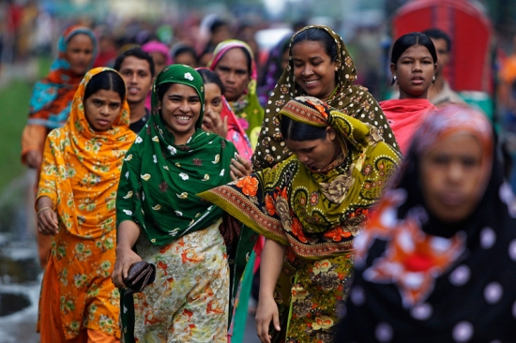

Slide 6
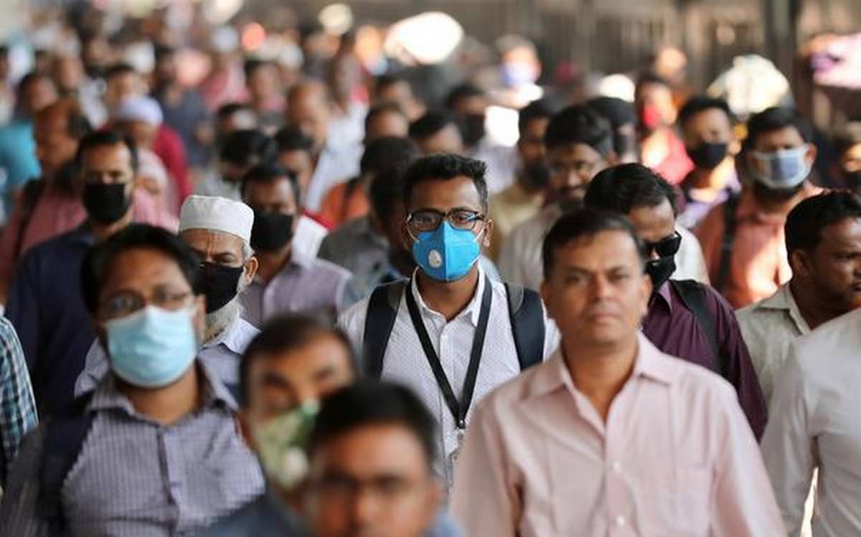

Slide 7
