Slide 1

CT111
Project
Presented by team 6 of group 6
Date: 19th July 2021.

Slide 2
Honor Code
We declare that
The work that we are presenting is our own
work. We have not copied the work (the code,
the results, etc.) that someone else has done.
Concepts, understanding and insights we will be describing are our own.
We make this pledge truthfully. We know that violation of this solemn pledge can carry Grave consequences.
DA-IICT | CT111 Project | Group 6 | Team 6

Slide 3









Signatures of Team members
DA-IICT | CT111 Project | Group 6 | Team 6

Slide 4

Information is the resolution of uncertainty.
-Claude Shannon
DA-IICT | CT111 Project | Group 6 | Team 6

Slide 5
Contribution of Members
Task | Name | ID | Contribution
BEC & BSC Channel Coding | Kunal Hotwani Smit Bhavsar Om Patel | 202001468 202001464 202001462 | Designed channel for generating random Message.
BEC Hard decision decoder | Om Patel Kalp Pandya Kunal Hotwani | 202001462 202001466 202001468 | Designed algorithm and implementation in c++
BSC Hard decision decoder | Om Patel Chintan Kanpariya Raj Shah | 202001462 202001463 202001460 | Designed algorithm and implementation in c++
DA-IICT | CT111 Project | Group 6 | Team 6

Slide 6
Contribution of Members
Task | Name | ID | Contribution
BEC Soft decision decoder | Om Patel Jay Navadiya Jay Grover | 202001462 202001465 202001467 | Designed algorithm and implementation in c++
BSC soft decision decoder | Om Patel Jay Navadiya Kalp Pandya | 202001462 202001465 202001466 | Designed algorithm and implementation in c++
Presentation | Jay Navadiya Raj Shah Harsh Agheda | 202001465 202001460 202001461 | Content Creation, Designing and Animations.
DA-IICT | CT111 Project | Group 6 | Team 6

Slide 7
Contribution of Members
Task | Name | ID | Contribution
Monte-Carlo Simulations | Jay Navadiya Chintan Kanpariya Harsh Agheda | 202001465 202001463 202001461 | Did most number of simulations and derived data for graphs
Graph Plotting & Matrix Loading | Kunal Hotwani | 202001468 | Plotted graphs in MATLAB with the data generated, Loaded H matrices in C++.
DA-IICT | CT111 Project | Group 6 | Team 6

Slide 8
MVP of Our Team
MVP
Special Mentions
Om Patel
(202001462)
Jaykumar Navadiya (202001465)
Kunal Hotwani (202001468)
Kalp Pandya (202001466)
DA-IICT | CT111 Project | Group 6 | Team 6

Slide 9
The Main Learnings
DA-IICT | CT111 Project | Group 6 | Team 6

Slide 10
Main Learnings
01
02
03
04
LDPC Codes
Debugging skills
How to work in a Team?
Patience
DA-IICT | CT111 Project | Group 6 | Team 6

Slide 11
Difficulties we faced
We did not have direct functions for Matrix and XOR operations because we decided to use C++.
Matrix computations were therefore harder to perform in C++.
Running Monte Carlo simulations sometimes crashed our computers and sometimes terminal was forcefully stopped by the computer giving us partial result of the simulations.
(showed zsh: killed )
Apart from this we also faced many issues which we debugged later on.
DA-IICT | CT111 Project | Group 6 | Team 6

Slide 12
Solution to the problems
We performed the matrix operations manually by using loops in C++.
Divided Monte-Carlo simulations in parts for using time efficiently.
(0-0.3, 0.31-0.6,0.61-1)
DA-IICT | CT111 Project | Group 6 | Team 6

Slide 13
Major Accomplishments
(Novelty of our approach)
We were able to obtain great time efficiency because of our algorithms expect
BSC hard decision decoding because we did not had to store messages of VN to CN or CN to VN anywhere else. We did that by only using h matrix itself. It reduced running time by quite a lot.
DA-IICT | CT111 Project | Group 6 | Team 6

Slide 14
Roadmap for Project
01
02
03
04
Converting .mat to .txt
Implementing Decoders
Required functions for c++
Analysis of
Decoders
DA-IICT | CT111 Project | Group 6 | Team 6

Slide 15
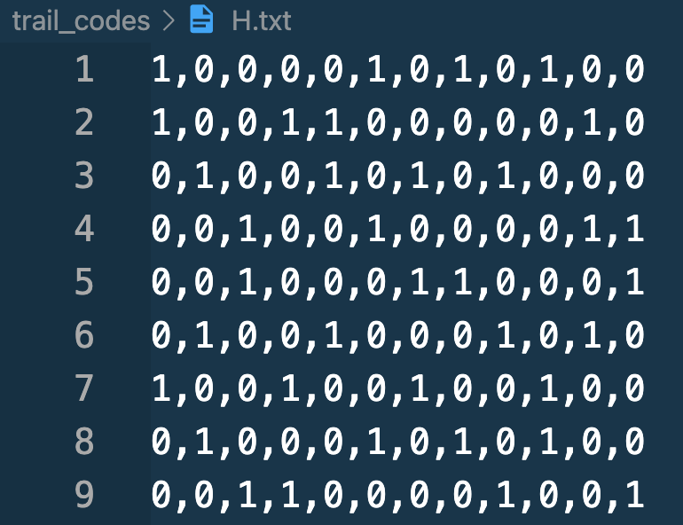
Converting .mat to .txt
We had to convert .mat files to .txt files as there is no way to load .mat into c++ directly.
To do so, we opened matlab and used dlmwrite function.
This function writes the data in the .mat file to a .txt file.
We then used this .txt file to read the data in C++.
DA-IICT | CT111 Project | Group 6 | Team 6

Slide 16
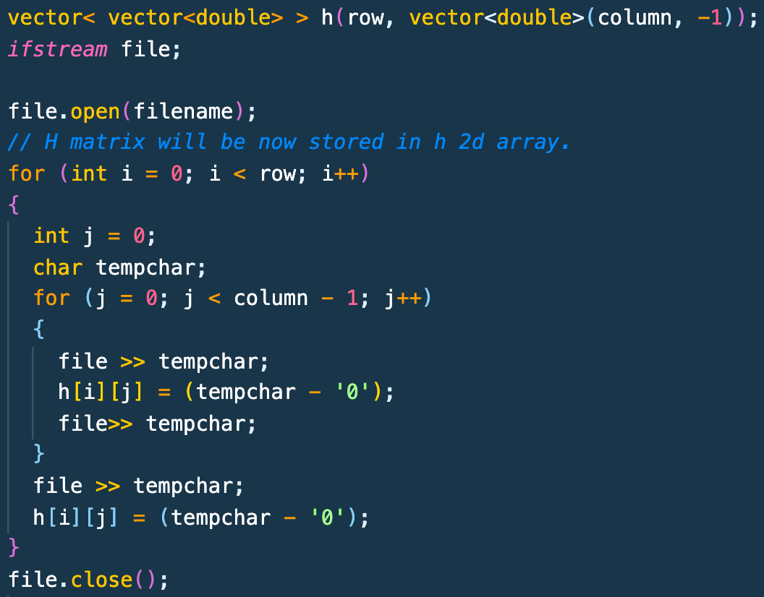
Loading .txt file in C++
We used the code given on the left for loading .txt files in C++.
It was stored in a 2d vector (Matrix) named h.
DA-IICT | CT111 Project | Group 6 | Team 6

Slide 17
Channels
DA-IICT | CT111 Project | Group 6 | Team 6

Slide 18
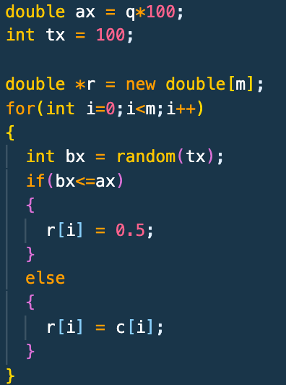
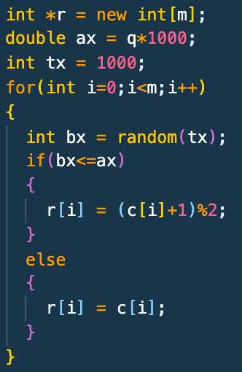
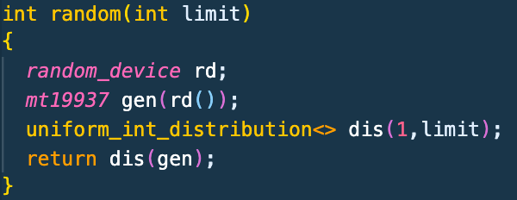
BEC Channel (Soft)
BSC Channel
Random function

Slide 19
Decoding Algorithms
DA-IICT | CT111 Project | Group 6 | Team 6

Slide 20
BEC Hard Decision Decoding
At the very ﬁrst,we will load the variable nodes with message from the channel.
After this, all the variable nodes will pass the message to their respective check nodes.
Then we will start iteration through check nodes.
If there is one erasure in the check node then,the value of that erased node will be modulo two sum· of all other variable nodes values in the check nodes.
If there is more than one erasure then the erasure is not solvable.
We will return this value to the connected variable node.
If there is no erasure present in all of the variable nodes or if the number of iterations exceeds the given maximum number of iterations then we will break the loop.
After this, it is checked if all the erasures are removed. If there is an erasure present then we will consider that the message was not decoded successfully.
DA-IICT | CT111 Project | Group 6 | Team 6

Slide 21
BSC Hard Decision Decoding
We just load values of received message as the value of corresponding VN for the zeroth iteration.
Further, we send message[1] from each VN to all connected CN and calculate decision bit for corresponding VN[2].
Next, we send message[3] from CN to VN.
Lastly, we check whether codeword gets updated from previous iteration. If codeword does not gets updated, we break the loop else we move to next iteration with updated values for VNs until we have reached iterations limit.
When we have exited the loop either due to no updation or iteration limit reached, we check whether received and transmitted codewords are same or not. If they are same, we are assured that the codeword is successfully decoded.
[1] Majority vote of d_{v} – 1 messages and message received over channel
[2] Majority vote of d_{v} CNs and received message over channel
[3] Modulo 2 sum of d_{c} – 1
DA-IICT | CT111 Project | Group 6 | Team 6

Slide 22
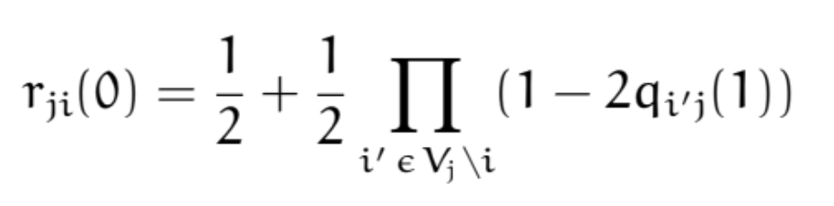
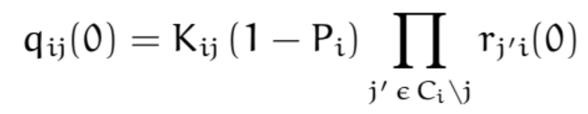
BSC Soft Decision Decoding
We just load values of VNs with probabilities from received codeword from channel for zeroth iteration.
Further, we send message[1] from each VN to all connected CN and calculate decision bit for corresponding VN[2]. Next, we send message[3] from CN to VN. The message will be calculated by the formulae:
Lastly, we check whether codeword gets updated from previous iteration. If codeword does not gets updated, we break the loop else we move to next iteration with updated beliefs for VNs until we have reached iterations limit.
When we have exited the loop either due to no updation or iteration limit reached, we check whether received and transmitted codewords are same or not. If they are same, we are assured that codeword is successfully decoded.
DA-IICT | CT111 Project | Group 6 | Team 6

Slide 23
BSC Soft Decision Decoding
[1] VN sends probability of itself happening 0 when value at d_{v} – 1 check nodes and receiving channel are all 0.
[2] Decision is set to 1 when λ₁ (product of likelihoods that VN is 1 for d_{v} CNs and receiving channel) is greater equal to 1.
[3] CN sends probability of VN happening 0 that accounts for different cases of d_{c} – 1 VNs connected to it.

Slide 24
BEC Soft Decision Decoding
At the very ﬁrst,we will load the variable nodes in the array Respectively.if r_{i} 0 it will send 0 else if r_{i} 1 it will send 1 else it will send 0.5.
Everything else is just same as BSC Soft decision decoding and we will remove erasure if λ is not equal to 1.
Breaking conditions will be when there are no erasures or the iterations are completed.
DA-IICT | CT111 Project | Group 6 | Team 6

Slide 25
Numerical
Results
DA-IICT | CT111 Project | Group 6 | Team 6

Slide 26
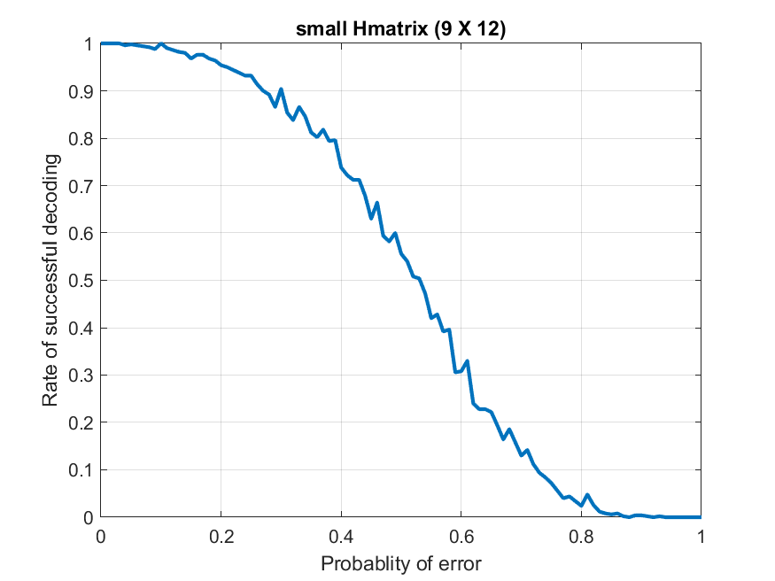
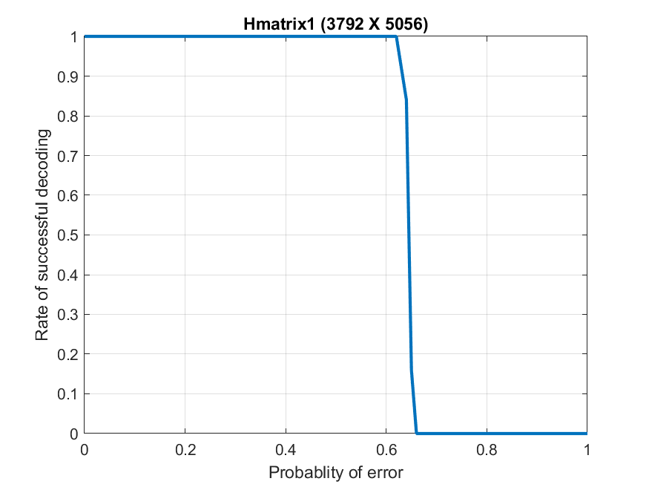
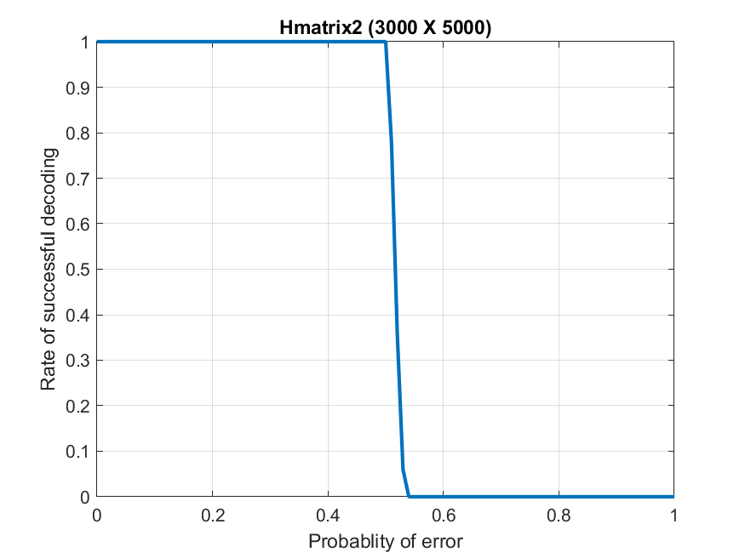
BEC Hard Decision Decoding
Small H matrix (9 x 12)(3,4)
Hmatrix1 (3792 x 5056)(4,3)
Hmatrix2 (3000 x 5000)(5,3)
Drops to 0 at P_{error}=1.
Drops to 0 at P_{error}=0.62.
Drops to 0 at P_{error}=0.51.
DA-IICT | CT111 Project | Group 6 | Team 6

Slide 27
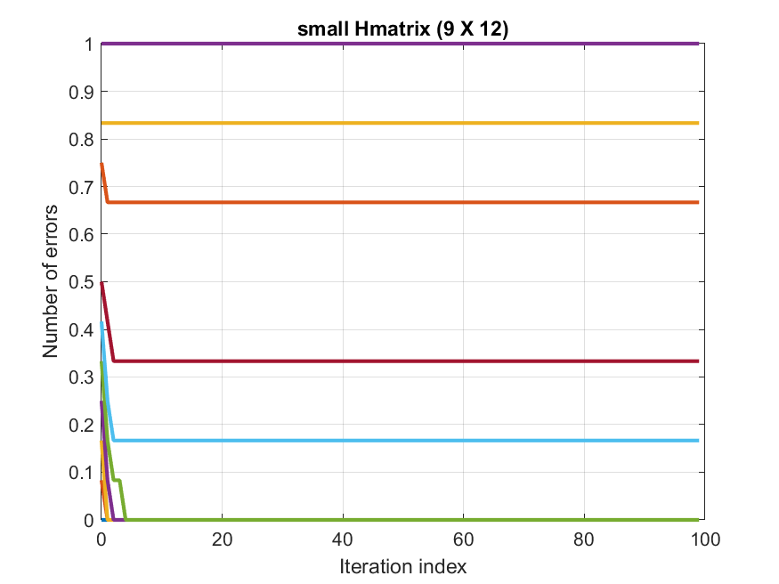
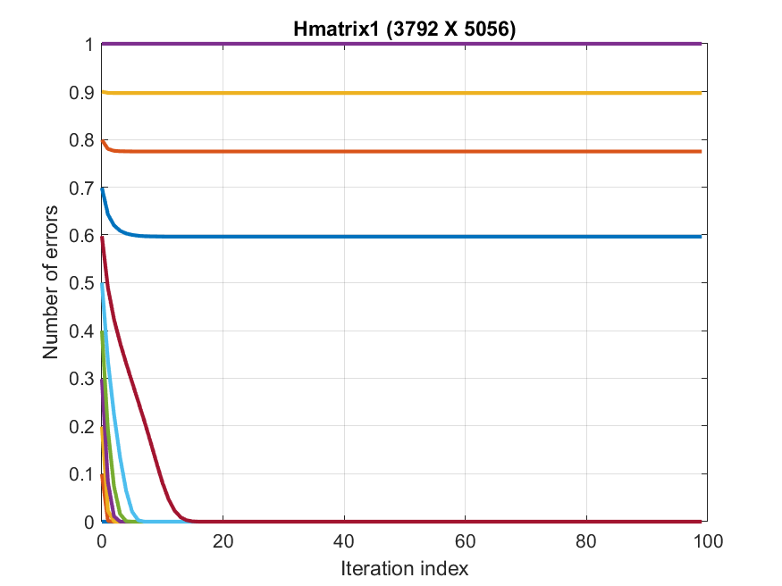
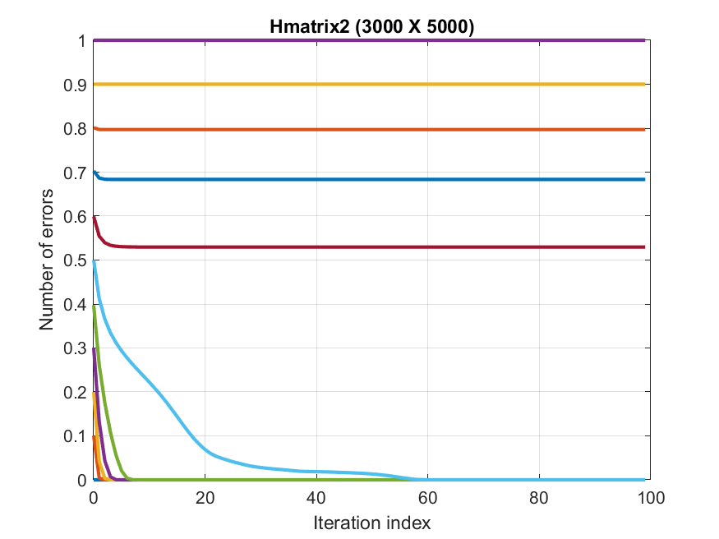
BEC Hard Decision Decoding
Algorithm Convergence Graphs
Small H matrix (9 x 12)(3,4)
Hmatrix1 (3792 x 5056)(4,3)
Hmatrix2 (3000 x 5000)(5,3)
Drops to 0 at P_{error}=1.
Drops to 0 at P_{error}=0.62.
Drops to 0 at P_{error}=0.51.
DA-IICT | CT111 Project | Group 6 | Team 6

Slide 28
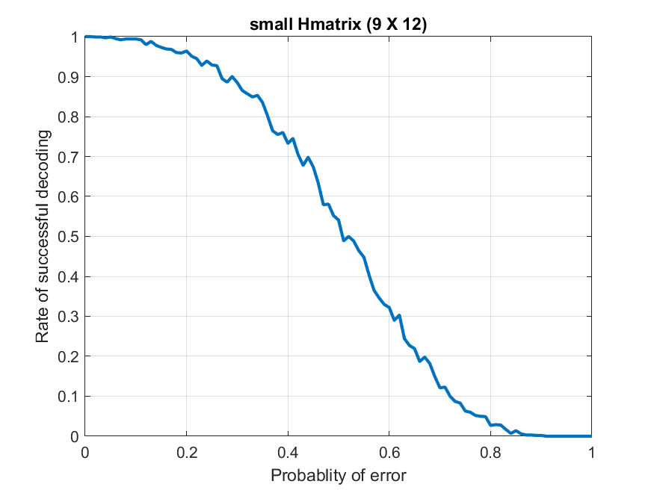
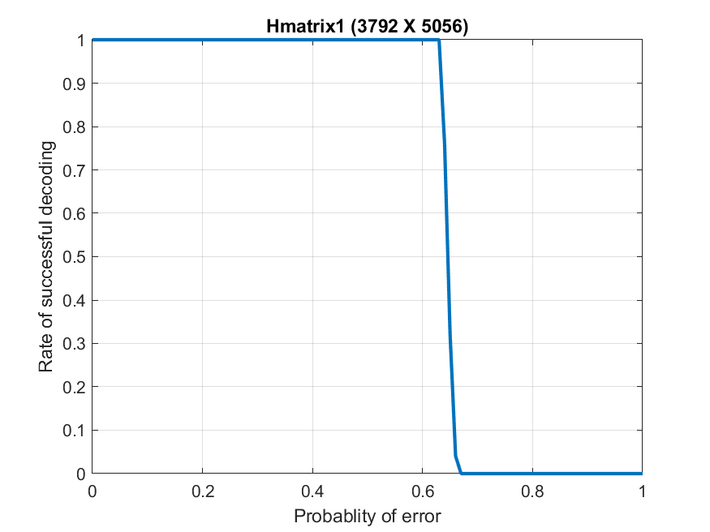
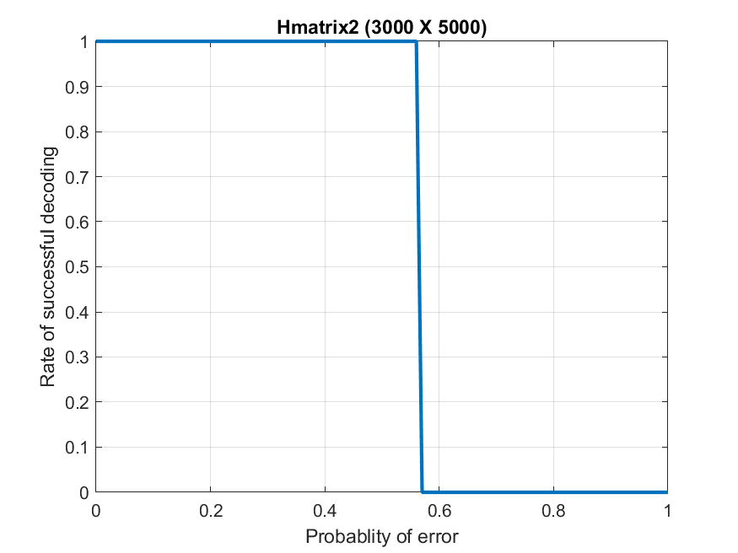
BEC Soft Decision Decoding
Small H matrix (9 x 12)(3,4)
Hmatrix1 (3792 x 5056)(4,3)
Hmatrix2 (3000 x 5000)(5,3)
Drops to 0 at P_{error}=1.
Drops to 0 at P_{error}=0.63.
Drops to 0 at P_{error}=0.57.
DA-IICT | CT111 Project | Group 6 | Team 6

Slide 29
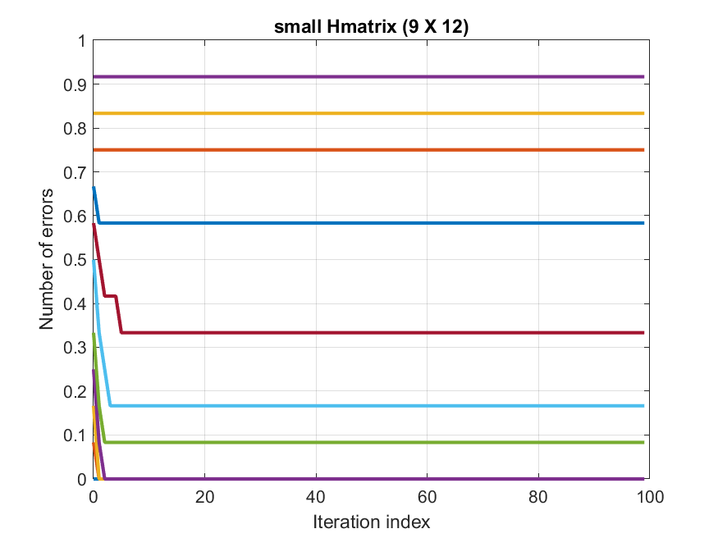

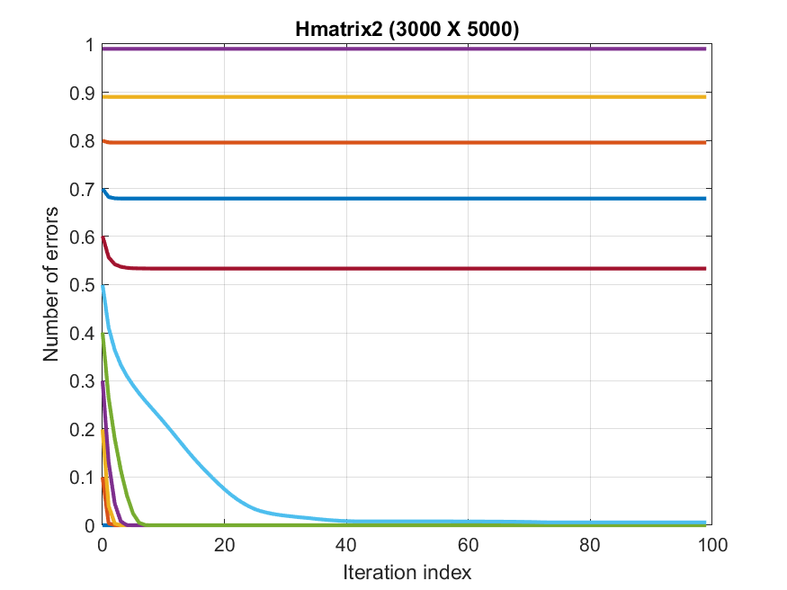
BEC Soft Decision Decoding
Algorithm Convergence Graphs
Small H matrix (9 x 12)(3,4)
Hmatrix1 (3792 x 5056)(4,3)
Hmatrix2 (3000 x 5000)(5,3)
Drops to 0 at P_{error}=1.
Drops to 0 at P_{error}=0.63.
Drops to 0 at P_{error}=0.57.
DA-IICT | CT111 Project | Group 6 | Team 6

Slide 30
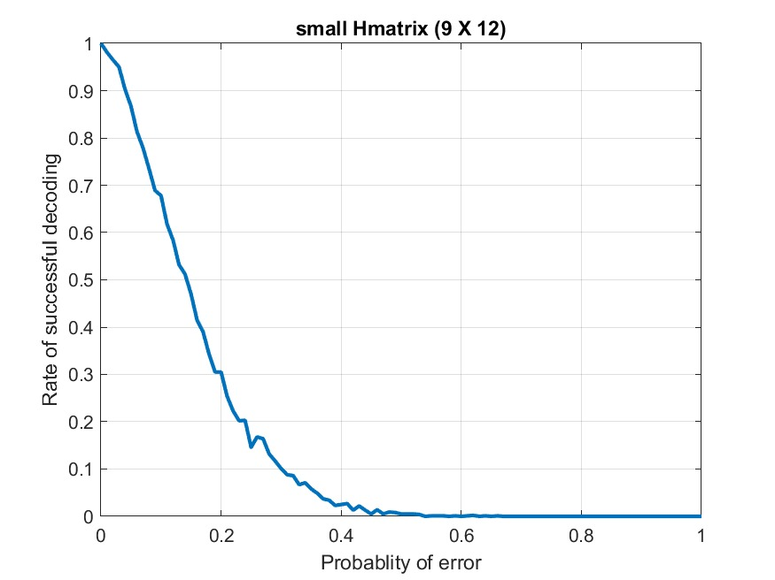
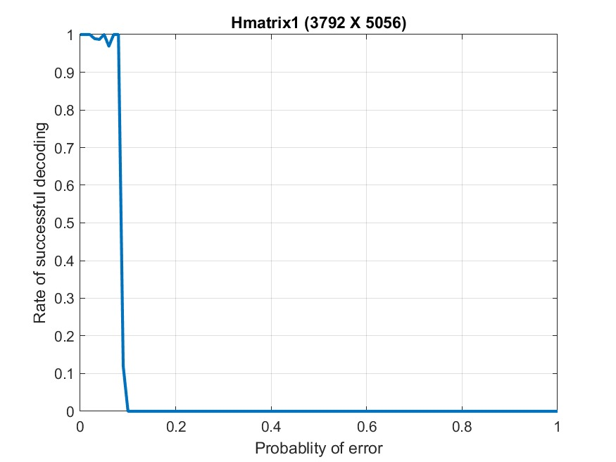
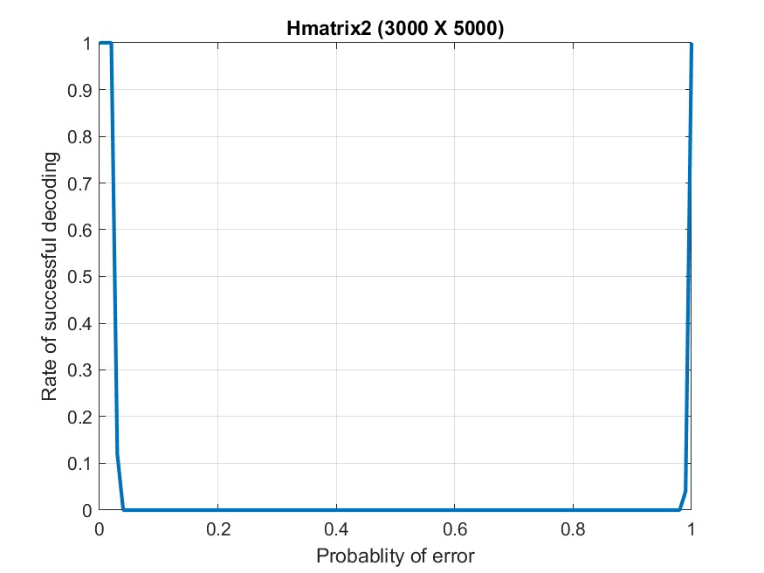
BSC Hard Decision Decoding
Small H matrix (9 x 12)(3,4)
Hmatrix1 (3792 x 5056)(4,3)
Hmatrix2 (3000 x 5000)(5,3)
Here small H matrix and Hmatrix1’s have their check node’s degree even. That’s why they will not be decoded at P_{error}=1.
As we can see, BSC is giving much worse efficiency compared to BEC decoders
DA-IICT | CT111 Project | Group 6 | Team 6

Slide 31
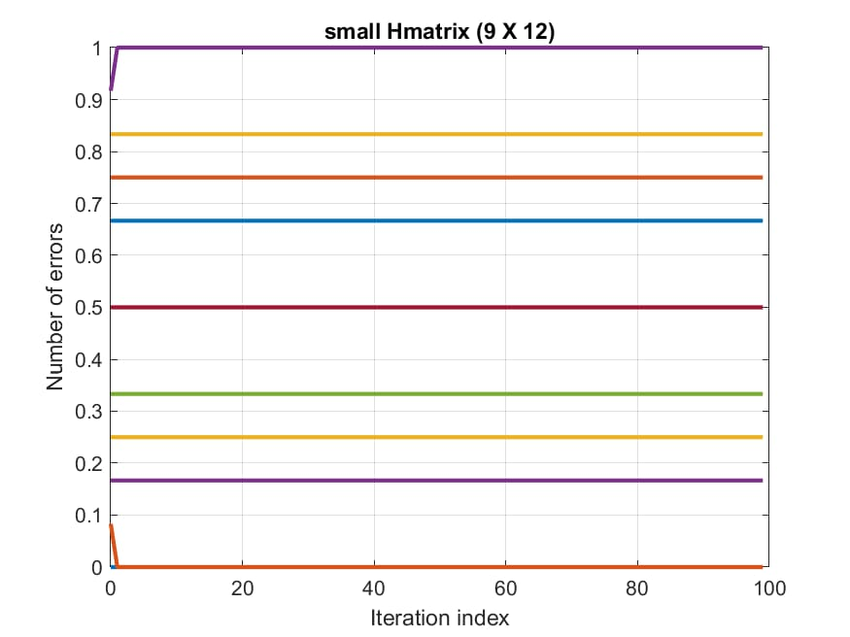
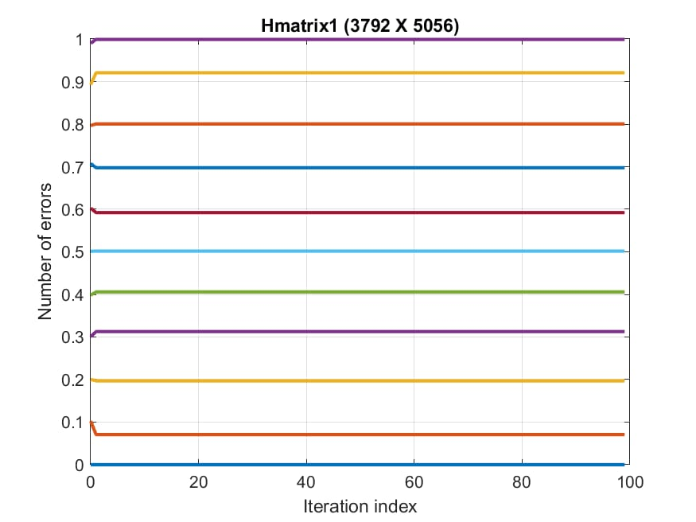
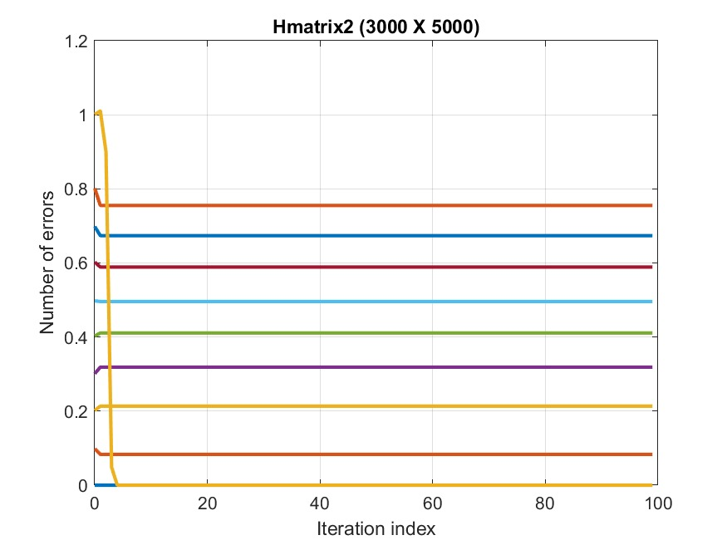
BSC Hard Decision Decoding
Algorithm Convergence Graphs
Small H matrix (9 x 12)(3,4)
Hmatrix1 (3792 x 5056)(4,3)
Hmatrix2 (3000 x 5000)(5,3)
Drops to 0 at P_{error}>0.5.
Drops to 0 at P_{error}=0.09.
Drops to 0 at P_{error}=0.04.
DA-IICT | CT111 Project | Group 6 | Team 6

Slide 32
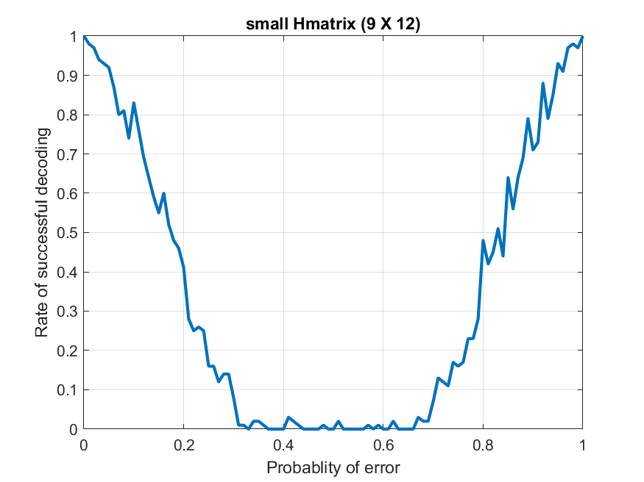
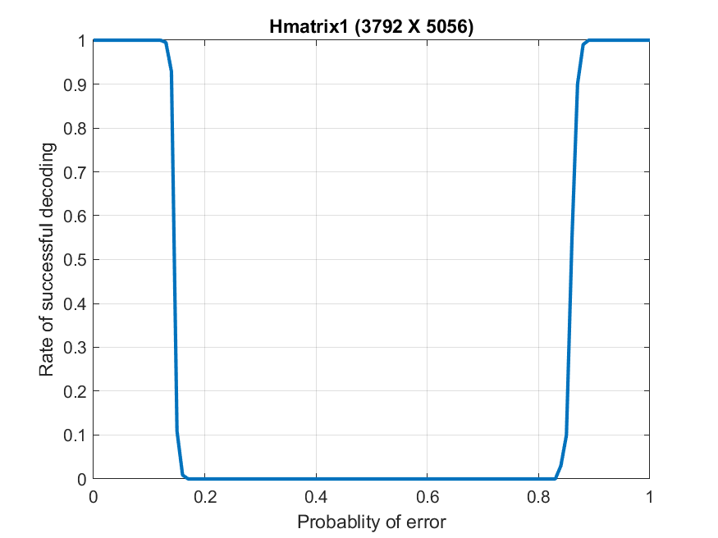
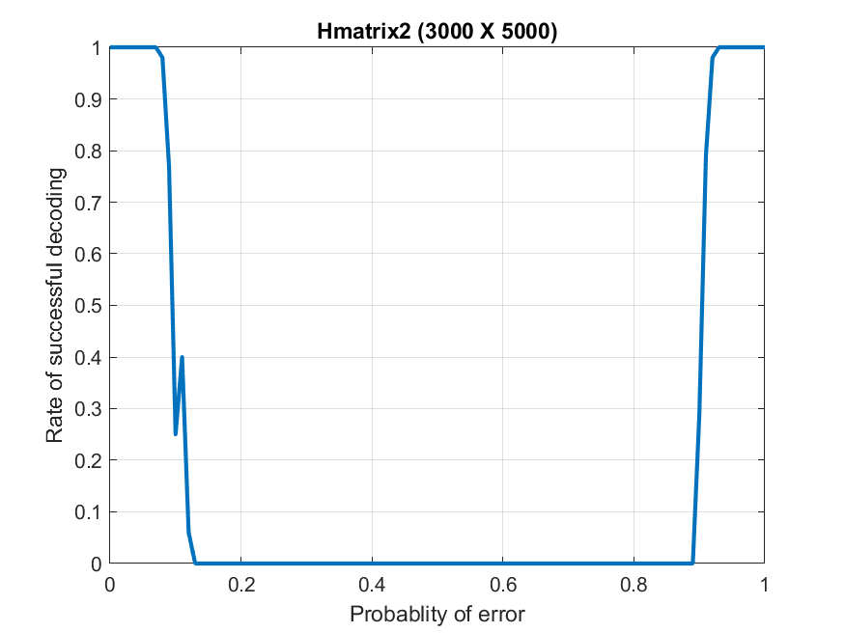
BSC Soft Decision Decoding
Small H matrix (9 x 12)(3,4)
Hmatrix1 (3792 x 5056)(4,3)
Hmatrix2 (3000 x 5000)(5,3)
Drops to 0 at 0.3<P_{error}<0.65.
Drops to 0 at 0.15<P_{error}<0.86.
Drops to 0 at 0.11<P_{error}<0.89.
DA-IICT | CT111 Project | Group 6 | Team 6

Slide 33
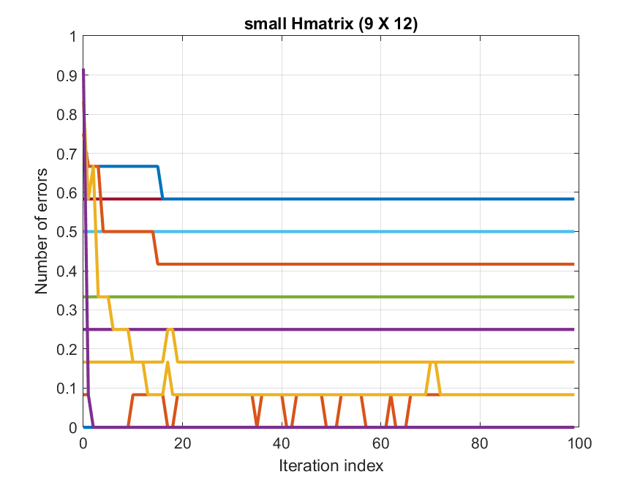
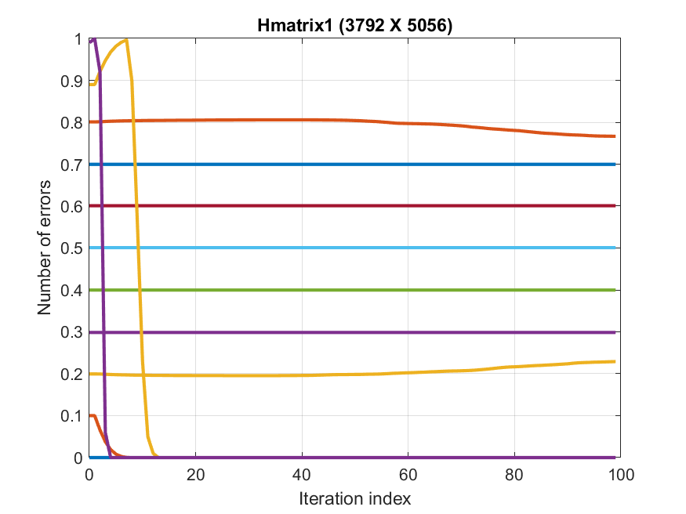
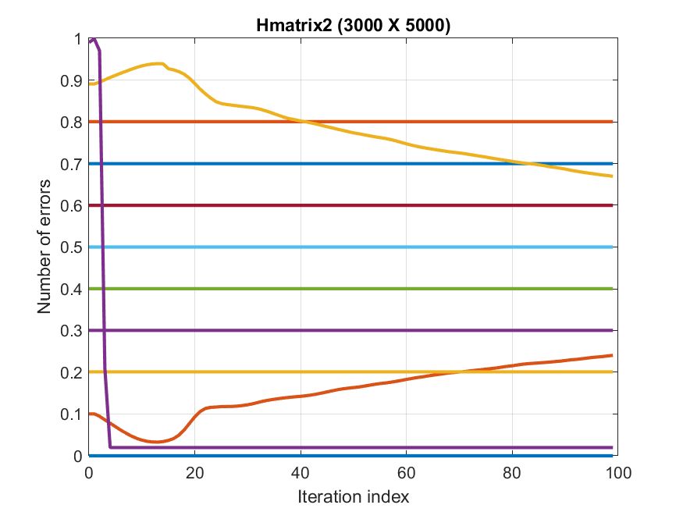
BSC Soft Decision Decoding
Algorithm Convergence Graphs
Small H matrix (9 x 12)(3,4)
Hmatrix1 (3792 x 5056)(4,3)
Hmatrix2 (3000 x 5000)(5,3)
Drops to 0 at 0.3<P_{error}<0.65.
Drops to 0 at 0.15<P_{error}<0.86.
Drops to 0 at 0.11<P_{error}<0.89.
DA-IICT | CT111 Project | Group 6 | Team 6

Slide 34

Comparison Of decoders
Compared at error probability = 0.1
As we can see BSC decoders are not efficient to use compared to the BEC decoders as BEC decoders successfully decodes till P_{error} =0.63.

Slide 35
Summary
DA-IICT | CT111 Project | Group 6 | Team 6

Slide 36
Efficiency of various decoders
60%
9%
63%
14%
BEC Hard
BSC Hard
Decodes successfully till 0.6
Decodes successfully till 0.9
BEC Soft
BSC Soft
Decodes successfully till 0.63
Decodes successfully till 0.14 and 0.88-1
For Hmatrix1 (3792 x 5056)
DA-IICT | CT111 Project | Group 6 | Team 6

Slide 37
Brief Discussion on Every Algorithm
Our BEC algorithms were quite efficient as they were able to decode for error probabilities as high as 0.67.
While BSC algorithms were not that efficient. So it’s practical to use BEC algorithms in Real world applications.
In BSC Hard decision decoding, Hmatrix1 and small H matrix will not be decoded at error probability = 1.
(Reason: they have even degree of check Node)
DA-IICT | CT111 Project | Group 6 | Team 6

Slide 38
Difficulty Level for implementing various decoders
BSC Hard < BEC Hard < BSC Soft < BEC Soft
DA-IICT | CT111 Project | Group 6 | Team 6

Slide 39
References
01
02
03
Presentation Template by: SlidesGo.com
Vector Images by: freepik.com
Tutorial paper by Bernard Leiner
Gallager’s original LDPC Paper
GeeksforGeeks
DA-IICT | CT111 Project | Group 6 | Team 6
DA-IICT | CT111 Project | Group 6 | Team 6

Slide 40
Appendix
DA-IICT | CT111 Project | Group 6 | Team 6

Slide 41
Why does the graph of Hmatrix1 and small H matrix does not go upwards at higher error probability = 1?
Because degree of check node is even in Hmatrix1 and small H matrix. That’s why the parity check equations will give value 1.
Because the Variable Node receives 1, it’s not said to be decoded.
DA-IICT | CT111 Project | Group 6 | Team 6

Slide 42
What could have been changed in the soft decision decoding algorithms?
We could have implement log likelihood ratio based algorithm instead of simple likelihood ratios because addition operations takes less time to be done compared to multiplication operations.
Though we did not notice any slowing in the algorithm of the tutorial paper by Bernard too.
Because of C++ our Multiplication operations were faster too.
DA-IICT | CT111 Project | Group 6 | Team 6

Slide 43
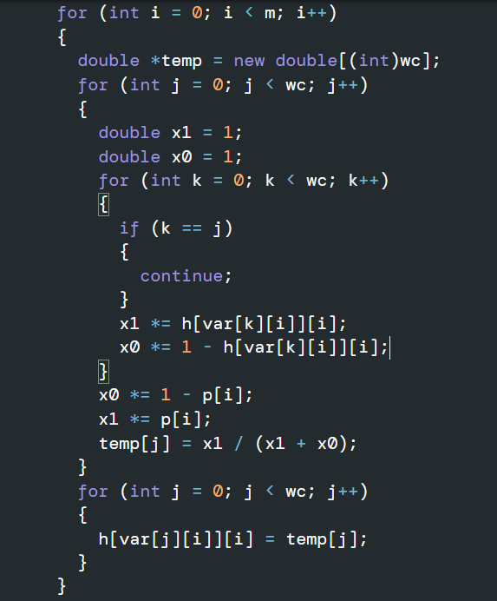
Why did not we faced the issue of having 0 in the denominator in soft decision decoding schemes?
At a time we do not divide 1’s and 0’s belief. We do multiply them.
Then we find the constant and then we divide so we will never get 0 in denominator.
As belief of 0+belief of 1 can not be 0 at a time.
DA-IICT | CT111 Project | Group 6 | Team 6

Slide 44

Thank You
Guided By:
Prof. Yash Vasavada
Teaching Assistants:
Ritik Malaviya sir and Vivek Aswani sir
Project is also Available at...
DA-IICT | CT111 Project | Group 6 | Team 6

