Slide 1
Modern ETL Pipeline
- p360 Team

Slide 2
Who we are
and
What we do

Slide 3


Conceptual Data Pipeline
Data Ingestion
Services
Transformation, Validation, Rollup, Joining, Enrichment
Services
Metrics Aggregation
Services
Data Sink Services
Data Store
API
Kafka Connect Java / Kotlin
Spring Boot with
Spring Kafka
Spring Boot with Kafka Streams
Spring Boot with Kafka Streams on RocksDB
Kafka Connect Java / Kotlin SpringBoot
Spring Kafka and Spring Data
Cassandra
Elasticsearch
Spring Boot
Java / Kotlin
Spring Web flux
Data Movement
Total of 2B claims and 3B prior auth events (largest subject areas)
5-10M events a day
Tables with 40B+ rows
Data store handles inserts of 10s of Millions while serving up data with 2-5s latency
API response times < 300ms tested for 100 TPS
Notes:
We have been tested for > 100 tps
< 500ms
some of the tables have upwards of 40 billion rows. And we no problem inserting 10s of million rows while serving up data with 2-5ms latency at the same time
2 billion claims going back 3 years.97% coverage. 5-10 millions events per day. 3 billion prior auth events. Metrics aggregation updates in seconds compare to days or hours in traditional wh system

Slide 4
Agenda
Docker and Kubernetes
Intro on how we run our pipeline
Spring Boot
Intro to spring framework which is used for processing the data including how data is exposed via API
Kafka and Kafka Streams
Learn about kafka and libraries we use to transform messages and calculate metrics
Elasticsearch
Learn about one of our datastore.
E2E Demo
Ties above concepts together and shows how we make our streaming data pipeline work

Slide 5
Basics of Docker and Kubernetes

Slide 6
What is docker and why we use it

Slide 7
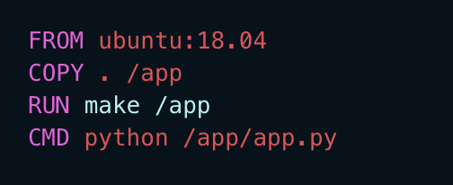
Dockerfile

Slide 8
Image Repository
Artifactory
Dockerhub
ECR
ACR

Slide 9
Other Docker Features
Port Forward
Volume Mount
Environment Injection

Slide 10
Anti Pattern
Avoid putting Secrets and Keys
Building different images per environment.
Attempting to use VM practices on containers.

Slide 11
Kubernetes

Slide 12
Why do we need k8s

Slide 13
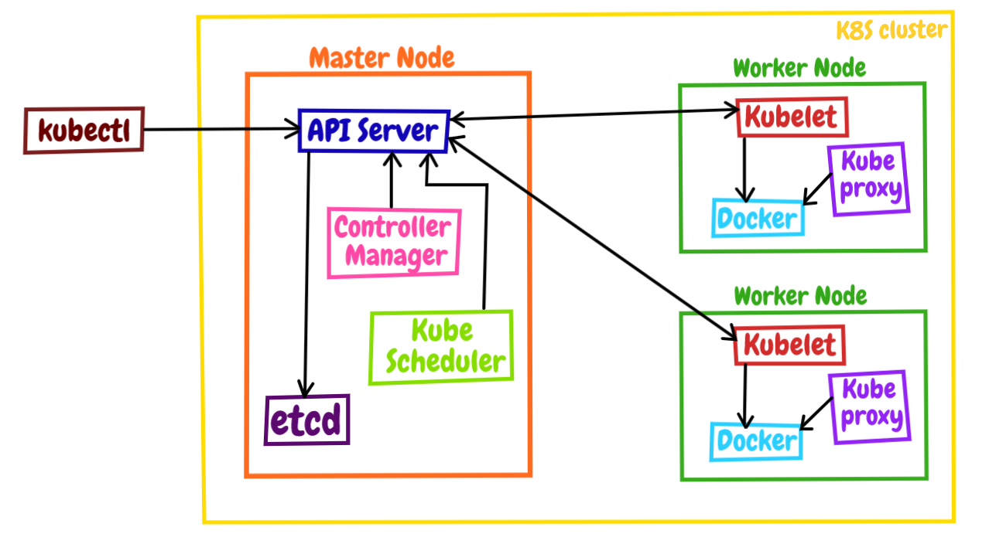
High level architecture

Slide 14
Core Concepts
Namespace
Pod
Deployment
Service
Ingress
Secret
Configmap
Persistance Storage

