Slide 1

Elastic _________________ Modern ETL Pipeline

Slide 2
Agenda
Introduction to Elastic Stack
Components Elastic Stack: Kibana/Logstash/Elastic Search
Data ingestion/Query
Data Ingestion
Indexing
Data Analysis
Demo & Labs

Slide 3
Introduction
What is it
Open source, Analytics and distributed full-text search engine (java based)
Data from Anysource, any format
Index data of all types
Distributed Cluster features, sharding for Indexes, advanced search and aggregation
Scalable
Core of "Elastic Stack" (formerly ELK stack)
What can we do with it?
Index data - Structured or unstructured (possibly using the "L")
Search for it (Using the "E")
Aggregated data
Filter data
Analyze and Visualize it (Using the "K")
Read about it at elastic.co

Slide 4
Installation
Local Instances
Running Elastic search/Kibana with in Docker
Elastic Cloud

Slide 5
Terminology
Node : Where data is stored in Elastic Search (Instance , not a machine)
Cluster : Collection of related nodes
Document: Each Unit of data that is stored with in the cluster
Index: Every document is stored in Indices. (Collection of documents)
Sharding: Diving Index into separate pieces (Each piece is a SHARD)
To horizontally scale the data volume
Replication of Shards

Slide 6
Elastic Stack (Formerly ELK Stack)
E - Elasticsearch
Heart of the whole operation. The data lives here. (store/Search/Analyze)
Exposes a REST API
L - Logstash
Used collecting logs, data events, transforms
K - Kibana
Analytics and visualization platform, Web interface users the REST API to interact with Elastic Search
visualizing data such as charts, Dashboards, configure change direction and forecasting.
The data is stored in Elastic search itself.

Slide 7

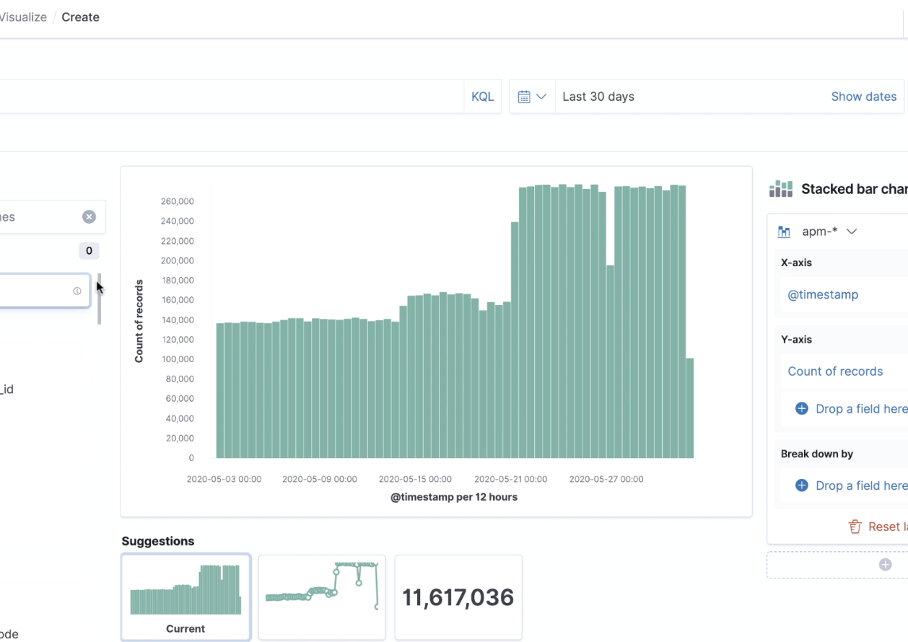
Kibana
Analytics and visualization platform with Key points of interest
The data is stored in Elastic search itself.
Web interface users the REST API to interact with Elastic Search
Dashboards for number of metrics for monitoring/ Performance of servers
Administrators - Dashboards : CPU, Memory usage
Developers : Application Errors/ API Response times

Slide 8

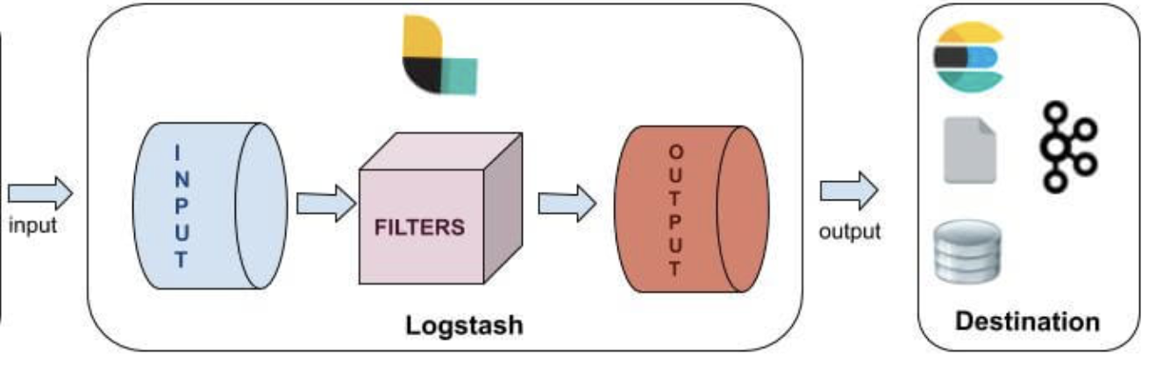
Logstash
Traditionally, Used to process logs from applications , send to Elastic Search, More evolved as generic Tool for data processing pipeline
Data collection, enrichment, and Transformation pipeline
Log stash events can be any data: Structured/unstructured
Input plugins: File, STDIN, Beats, JDBC, Elastic Search, Kafka, http
Filter Plugins: CSV, JDBC, JSNO, XML etc
Output Plugins : Elastic Search, Kafka, S3, File, Stdout, Database (mongo)
Structure of the config file : ex:
input { ……… } filter { ………. } output { ……... }

Slide 9
Data Ingestion
Logstash - Used for ingesting many things - not just logs
Use to enrich ingested data
Inputs - Data sources include files, logs, http, jdbc, kafka, and on and on
Filters - Process and enrich the data (DNS lookups, Geographic information, custom dictionaries)
Output - Usually to Elasticsearch, but other places as well
Elastic Beats - Lightweight data shippers
Low resource usage
Used for ingesting logs, metrics, many other things

Slide 10
Data Ingestion
Application code
Use code to push data into Elasticsearch
Many native client libraries including for Java, Python, etc.
Kibana - Some functionality to put data into Elasticsearch
Any kind of REST client (Postman, curl, etc.)

Slide 11
Query the Elastic Search
Query the documents with proprietary query language called Query DSL. - Verbose
SQL Queries over HTTP alternatively. (Elastic search translates the SQL query to Query DSL format behind)
Ex:
”_cat” API
GET _search
{
"query": {
"match_all": {}
}
}

Slide 12
Indexing/Mapping
Dynamic Mapping - Automatically created by just indexing a document
Elasticsearch guesses everything
All properties are mapped and indexed
Good way to get a base mapping
Explicit Mapping - Usually a better option
You know your data types
You know what data needs to be indexed

Slide 13
Visualization - Kibana
Use Kibana!
Web-based UI for Elasticsearch
Search application logs or other data
Visualize data with charts, graphs, tables, and more
Use it for some Elasticsearch management (configure or delete indexes, other settings)

Slide 14
Demo
Kibana Visualization!
Spring Boot App for Data Ingestion and querying

Slide 15
Further References
Elastic Core
https://www.elastic.co/
Elastic Stack as service on Cloud
https://www.elastic.co/elasticsearch/service

