Slide 1
Basics of Docker and Kubernetes

Slide 2
What is docker and why is it popular

Slide 3
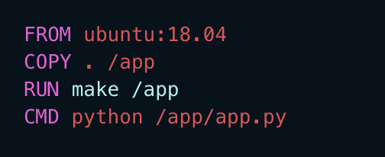
Dockerfile

Slide 4
Image Repository
Artifactory
Dockerhub
ECR
ACR

Slide 5
Other Docker Features
Port Forward
Volume Mount
Environment Injection

Slide 6
Anti Pattern
Avoid putting Secrets and Keys
Building different images per environment.
Attempting to use VM practices on containers.

Slide 7
Kubernetes

Slide 8
Why do we need k8s

Slide 9
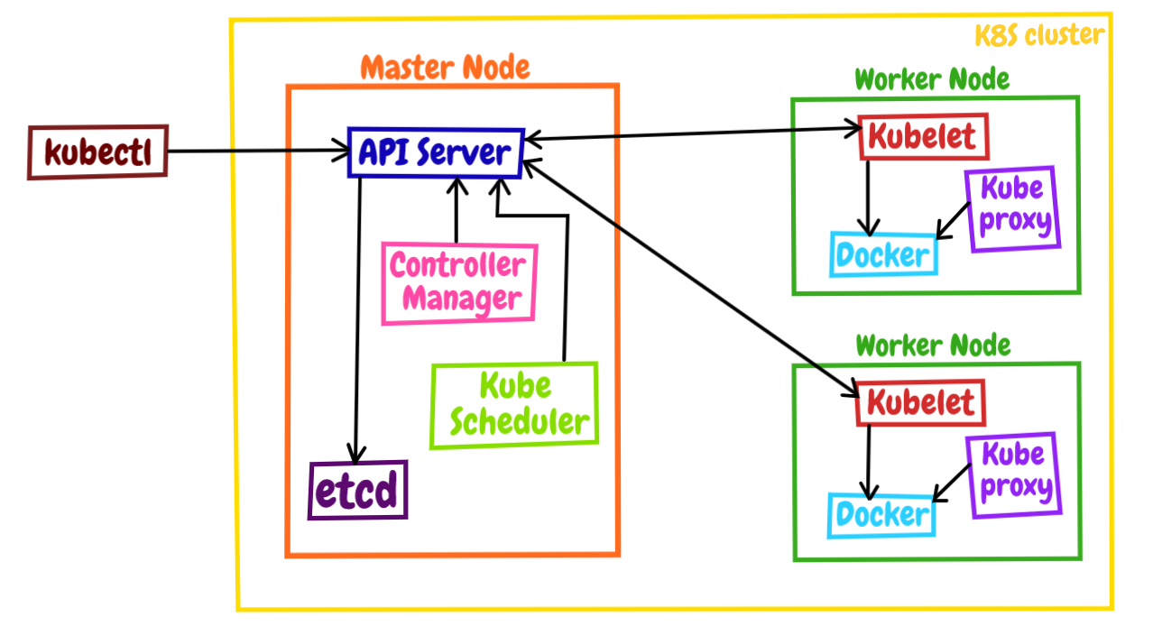
High level architecture

Slide 10
Core Concepts
Namespace
Pod
Deployment
Service
Ingress

Slide 11
Core Concepts
Secret
Configmap
Persistance Storage

