Slide 1
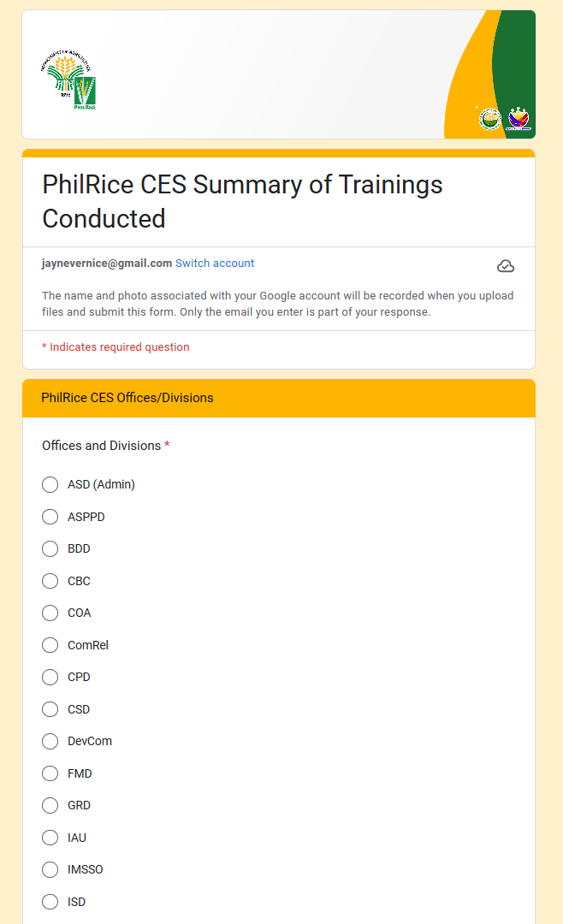
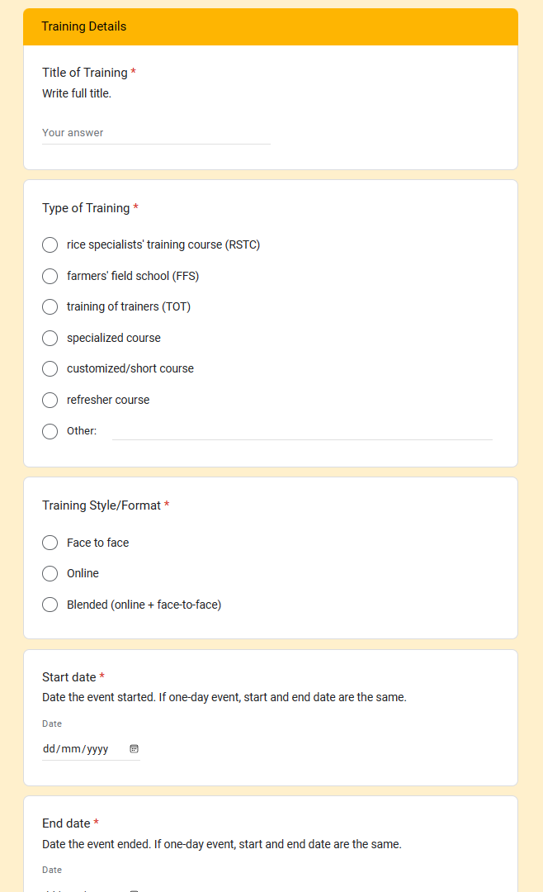
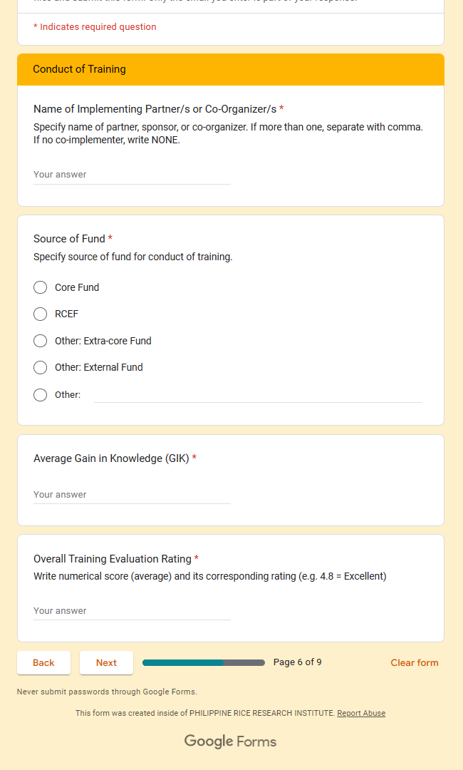

Slide 2
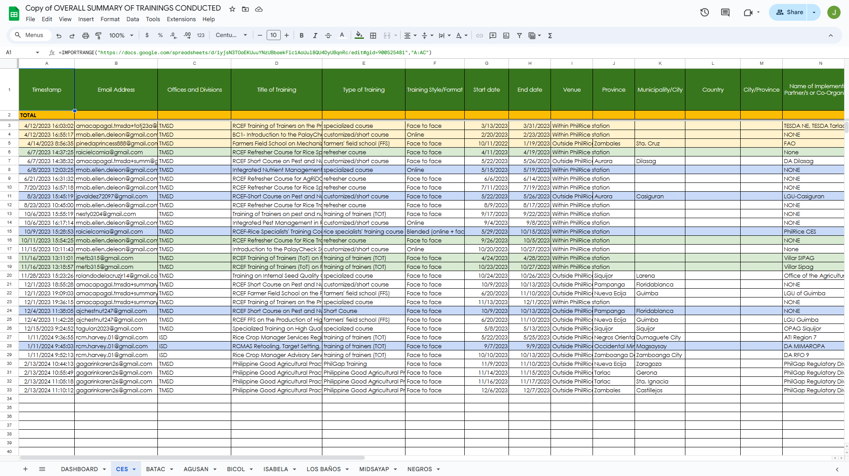

Slide 3
TRAINING RECORDS ANALYSIS AND CHARTING FOR ENHANCED RESULTS (TRACER)

Slide 4
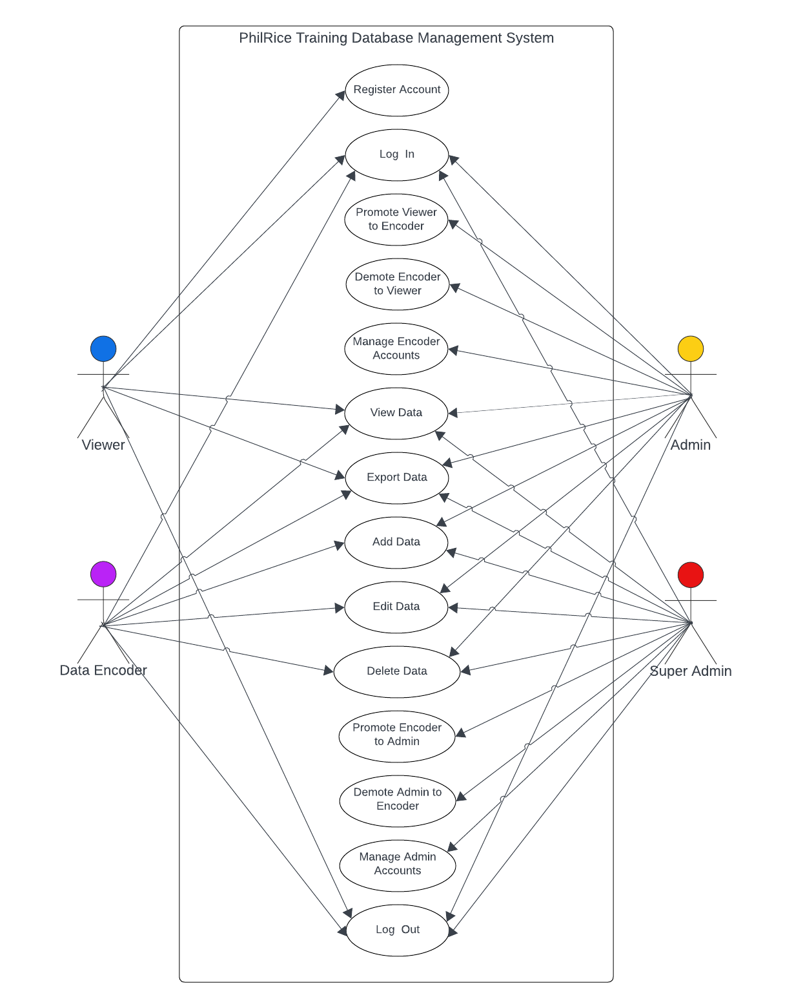
TRACER
Super admin is kaya niya rin mag promote and demote ng encoder.
if admin is not available, si super-admin na gagawa non. Take note this will be used and will be implemented sa lahat ng station
Just want to ask ano ang bearing if merong manage super admin?

Slide 5
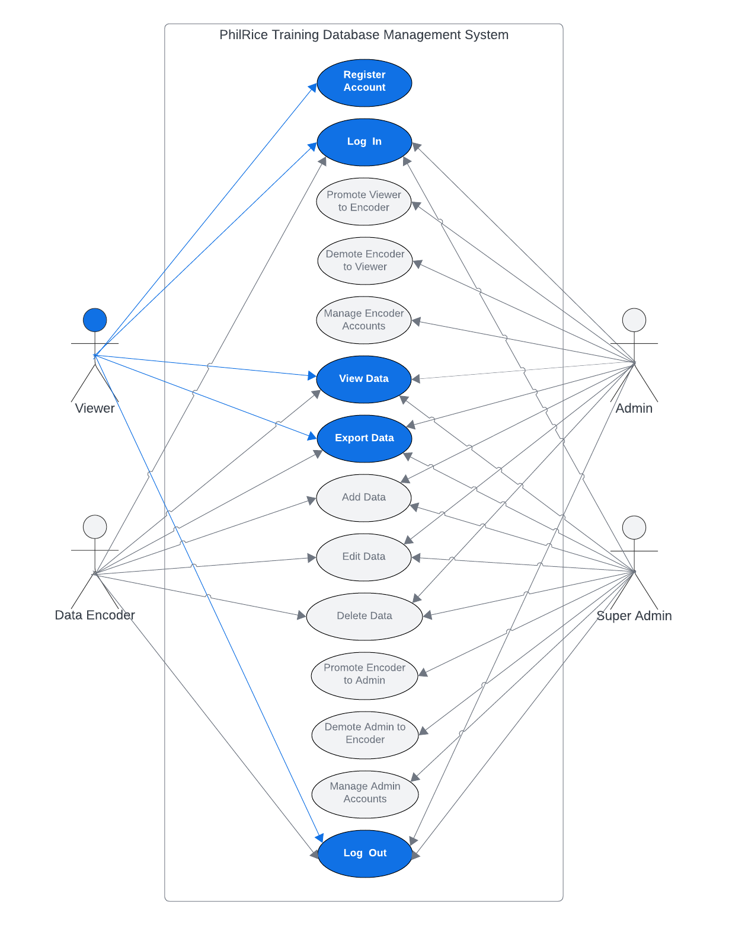
TRACER

Slide 6
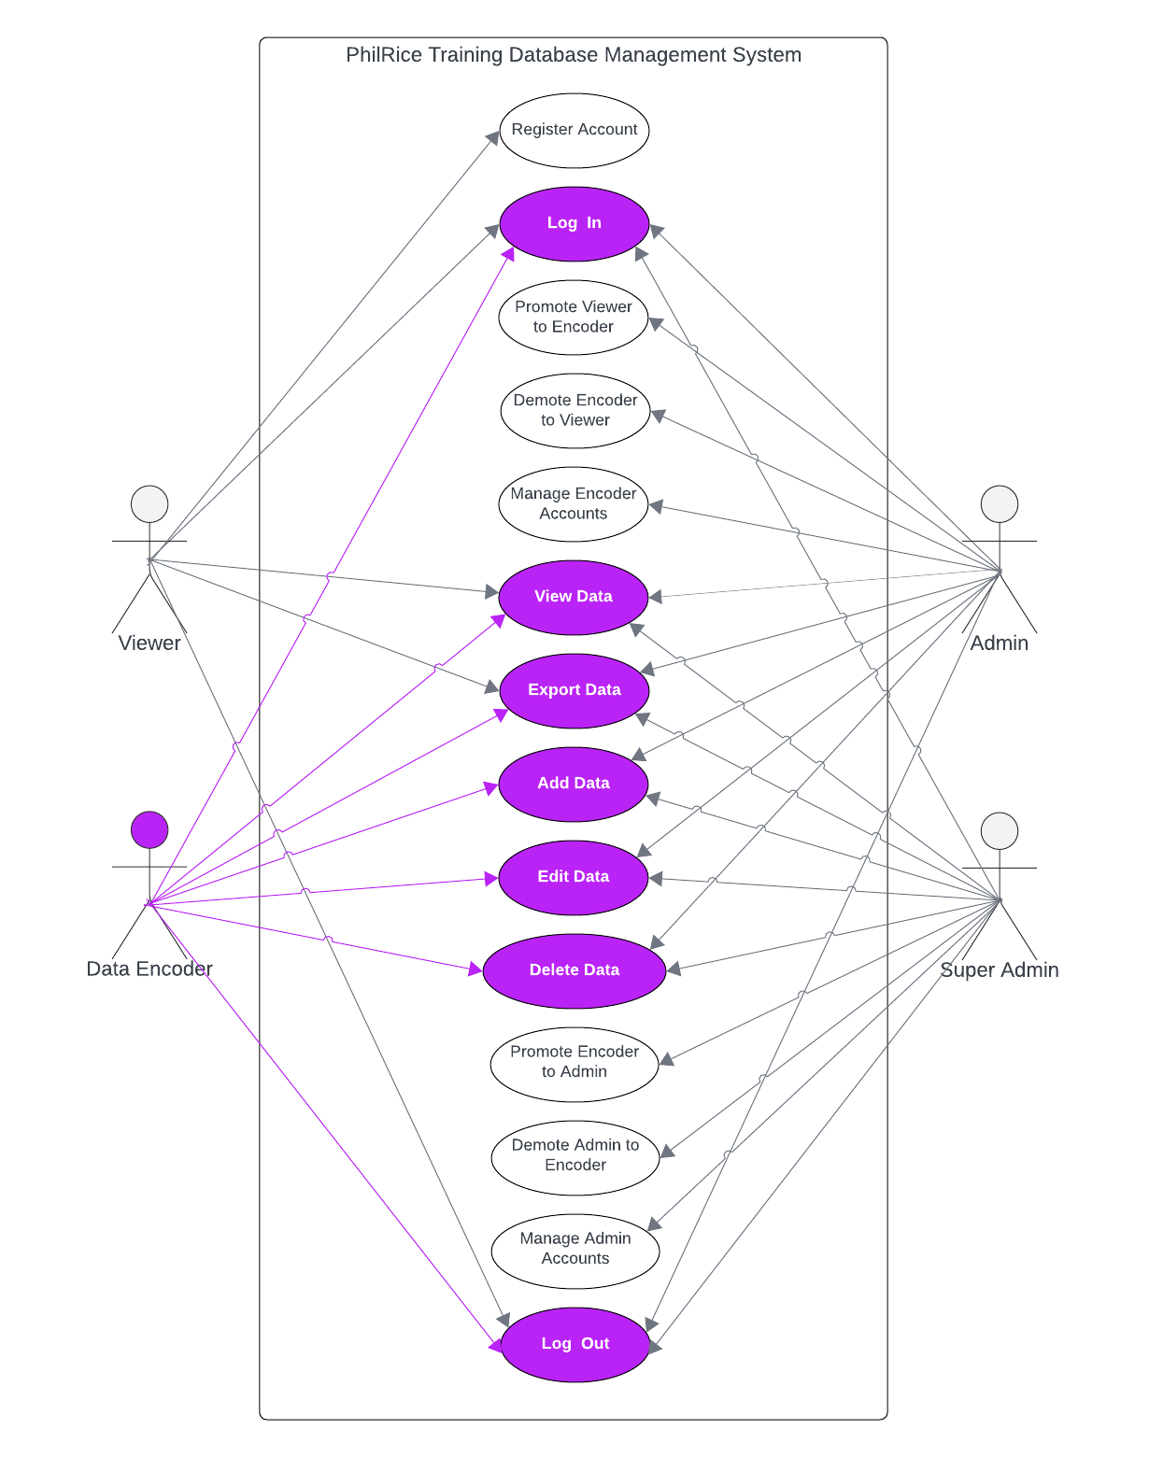
TRACER

Slide 7
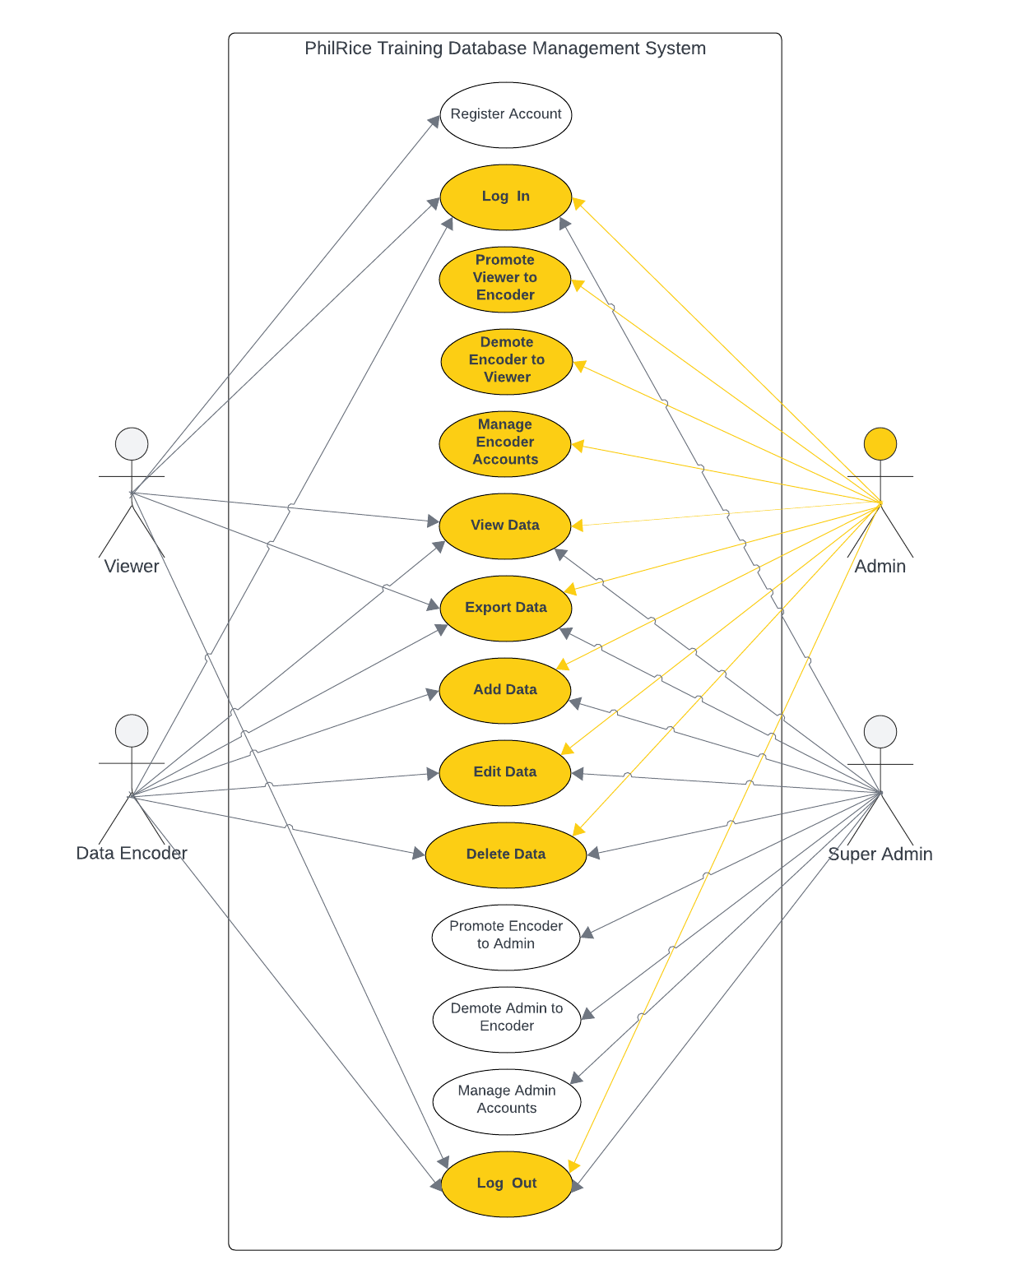
TRACER

Slide 8
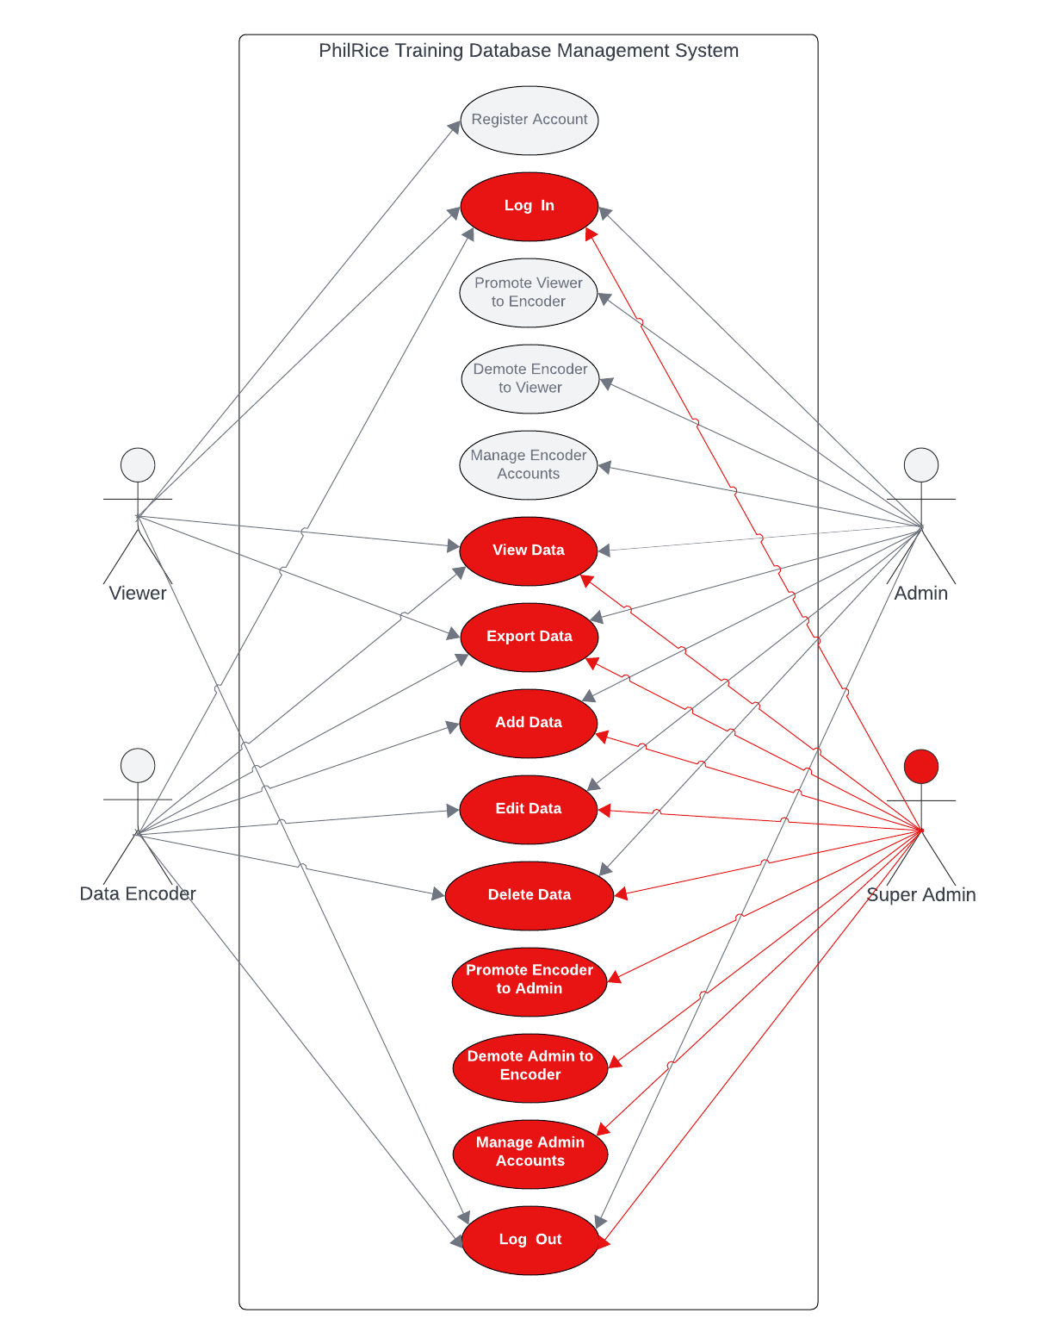
TRACER

Slide 9
-END-

