Slide 1


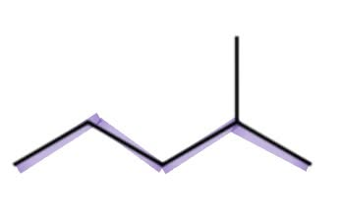


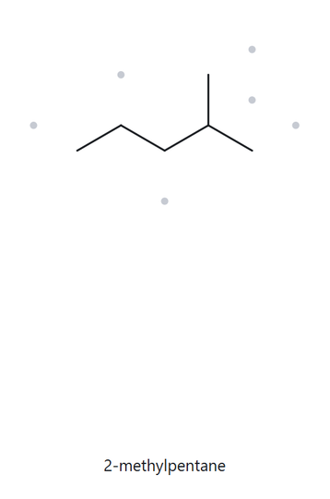
NAME IT, DRAW IT (PART A)
level:
foundation
2-
METHYLPENTANE
formula:
C6H14
naming trail (3 short lines)
4
2
step 1: parent
5
3
1
longest chain = 5C
pentane
1
2
4
3
5
step 2: numbering
numbered parent
the alkane check
left-to-right gives 4; right to left gives 2. Choose 2
step 3: substituents
Methyl on C2
2-methyl
my name
2-methylpentane
longest chain verified
lowest locant verified
formula counted
MATCH

Slide 2
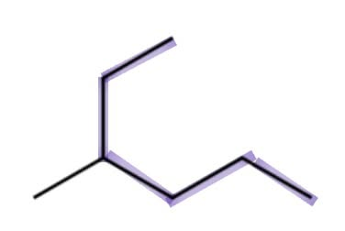
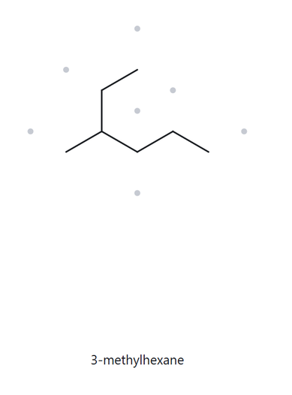
NAME IT, DRAW IT
level:
foundation
3-
METHYLHEXANE
formula:
C7H16
1
6
naming trail (3 short lines)
2
5
2
step 1: parent
3
4
5
longest chain = 6C
hexane
3
1
1
2
4
4
6
3
5
step 2: numbering
numbered parent
the alkane check
  upper to right gives 3; reverse gives 4. Choose 3
step 3: substituents
Methyl on C3
3-methyl
my name
3-methylhexane
longest chain verified
lowest locant verified
formula counted
MATCH

Slide 3
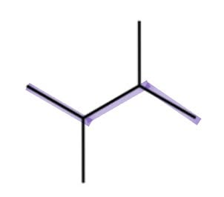
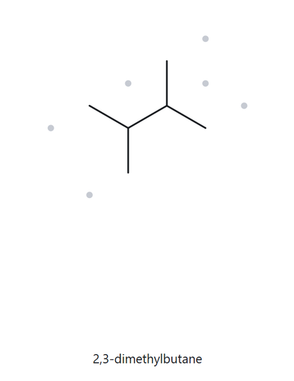
NAME IT, DRAW IT
level:
foundation
2,3-
DIMETHYLBUTANE
formula:
C6H14
naming trail (3 short lines)
4
2
step 1: parent
1
3
1
longest chain = 4C
butane
3
2
4
step 2: numbering
numbered parent
the alkane check
both directions give locants 2,3
step 3: substituents
Methyl on C2
2,3-dimethyl
my name
2,3-dimethybutane
longest chain verified
lowest locant verified
formula counted
MATCH

Slide 4
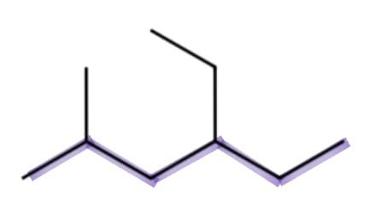
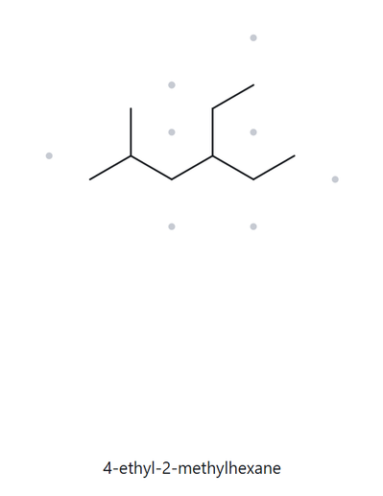
NAME IT, DRAW IT
level:
developing
4-
ETHYL-2-METHYLHEXANE
formula:
C9H20
naming trail (3 short lines)
1
6
ethyl substituent
3
1
step 1: parent
methyl substituent
5
2
longest chain = 6C
hexane
4
1
2
4
6
3
5
step 2: numbering
numbered parent
the alkane check
left to right gives 2,4; right to left gives 3,5. Choose 2,4.
step 3: substituents
Ethyl on C4, methyl in C2; Ethyl is cited before methyl alphabetically
4-ethyl-2-methyl
my name
4-ETHYL-2-METHYLHEXANE
longest chain verified
lowest locant verified
formula counted
MATCH

Slide 5
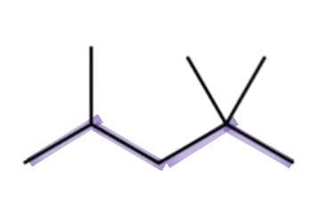
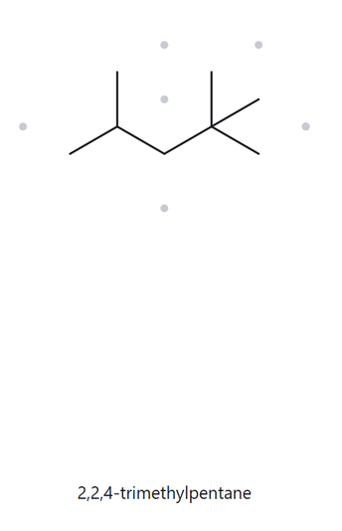
NAME IT, DRAW IT
level:
developing
2,
2,4-TRIMETHYLPENTANE
formula:
C8H18
5
1
naming trail (3 short lines)
4
4
2
2
step 1: parent
3
3
1
longest chain = 5C
pentane
5
4
2
5
3
1
step 2: numbering
numbered parent
the alkane check
left to right gives 2,4,4; right to left gives 2, 2, 4. Choose 2, 2, 4.
step 3: substituents
trimethyl
two methyl groups at C2 and one at C4
my name
2,2,4-TRIMETHYLPENTANE
longest chain verified
lowest locant verified
formula counted
MATCH

Slide 6
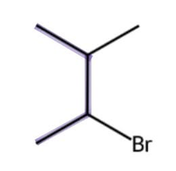
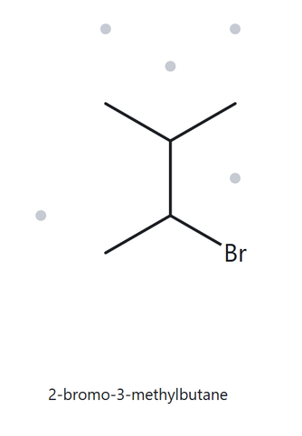
NAME IT, DRAW IT
level:
developing
2-
BROMO-3-METHYLBUTANE
formula:
C5H11Br
4
naming trail (3 short lines)
1
3
2
step 1: parent
3
2
4C
butane
1
4
step 2: numbering
numbered parent
the alkane check
bromo comes before methyl; bromo receives C2.
step 3: substituents
Bromo on C2, methyl on C3
2-bromo-3-methyl
my name
2-BROMO-3-METHYLBUTANE
longest chain verified
lowest locant verified
formula counted
MATCH

Slide 7
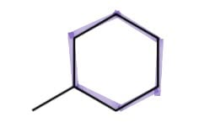
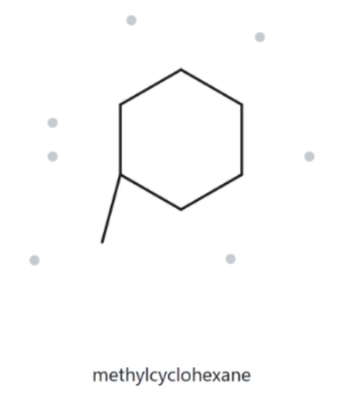
NAME IT, DRAW IT
level:
developing
METHYLCYCLOHEXANE
formula:
C7H14
cyclohexane ring
naming trail (3 short lines)
step 1: parent
methyl substituent
6C
cyclohexane
step 2: numbering
numbered parent
the alkane check
substituted carbon is automatically C1
step 3: substituents
methyl
Methyl on the ring
my name
METHYLCYCLOHEXANE
longest chain verified
lowest locant verified
formula counted
MATCH

Slide 8
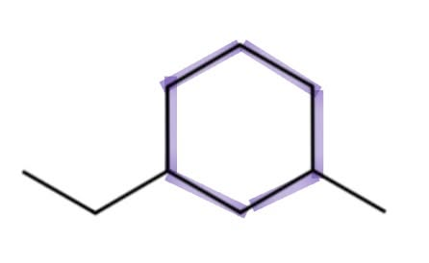
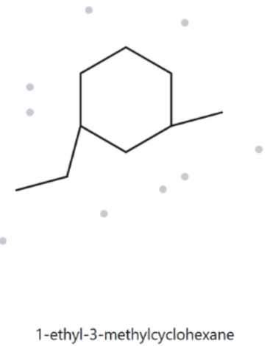
NAME IT, DRAW IT
level:
challenge
1-
ETHYL-3-METHYLCYCLOHEXANE
formula:
C9H18
naming trail (3 short lines)
cyclohexane ring
step 1: parent
ethyl substituent
3
2
3
methyl substituent
cyclohexane
1
6C
1
2
step 2: numbering
numbered parent
the alkane check
Both directions give 1,3; ethyl comes before methyl, so ethyl receives C1
step 3: substituents
Ethyl on C1, methyl on C3
1-ethyl-3-methyl
my name
1-ETHYL-3-METHYLCYCLOHEXANE
longest chain verified
lowest locant verified
formula counted
MATCH

Slide 9
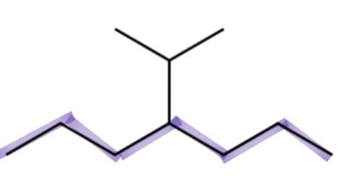
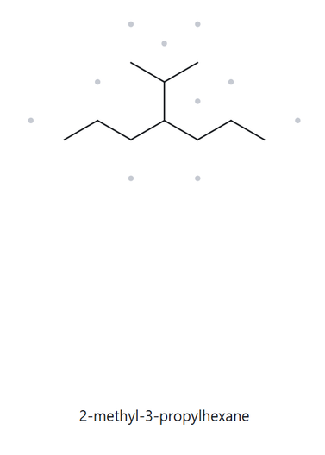
NAME IT, DRAW IT
level:
challenge
4-
(1-METHYLETHYL)HEPTANE
formula:
C10H22
1
naming trail (3 short lines)
methyl substituent
2
step 1: parent
5
3
2
6
5
propyl substituent
7C
heptane
6
4
1
7
4
3
step 2: numbering
numbered parent
the alkane check
both directions give locant 4
step 3: substituents
(1-methylethyl) at C4
my name
4-(1-METHYLETHYL) HEPTANE
longest chain verified
lowest locant verified
formula counted
MATCH

Slide 10
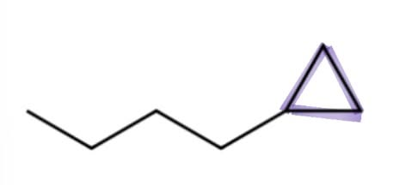
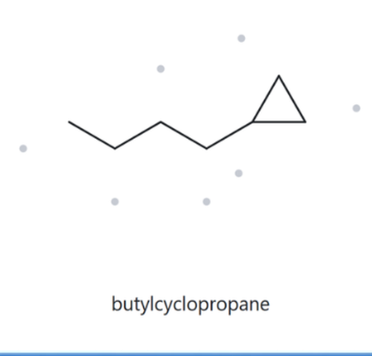
NAME IT, DRAW IT
level:
developing
2-
BROMO-3-METHYLBUTANE
formula:
C7H14
2
naming trail (3 short lines)
2
step 1: parent
4
3
1
3C ring
cyclopropane
3
1
step 2: numbering
numbered parent
the alkane check
One substituent on the ring
C1 (locant omitted)
step 3: substituents
butyl group on C1
my name
BUTYLCYCLOPROPANE
longest chain verified
lowest locant verified
formula counted
MATCH

Slide 11
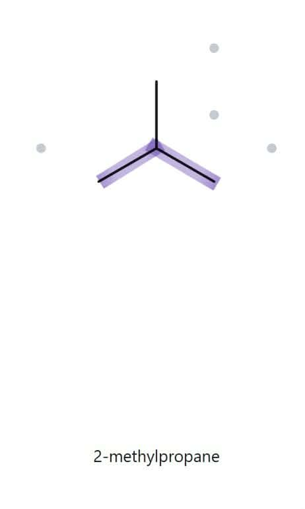
NAME IT, DRAW IT (PART B)
level:
foundation
2-
METHYLPROPANE
NAME DECODED
parent
3C continuous chain - propane
substituents
methyl on C2
expected formula
3 + 1 = 4 C; open chain
expected molecular formula
C4H10
counted from the drawing
formula check
C4H10
One ring:
CnH2n+2
parent length matches
formula agrees
numbered parent
substituent positions match
back-check recorded

Slide 12
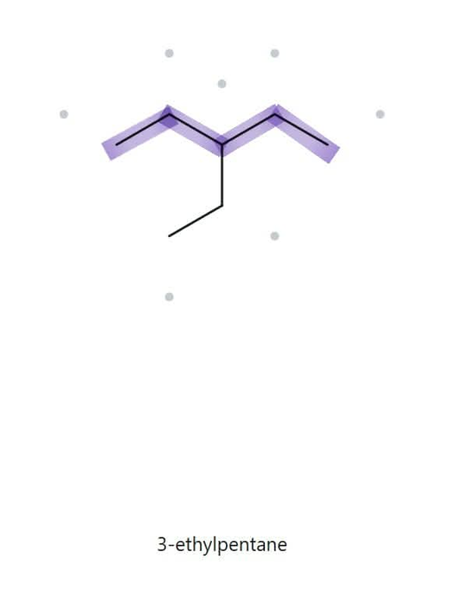
NAME IT, DRAW IT (PART B)
level:
foundation
3-
ETHYLPENTANE
NAME DECODED
parent
5C continuous chain - pentane
substituents
ethyl on C3
expected formula
5 + 2 = 7; open chain
expected molecular formula
C7H16
counted from the drawing
formula check
C7H16
One ring:
CnH2n+2
parent length matches
formula agrees
numbered parent
substituent positions match
back-check recorded

Slide 13
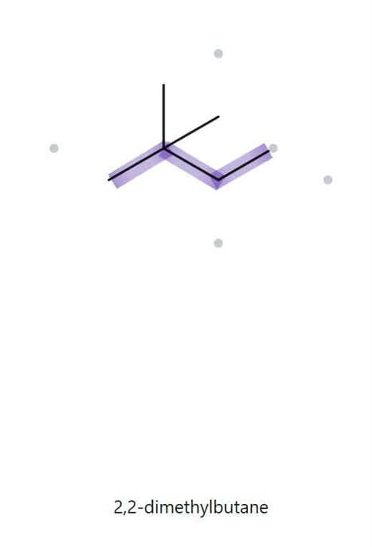
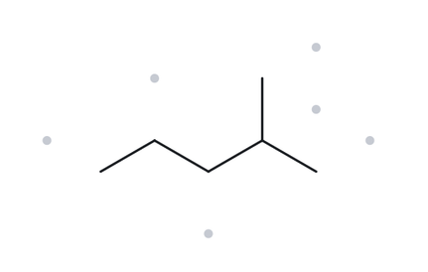
NAME IT, DRAW IT (PART B)
level:
foundation
2,
2-DIMETHYLBUTANE
NAME DECODED
parent
4C continuous chain - butane
substituents
methyl on C2 (x2)
expected formula
numbered parent
4 + 1 + 1 = 6; open chain
expected molecular formula
C6H14
counted from the drawing
formula check
C6H14
One ring:
CnH2n+2
parent length matches
the alkane check
formula agrees
numbered parent
substituent positions match
back-check recorded

Slide 14
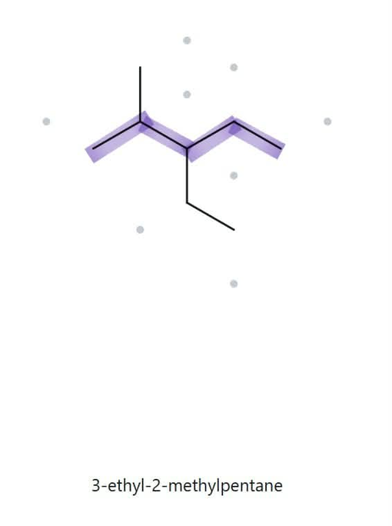
NAME IT, DRAW IT (PART B)
level:
developing
3-
ETHYL-2-METHYLPENTANE
NAME DECODED
parent
5C continuous chain - pentane
substituents
ethyl on C3, methyl on C2
expected formula
5 + 2 + 1 = 8; open chain
expected molecular formula
C8H18
counted from the drawing
formula check
C8H18
One ring:
CnH2n+2
parent length matches
formula agrees
numbered parent
substituent positions match
back-check recorded

Slide 15
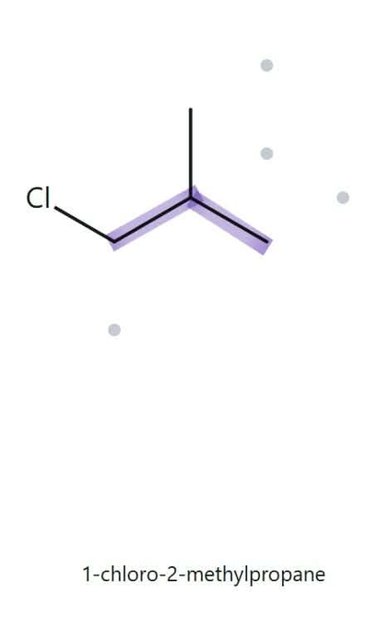
NAME IT, DRAW IT (PART B)
level:
developing
1-
CHLORO-2-METHYLPROPANE
NAME DECODED
parent
3C continuous chain - propane
substituents
chloro on C1, methyl on C2
expected formula
3 + 1 = 4; open chain; chloro replaces H
expected molecular formula
C4H9Cl
counted from the drawing
formula check
C4H9Cl
One ring:
CnH2n+2
parent length matches
formula agrees
numbered parent
substituent positions match
back-check recorded

Slide 16
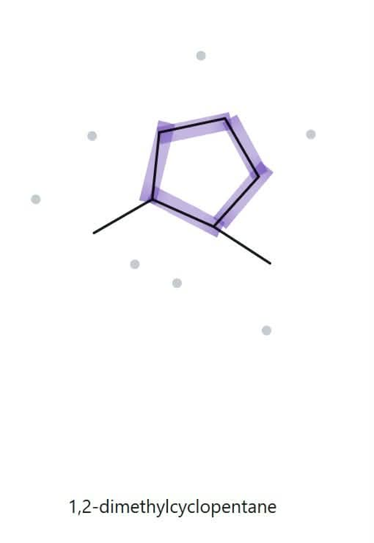
NAME IT, DRAW IT (PART B)
level:
developing
1-
2-DIMETHYLCYCLOPENTANE
NAME DECODED
parent
5C ring - cyclopentane
substituents
methyl on C1, methyl on C2
expected formula
5 + 1 + 1 = 7 C; one ring
expected molecular formula
C7H14
counted from the drawing
formula check
C7H14
One ring:
CnH2n
parent length matches
formula agrees
numbered parent
substituent positions match
back-check recorded

Slide 17
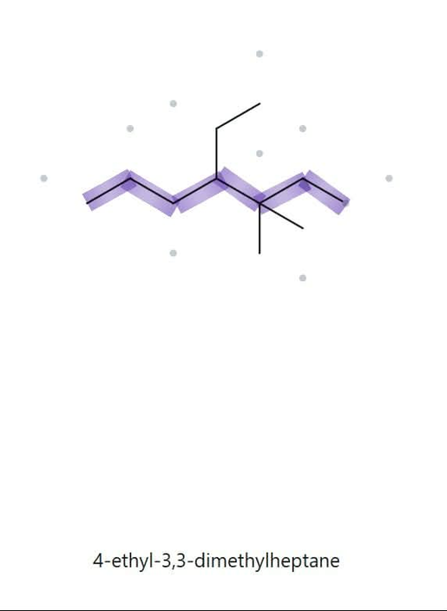
NAME IT, DRAW IT (PART B)
level:
developing
4-
ETHYL-3,3-DIMETHYLHEPTANE
NAME DECODED
parent
7C continuous chain - heptane
substituents
ethyl on C4, methyl on C3 (x2)
expected formula
7 + 2 + 1 + 1 = 11; open chain
expected molecular formula
C11H24
counted from the drawing
formula check
C11H24
One ring:
CnH2n+2
parent length matches
formula agrees
numbered parent
substituent positions match
back-check recorded

Slide 18
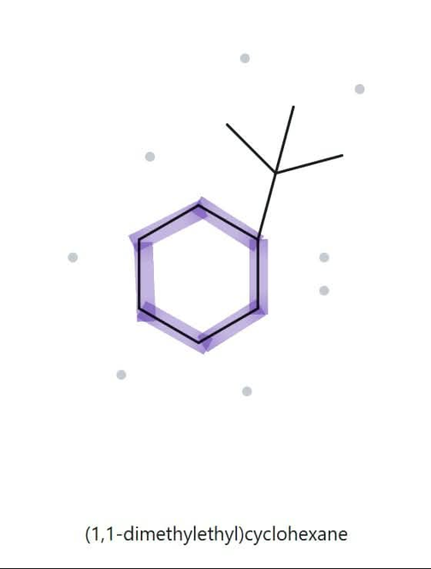
NAME IT, DRAW IT (PART B)
level:
challenge
T
ERT-BUTYLCYCLOHEXANE
NAME DECODED
parent
6C ring - cyclohexane
substituents
tert-butyl on C1
expected formula
6 + 4 = 10; one ring
expected molecular formula
C10H20
counted from the drawing
formula check
C10H20
One ring:
CnH2n
parent length matches
formula agrees
numbered parent
substituent positions match
back-check recorded

Slide 19
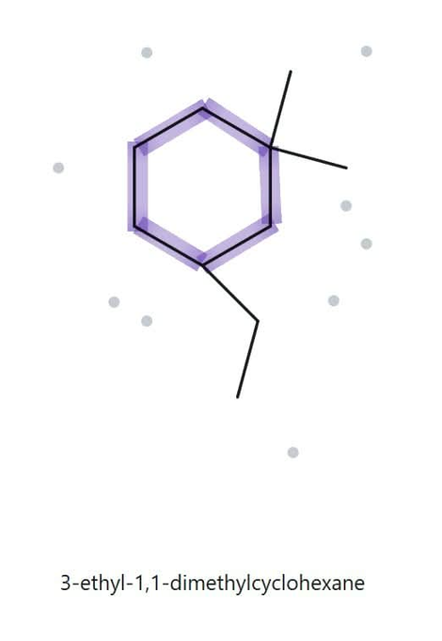
NAME IT, DRAW IT (PART B)
level:
challenge
3-
ETHYL-1,1-DIMETHYLCYCLOHEXANE
NAME DECODED
parent
6C ring - cyclohexane
substituents
ethyl on C3, methyl on C1 (x2)
expected formula
6 + 2 + 1 + 1 = 10 C; one ring
expected molecular formula
C10H20
counted from the drawing
formula check
C10H20
One ring:
CnH2n
parent length matches
formula agrees
numbered parent
substituent positions match
back-check recorded

Slide 20
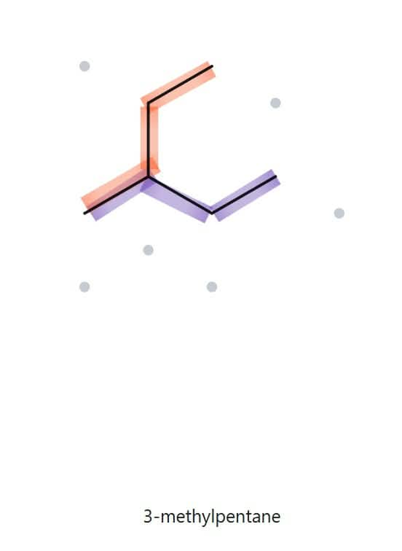
NAME IT, DRAW IT (PART B)
level:
challenge
3-
ETHYLBUTANE
NAME DECODED
parent
5 C continuous chain - pentane
substituents
methyl on C3
expected formula
4 + 2 = 6C; open chain
expected molecular formula
C6H14
counted from the drawing
formula check
C6H14
One ring:
CnH2n+2
parent length matches
formula agrees
numbered parent
substituent positions match
back-check recorded

