Slide 1

Electric Vehicle Data Analysis in SQL
- Jaynil Patel

Slide 2
Table Name : electric_vehicles Total number of rows : 1,86,879
This dataset contains detailed information about electric vehicles registered in a certain region.
Each record represents an individual electric vehicle and includes various attributes such as location, vehicle specifications, and utility details.
The dataset can be used to analyze trends in electric vehicle adoption, geographic distribution, and the characteristics of different electric vehicle models.

Slide 3
Columns Description:
VIN (Vehicle Identification Number): A unique identifier for each vehicle, typically composed of 17 characters, but this dataset seems to be using the first 10 characters.
County: The county in which the vehicle is registered.
City: The city in which the vehicle is registered.
State: The state in which the vehicle is registered.
Postal Code: The postal code for the vehicle’s registration address.
Model Year: The year the vehicle model was manufactured.
Make: The manufacturer or brand of the vehicle (e.g., Tesla, Nissan).
Model: The specific model name or number of the vehicle.
Electric Vehicle Type: The type of electric vehicle (e.g., Battery Electric Vehicle (BEV), Plug-in Hybrid Electric Vehicle (PHEV)).
Clean Alternative Fuel Vehicle (CAFV) Eligibility: Indicates whether the vehicle is eligible for clean alternative fuel vehicle incentives.

Slide 4
Columns Description:
Electric Range: The maximum distance the vehicle can travel on a single charge.
Base MSRP: The manufacturer’s suggested retail price for the base model of the vehicle.
Legislative District: The legislative district where the vehicle is registered.
DOL Vehicle ID: A unique identifier assigned by the Department of Licensing.
Vehicle Location: General location information for the vehicle.
Electric Utility: The utility company providing electric service to the vehicle’s location.
2020 Census Tract: The census tract for the vehicle's location based on the 2020 census.

Slide 5
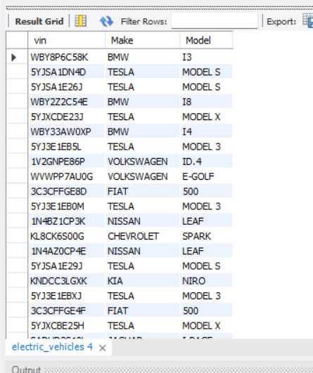
Query to list all electric vehicles with their VIN (1-10), Make, and Model. select vin, Make, Model from electric_vehicles;

Slide 6
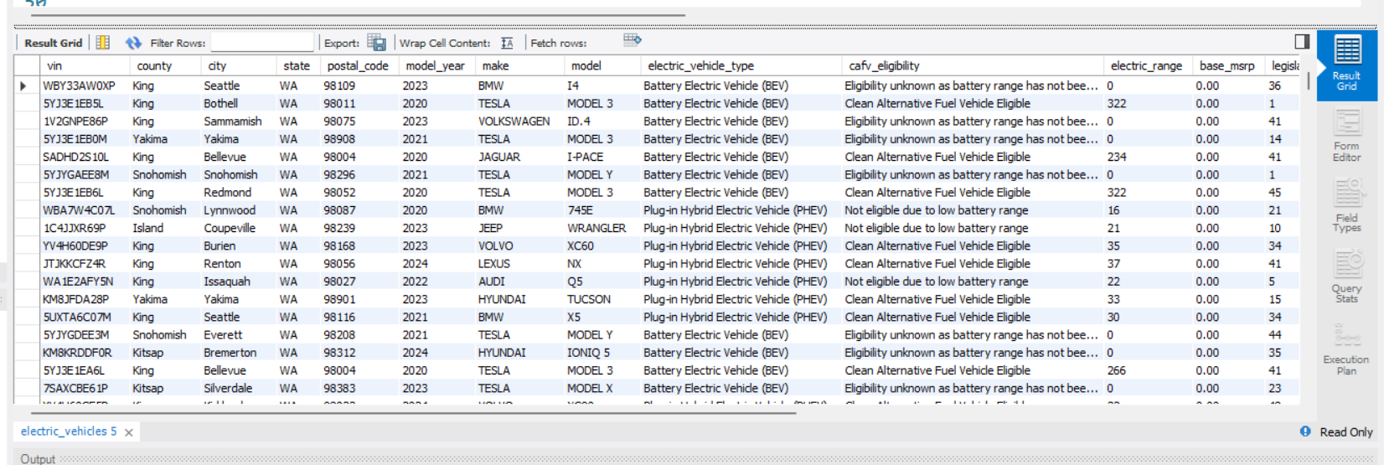
Query to display all columns for electric vehicles with a Model Year of 2020 or later. select * from electric_vehicles where model_year >= 2020;

Slide 7
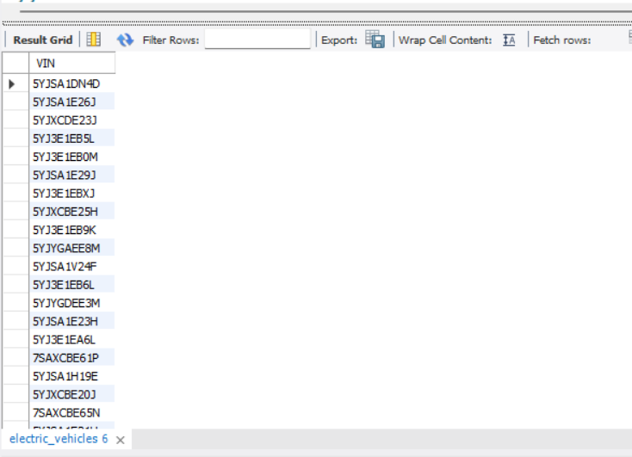
Query to list electric vehicles manufactured by Tesla. select VIN from electric_vehicles where make= "TESLA";

Slide 8
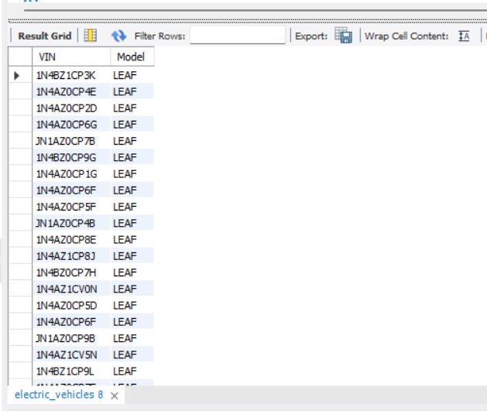
Query to find all electric vehicles where the Model contains the word Leaf. select VIN from electric_vehicles where Model like "%LEAF%";

Slide 9
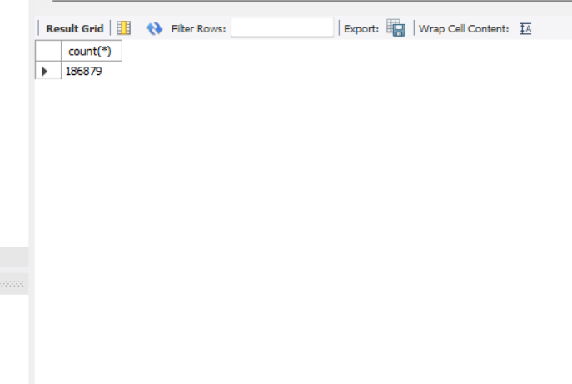
Query to count the total number of electric vehicles in the dataset. select count(*) from electric_vehicles;

Slide 10
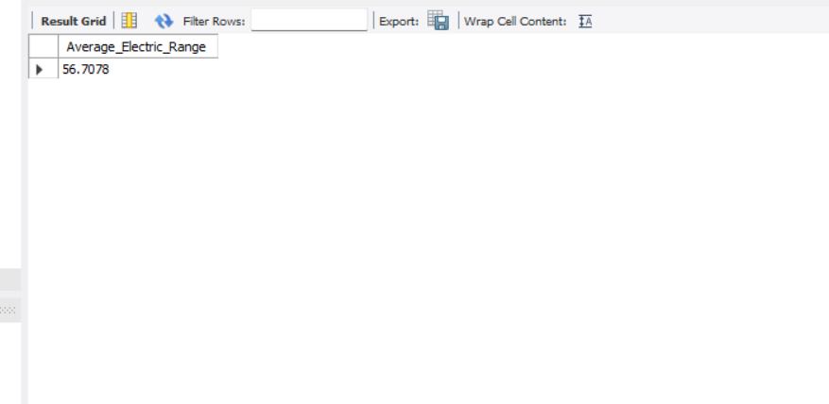
Query to find the average Electric Range of all electric vehicles. select avg(electric_range) as Average_Electric_Range from electric_vehicles;

Slide 11
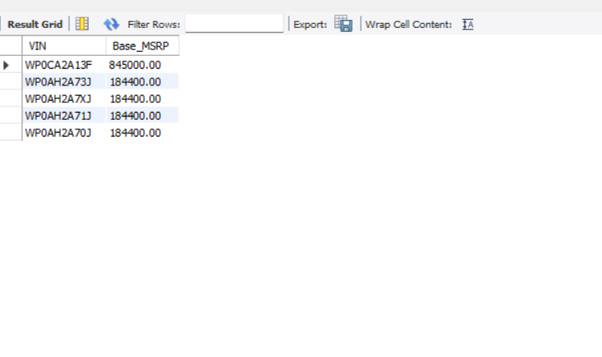
Query to list the top 5 electric vehicles with the highest Base MSRP, sorted in descending order. select VIN, Base_MSRP from electric_vehicles order by Base_MSRP desc limit 5;

Slide 12
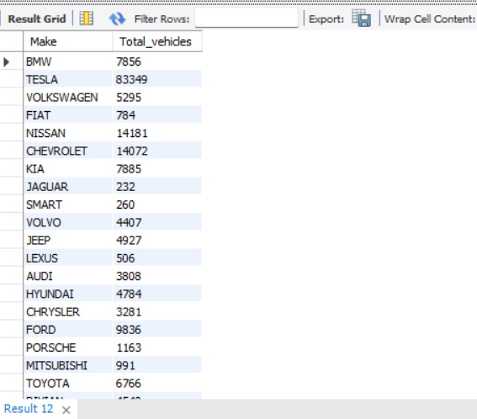
Query to find the total number of electric vehicles for each Make. select Make, count(vin) as Total_vehicles from electric_vehicles group by Make;

Slide 13
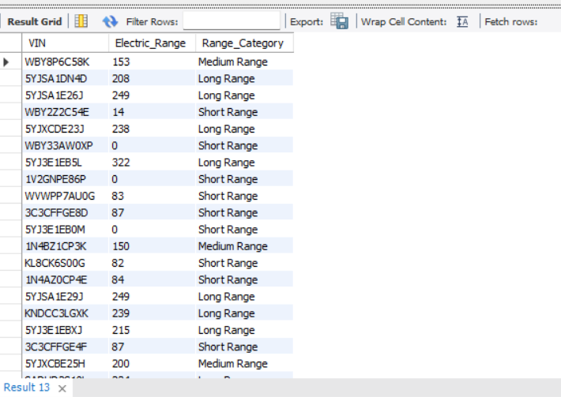
Query using a CASE statement to categorize electric vehicles into three categories based on their Electric Range: Short Range for ranges less than 100 miles, Medium Range for ranges between 100 and 200 miles, and Long Range for ranges more than 200 miles. select VIN, Electric_Range, case when Electric_Range < 100 then "Short Range" when Electric_Range >= 100 and Electric_Range <= 200 then "Medium Range" else "Long Range" end as Range_Category from electric_vehicles;

Slide 14
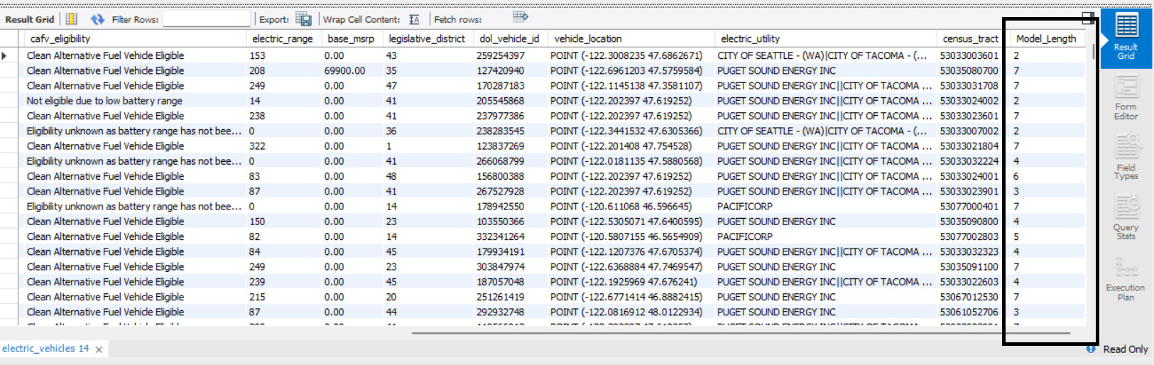
Query to add a new column Model_Length to the electric vehicles table that calculates the length of each Model name. alter table electric_vehicles add column Model_Length int; update electric_vehicles set Model_Length = char_length(Model);

Slide 15
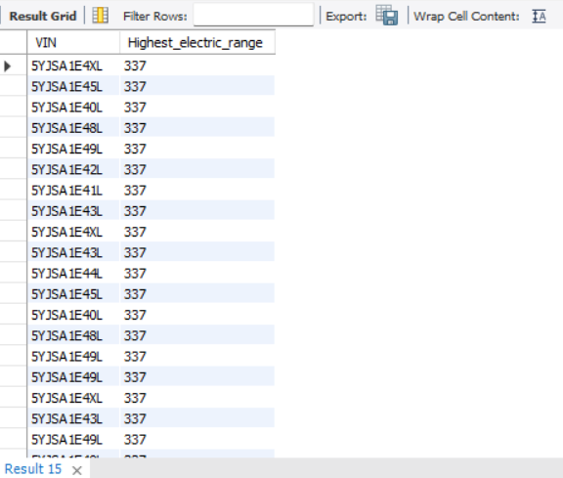
Query using an advanced function to find the electric vehicle with the highest Electric Range. with cte as (select vin, electric_range, rank() over (order by electric_range desc) as Ranking from electric_vehicles) select VIN, Electric_Range as Highest_electric_range from cte where Ranking=1;

Slide 16
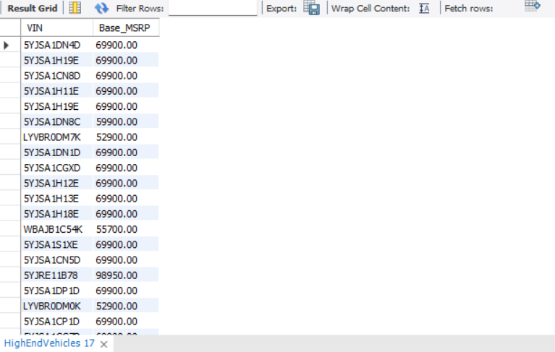
Createing a view named HighEndVehicles that includes electric vehicles with a Base MSRP of $50,000 or higher. create view HighEndVehicles as (select VIN, Base_MSRP from electric_vehicles where Base_MSRP >= 50000); select * from HighEndVehicles;

Slide 17
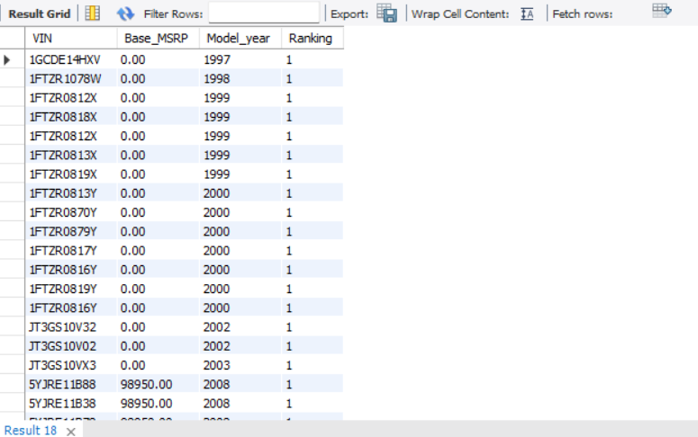
Query using a window function to rank electric vehicles based on their Base MSRP within each Model Year. select VIN, Base_MSRP, Model_year, rank() over (partition by Model_year order by Base_MSRP desc) as Ranking from electric_vehicles;

Slide 18
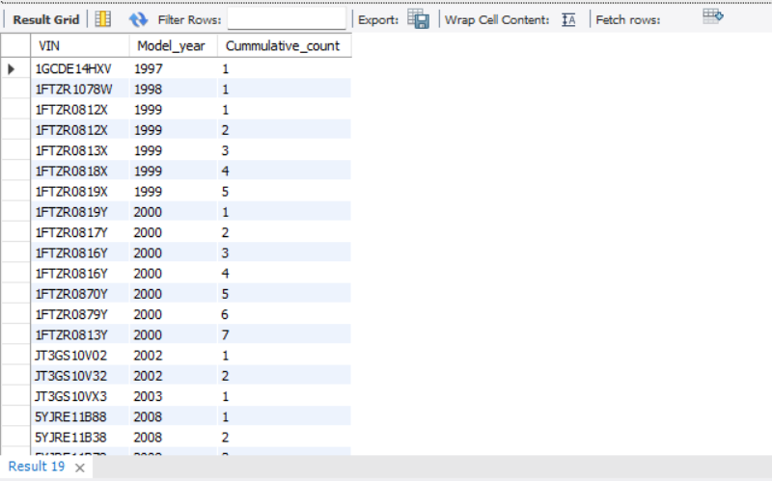
Query to calculate the cumulative count of electric vehicles registered each year sorted by Model Year. select VIN, Model_year, count(vin) over (partition by Model_year rows between unbounded preceding and current row) as Cummulative_count from electric_vehicles order by Model_year;

Slide 19
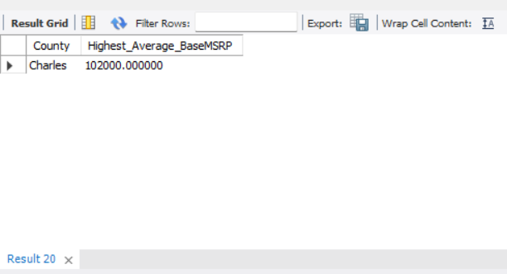
Query to find the county with the highest average Base MSRP for electric vehicles using subqueries and aggregate functions. select County, Average_BaseMSRP as Highest_Average_BaseMSRP from (select county, avg(Base_MSRP) as Average_BaseMSRP from electric_vehicles group by county) tbl order by Average_BaseMSRP desc limit 1;

Slide 20
Stored procedure to update the Base MSRP of a vehicle given its VIN (1-10) and new Base MSRP.
delimiter //
create procedure
update_Base_MSRP(in viNumber varchar(200), in New_Base_MSRP varchar(300))
begin
update electric_vehicles
set Base_MSRP= New_Base_MSRP where vin = viNumber ;
end //
delimiter ;
call update_Base_MSRP("WBY8P6C58K", 40000);

Slide 21
Dataset Report Summary:
This dataset provides comprehensive information about electric vehicles, including their geographic distribution, manufacturing details, and eligibility for clean alternative fuel incentives. Each record is uniquely identified by the Vehicle Identification Number (VIN) and includes details such as the make, model, and year of the vehicle, as well as its electric range and base MSRP. Location-based attributes such as county, city, state, postal code, and census tract enable detailed geographic analysis.
This dataset is valuable for studying electric vehicle adoption patterns, assessing the impact of clean energy policies, and planning for infrastructure development to support electric vehicles.

