Slide 1
INFO 4000
Informatics III
Data Science Specialization - Advanced
Week6 Reinforcement Learning contd…
Course Instructor
Jagannath Rao
raoj@uga.edu

Slide 2
Reinforcement learning:
Discrete spaces and actions

Slide 3
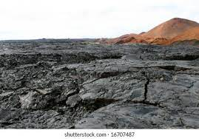
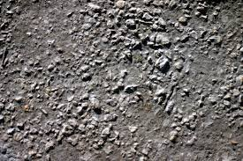
Return and Reward in RL
Terminal State
Terminal State
100
0
0
0
0
40
Rewards
States 1 2 3 4 5 6
Reward is immediate
Return is the long-term gain
Like – cash in hand v/s in the future. Present Value of future return is computed as FV * discounting factor (example interest rate).
What would prefer – get cash now or in the future?
Computing Return
Go left:
State: 4 3 2 1
Return: 0 + (0.9)0 + (0)(0.9)^2 + (0.9)^3 100 = 72.9
Generally:
Return = R1 + γ R2 + γ² R3 + γ³ R4
where, ‘γ’ is the discount factor.

Slide 4
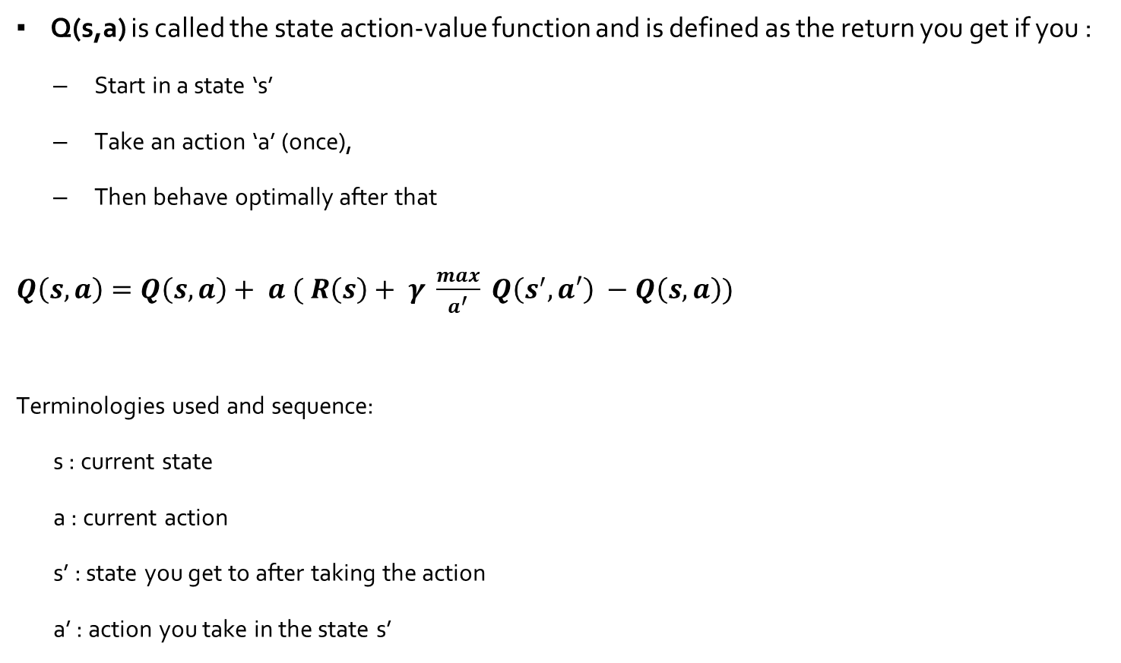
Q value function and the updated Bellman Equation
Q(s,a) is called the state action-value function and is defined as the return you get if you :
  Start in a state ‘s’
  Take an action ‘a’ (once),
  Then behave optimally after that
$Q\left(s,a\right)=Q\left(s,a\right)+ a ( R\left(s\right)+ γ \frac{max}{a^{′}} Q\left(s^{′}, a′\right) −Q\left(s,a\right))$
Terminologies used and sequence:
  s : current state
  a : current action
  s’ : state you get to after taking the action
  a’ : action you take in the state s’

Slide 5
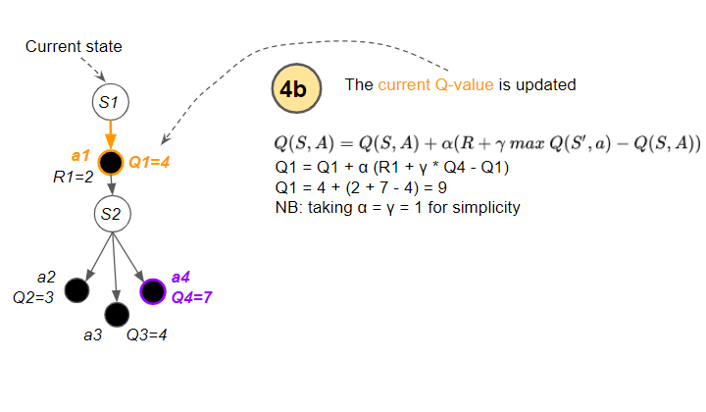
Overall flow of the Q-Learning algorithm
Initially, the agent randomly picks actions.
But as the agent interacts with the environment, it learns which actions are better, based on rewards that it obtains..
It uses this experience to incrementally update the Q values.

Slide 6
Let us do an exercise to understand the concept
Actions, Terminal state and Rewards:
- Up, down, left, right
If you hit the side walls you remain there
Episode end when goal is reached or 10 moves are made
Rewards: 0 in all states except goal and dangerous state
Gamma = 0.5, alpha = 0.5
We shall do 2 episodes
  a) R-R-D-D
  b) D-R-D-R

Slide 7
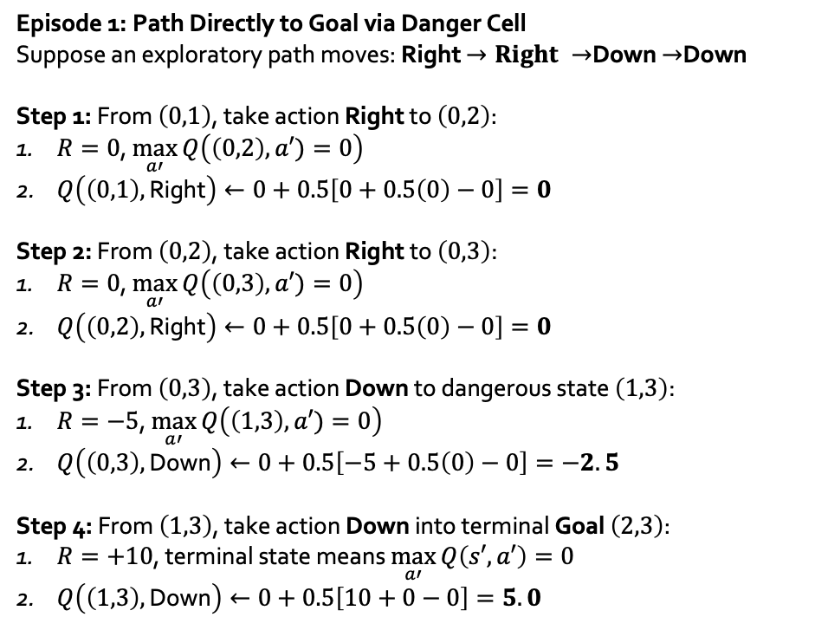
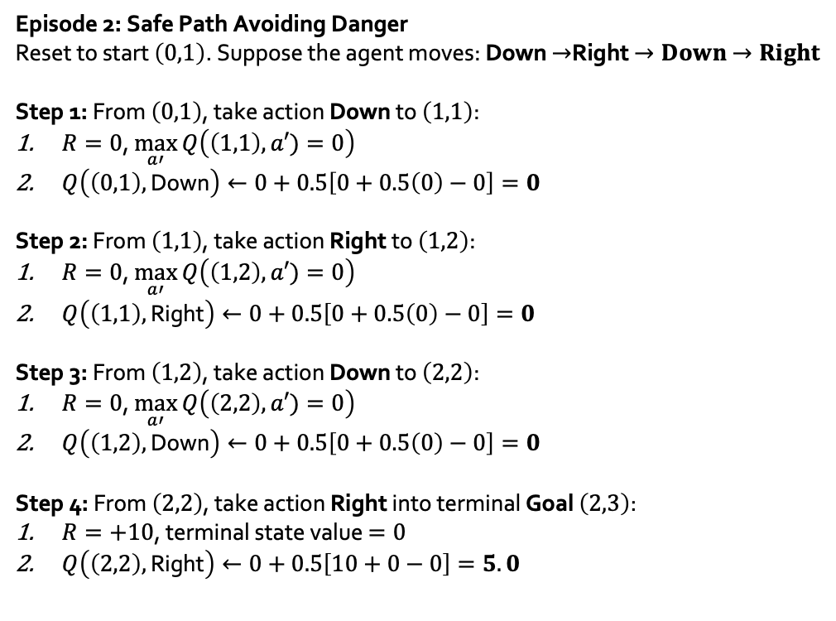
Calculations Episodes
Episode 1: Path Directly to Goal via Danger Cell
Suppose an exploratory path moves: Right $→Right →$Down $→$Down
Step 1: From $\left(0,1\right)$, take action Right to $\left(0,2\right)$:
  $R=0$, $\max_{a′}{Q\left(\left(0,2\right),a′)=0\right)}$
  $Q\left(\left(0,1\right),\text{Right}\right)←0+0.5\left[0+0.5\left(0\right)−0\right]=0$
Step 2: From $\left(0,2\right)$, take action Right to $\left(0,3\right)$:
  $R=0$, $\max_{a′}{Q\left(\left(0,3\right),a′)=0\right)}$
  $Q\left(\left(0,2\right),\text{Right}\right)←0+0.5\left[0+0.5\left(0\right)−0\right]=0$
Step 3: From $\left(0,3\right)$, take action Down to dangerous state $\left(1,3\right)$:
  $R=−5$, $\max_{a′}{Q\left(\left(1,3\right),a′)=0\right)}$
  $Q\left(\left(0,3\right),\text{Down}\right)←0+0.5\left[−5+0.5\left(0\right)−0\right]=−2.5$
Step 4: From $\left(1,3\right)$, take action Down into terminal Goal $\left(2,3\right)$:
  $R=+10$, terminal state means $\max_{a′}{Q\left(s′,a′\right)}=0$
  $Q\left(\left(1,3\right),\text{Down}\right)←0+0.5\left[10+0−0\right]=5.0$
Episode 2: Safe Path Avoiding Danger
Reset to start $\left(0,1\right)$. Suppose the agent moves: Down $→$Right $→Down$ $→Right$
Step 1: From $\left(0,1\right)$, take action Down to $\left(1,1\right)$:
  $R=0$, $\max_{a′}{Q\left(\left(1,1\right),a′)=0\right)}$
  $Q\left(\left(0,1\right),\text{Down}\right)←0+0.5\left[0+0.5\left(0\right)−0\right]=0$
Step 2: From $\left(1,1\right)$, take action Right to $\left(1,2\right)$:
  $R=0$, $\max_{a′}{Q\left(\left(1,2\right),a′)=0\right)}$
  $Q\left(\left(1,1\right),\text{Right}\right)←0+0.5\left[0+0.5\left(0\right)−0\right]=0$
Step 3: From $\left(1,2\right)$, take action Down to $\left(2,2\right)$:
$R=0$, $\max_{a′}{Q\left(\left(2,2\right),a′)=0\right)}$
$Q\left(\left(1,2\right),\text{Down}\right)←0+0.5\left[0+0.5\left(0\right)−0\right]=0$
Step 4: From $\left(2,2\right)$, take action Right into terminal Goal $\left(2,3\right)$:
$R=+10$, terminal state value $=0$
$Q\left(\left(2,2\right),\text{Right}\right)←0+0.5\left[10+0−0\right]=5.0$

Slide 8
ε – Greedy policy

Slide 9
Trade off between Explore and Exploit strategy:
Exploration: It's about gathering more information about the environment. By exploring, the agent can learn about rewards associated with actions it has not tried before. Random actions.
Exploitation: Once the agent has gathered some knowledge about the environment, it can use that knowledge to take actions that it believes will maximize its reward. In other words, the agent uses the knowledge it has to get the best possible outcome.
Imagine playing a new video game and finding a strategy that works reasonably well early on. If you never try anything different, you might miss out on a much better strategy. Exploration ensures that the agent doesn't get trapped in local optima and has a chance to find the global optimum.
Epsilon-greedy: This is one of the most commonly used strategies. Here, with probability less than ϵ (where ϵ is a small positive value), the agent takes a random action (exploration), and with probability 1−ϵ, the agent takes the action that it believes to be the best based on its current knowledge (exploitation).
Achieving the right balance is essential. Too much exploration can result in the agent never really benefiting from what it learns (always trying new things and never capitalizing on known good actions). Conversely, too much exploitation can prevent the agent from discovering potentially better strategies.

Slide 10
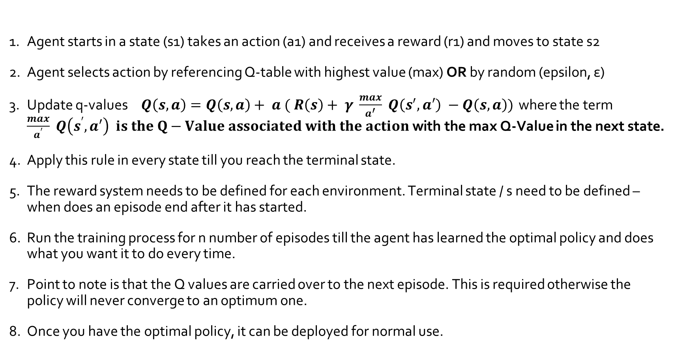
Basic steps in training an agent using Q-learning
Agent starts in a state (s1) takes an action (a1) and receives a reward (r1) and moves to state s2
Agent selects action by referencing Q-table with highest value (max) OR by random (epsilon, ε)
Update q-values$Q\left(s,a\right)=Q\left(s,a\right)+ a ( R\left(s\right)+ γ \frac{max}{a^{′}} Q\left(s^{′}, a′\right) −Q\left(s,a\right))$ where the term $\frac{max}{a^{′}} Q\left(s^{′}, a′\right) is the Q−Value associated with the action$with the max Q-Value in the next state.
Apply this rule in every state till you reach the terminal state.
The reward system needs to be defined for each environment. Terminal state / s need to be defined – when does an episode end after it has started.
Run the training process for n number of episodes till the agent has learned the optimal policy and does what you want it to do every time.
Point to note is that the Q values are carried over to the next episode. This is required otherwise the policy will never converge to an optimum one.
Once you have the optimal policy, it can be deployed for normal use.

Slide 11
gymnasium: Python library
Simulated environments for RL

Slide 12
Environments in basic gymnasium
Gymnasium includes the following families of environments along with a wide variety of third-party environments:
Classic Control - These are classic reinforcement learning based on real-world problems and physics.
Box2D - These environments all involve toy games based around physics control, using box2d based physics and PyGame-based rendering
Toy Text - These environments are designed to be extremely simple, with small discrete state and action spaces, and hence easy to learn.
MuJoCo - A physics engine based environments with multi-joint control which are more complex than the Box2D environments.
Atari - A set of 57 Atari 2600 environments simulated through Stella and the Arcade Learning Environment that have a high range of complexity for agents to learn.
Third-party - A number of environments have been created that are compatible with the Gymnasium API.
Be aware of the version that the software was created for and use the “apply_env_compatibility” in “gymnasium.make“if necessary..

Slide 13
Interacting with the environment
reset: This function resets the environment to its initial state and returns the observation of the environment corresponding to the initial state.
step : This function takes an action as an input and applies it to the environment, which leads to the environment transitioning to a new state. The step function returns four things:
observation: The observation of the state of the environment.
reward: The reward that you can get from the environment after executing the action that was given as the input to the step function.
done: Whether the episode has been terminated. If true, you may need to end the simulation or reset the environment to restart the episode.
info: This provides additional information depending on the environment, such as number of lives left, or general information that may be conducive in debugging.

Slide 14
gymnasium –
Taxicab Example 2,2a for discrete space & action

Slide 15
RL for continuous spaces

Slide 16
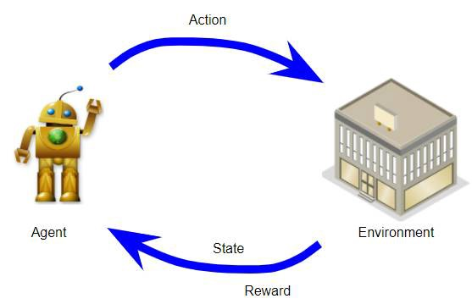
Here is what we needed to do in discrete spaces
We have 2 actions and 6 states (including 2 terminal states).
Q-table has to be a 6 x 2 size table all initialized with zero except the terminal states.
It updates them using the Bellman equation.
Terminal states are assigned their fixed reward values and episodes end at the terminal states.
100
40
50
12.5
25
6.25
12.5
10
6.25
20
100
0
0
0
0
40

Slide 17
Continuous spaces
A q-table only works with a discrete state space, or when the agent can only be in a set number of states.
Think a grid. A maze. A card game. Not the movements of a robot. Not for a racecar going around a track.
Blackjack-v0: states are made up of the combinations of the players current card sum, the faceup card of the dealer, and if the player has a useable ace. This is discrete states.
MountainCar: state is car position and car velocity. This means continuous states.
A q-table assumes that each state is independent of each other. This clearly isn’t true for continuous environments.
Many states are very similar to each other, and we’d like our agent to behave similarly in those states.

Slide 18
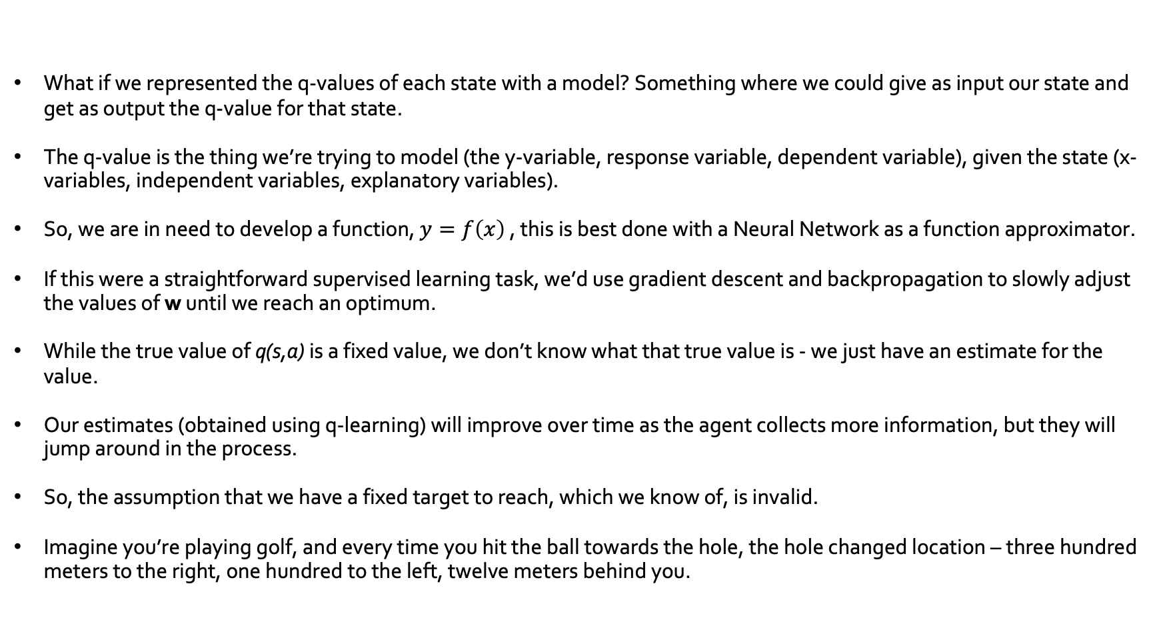
Developing a function approximator
What if we represented the q-values of each state with a model? Something where we could give as input our state and get as output the q-value for that state.
The q-value is the thing we’re trying to model (the y-variable, response variable, dependent variable), given the state (x-variables, independent variables, explanatory variables).
So, we are in need to develop a function, $y=f\left(x\right)$ , this is best done with a Neural Network as a function approximator.
If this were a straightforward supervised learning task, we’d use gradient descent and backpropagation to slowly adjust the values of w until we reach an optimum.
While the true value of q(s,a) is a fixed value, we don’t know what that true value is - we just have an estimate for the value.
Our estimates (obtained using q-learning) will improve over time as the agent collects more information, but they will jump around in the process.
So, the assumption that we have a fixed target to reach, which we know of, is invalid.
Imagine you’re playing golf, and every time you hit the ball towards the hole, the hole changed location – three hundred meters to the right, one hundred to the left, twelve meters behind you.

Slide 19
Continuous Spaces Reinforcement Learning(RL) –
Deep Q-Learning or DQN

Slide 20
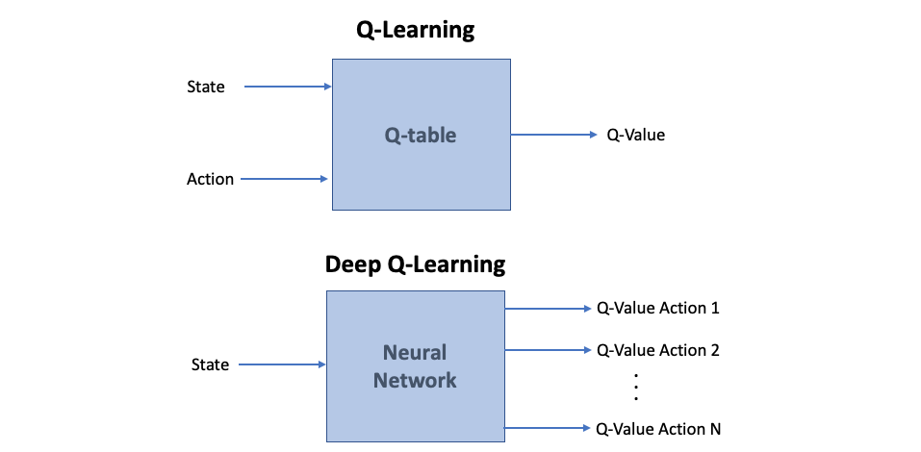
DQN - basics
Since we use deep neural networks to create the function approximator we alluded to, it gets the name DQN or Deep Q Network.
In a traditional reinforcement learning setup only one Q-value is produced at a time
Deep Q-network is designed to produce in a single forward pass a Q-value for every possible action available in the Environment:
This approach of having all Q-values calculated with one pass through the network avoids having to run the network individually for every action and helps to increase speed significantly..
We can simply use this vector to take an action by choosing the one with the maximum value.
This neural network can be a simple NN, a CNN or any other structure depending on what the input is.
Training such a network requires a lot of data to even do a mini-batch gradient descent and we need to figure out how to provide that data.

Slide 21
Bellman Equation for Continuous spaces
$Q\left(s,a\right)=Q\left(s,a\right)+ a ( R\left(s\right)+ γ \frac{max}{a^{′}} Q\left(s^{′}, a′\right) −Q\left(s,a\right))$ the normal Bellman equation.
Bellman Equations for continuous spaces reduces to:
  $Q\left(s,a\right)=R\left(s\right)+\frac{max}{a”}\left(Q\left(s^{′},a^{′}\right)\right)$ .
  This is because NN’s have the learning rate factor built in and the changes to Q values will be incremental.

Slide 22
Q-Network and Target Network
Neural Network is a supervised learning algorithm and to train them and build a model, they need features and a fixed target value to compare with.
The feature we provide the NN (Q-Network) is the current state and the output we should get is the predicted Q-Value of that state.
If we knew the final Q-Value then we could train the network by comparing the predicted value with that. But we do not know that final value.
So, the trick is to use a target network which provides that target even if they are intermediate targets. We make a 2nd NN which is a copy of the Q-Network to start with. This is called the Target Network.
This network is not trained (no back prop). This is important to remember. Therefore, the Q values this network generates remains the same and hence is a good target value.
After every so many episodes, the weights of the original network, which are being updated through gradient descent, is copied on to the Target Network. This enables a smooth progress towards optimal Q values.

Slide 23
Technique for generating and feeding data – Experience Replay
We are trying to approximate a complex, nonlinear function, Q(s, a), with a Neural Network.
We need data containing features and we collect this in a “The replay buffer”, that contains a collection of tuples (S, A, R, S′).
The buffer can be of a fixed size and is populated based on interactions with the environment.
We can then sample training data from this, randomly, in mini-batches. This is also referred to as “ Experience Replay”.
In order to store the Agent’s experiences, we used a data structure called “deque” in Python’s built-in collections library. It’s basically a list that you can set a maximum size on so that if you try to append to the list and it is already full, it will remove the first item in the list and add the new item to the end of the list.
The experiences themselves are tuples of [observation, action, reward, done flag, next state].

Slide 24
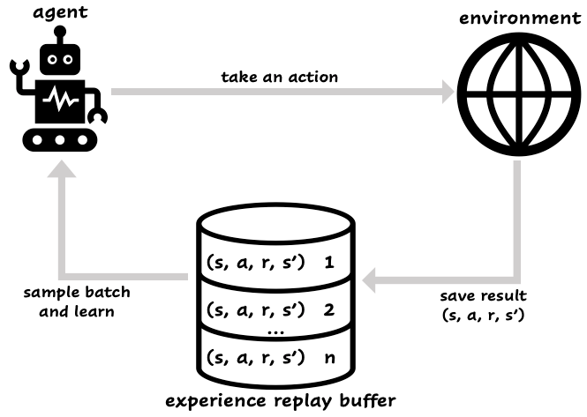
Building a dataset for training the NN

Slide 25
  Example 3: How to create Experience Replay buffer

Slide 26
DQN training and flow
Q-Network
a0
a1
a2
0.2
0.8
-1.1
Replay Buffer
s_{t} , a₀ , r_{t} , s_{t+1} , done
s_{t}
Trainable
Q _ Predicted for action a₀
s_{t} , a₂ , r_{t} , s_{t+1} , done
s_{t} , a₁ , r_{t} , s_{t+1} , done
MSE Loss
Target-Network
1.2
0.3
-1
Q(s_{t} , a_{o} ) = r_{t} + γ. max(Q)
OR
Q(s_{t} , a_{o} ) = r_{t} (if done = True)
(terminal state)
s_{t+1}
Fixed
After every so many episodes copy the weights from the Q-Network to the Target-Network and continue the journey

Slide 27
Numerical example to illustrate previous slide details
Assumptions: actions = 4 and γ = 0.95
Replay buffer row content = [current state = 100, action = 0, reward = 5, next state = 102]
Q-Network output = [2.3, -1.5, 0.8, 0.1] Predicted Q-values for actions 0, 1, 2, 3 respectively
Target Network output = [3.1, 0.5, 2.2, -0.3] Predicted Q-values for actions 0, 1, 2, 3 in the next state
Bellman Equation and Loss Calculation:
max Q from Target network for next state = 3.1
Target Q value for the current state-action pair is : Q(s,a) =R(s) + γ * max Q(s’,a’) which is 5 + 0.95 * 3.1 = 7.945
Predicted Q value from the Q-network is 2.3 for action 0
MSE = 1/2 * (7.945 – 2.3) ²

Slide 28
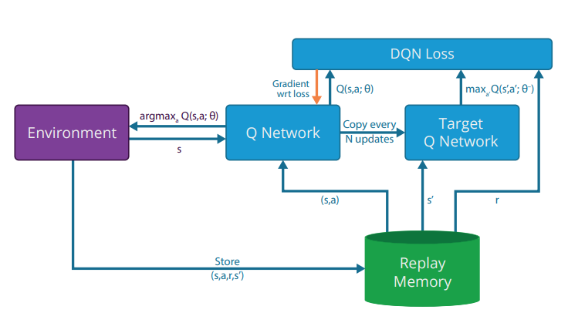
DQN training and flow

Slide 29
  Example 4: Cartpole

Slide 30
  RL in Environments with:
  Continuous actions and continuous spaces

Slide 31
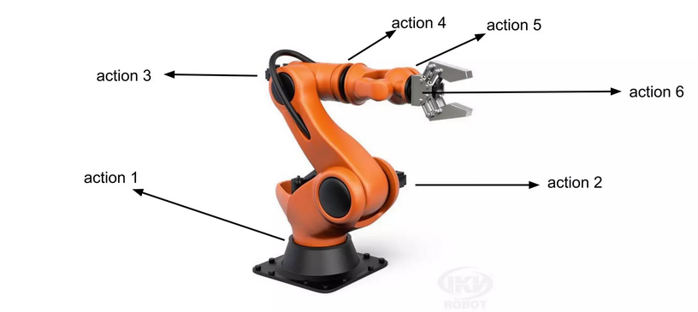
What is the continuous action space?
Example 1:
When you're driving of your car and you turn the wheel, it is continuous, because you can control
- How much you turn the wheel.
- How much do you press the gas
pedal?
2. This leads to a continuous action space:
- e.g., for each positive real number x in some
range, "turn the wheel x degrees to the
right" is a possible action.
Example 2:

Slide 32
Challenges in continuous space and action environments
Challenges of a robot learning to pick n place,
  It has countless joint angles (continuous state space) and
  It can apply varying forces to its motors (continuous action space).
  The number of possible states and actions explodes
  The robot must decide on precise values (e.g., rotate joint 32.5 degrees).
  All this requires more sophisticated decision-making.

Slide 33
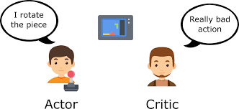
Question is, how do we solve the RL problem under these conditions
Policy Gradients: These methods directly optimize the policy (the strategy for choosing actions) by adjusting it based on feedback.
  A robot can slightly tweak its walking style after each step based on how well it's doing.
Actor-Critic Methods: These combine value estimation (critic) with policy improvement (actor) for more efficient learning.
  Think of it as the robot having a coach (critic) who provides feedback on its performance, helping it refine its walking technique (actor).

Slide 34
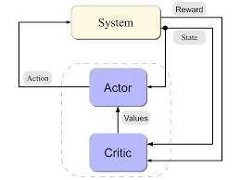
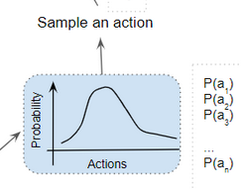
Actor-Critic: How does it work?
They address the challenges by combining two key components:
Actor:
  This is a neural network that learns the optimal policy, mapping states to actions – unlike DQN which does states to Q-Values
  Think of it as the "brain" of the robot, deciding what actions to take based on the current situation.
  Because it is continuous action, the actions are picked up from a normal probability distribution.
  In other words, the actor outputs parameters for a probability distribution - mean and standard deviation of a Gaussian
Critic:
  This is another neural network that estimates the value function,
  Predicting the expected cumulative reward from a given state.
  It acts as a "coach" or "evaluator," providing feedback to the actor on how good its actions are.
  This helps the actor learn more efficiently by focusing on actions that lead to higher values.

Slide 35
Proximal Policy Optimization (PPO) – Most popular variant of Actor-Critic
What is it?
Imagine teaching someone to drive.
  The actor is the driver’s hands and feet.
  The critic is a calm instructor in the passenger seat saying, “that move was better/worse than average.”
  Training = lots of short drives. After each drive, you tweak the driver’s habits.
PPO specific:
  You put guardrails on how much you’re allowed to change the driver after each lesson.
  Even if the instructor thinks “wow, turning hard like that worked great once,” you don’t overhaul the driver’s whole style in one go.
  You only allow small, safe nudges toward what seemed better.
  So, If a suggested change is too big, PPO clips it — “that’s past the guardrail; no extra credit for pushing further.”
Why?
  Because sometimes a move looks amazing just by luck (traffic broke your way). If you overreact, you teach the driver bad habits.
  PPO’s guardrails keep each update proportional but modest, so learning is steady, not swingy.

Slide 36
The “Advantage function”:
The difference between actual reward and expected value
Imagine you're training an agent to play a game, like a racing game or a simple Atari game:
  The advantage function helps the agent figure out how *good* an action was in a particular situation,
  It is measured as , compared to what it *expected* to be good.
The advantage function provides a way to isolate:
  how much better an action was than the average action in that situation.
  It’s like, did the student perform above, same as or below the class average.
The Importance of the Advantage computation
  Without an advantage function, the agent would be constantly learning from noisy rewards. It's hard to tell if a reward was due to a good action or just random luck.
  Focus on Improvement: The advantage function helps the agent focus on actions that actually improve its performance. It tells the agent which actions are worth learning.
  Faster Learning: By focusing on good actions, the agent can learn much faster than if it had to learn from every single reward.

Slide 37
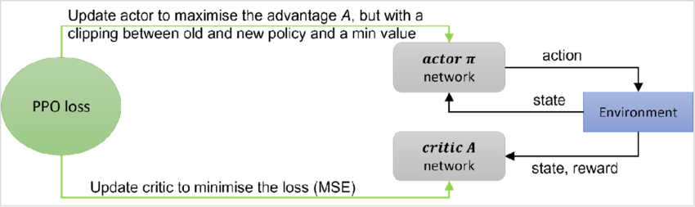
Proximal Policy Optimization (PPO) – How does it work?
  Agent is in a particular state - s
  The actor network outputs actions from the probability distribution and from this action can be picked randomly or max value basis
  At the same time the critic network makes a prediction of the value of the current state – V(s ; θ)
  Based on the action taken by the actor the environment gives back (as always) a reward and the next state – s’
  The critic which predicted the value of state s can now predict the value of the next state and therefore compute what the real estimated value of s is using the Bellman equations as the foundation and the reward -> V(s ; θ) = R(s) + γ V(s’ ; θ)
  Now the MSE can be computed between the predicted and estimated value as -> MSE = (TD error)² = (R + γV(s'; θ) - V(s; θ))²
  The actor network uses the same MSE loss, but we also add a couple of other terms to it (ratio of probability of previous to current action in the same state) and we clip the network update value to avoid big changes in actor parameter values.
Policy Network (actor): This network is responsible for predicting the parameters of the policy. It takes the current state (`s`) as input and outputs the parameters that define the probability distribution over actions
Value Network (critic): This network estimates the value of being in a given state. It takes the current state (`s`) as input and outputs an estimate of the expected cumulative reward from that state onwards. This is often referred to as the state-value function.

Slide 38
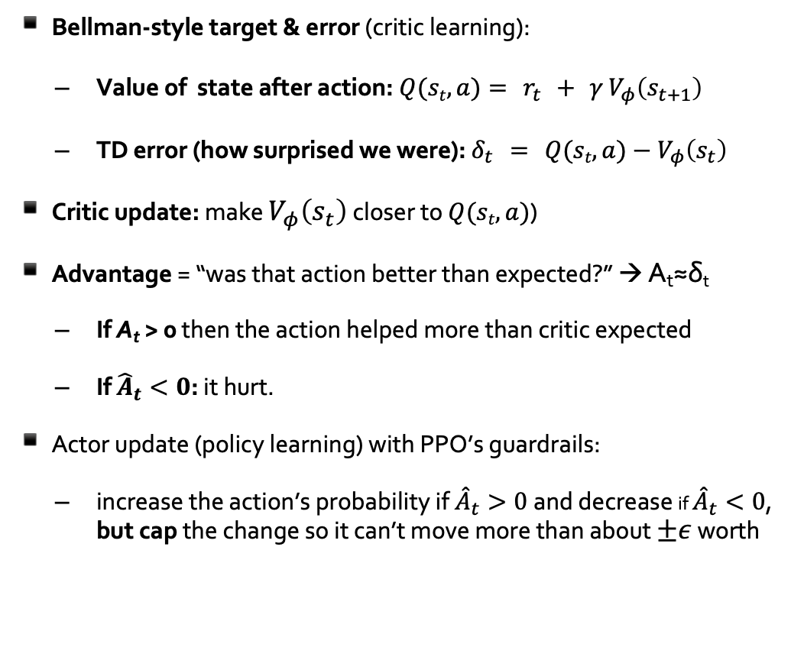
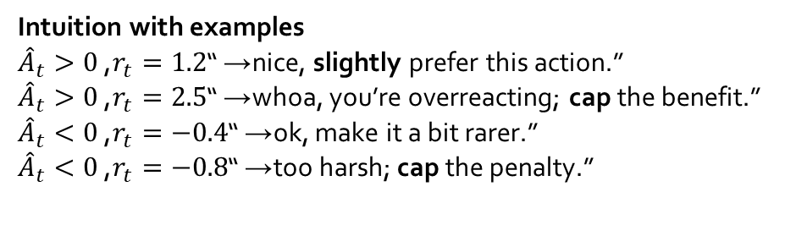
Proximal Policy Optimization (PPO) – Mathematically
Bellman-style target & error (critic learning):
  Value of state after action:$Q(st,a)= r_{t} + γ V_{φ}\left(s_{t+1}\right)$
  TD error (how surprised we were): $δ_{t} = Q(st,a)−V_{φ}\left(s_{t}\right)$
Critic update: make $V_{φ}\left(s_{t}\right)$ closer to $Q(st,a)$(
Advantage = “was that action better than expected?” → A_{t}​≈δ_{t}
  If A_{t} > 0 then the action helped more than critic expected
  If ${\hat{A}}_{t}<0$: it hurt.
Actor update (policy learning) with PPO’s guardrails:
  increase the action’s probability if ${\hat{A}}_{t}>0$and decrease if ${\hat{A}}_{t}<0$,
  but cap the change so it can’t move more than about $±ε$ worth
Intuition with examples
${\hat{A}}_{t}>0$, $r_{t}=1.2$→ “nice, slightly prefer this action.”
${\hat{A}}_{t}>0$, $r_{t}=2.5$→ “whoa, you’re overreacting; cap the benefit.”
${\hat{A}}_{t}<0$, $r_{t}=−0.4$→ “ok, make it a bit rarer.”
${\hat{A}}_{t}<0$, $r_{t}=−0.8$→ “too harsh; cap the penalty.”

Slide 39


Applications of RL with PPO in industry
Optimizing Robotic Arm Control for Assembly Tasks
  Imagine a manufacturing line where robotic arms assemble intricate products, like smartphones or electronics. These robots need to perform precise movements in a continuous space to pick up components, align them correctly, and fasten them together.
  Electronics assembly: Companies like Siemens and Foxconn are exploring using RL to optimize robotic assembly in electronics manufacturing.
  Automotive manufacturing: RL is being used to improve the precision and efficiency of robotic arms for tasks like welding and painting in car factories.
When does training happen?
  Offline Training: Most of the training (simulation and potentially pre-training) happens offline before deployment.
  Fine-tuning and Adaptation: Real-world fine-tuning and any ongoing learning occur after the robot is deployed.

Slide 40
Understanding the StableBaselines3 Library:
Functionality and Applications in Reinforcement Learning

Slide 41
Unified and Reliable RL Algorithms
Stable Baselines is a popular Python library that provides implementations of various Reinforcement Learning (RL) algorithms
State-of-the-art implementations. Offers clean, highly optimized versions of major Reinforcement Learning algorithms like PPO, A2C, SAC, and TD3.
Consistent performance. Built to replace older, fragmented codebases with reliable, benchmarked baselines that researchers and developers can trust.
Notes:
StableBaselines simplifies the process of applying RL algorithms by providing robust, well-maintained implementations. This makes it a go-to library for both researchers and practitioners who want to build and test RL models efficiently.

Slide 42
User-Friendly and Production-Ready
Minimal boilerplate. Enables training an agent in just a few lines of clean, readable Python code.
Seamless model deployment. Features simple functions to save, load, and export trained policies to production environments.
Community Support: Extensive documentation and active community.
Notes:
These benefits collectively reduce the time and effort needed to get RL models up and running, allowing you to focus more on refining the models and applying them to real-world problems.

Slide 43
Built on a Clean, Modern Stack
Fully PyTorch-driven. Leverages PyTorch for all neural network structures, making custom network architectures easy to build.
Type-hinted code. Uses strict Python type hinting and clean object-oriented design to reduce bugs and improve developer workflow.
Gymnasium compatibility. Integrates out of the box with standard environments like OpenAI Gym and its successor, Gymnasium.
Pre-configured hyperparameters. Works out of the box for common control and robotics tasks, minimizing the time spent tuning models.
Notes:
Understanding these components is crucial because they form the foundation of how you interact with and build models using StableBaselines. Each component plays a specific role in the RL pipeline, from defining the problem to executing and evaluating the solution.

Slide 44
Getting Started with StableBaselines3
Installation: uv add “stable-baselines3[extra]”
It works best with Python 3.12 – So you can create a Week6 folder and have a uv venv in that with Python 3.12 in it.
Dependencies: Gymnasium, PyTorch
Basic coding Setup example:
  from stable_baselines3 import PPO
  from gymnasium import make
  env = make('CartPole-v1')
  model = PPO('MlpPolicy', env, verbose=1)
  model.learn(total_timesteps=10000)
  Links: Stablebaselines3 , SB3-PPO , Custom-Policies , Getting-Started
Notes:
This simple code block demonstrates how easy it is to get started with StableBaselines. By running just a few lines of code, you can set up an environment, select an algorithm, and begin training your model.

Slide 45
Model Evaluation and Visualization
Use `evaluate_policy` to assess model performance.
Visualize rewards using TensorBoard or Matplotlib.
Notes:
Evaluating and visualizing the performance of your RL model is crucial to understanding its learning progress. This slide explains how to use the `evaluate_policy` function and visualization tools to monitor your model.

Slide 46
  Let us train a “bipedal-walker” using SB3

Slide 47
  Building your own environment using gymnasium

Slide 48
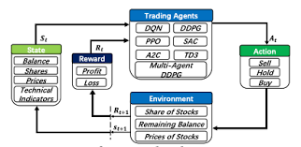
Why would you build your own environment?
Unique Problem: You might be working on a problem that has no readily available environment
Fine-grained Control: Building your own environment gives you complete control over every aspect:
  State Space: Define exactly what information the agent observes.
  Action Space: Design the actions the agent can take, whether discrete (e.g., move left/right) or continuous (e.g., apply a specific force).
  Reward Function: Craft a reward function that truly aligns with your desired agent behavior.
  Dynamics: Determine how the environment changes in response to the agent's actions.

Slide 49
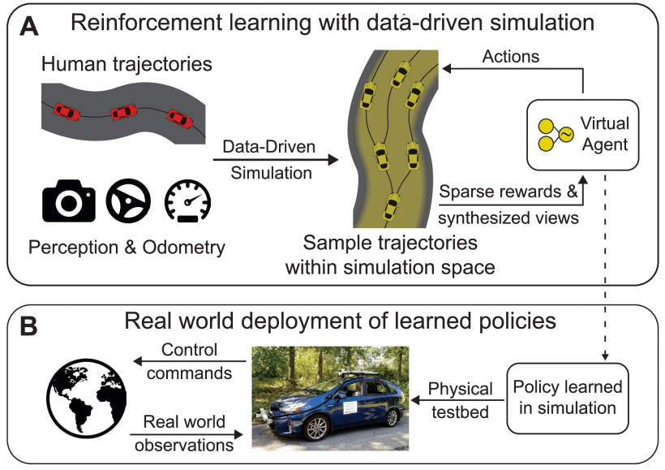
Real world dynamics
Learning by Doing: Implementing an environment from scratch forces you to deeply understand the underlying principles of RL and how environments interact with agents.
Simulating Real-World Scenarios:
  Safe and Cost-Effective:
    RL environments allow you to simulate real-world scenarios that might be dangerous, expensive, or time-consuming to test in reality.
  Data Augmentation: You can generate large amounts of synthetic data from your environment to supplement real-world data, improving the robustness of your RL agent.
  Research and Development:
    Novel Environments: Creating new environments can drive research in RL by introducing new challenges and benchmarks for the community.
    Algorithm Testing: You can use your custom environment to test the performance and limitations of different RL algorithms.

Slide 50
Gymnasium's ‘ENV’ Class provides us with the tools:
Methods we can use
reset: This function resets the environment to its initial state and returns the observation of the environment corresponding to the initial state.
step : This function takes an action as an input and applies it to the environment, which leads to the environment transitioning to a new state. The step function returns four things:
  observation: The observation of the state of the environment.
  reward: The reward that you can get from the environment after executing the action that was given as the input to the step function.
  done: Whether the episode has been terminated. If true, you may need to end the simulation or reset the environment to restart the episode.
  info: This provides additional information depending on the environment, such as number of lives left, or general information that may be conducive in debugging.
spaces:
  spaces.Discrete(n): For a state that is a single number from \(0,...,n-1\).
  spaces.Box(low, high, shape, dtype): For a state that is a continuous n-dimensional array, like a position and velocity.spaces.
  Dict({"key1": space1, "key2": space2}): For a state composed of different, named components.

Slide 51
Stepwise details
Create Environment Class: Define a new Python class that inherits from “gymnasium.Env”
Initialize attributes:
  observation_space: Define the format of the state information the agent receives (e.g., using “gym.spaces.Box” for continuous values or “gym.spaces.Discrete” for discrete options).
  action_space: Specify the possible actions the agent can take (e.g., using gym.spaces.Discrete for a set of actions).
Implement reset function: This function is called at the start of each episode to set the environment to its initial state and return the initial observation.
Implement “step” function:
  Takes an action from the agent as input.
  Updates the environment state based on the action.
  Calculates and returns the new observation, reward, done flag (indicating episode termination), and any additional information.
Optional: Implement render function: Visualizes the current state of the environment (can be a simple text output or a graphical display).

Slide 52
Key points to remember
Flexibility:
  Design your environment to match the specific problem you want to solve in reinforcement learning.
Clear state representation:
  Ensure the observation space accurately reflects the information an agent needs to make decisions.
Reward function design:
  Carefully craft the reward structure to guide the agent towards the desired behavior.
Testing and debugging:
  Thoroughly test your custom environment to ensure it functions as expected
Video Link: Build your own Environment

Slide 53
  Let us code and build our own environment:
  We shall use the same old Mineral Explorer

Slide 54
  HW 2

Slide 55
Part 1: MQTT
Write separate python scripts, for publishing data and to receive that data using MQTT.
You will write 2 separate publish scripts
  one for temperature and humidity with numbers for temperature ranging between 50 to 52 F and numbers for humidity between 60 and 80 percentage.
  the other publish file will be for rainfall with numbers ranging between 0 and 2 inches.
You will also write 2 separate subscriber scripts with
  One subscriber subscribing to all the weather data
  This script will start getting the data with client.loop_start() and when 50 data points are reached, it will stop subscribing using client.loop_stop()
  The other subscriber will receive the temperate and humidity data and will loop_forever.

Slide 56
Part 2: Build the DQN Model for the MountainCar-v0
From the Farama Gymnasium library choose the version MountainCar-v0". This is the version with continuous spaces and discrete actions.
Build the solution from scratch using the DQN algorithm.
Check the goals, rewards and other details in the documentation on the webpage of Farama Gymnasium - https://gymnasium.farama.org/environments/classic_control/mountain_car/
You will write a separate function for the NN training and build a simple architecture for that.
You will write the training loop such that the Neural Network that you build is separate function and is called from the main training loop.
Once the model achieves its goals (based on details given in the gymnasium documentation) save the model.
Use the saved model (the Policy) to run 5 complete episodes with flawless goal achievement.

Slide 57
Due data and grading
HW 2 will be due by October 3rd midnight.
Grading criteria (weightage 40-60)
  All code is implemented as per instructions and runs error free
  Questions given below are answered for each part
  Code is well commented
Part 1 Questions:
  What was you biggest takeaway from the MQTT exercise
  What is different between looping forever and looping with start – stop? 4. Part 2 Questions:
Part 2 Questions:
  Explain how DQN works in the application that you built? Answer should be specific to what you developed.
  Give me an example of a RL environment that you would like to design for training an agent to operate in it. Something from things you are learning in engineering / MIS.

Slide 58
Introduction to Sound or Audio as Data

Slide 59
Sound as data – how should we understand it
Easy way is to compare it with image as data -
An image is a grid of:
  tiny dots called pixels,
  and each pixel has a number representing its color
Sound as data is:
  simply a long, ordered sequence of numbers,
  each number represents how much the air pressure is vibrating (the loudness) at a specific instant in time.

Slide 60
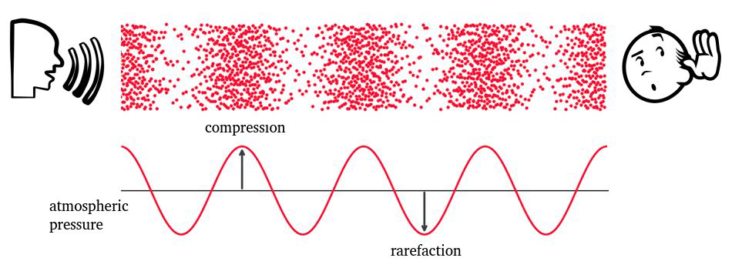
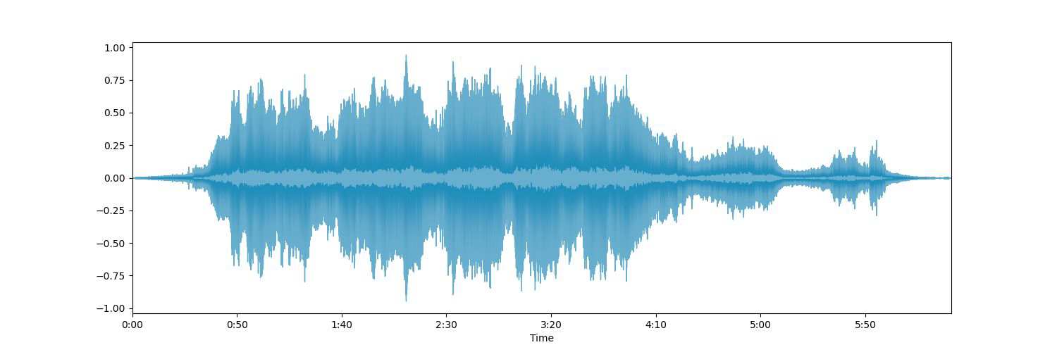
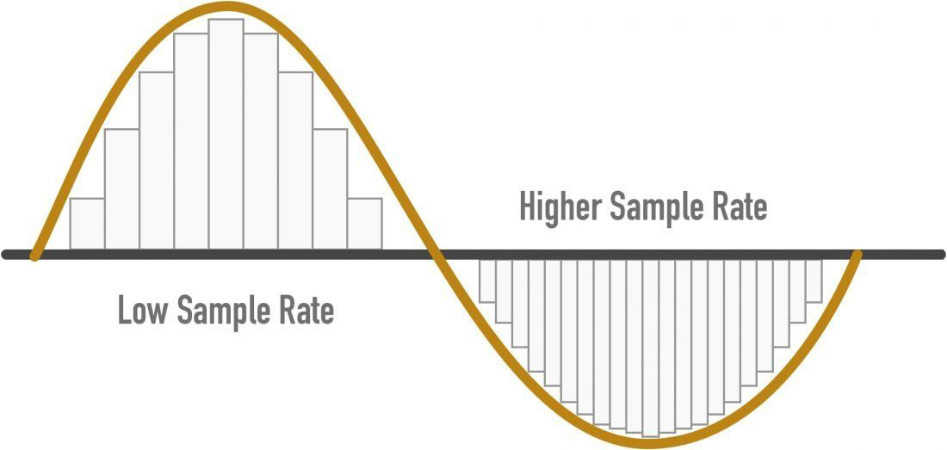
What is audio?
Audio, which is another form of unstructured data, is essentially sound represented in a way that can be recorded, stored, transmitted, and reproduced.
It's the vibration of air molecules that our ears perceive as sound but captured and converted into a form that machines can understand.
Analog Representation: This is the natural form of audio, where the sound waves are directly represented as continuous variations in a physical medium.
Digital Representation:
    - This is how audio is stored and processed in computers and modern devices. - The continuous sound wave is converted into a series of discrete numbers (samples) through a process called sampling.
    - Each sample represents the amplitude of the sound wave at a specific point in time.
Imagine a bird singing.
  - The bird's song itself is the audio.
  - Analog representation: Recording the song on Vinyl.
  - Digital representation: Recording the song on your smartphone as an MP3 file.

Slide 61
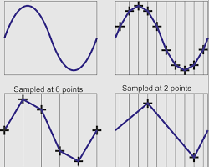
Brief explanation of sampling
Think of a continuous audio signal as a smooth curve.
                Sampling is the process of taking discrete measurements of this curve at regular intervals.
                It's like taking snapshots of the curve at specific points in time.
Why is Sampling Done?
Digital Representation: Computers can only process digital data. Sampling converts the continuous analog audio signal into a digital format.
Storage and Transmission: Sampled audio data can be easily stored and transmitted in digital form.
Feature Extraction: Many feature extraction techniques, especially in classical machine learning, require discrete time-domain or frequency-domain representations.
How is Sampling Done?
The sampling rate determines the number of samples taken per second.
A higher sampling rate captures more detail of the original signal but also requires more storage space.
Choosing the Right Sampling Rate:
The Nyquist-Shannon sampling theorem states that a signal must be sampled at a rate at least twice its highest frequency component to avoid losing information.
For example, to accurately capture a signal with a maximum frequency of 20 kHz, you would need a sampling rate of at least 40 kHz.

Slide 62
Application with audio as data
Speech Recognition: Relate this to how voice assistants like Siri or Google Assistant work. The audio is analyzed to understand the spoken words.
Music Genre Classification: Think of how Spotify or Apple Music recommends songs. They analyze audio features to categorize music.
Sound Event Detection: This is like how a smart home system recognizes the sound of a doorbell or a smoke alarm.
Sound classification: Recognizing everyday urban sounds, identifying birds in nature from their tweets, studying bio-diversity in nature, etc.
Automatic Lyrics Alignment: Implement a system that aligns lyrics with the sung audio in songs, useful for karaoke applications or music learning.
Bio-acoustic Monitoring: Use audio deep learning for ecological studies, such as identifying bird calls or monitoring rainforest sounds to assess biodiversity.
Audio-based Health Diagnostics: Develop tools for diagnosing health conditions through sound, such as analyzing cough sounds to detect respiratory diseases.

Slide 63
Audia signal characteristics

Slide 64
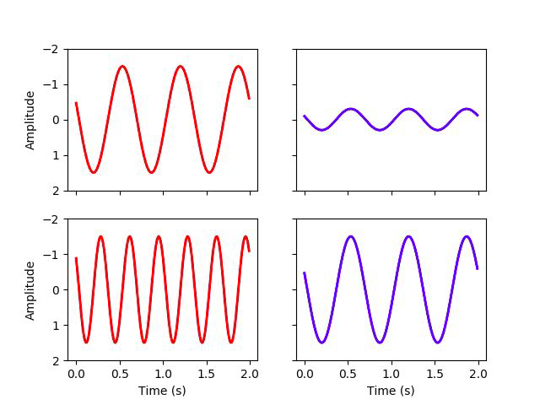
Frequency and amplitude
higher frequency -> higher pitch sound
Measured in Hertz (Hz) (cycles per second).
larger amplitude -> louder
Measured using metrics like Root Mean Square (RMS) energy
In analytics: Complex sounds (like speech or music), we use a mathematical tool called a Fourier Transform to break the sound down and see exactly which frequencies are present at any given time – spectrogram.

Slide 65
Sound Power and Intensity
Power
Rate at which energy is transferred
Energy per unit of time emitted by a sound source in all directions
Measured in watt (W)
Intensity
Sound power per unit area
Unit – W/m²
Threshold of hearing = 10⁻¹² W/m^{2.}
Threshold of pain = 10 W/m²
Logarithmic scale
Measured in decibels (dB)

Slide 66
Music related
Beat - rhythm
Timbre – Sound quality and is a mix of different frequencies occurring simultaneously
Pitch – high or low frequency
Harmony – frequencies which are multiples of a fundamental
many more

Slide 67
  End of Lesson

