Slide 1
Predicting Subreddits by
their posts
James Oomens | Project 3

Slide 2
Problem Statement
Our marketing agency is looking to help an online sporting goods store push their sales in 2025 with targeted ads via forum posts. The problem is, the client has many different products for different types of sports and needs a way to automate this process.

Slide 3
01
Data Acquisition

Slide 4
How did we scrape the data?
Step 1
Step 2
Step 3
Step 4
Configure the Reddit API
Put them together
Turn it into a Dataframe!
Develop a “for loop” to scrape each subreddit

Slide 5

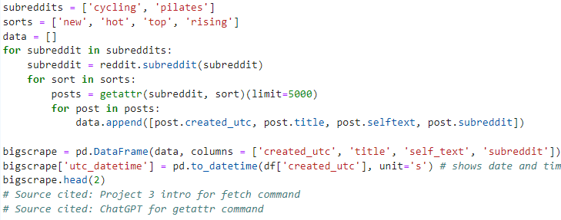
Scraping Code

Slide 6
9,661
How many posts we were able to scrape

Slide 7
02
EDA

Slide 8
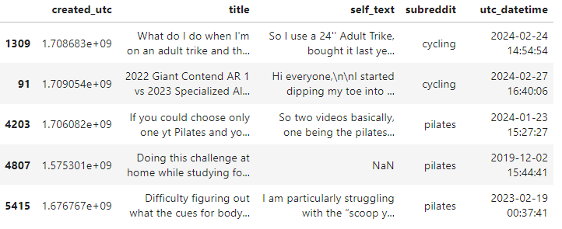
What does a sample of this dataframe look like?

Slide 9
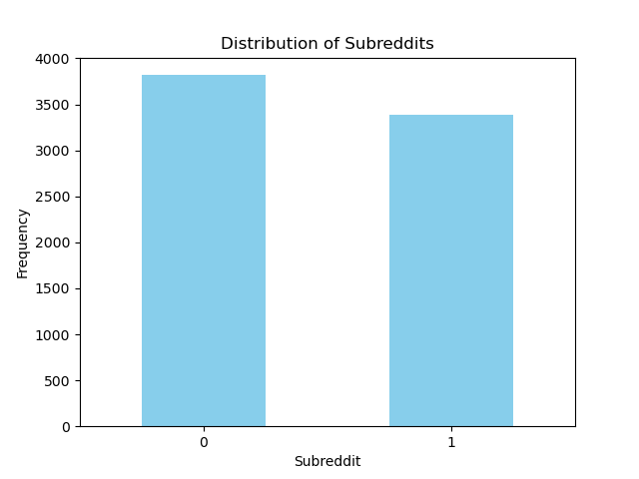
Class Balance
Cycling
3818 posts
Pilates
3388 posts
Cycling
Pilates

Slide 10
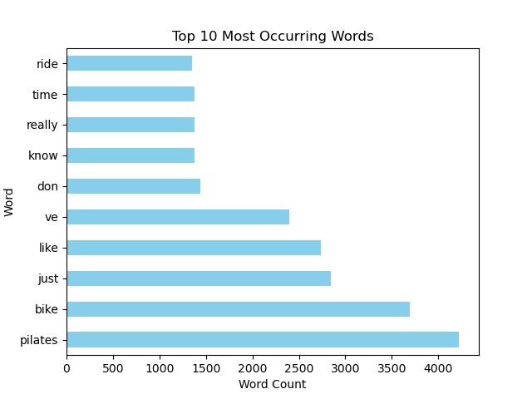
Top 10 Occurring Words
Notice!
Bike and Pilates are the top words

Slide 11
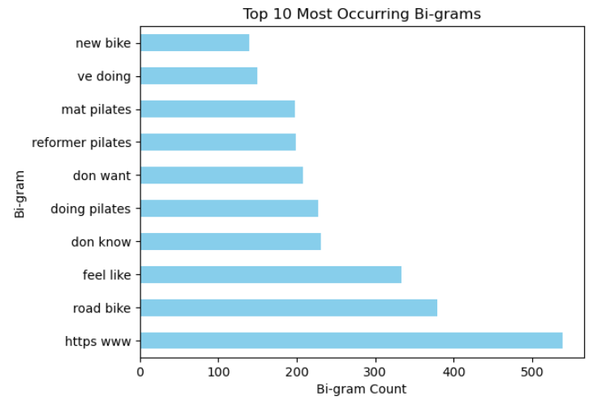
Top 10 Occurring Bi-grams
Some key bi-grams
i.e. “new bike”, “doing pilates”, “road bike”
“Https www” will be removed since it is irrelevant to our objective

Slide 12
03
Data Cleaning

Slide 13
Cleaning Steps
01
02
03
04
05
Nulls
Binaries
Dropped Unnecessary Columns
Removed Nulls
Turned subreddits into 0s & 1s
I.e. “utc”, “title”
Removed irrelevant characters
Converted to cleaned dataframe
I.e. “/n” and “https”, & “www”

Slide 14
04
NLP

Slide 15
What Pre-processors were used?
Count Vectorizer
Stemming
N-grams
Lemmatizing

Slide 16
05
Modeling

Slide 17
Baseline Model
54%
45%
Pilates
Cycling
The baseline score here is the majority class. This simple baseline model will predict posts to be "pilates" 54% of the time.

Slide 18
How do we measure success?
How much false positives can be minimized
Model precision

Slide 19
Models Tested
Naive Bayes
Logistic Regression
Random Forests

Slide 20
Naive Bayes
Features explored:
Gridsearch
  3_000, 4_000,
  'cvec__max_features': [2_000, 3,000, 4,000, 5,000, 10_000, 12_000, 20_000, 25,000 30_000]
  'cvec__min_df': [1, 2, 3, 4, 5]
  'cvec__max_df': [.85, .9, .98],
  'cvec__ngram_range': [(1, 1), (1, 2), (2, 2), (3, 3)
  'cvec__stop_words': [None, 'english'],
Lemmatizing was removed as it lowered score and overfit model
Model Scores:
Train 0.990007
Test 0.986126

Slide 21
Random Forests
Features explored:
Count Vectorizer
English stopwords
Stemming
Model Scores:
Train 1.0
Test 0.990566
evaluation:
Model was too overfit

Slide 22
Logistic regression
Features explored:
Count Vectorizer
Gridsearch
  3_000, 4_000,
  'cvec__max_features': [2_000, 3,000, 4,000, 5,000, 10_000, 12_000, 20_000, 25,000 30_000]
  'cvec__min_df': [1, 2, 3, 4, 5]
  'cvec__max_df': [.85, .9, .98],
  'cvec__ngram_range': [(1, 1), (1, 2), (2, 2), (3, 3)
  'cvec__stop_words': [None, 'english'],
English stopwords
Stemming
Lemmatizer was also removed due to overfitting
Model Scores:
Train 0.999075
Test 0.993344

Slide 23
Model of Choice
Logistic Regression
(with Gridsearch)
Why this model was chosen:
Highest Train and test scores
Both train and test scores were close together
Not overfit nor underfit; was balanced
It will predict true positives for both subreddits 99.2% of the time

Slide 24
06
Evaluation

Slide 25
Evaluation
 | Precision | Recall | F1-Score | Support
Cycling | 0.98986 | 0.99592 | 0.99288 | 980
Pilates | 0.99510 | 0.98783 | 0.99145 | 822
Accuracy |  |  | 0.99223 | 1802
Macro avg | 0.99248 | 0.99188 | 0.99217 | 1802
Weighted avg | 0.99225 | 0.99223 | 0.99223 | 1802

Slide 26
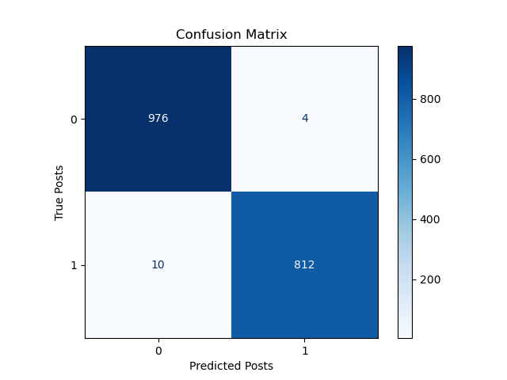
Evaluation

Slide 27
07
Conclusion & Next Steps

Slide 28
Winning Model Stats
99.2%
0.5%
Overall Accuracy
of model
Percent of the time model will predict a false positive
Conclusion
This model proves to be accurate when tested on new data and eliminates false positives which will be effective given another set of subreddits or forum text in future projects
Future & Next Steps
my recommendation for future projects would be to create a function that combines all of these steps taking as many subreddits as input, testing all 3 models, taking it all the way to the final steps in step to maximize efficiency in this process for the client.

Slide 29
Thanks!
Questions?

