Slide 1
LoadBalancer
vmONE
vmTWO
http://0.0.0.0/
http://0.0.0.0/healthprobe
http://vmONE/healthprobe
vmONE Health Probe calls
200 OK
vmONE
http://vmTWO/healthprobe
http://vmONE/healthprobe
vmTWO Health Probe calls – vmONE is UP, hence vmTWO fails in health check
200 OK
404
http://vmTWO/healthprobe
http://vmONE/healthprobe
vmTWO Health Probe calls – vmONE is DOWN and hence vmTWO takes over
400-500
vmTWO
200 OK
http://0.0.0.0/
http://0.0.0.0/healthprobe

Slide 2
http://a.b.c.d/
http://v.x.y.z/
http://a.b.c.d/healthprobe
http:// v.x.y.z/healthprobe
vmONE
vmTWO

Slide 3
LoadBalancer
vmONE (Agent)
Primary
vmONE (MQ)
vmTWO (Agent)
Secondary
vmTWO (MQ)
http://vmONE/healthprobe
tcpdial
200 OK
connected
Primary Health Probe calls
connection error
404
http://vmTWO/healthprobe
Secondary Health Probe calls
tcpdial
connected
connection error
200 OK
404

Slide 4
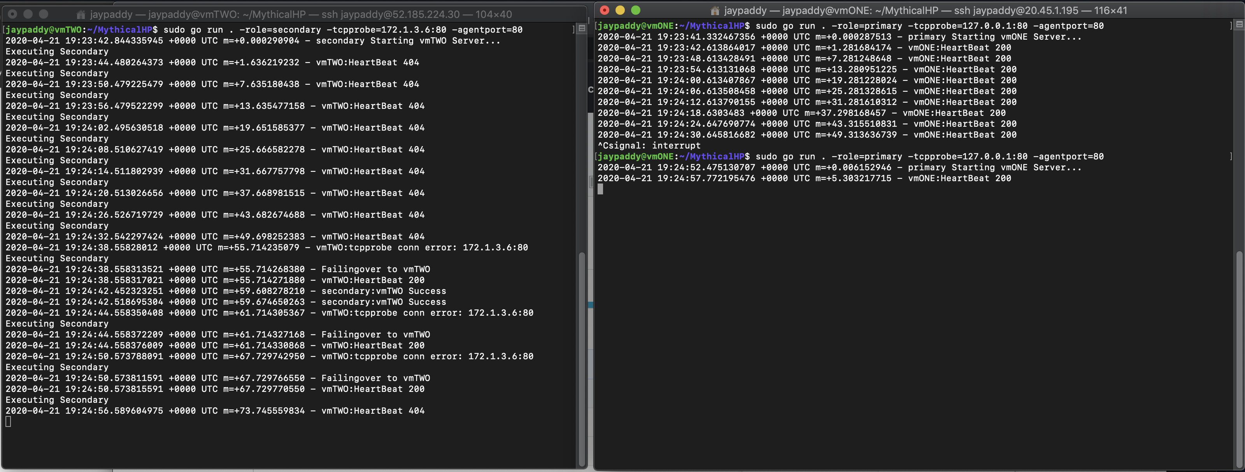
Secondary
Primary
1
Endpoint closed on primary
2
tcp connection from secondary
Primary is back
4
Secondary takes over
3
5
Secondary Stops

