Slide 1
KMS on Azure AI Search
Secure by design: OAuth on every call, no keys, private links only
✓
No API keys
✓
One gateway
✓
Private links only
KMS keeps its features - Secured Plumbing Changes
Notes:
SAY:
"Thanks for the time. Today is about one thing: getting KMS through the Security review.
Security asked for OAuth on every call. Today KMS uses an API key to write to AI Search, and when we route that through a gateway, the payload is too big.
In the next 30 minutes I'll show you the problem, the fix, and then prove it live in Azure. Everything you'll see is running right now.
Two stand-ins: a VM plays the KMS server, and the articles are synthetic copies of real KMS articles."

Slide 2
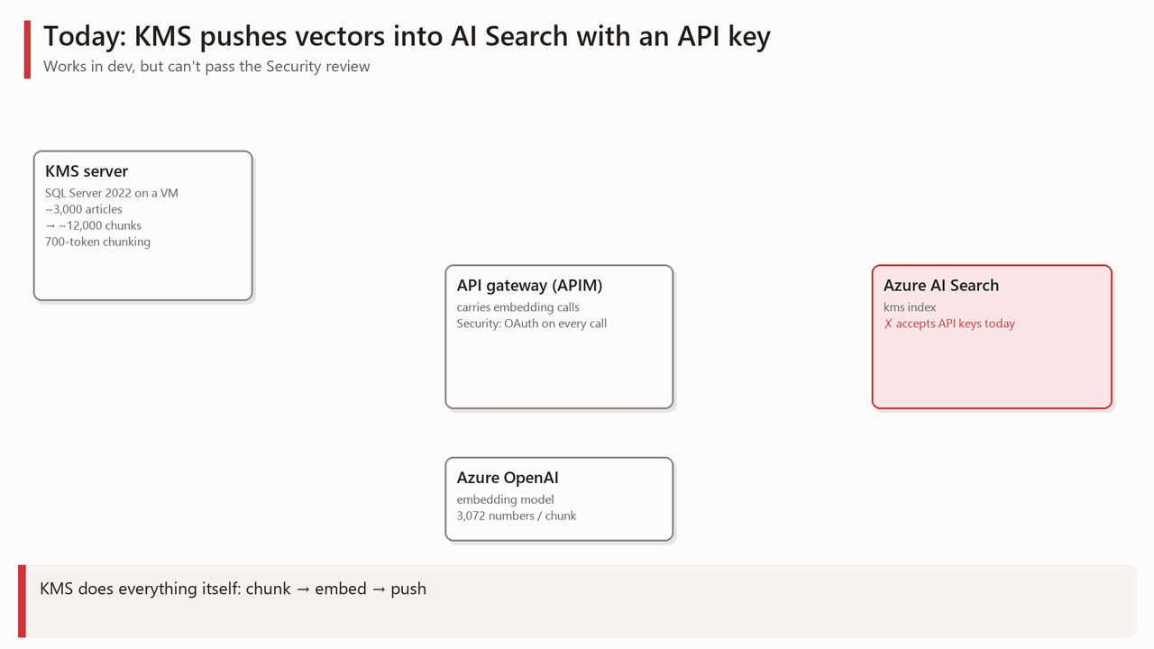
Takeaway: Two blockers: a shared API key, and a payload too big for the gateway.
Notes:
SAY (let the GIF play):
"Here's how KMS works today.
One: KMS cuts each article into chunks and sends each chunk to the embedding model through the gateway. That part is fine.
Two: KMS pushes the chunks and their vectors straight into AI Search, using an API key. That call goes around the gateway.
That gives us Blocker 1: an API key is a shared secret. But Security requires Oauth for Production workloads – so obvious fix is to send the push through the gateway.
But then that's Blocker 2: Each article with its vectors is about 140 KB, a full reindex is about 400 MB, and the gateway rejects or throttles it.
So - we have to fix both: the credential and the payload."

Slide 3
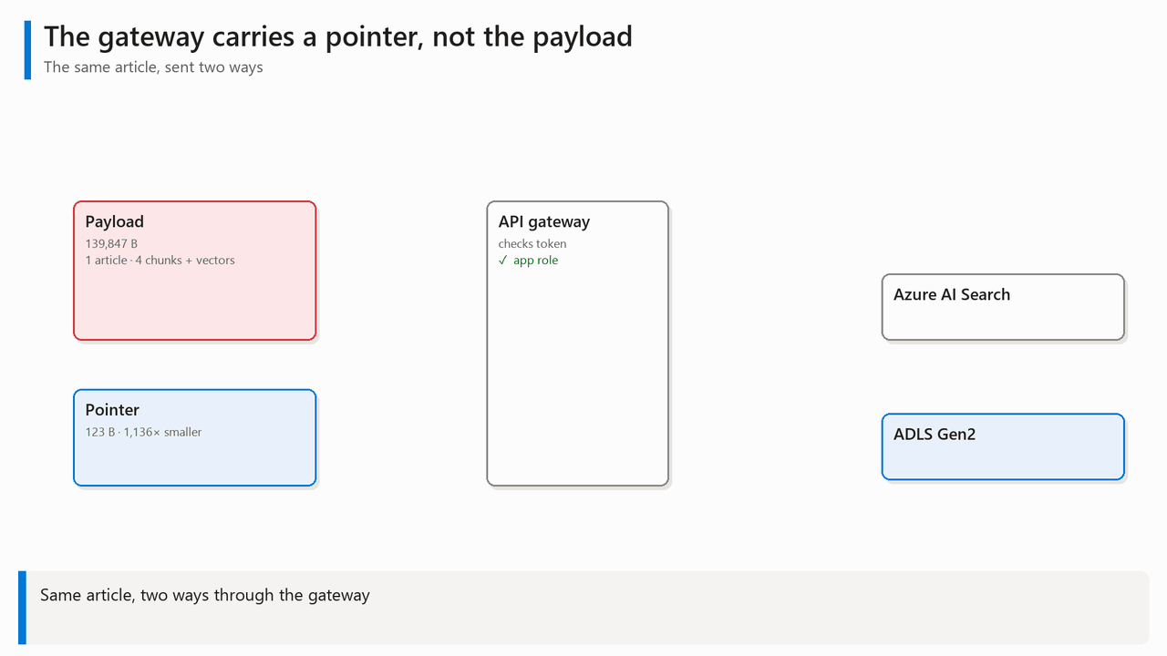
Takeaway: Send a ~120-byte pointer through the gateway, not the 140 KB payload.
Notes:
SAY – so this is the core idea of the solution
"This is the core idea. On the left, one article with its vectors: 140KB - It hits the gateway and is rejected.
Below it, a pointer: only ~120 bytes, over a thousand times smaller. It just says 'article KA-1003 changed’ -- The gateway accepts it with a 202.
The gateway then tells AI Search to run its indexer, and AI Search pulls the heavy data from storage over a private link.
The big data never needs to squeeze through the gateway

Slide 4
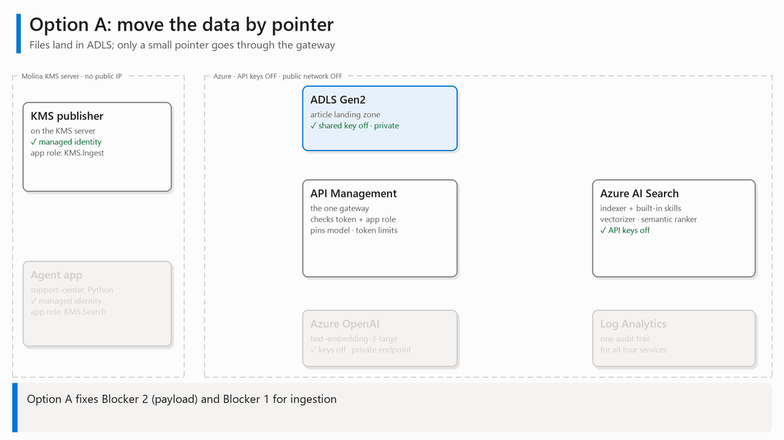
Takeaway: Files go to ADLS; only a tiny pointer goes through the gateway.
Notes:
SAY (walk the numbers 1 to 4):
"Option A moves the data by pointer.
One: KMS writes the article, with its own chunks, into ADLS. It uses a managed identity. No key.
Two: KMS sends a ~120-byte pointer to API Management. APIM checks the token and the KMS.Ingest role.
Three: APIM tells AI Search to run the indexer, using APIM's own identity. KMS needs no Search permissions at all.
Four: AI Search pulls the files from ADLS over a private link.
That fixes the payload. One question is left: who makes the vectors? That's Option B."

Slide 5
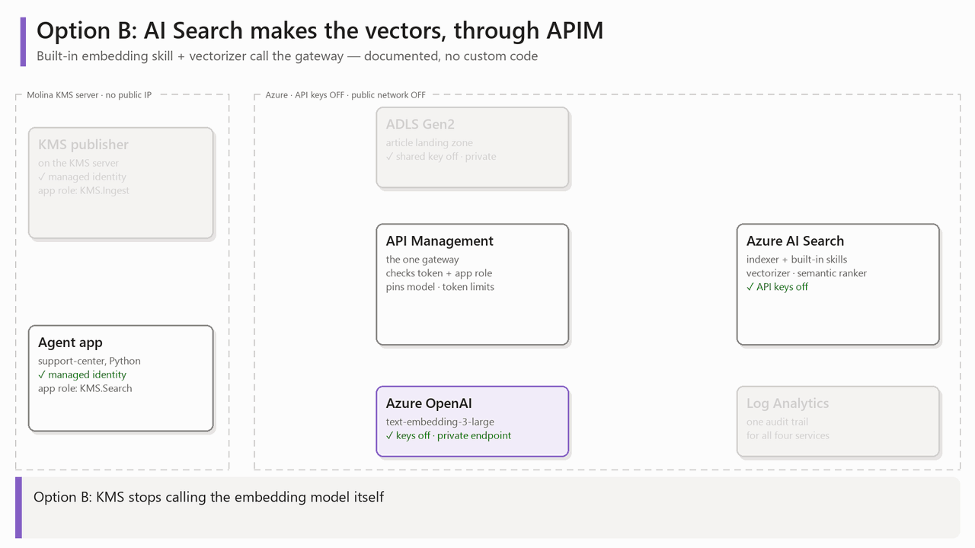
Takeaway: AI Search makes the vectors itself, through the gateway, with no custom code.
Notes:
SAY (walk 5, 6, Q1, Q2):
"Option B: KMS stops calling the embedding model itself.
Five: AI Search's built-in embedding skill calls the model through APIM, with a managed-identity token over a private link. This is a documented feature, not custom code.
Six: APIM forwards to one pinned model deployment. Same model at index time and query time, so the vectors always match.
Q1: the agent app asks a question through APIM with its own token and the KMS.Search role.
Q2: APIM runs a hybrid plus semantic search, and only published articles come back.
Every AI call goes through one gateway, with an identity, on a private link."

Slide 6
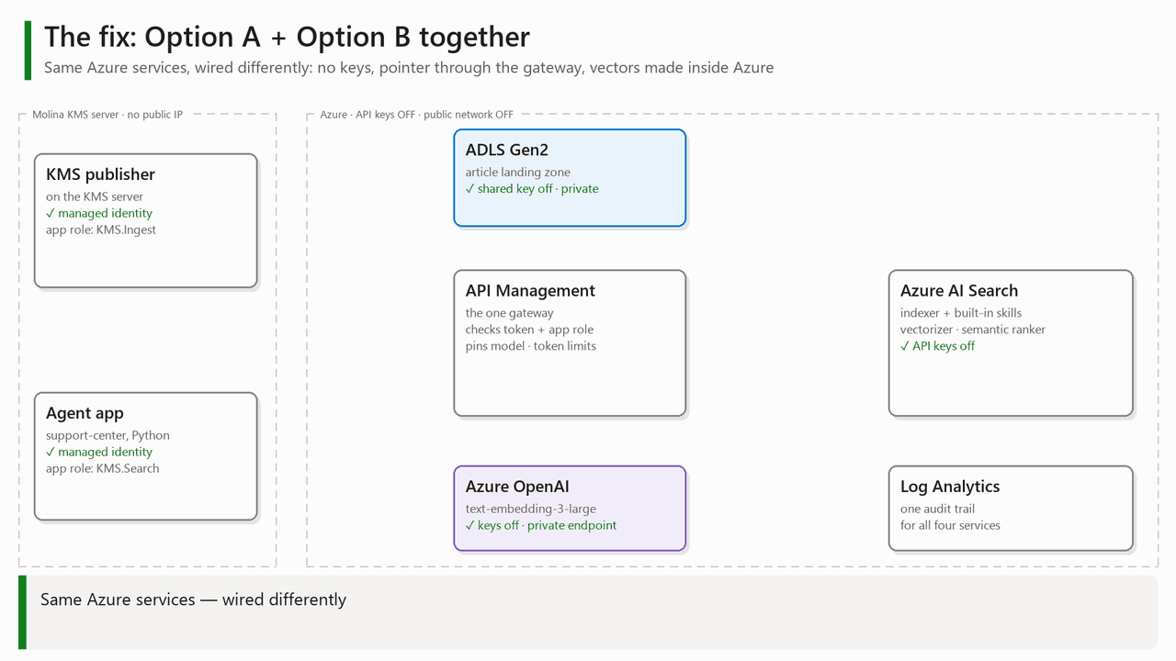
Takeaway: Same Azure services, wired differently: no keys, one gateway, private links.
Notes:
SAY -- So now the final solution
"Put A and B together and this is the full picture to solve the issue --
Blue is how articles get in. Purple is how vectors get made and how the agent asks questions.
Three things to remember:
One: no API keys anywhere. Every hop is OAuth or a managed identity.
Two: KMS only sends a small pointer through the gateway. No bulk index payload crosses it.
Three: everything is on private endpoints and private links, and every call is logged in one place.
IF ASKED 'Do vectors go through the gateway?':
"The embedding calls do, as normal AI-gateway traffic: text in, vector out, governed by token limits. What doesn't cross the gateway is the bulk index payload."

Slide 7
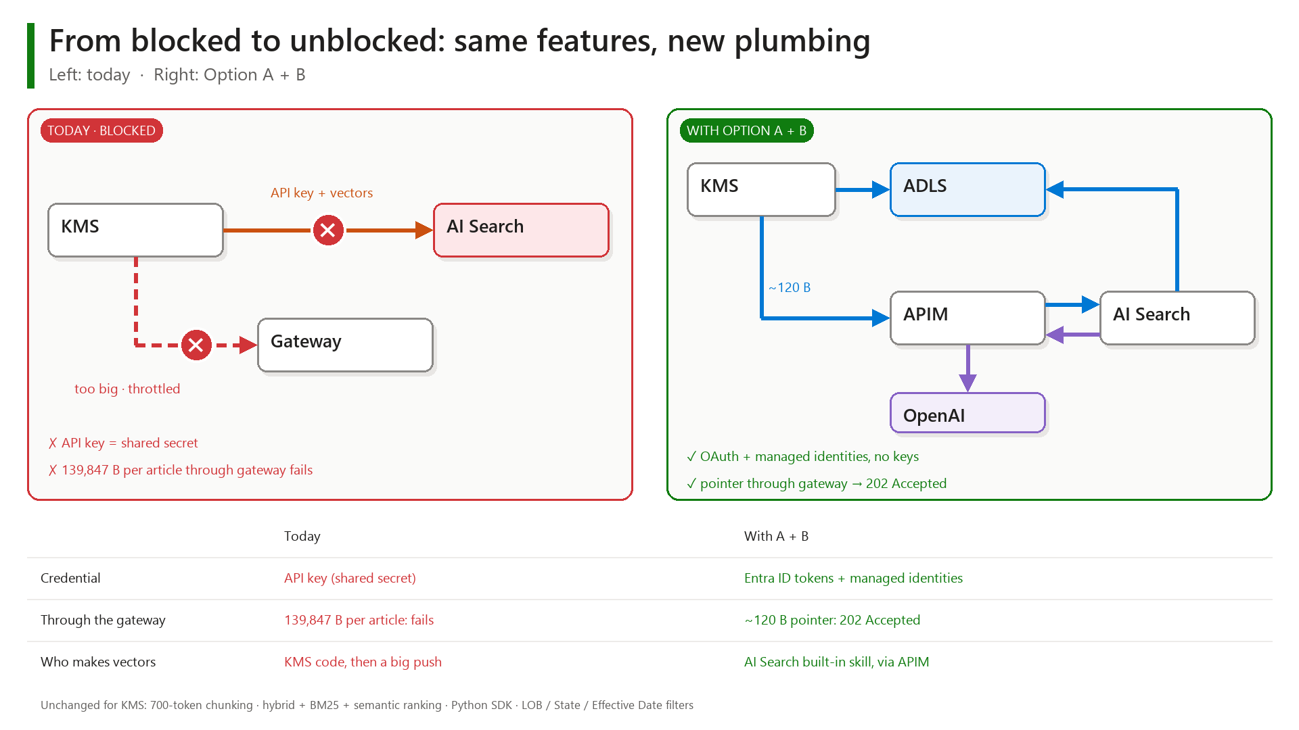
Takeaway: Same KMS features. Secured plumbing.
Notes:
SAY:
"Side by side.
Credential: an API key today. Tomorrow, Entra ID tokens and managed identities.
Through the gateway: 140 KB per article that fails today. Tomorrow, a 120-byte pointer that's accepted.
Vectors: KMS code plus a big push today. Tomorrow, AI Search's built-in skill, through APIM.
And at the bottom: what does NOT change for KMS. Same 700-token chunking, same hybrid and semantic ranking, same Python SDK, same filters."

Slide 8
Live proof, in Azure, right now
1
2
3
4
No keys to steal
Only way in
Pointer, not payload
Who did what
Portal: keys and public access are off
Script: Demo-01-Posture
Script: Demo-02-OAuthMatrix
11 calls · only a token via APIM works
Script: Demo-05-Payload
413 vs 202 Accepted
Portal: Log Analytics
every call, by identity
Takeaway: Not slides: live settings and live calls you can re-run yourselves.
Notes:
SAY (before switching screens):
"Now let me prove it. Not slides live settings and live calls."
── 1 · NO KEYS TO STEAL ──
DO (portal): AI Search → Settings → Keys.
SAY: "API access control is set to role-based access control. API keys don't work here."
DO: AI Search → Networking.
SAY: "Public network access: Disabled. And under Shared private access, three approved links: two to storage, one to the gateway."
DO: Storage account → Configuration.
SAY: "Allow storage account key access: Disabled. Storage only accepts identities."
DO: Run .\Demo-01-Posture.ps1
SAY: "This script reads the same settings live, for all four services, so you can re-run it yourselves. Every line passes."
EXPECT: "All posture checks passed."
DON'T open Search Explorer or the index blades: public access is off, so they show errors. If asked: "That error is the proof."
── 2 · THE ONLY WAY IN ──
DO: Run .\Demo-02-OAuthMatrix.ps1 -Pause
SAY: "Eleven calls. No token: 401. Wrong audience: 401. Tampered token: 401. Valid token with the right role: 200."
SAY (row 10): "This is today's KMS write path, Search with an API key. It now gets 401."
SAY (row 11): "I hold Search admin roles, and I still can't reach Search from the internet. Identity AND network."
EXPECT: "All OAuth checks passed."
── 3 · POINTER, NOT PAYLOAD ──
DO: Run .\Demo-05-Payload.ps1 -FromVm -Pause
SAY: "One article with its vectors: 139,847 bytes. Rejected with 413, payload too large."
SAY: "The pointer: 123 bytes. 202 Accepted. A thousand times smaller."
SAY: "The KMS app needs no Search permissions at all. The gateway starts the indexer."
── 4 · WHO DID WHAT ──
DO (portal): Log Analytics workspace → Logs → run the saved query (or .\Demo-06-Logs.ps1 -Pause).
SAY: "Every call, by identity: who called, their role, the status, and whether it came over the private endpoint."
SAY: "Even the rejections are here, with the reason. In production, this flows into your SIEM."
IF FEW ROWS: "Logs lag 2 to 5 minutes", then re-run with -Minutes 240.
IF A SCRIPT FAILS: usually an expired az login. Run az login, re-run. Fallback: show the same setting in the portal.

Slide 9
What we need from you
1
2
3
Approve the design
Pick the network posture
Confirm the platform
ADLS + pointer, API Management as the one gateway, built-in embedding skill
Identity only, or identity + private link only. We recommend both.
Dedicated production Search service; gateway tier that accepts a private endpoint
Takeaway: Three decisions today keep the go-live on track.
Notes:
SAY:
"Three decisions from this room.
One: approve the design. ADLS plus a pointer, API Management as the one gateway, and AI Search's built-in embedding skill.
Two: pick the network posture. Identity only, or identity plus private link only. It's a policy switch, not a rebuild. We recommend both.
Three: confirm the platform. A dedicated production Search service, and a gateway tier that can accept a private endpoint.
With those three, we start building production next week."
CLOSE:
"No keys. One gateway. Private links. Same KMS features. Questions?"

