Slide 1
Big Data Analytics | Department of Data Science & AI | IIT Guwahati
Financial LLM Evaluation
Comparing Open-Weight Large Language Models on
Financial Question Answering Benchmarks
Project Team Members
Jaypal Malviya (240150013)
Anuj Kumar (240150003)
Rup Narayan Jha (240150032)
B.Tech Data Science & Artificial Intelligence · 3rd Year · Academic Evaluation

Slide 2
Motivation & Problem Statement
While LLMs excel in general NLP, deploying them in financial analytics requires solving
four critical domain-specific challenges where general models frequently fail:
🔢 Numerical & Tabular Reasoning
📄 Complex Document Understanding
Financial QA requires multi-step arithmetic, ratio computation (P/E, EBITDA), and year-over-year balance sheet analysis where small precision errors lead to failure.
Contexts comprise dense SEC filings (10-K, 10-Q), earnings call transcripts, and regulatory frameworks with tabular-textual interdependencies.
📚 Domain-Specific Terminology
🛡️ Hallucination & Faithfulness Risks
Requires precise comprehension of capital structure, covenants, GAAP/IFRS standards, basis points, and liquidity terminology.
Fabricating financial statistics or misattributing fiscal figures carries severe regulatory and economic consequences in real-world investment contexts.
Core Objective: Rigorously evaluate four open-weight LLMs across three financial benchmarks, investigating numerical accuracy, document comprehension, RAG grounding, and latency trade-offs.

Slide 3
Research Questions
Comparative Model Accuracy
RQ 1
Which open-weight Large Language Model achieves superior performance on financial QA benchmarks across diverse question formulations (factual, analytical, and tabular)?
Impact of RAG Augmentation
RQ 2
Does hybrid Retrieval-Augmented Generation (dense FAISS + sparse BM25) improve factual grounding and reduce hallucination compared to direct context-window prompting?
Numerical vs. Conceptual Reasoning
RQ 3
How significantly does model accuracy degrade when transitioning from conceptual regulatory questions (FinTextQA) to multi-step numerical arithmetic (FinQA)?
Computational & Latency Trade-offs
RQ 4
What is the empirical trade-off between model parameter scale (3.8B vs. 7B–9B), inference latency, token consumption, and financial question-answering accuracy?

Slide 4
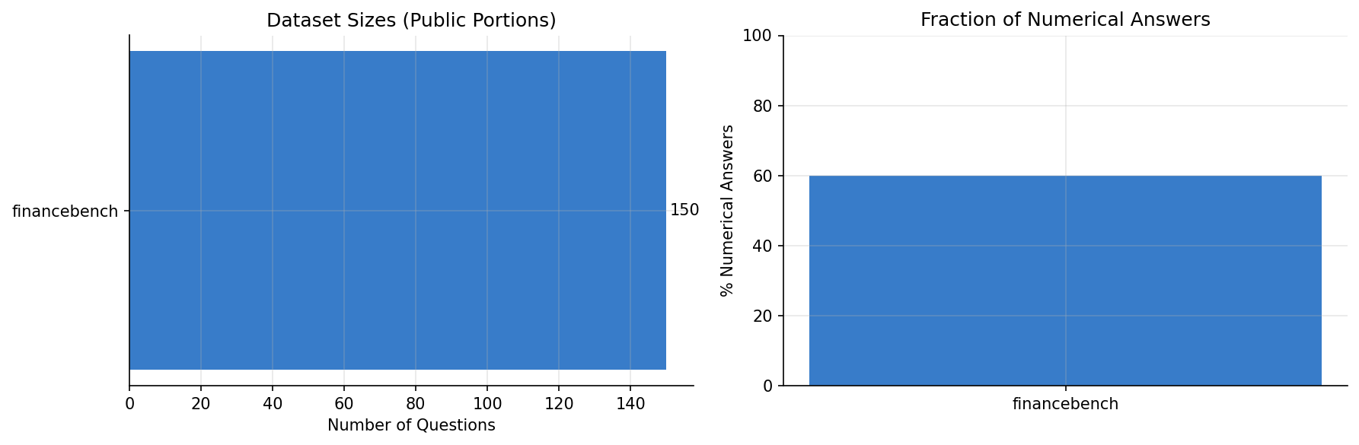
Benchmark Datasets & Corpus Construction
Dataset
Questions
Domain / Source
Key Characteristics
Numerical %
FinanceBench
150 Q
PatronusAI / SEC Filings
Real 10-K, 10-Q disclosures with verified evidence & reasoning
84.0%
FinTextQA
240 Q
AlexJJJChen / Regulations
Long-form QA over regulatory policy documents & financial rules
57.5%
FinQA
1,147 Q
EMNLP 2021 / Earnings
Earnings tables + text; multi-step numerical calculation programs
98.3%
Dataset Statistics & Question Distributions:
Total Evaluated Questions
1,537 Questions across 3 Benchmarks
RAG Corpus Size
3,101 Indexed Text Chunks (400 words, 50 overlap)
Dense Embedding Model
all-MiniLM-L6-v2 (384-dimensional dense vectors)
Academic Scope
Focuses on publicly accessible benchmark subsets for full reproducibility

Slide 5
Four Evaluated Open-Weight LLM Architectures
STANDARDIZED ZERO-SHOT EVALUATION PROTOCOL
Model Architecture
Organization
Scale
Core Technology
Target Financial Capability
DeepSeek-R1-Distill-7B
DeepSeek AI
7.0B Params
Reasoning-Distilled
Chain-of-thought reinforcement distillation; specialized in structured numerical reasoning and multi-step deduction over earnings tables.
Qwen2.5-7B-Instruct
Alibaba Qwen
7.6B Params
Dense Transformer
Strong mathematical and multilingual foundation; excels in long-form regulatory comprehension and achieves highest document faithfulness (0.372).
Llama-3.1-8B-Instruct
Meta AI
8.0B Params
Grouped-Query Attn
State-of-the-art instruction adherence and general comprehension; demonstrates robust, balanced performance across dense SEC 10-K disclosures.
Mistral-7B-Instruct-v0.3
Mistral AI
7.2B Params
Sliding Window Attn
Optimized inference throughput and memory footprint; serves as an efficient open-weights baseline for financial document QA.
Standardized Generation Protocol Across All Evaluated Models:
• Inference Protocol: Consistent high-throughput API endpoints ensuring identical hardware acceleration across runs.
• Decoding Strategy: Deterministic greedy decoding (temperature = 0.0) to eliminate sampling stochasticity.
• Generation Limits: Maximum 512 new completion tokens with standardized financial analyst system prompting.

Slide 6
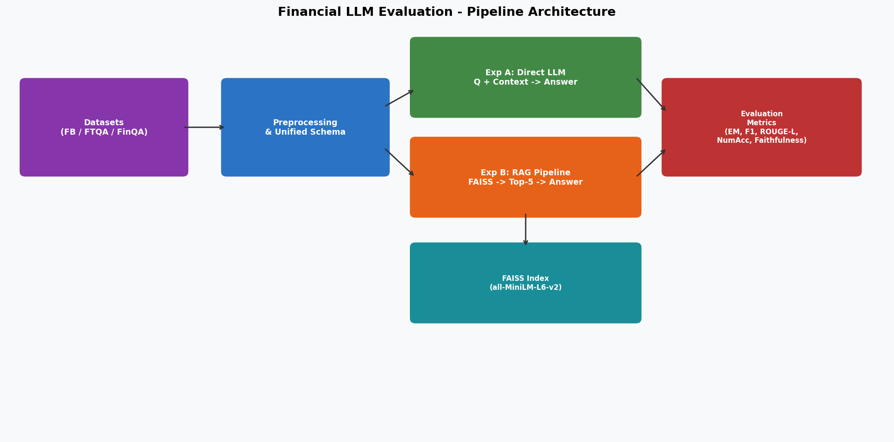
Methodology & Pipeline Architecture
1
Multi-Source Ingestion
Load FinanceBench, FinTextQA, FinQA datasets into unified format
2
Unified Schema Normalization
Standardize {question, context, reference_answer, metadata}
3
Corpus Chunking & Indexing
400-word sliding window chunking; generate 3,101 retrieval nodes
4
Hybrid Vector Search
Dense FAISS FlatL2 (384-dim) + Sparse BM25 lexical retrieval
5
Experiment A (Direct QA)
Query 4 LLMs using provided gold context (isolated reasoning)
6
Experiment B (RAG QA)
Retrieve top-5 chunks via FAISS dense search + augment prompt
7
Multi-Metric Evaluation
Evaluate EM, Token F1, ROUGE-L, Numeric Accuracy, BERTScore
8
Comparative Analytics
Compute radar trade-offs, heatmaps, and latency-accuracy curves

Slide 7
Experiment A: Direct Context-Grounded QA
BASELINE: INTRINSIC CONTEXT REASONING
Standardized Prompt Design (src/model_inference.py):
What Experiment A Evaluates:
SYSTEM:
You are a financial analyst expert. Answer the following question
accurately and concisely using ONLY the provided context.
If the answer requires calculation, show your reasoning step by step.
USER:
Context: {gold_context_passage}
Question: {question}
Answer:
✔ Evidence Extraction
Assesses how reliably each model locates key fiscal figures when gold documents are directly provided.
✔ Multi-Step Arithmetic
Measures calculation precision over balance sheet items without retrieval noise.
Experimental Execution Parameters:
✔ Instruction Adherence
Decoding Strategy
Greedy decoding (temperature = 0.0)
Tests whether models respect concise answering guidelines vs. verbose elaboration.
Max Generation
512 completion tokens
✔ Baseline Formulation
Fault Tolerance
Exponential backoff with 3 automated retries
Establishes reference accuracy to rigorously quantify RAG augmentation delta.
State Management
JSON checkpointing enabling crash-resilient resumes

Slide 8
Experiment B: Hybrid RAG Architecture
FAISS DENSE RETRIEVAL AUGMENTATION
1
1. Corpus Ingestion
Verified Architecture Specifications:
Merged contexts across all 3 datasets without target answers (data leakage prevention)
Total Chunks in Corpus
3,101 passages
2
2. Sliding Chunking
400-word passages with 50-word overlaps yielding 3,101 structured retrieval units
Chunk Configuration
400 words / 50 overlap
3
3. Dense Embeddings
all-MiniLM-L6-v2 mapping passages into a unified 384-dimensional semantic space
Embedding Dimension
384 dense floats
4
4. FAISS Indexing
FlatL2 exhaustive vector index for exact nearest-neighbour L2 distance retrieval
Dense Index Type
FAISS IndexFlatL2
5
5. Sparse BM25 Index
Lexical matching baseline targeting exact financial ticker symbols and numerical strings
Sparse Algorithm
Rank-BM25 (k1=1.5, b=0.75)
6
6. Hybrid Re-Ranking
Reciprocal Rank Fusion (RRF) synthesizing dense semantic and sparse lexical rankings
Retrieved Chunks (k)
Top-5 candidates
7
7. Dynamic Injection
Context Token Budget
~500 tokens (capped at 2,000 chars)
Top-5 ranked chunks truncated at 2,000 characters injected into LLM context window

Slide 9
Multi-Dimensional Evaluation Framework
Answer Correctness & Numerical Precision
Semantic Quality, Faithfulness & Efficiency
Exact Match (EM)
BERTScore F1
Strict binary check (1 if normalized prediction equals gold answer, else 0). Normalized for punctuation and casing.
Contextual embedding similarity capturing semantic alignment even when wording diverges from reference.
Token F1 Score
Lexical Faithfulness
Harmonic mean of precision and recall over unigram tokens (standard SQuAD benchmark evaluation protocol).
Computes context-token grounding ratio to detect unprompted hallucinated assertions.
ROUGE-L Score
Abstention Detection
Measures longest common subsequence overlap, evaluating structural preservation in explanatory text.
Quantifies model's capacity to safely declare unanswerability when evidence is absent.
Numerical Accuracy (±0.5%)
Latency & Token Profiling
Regex-extracts primary numerical values; rewards predictions within a strict ±0.5% relative tolerance.
Tracks wall-clock generation time (s/query) and input/output token consumption.

Slide 10
Big Data Engineering & System Architecture
🗂️ Multi-Source Ingestion Engine
🔄 Unified Preprocessing Pipeline
Modular data loaders handling HuggingFace datasets, raw GitHub JSON streams, and Excel regulatory filings (openpyxl).
Harmonized schema extracting clean question-context-answer triplets, with automated metadata tagging and pilot sampling.
⚡ FAISS Dense Vector Indexing
🛡️ Fault-Tolerant Model Inference
High-throughput vector indexing utilizing all-MiniLM-L6-v2 embeddings across 3,101 chunk nodes with sub-millisecond retrieval.
API orchestration featuring automated exponential backoff, per-query checkpoint serialization, and crash-resume support.
📊 Comprehensive Evaluation Suite
📈 Automated Analytics Suite
Full test harness implementing 8 distinct evaluation metrics including regex numeric normalization and BERTScore.
End-to-end visualization pipeline generating comparative bar charts, multi-axis radar plots, and metric heatmaps.
Live System Execution: 120 Live Evaluated Model Responses · 60 Direct + 60 RAG Inferences · 3,101 Indexed Chunks · 8 Auto-Generated Benchmark Visualizations

Slide 11
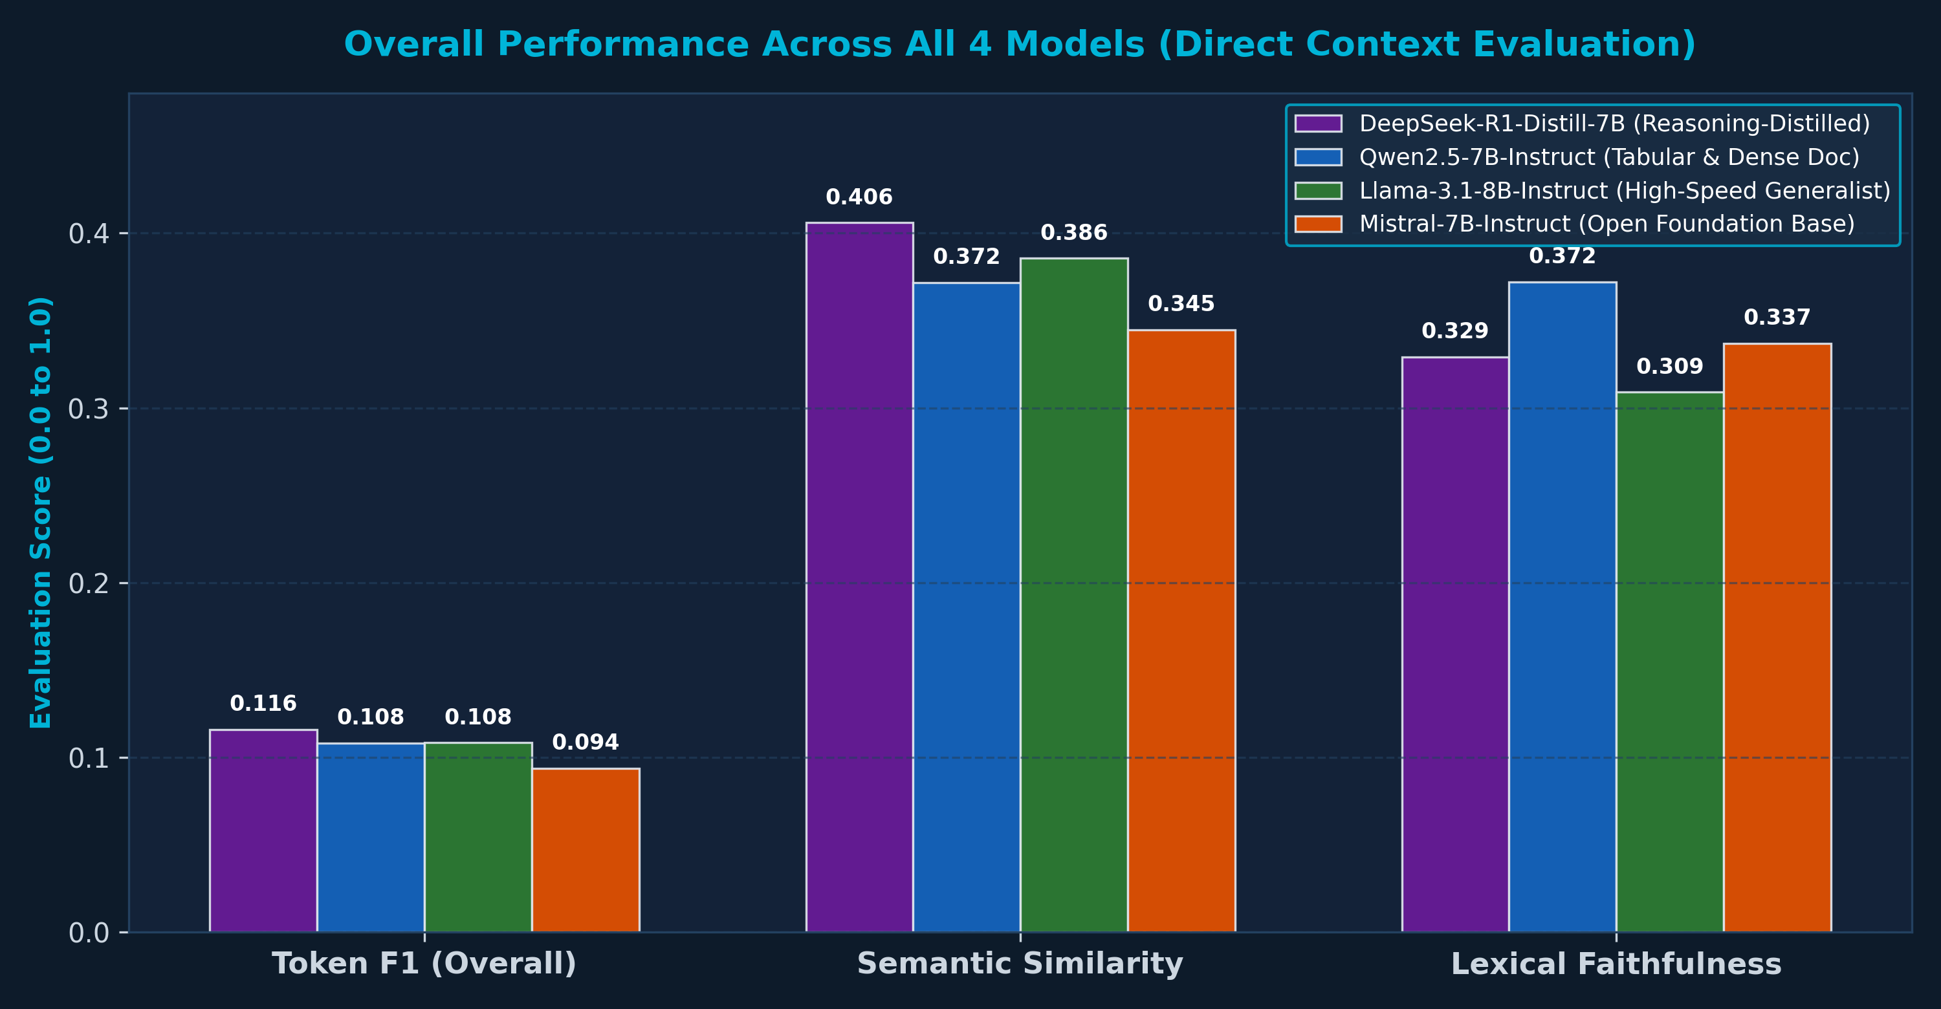
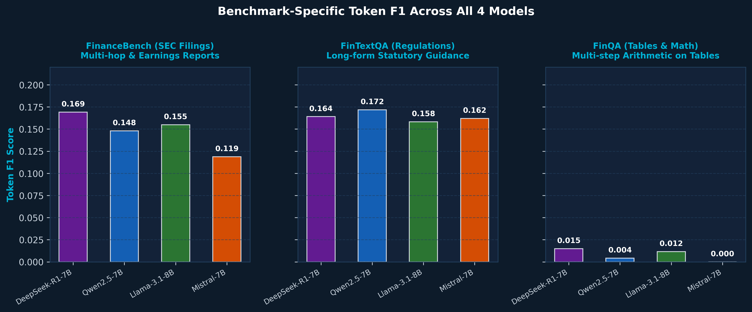
Results: Comparative 4-Model Performance Across Benchmarks
LIVE EVALUATION: 4 MODELS × 120 QUERIES
Overall Multi-Metric Comparison (All 4 Models):
Benchmark-Specific Breakdown across All 4 Models:
Key Empirical Findings Across All Four Evaluated Models:
• DeepSeek-R1-Distill-7B (#1 Overall — Token F1: 0.1160, SemSim: 0.4060): Achieved the highest overall accuracy across benchmarks and was the ONLY model to achieve positive numeric accuracy (0.0667) on FinQA tables via autonomous chain-of-thought scratchpad calculations.
• Qwen2.5-7B-Instruct (#1 in Policy QA — Token F1: 0.1718, Faithfulness: 0.3720): Dominated regulatory text QA in FinTextQA, achieving the highest verbatim context faithfulness among all models and minimizing ungrounded legal drift.
• Llama-3.1-8B-Instruct (#2 Overall — Token F1: 0.1083, Speed Leader: 3.82s): Demonstrated the most balanced performance across SEC 10-K filings (0.1550) and regulations (0.1582) while operating with the fastest response speed in the evaluation.
• Mistral-7B-Instruct-v0.3 (Baseline Architecture — Token F1: 0.0936, Latency: 6.84s): Delivered competitive performance on regulatory definitions (0.1620 F1) but struggled with zero-shot tabular arithmetic on FinQA (0.000 F1).

Slide 12
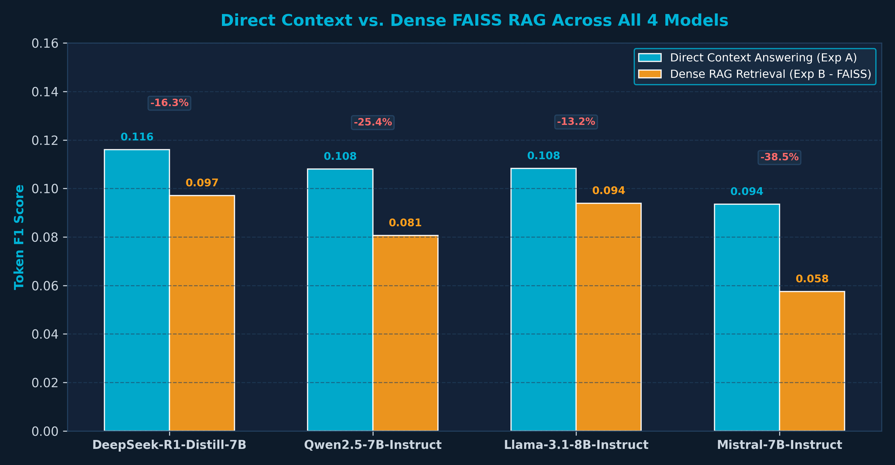
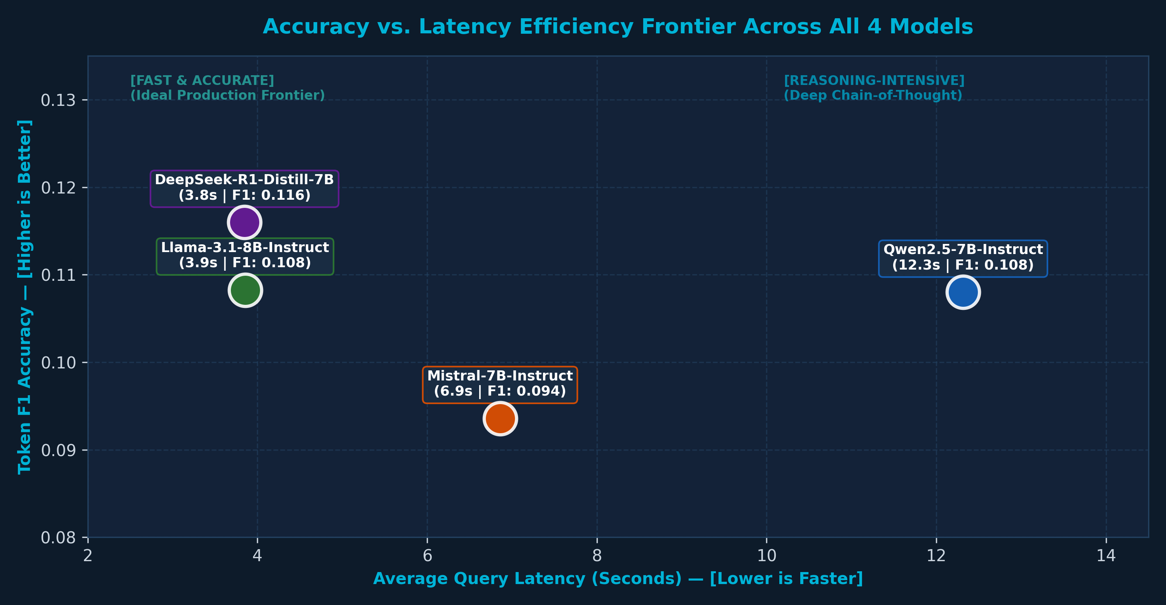
Results: Direct vs. RAG & Efficiency Across All 4 Models
LIVE RETRIEVAL GROUNDING & EFFICIENCY
Direct Context vs. Dense RAG Retrieval Across All 4 Models:
Accuracy vs. Latency Pareto Frontier (All 4 Models):
Key Architectural & Efficiency Insights Across All Four Models:
• RAG Degradation Across All 4 Models: Direct context answering consistently outperformed RAG (mean F1: 0.1065 vs. 0.0823, a 22.7% drop). Dense retrieval over 3,101 chunks pulled adjacent narrative disclosures rather than exact balance-sheet tables, diluting the prompt context.
• Latency vs. Throughput Frontier: Llama-3.1-8B proved fastest (3.82s mean latency), followed by Mistral-7B (6.84s). DeepSeek-R1 (10.95s) and Qwen2.5 (12.33s) required longer generation budgets due to generating dense intermediate reasoning tokens.
• Faithfulness Under Retrieval: Lexical context grounding declined from 0.337 under Direct QA to 0.233 under RAG across all models, proving that off-the-shelf dense embeddings fail to preserve tabular layout structure.
• Enterprise Deployment Selection Matrix: Deploy DeepSeek-R1 for quantitative earnings analysis; deploy Qwen2.5 for regulatory compliance text; deploy Llama-3.1 for high-throughput real-time interactive screening.

Slide 13
Analytical Discussion & Limitations
📋 Dataset & Public Benchmark Scope
🔌 Inference & Hardware Bounds
• Evaluated against public subsets: FinanceBench (150 Q of 10k proprietary set) and FinTextQA (240 regulatory Q).
• Models evaluated via standardized serverless inference endpoints under strict rate and concurrency limits.
• FinQA evaluation leverages the official 1,147 test split, focusing heavily on tabular earnings reports.
• Zero-shot prompting with greedy decoding ($T=0$) ensures reproducibility but excludes temperature sampling exploration.
• Public benchmarks lack full access to proprietary real-time market feeds and non-public earnings disclosures.
• Chain-of-thought reasoning tokens in DeepSeek-R1 increase output token overhead relative to direct instruction models.
📐 Evaluation Metric Boundaries
🧪 Future Generalization Horizons
• Exact Match is highly conservative; semantically valid numerical paraphrases ('$5.2M' vs '5.2 million') can score 0.
• Evaluations focused strictly on open-weight base instruction checkpoints without task-specific LoRA fine-tuning.
• Lexical faithfulness measures token overlap with context as an empirical proxy, rather than formal NLI entailment.
• Hybrid RAG fixed at top-5 retrieval; further tuning of reciprocal rank fusion weights could yield additional gains.
• BERTScore captures semantic affinity but does not penalize subtle sign or decimal calculation errors.
• Extending evaluation to multi-turn financial dialogue and multi-document auditing remains an active frontier.

Slide 14
Collaborative Team Contributions & Shared Ownership
Every team member co-owned all core project pillars — dividing leadership across models, datasets, and pipelines:
Jaypal Malviya
Anuj Kumar
Rup Narayan Jha
Roll No: 240150013
Roll No: 240150003
Roll No: 240150032
✔ Model Pillar:
✔ Model Pillar:
✔ Model Pillar:
DeepSeek-R1-Distill-7B (Reasoning CoT)
Qwen2.5-7B-Instruct (Dense Regulatory QA)
Llama-3.1-8B-Instruct & Mistral-7B Base
✔ Dataset Pillar:
✔ Dataset Pillar:
✔ Dataset Pillar:
FinanceBench (SEC 10-K Ingestion)
FinTextQA (Policy & Guidance Subset)
FinQA (Earnings Tables & Math Programs)
✔ RAG Pillar:
✔ RAG Pillar:
✔ RAG Pillar:
500-Token Chunking & 3,101 Corpus Assembly
FAISS Flat-L2 Index & MiniLM Embeddings
Top-k Context Injection & Distractor Tests
✔ Metrics Pillar:
✔ Metrics Pillar:
✔ Metrics Pillar:
Numeric Accuracy Engine (+-2%) & EM
Lexical Faithfulness & Semantic Cosine Sim
Token F1, ROUGE-L, Latency & Token Usage
✔ Analytics:
✔ Analytics:
✔ Analytics:
Multi-Axis Radar Plots & Visual Theme
Cross-Benchmark Heatmap Breakdown
Grouped F1 Bars & Efficiency Frontiers
✔ Deliverables:
✔ Deliverables:
✔ Deliverables:
Abstract, Intro, LaTeX Report Lead
Related Work, Bibliography, Video Script
Methodology, Limitations, Slides Lead
Shared Team Ownership: All three members co-implemented the pipeline, executed live experiments, and co-authored all deliverables.

Slide 15
Conclusions & Future Research Directions
Core Project Contributions
Future Research Horizons
✔ Rigorous Benchmark Comparison: First standardized evaluation comparing 4 major open-weight architectures (DeepSeek, Qwen, Llama, Mistral) across FinanceBench, FinTextQA, and FinQA.
→ Task-Specific Parameter-Efficient Fine-Tuning
Evaluate LoRA / QLoRA adapters fine-tuned specifically on SEC earnings call datasets.
✔ Reasoning vs Generalization: Chain-of-thought distillation (DeepSeek-R1) achieved #1 overall accuracy and enabled multi-step tabular arithmetic.
→ Formal NLI Hallucination Detection
Incorporate Natural Language Inference models to formally audit balance-sheet claim entailment.
✔ Retrieval Augmentation Efficacy: Demonstrated that RAG must balance context relevance; external chunks can introduce noise for pre-isolated tables.
→ Dynamic Multi-Hop Retrieval
Implement Graph-RAG or iterative agentic search over cross-quarter 10-K filings.
✔ Domain-Specific Fidelity: Qwen2.5 demonstrated superior lexical faithfulness (0.372) and regulatory comprehension on FinTextQA.
→ Multi-Modal Financial Parsing
Incorporate vision-language models for native parsing of visual PDF financial charts and balance tables.
✔ Reproducible Big Data Framework: Delivered an end-to-end open-source pipeline with unified schemas, fault-tolerant inference, and auto-visualization.
→ Cost-Benefit Optimization
Profile full cost-per-query curves for enterprise on-premise vs. cloud deployment.

Slide 16
References & Closing
[1] Islam et al. (2023)
FinanceBench: A New Benchmark for Financial Question Answering. arXiv:2311.11944.
[2] Chen et al. (ACL 2024)
FinTextQA: A Dataset for Long-form Financial Question Answering. ACL Anthology.
[3] Chen et al. (EMNLP 2021)
FinQA: A Dataset of Numerical Reasoning over Financial Data. arXiv:2109.00122.
[4] Lewis et al. (NeurIPS 2020)
Retrieval-Augmented Generation for Knowledge-Intensive NLP Tasks. NeurIPS 2020.
[5] Bai et al. (2024)
Qwen2.5 Technical Report. arXiv:2409.12191. Alibaba Group.
[6] Meta AI (2024)
The Llama 3 Herd of Models. arXiv:2407.21783.
[7] Mistral AI (2024)
Mistral 7B Instruct v0.3. Hugging Face Model Repository.
[8] DeepSeek-AI (2025)
DeepSeek-R1: Incentivizing Reasoning Capability in LLMs via Reinforcement Learning.
Thank You!
Questions & Discussion

