Slide 1










Record Of Sea Turtles Electronic Reports
J. P. Alexander
http://www.CodeLikeTheWind.com/roster

Slide 2
What is ROSTER?
http://www.CodeLikeTheWind.com/roster
ROSTER (Record Of Sea Turtles Electronic Reports) is a computer program (currently in beta testing status) designed to facilitate the collection and reporting of marine turtle and holding tank data required by the Florida Fish and Wildlife Conservation Commission (FWC).

Slide 3
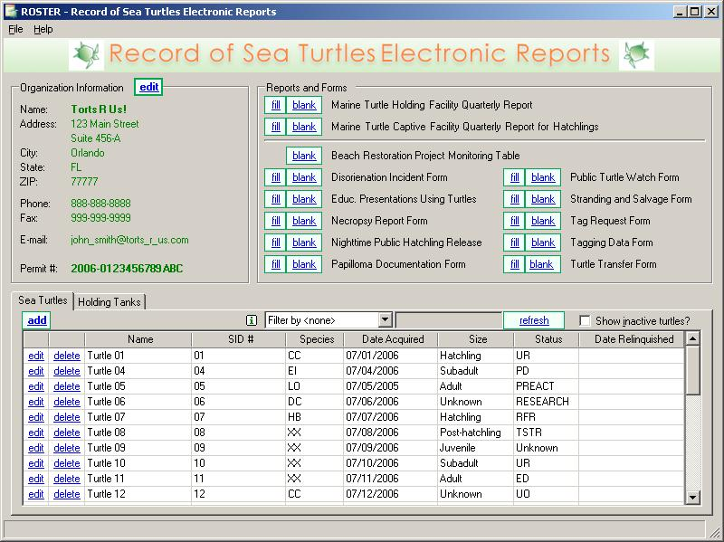
Main Screen
http://www.CodeLikeTheWind.com/roster
Portal to data-entry screens
  Organization
  Sea Turtles
  Holding Tanks
  Reports and Forms

Slide 4
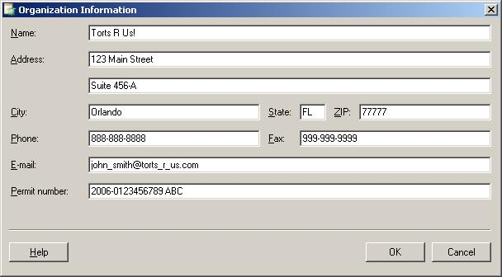
Organization Information
http://www.CodeLikeTheWind.com/roster
*Name
Address
*Permit Number

Slide 5
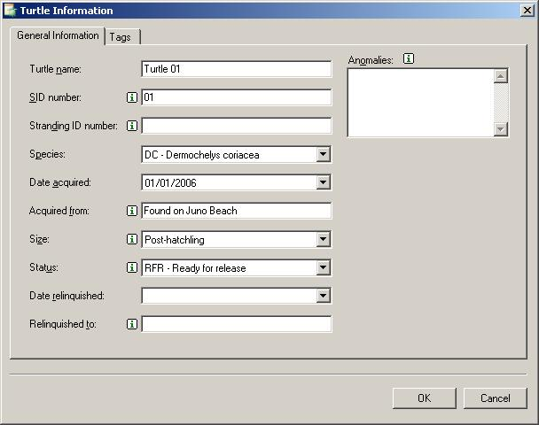
Turtle Information
http://www.CodeLikeTheWind.com/roster
Turtle Name
SID Number
Stranding ID Number
Species
Date Acquired
Acquired From
Size
Status
Date Relinquished
Relinquished To
Anomalies

Slide 6
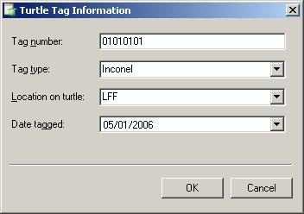
Tag Information
http://www.CodeLikeTheWind.com/roster
Number
Type
  Inconel
  Monel
  Roto
  PIT
  Other
  free-form text
Location
  all flippers
  free-form text
Date Tagged

Slide 7
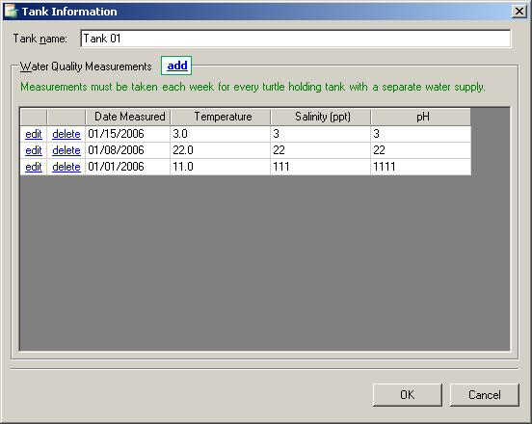
Holding Tank Information
http://www.CodeLikeTheWind.com/roster
Tank name

Slide 8
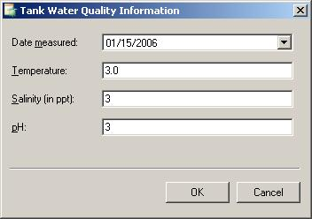
Tank Water Quality Information
http://www.CodeLikeTheWind.com/roster
Date Measured
Temperature
Salinity (ppt)
pH

Slide 9
Reports and Forms
http://www.CodeLikeTheWind.com/roster
Full data collection and report generation functionality for:
Marine Turtle Holding Facility Quarterly Report
Filling out Adobe Acrobat (PDF) form fields for:
Marine Turtle Captive Facility Quarterly Report for Hatchlings Disorientation Incident Form Education Presentations Using Turtles Form Necropsy Report Form Nighttime Public Hatchling Release Form Papilloma Documentation Form | Public Turtle Watch Form Stranding & Salvage Form Tag Request Form Tagging Data Form Turtle Transfer Form
Printing out of blank forms for:
Beach Restoration Project Monitoring Table

Slide 10
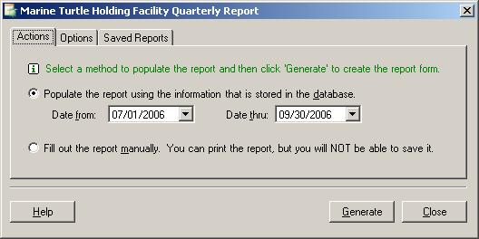
Marine Turtle Holding Facility
Quarterly Report
http://www.CodeLikeTheWind.com/roster
Blank form
Fill manually
Fill from data for a date range
  Include anomalies
  Include acquired from
  Include turtle name
  Group tank data by tank or date
View saved reports

Slide 11
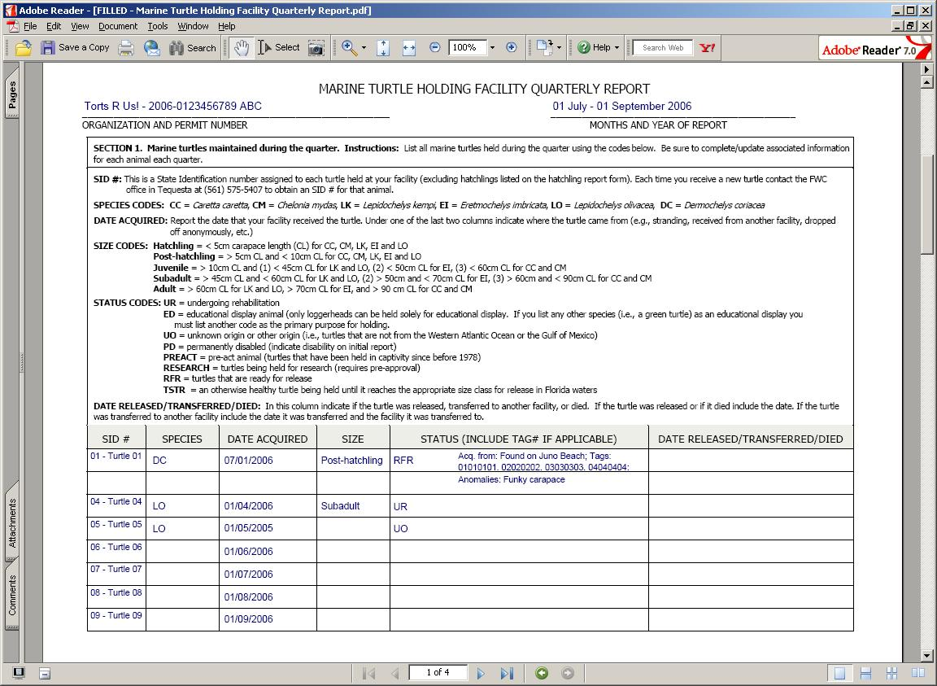
Sample Filled Report
http://www.CodeLikeTheWind.com/roster

Slide 12
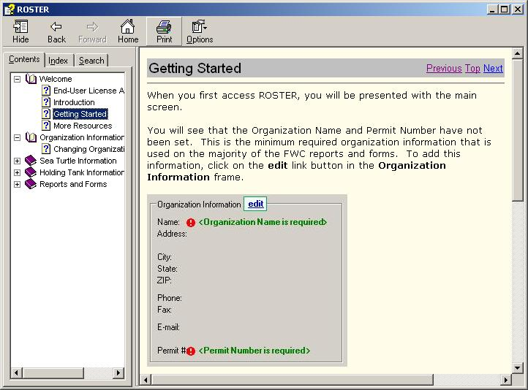
Help File
http://www.CodeLikeTheWind.com/roster
In progress
Waiting for program to settle a bit

Slide 13
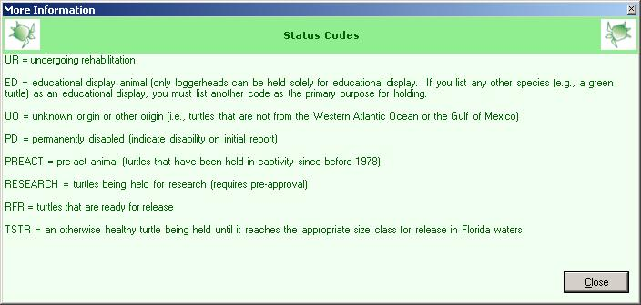
“More Information” Pop Ups
http://www.CodeLikeTheWind.com/roster
Click the little “i” to get more information about a field or a feature

Slide 14
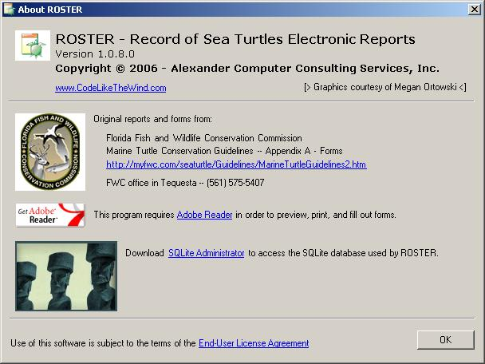
About ROSTER
http://www.CodeLikeTheWind.com/roster
Version
Website
EULA
Acknowledgements
Other links

Slide 15
What’s Next for ROSTER?
http://www.CodeLikeTheWind.com/roster
More beta test sites
Hatchling report?
Your requests

