Slide 1

G2M Case Study
Virtual Internship
21 - Sep - 2022

Slide 2
Background –G2M(cab industry) case study
XYZ is a private equity firm in US. Due to remarkable growth in the Cab Industry in last few years and multiple key players in the market, it is planning for an investment in Cab industry.
Objective : Provide actionable insights to help XYZ firm in identifying the right company for making investment.
The analysis has been divided into four parts:
Data Understanding
Forecasting profit and number of rides for each cab type
Finding the most profitable Cab company
Recommendations for investment

Slide 3
Data Exploration
Utilized 4 datasets:
Cab_Data.csv – this file includes details of transaction for 2 cab companies
Customer_ID.csv – this is a mapping table that contains a unique identifier which links the customer’s demographic details
Transaction_ID.csv – this is a mapping table that contains transaction to customer mapping and payment mode
City.csv – this file contains list of US cities, their population and number of cab users

Slide 4
Data Exploration
Cab Data:
It has 359392 rows and 7 columns.
It consists of 7 features and they are : 'Transaction ID', 'Date of Travel', 'Company', 'City', 'KM Travelled', 'Price Charged', 'Cost of Trip'.
City Data:
It has 20 rows and 3 columns.
It consists of 3 features namely, 'City', 'Population', 'Users'.
Customer_ID:
It consists of 49171 rows and 4 columns.
The 4 features are 'Customer ID', 'Gender', 'Age', 'Income (USD/Month)'.
Transaction_ID:
It consists of 440098 rows and 3 columns.
The 3 features are 'Transaction ID', 'Customer ID', 'Payment_Mode'

Slide 5
Hypothesis
Which company has maximum cab users at a particular time period?
Is there any relation between the age and the cabs utilized by them?
Are companies having a good business?
Which company performs better?
Where to invest in?

Slide 6
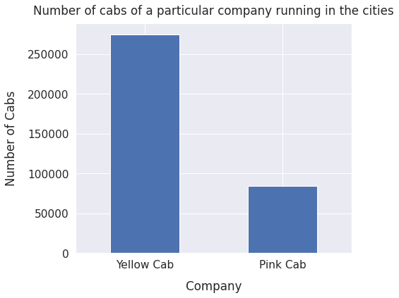
Cabs per comapny
More yellow cabs running in the cities compared to the pink cabs

Slide 7
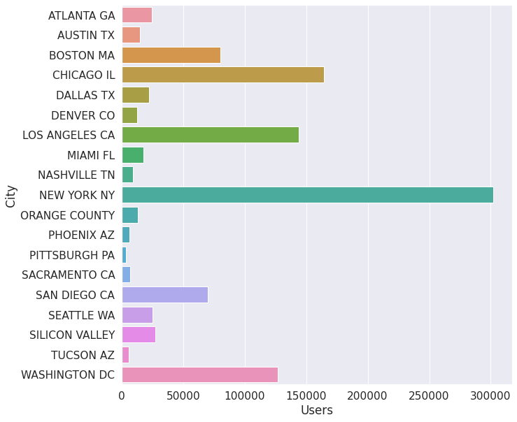
Users vs City
New York has most number of users which is more than 300,000 followed by Chicago and Los Angeles.

Slide 8
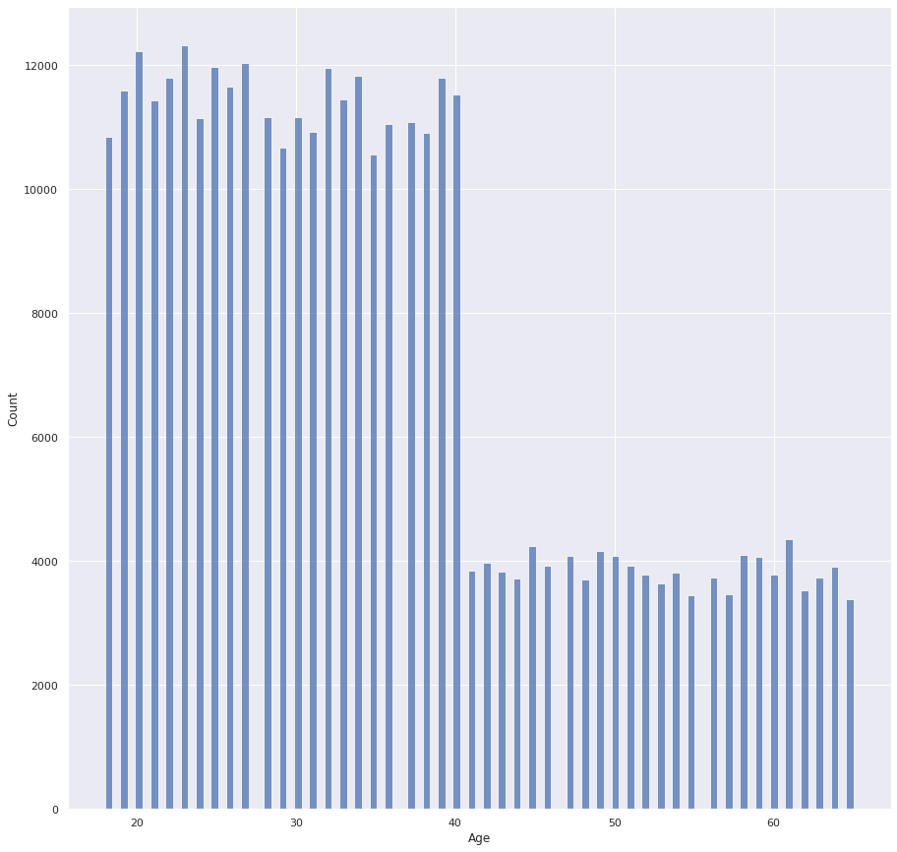
Cab requirement analysis as per the age
Significant decrease in the number of users opting for the cab service after the age of 40.

Slide 9
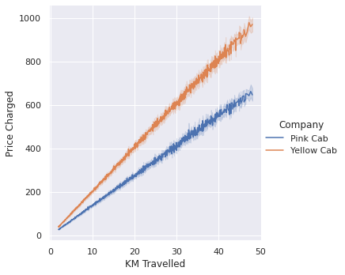
Price vs KM Travelled
Linear relation between KM travelled and Prices charged.
Yellow cab prices higher than pink cab company.

Slide 10
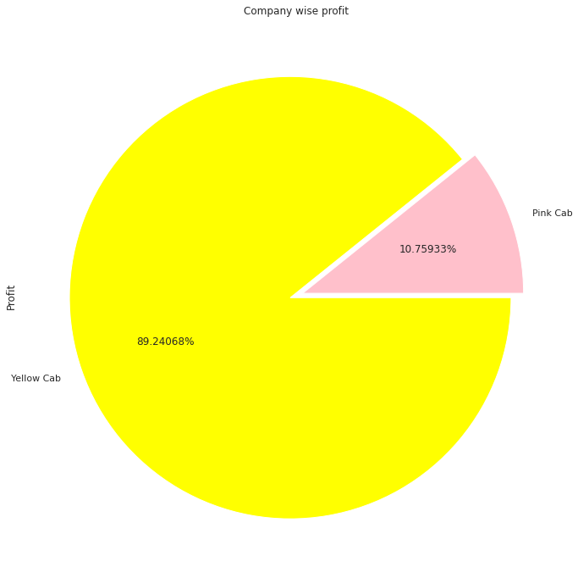
Profit share
Yellow cab company has almost 90% of the profit share.
Pink has a mere 10% of the profit share.

Slide 11
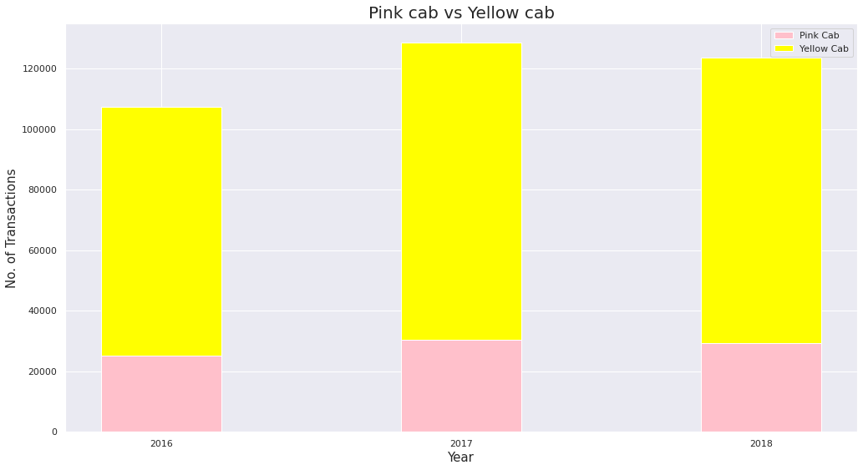
Yearly transaction analysis
Yellow cab has more customers than pink cab services in all the three years.

Slide 12
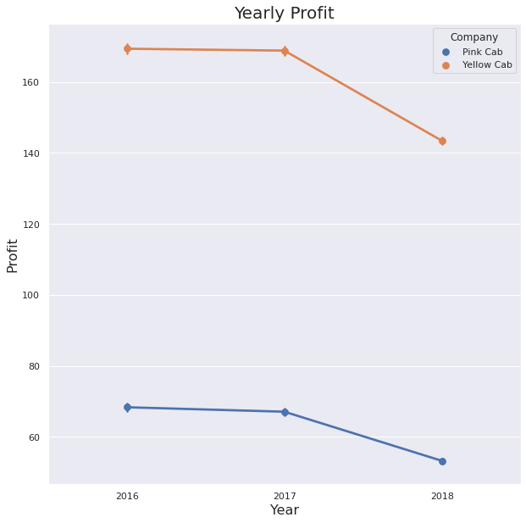
Yearly profit analysis
Decline in the profits for both the cab services.
Yellow cab has a steeper profit decline.

Slide 13
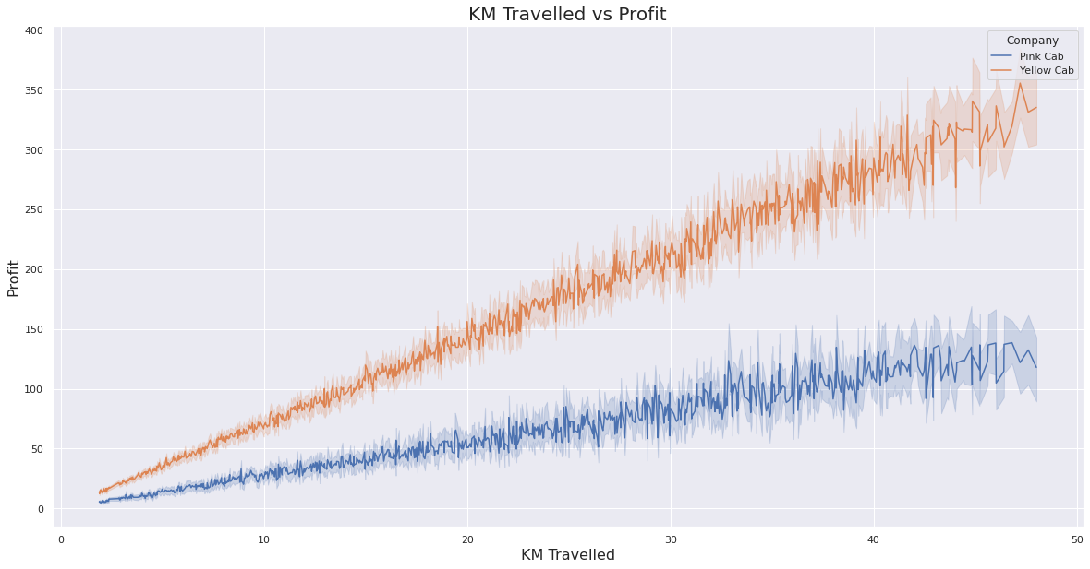
KM Travelled vs Profit
The profit margin for the Yellow cab services is more for the KM travelled than the pink services.

Slide 14
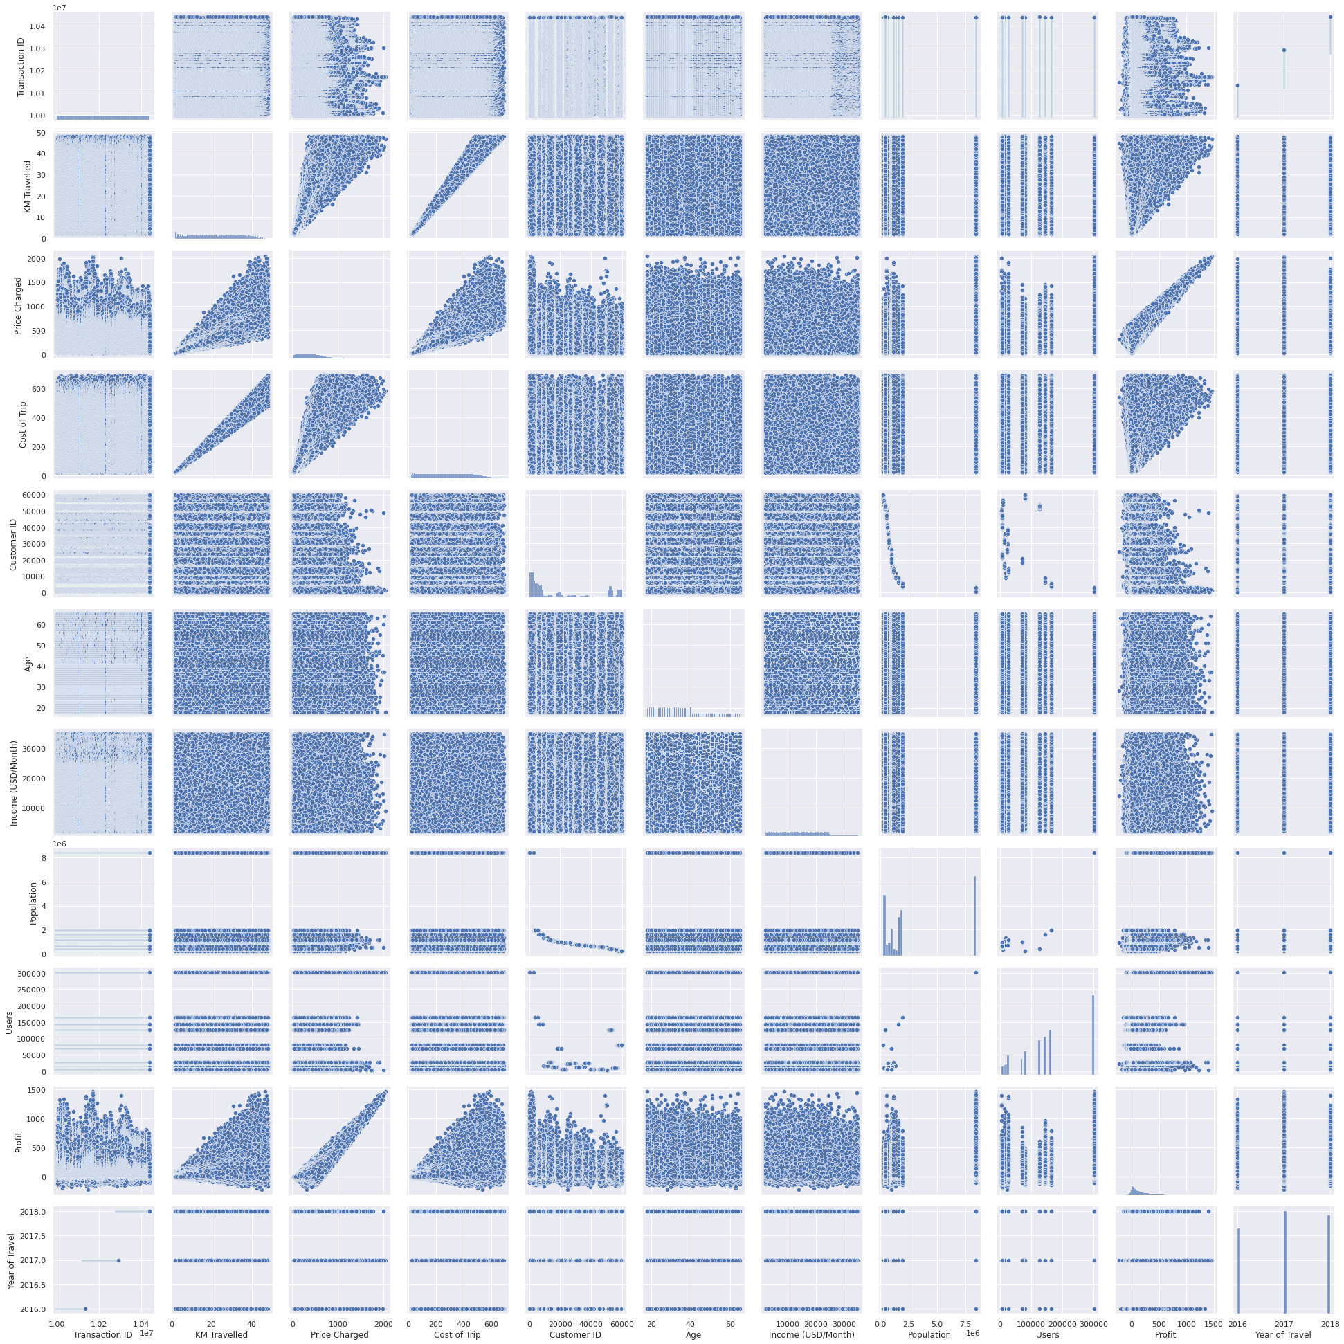
Relation between all features

Slide 15
Answers to the Hypothesis
Which company has maximum cab users at a particular time period? - Yellow Cab Services have significantly higher users.
Is there any relation between the age and the cabs utilized by them? - The age groups above 40 have a significantly lower interest in the cab services.
Are companies having a good business? - Both the companies have a decrement of profit during the three year period.
Which company performs better? Depending on the number of users and the profit margin of two services, Yellow cab services perform better in the market.
Where to invest in? - It is advised to invest in the Yellow Cab services due to a larger market monopoly and profit margins.

Slide 16
Recommendation
It is observed that that are more yellow cabs running in the cities.
New York city has the highest number of cab users.
There are more transactions occurring for the yellow cab company compared to the pink cab company.
Age groups below 40 prefer cabs than the ones above the age of 40.
More prices are charged by the yellow company for the KMs travelled than its counterpart.
The profit percent share of the yellow cab is almost 90% and that of the pink is 10%.
There is a dip in the profit margins for both the companies.
It is observed that more the distance travelled more is the profit for the companies.
There are outliers present in the dataset for prices charged and the profit.
Depending on the analysis from the graphs I would recommend to invest on the Yellow Cab Services.

Slide 17
Thank You

