Slide 1
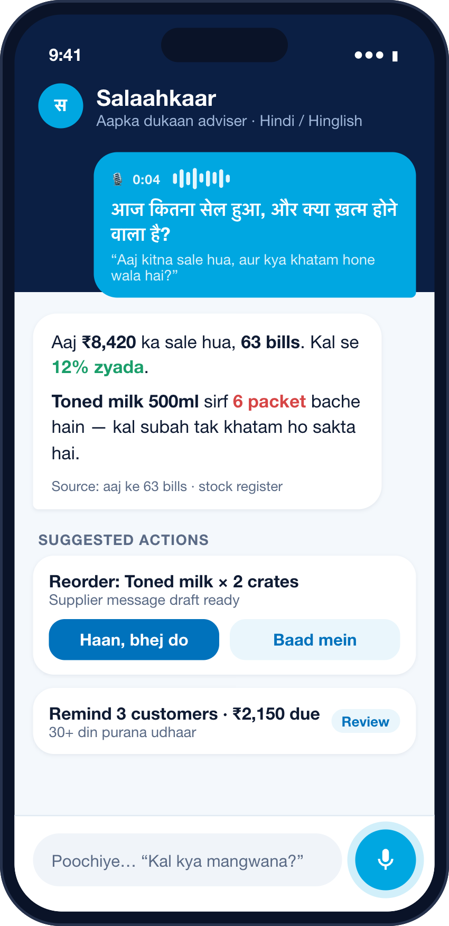
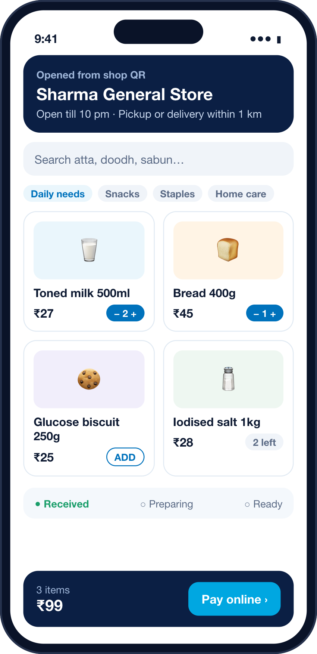




PAYTM BUILD FOR INDIA AI HACKATHON · MERCHANT GROWTH AI TRACK
Kirana Shop AI
An AI business partner for every neighbourhood dukaan.
Payments at the kirana are already digital. Kirana Shop AI helps the rest of the shop catch up: billing, online orders, udhaar and daily decisions, in the shopkeeper’s own language.
Counter
Shop
Khata
Salaahkaar
Every sale, easy
Every store, online
Every due, tracked
Data → decisions
Team HackHorizon · Round 1 submission · September 2026
Concept screens
Notes:
OPENING (30 sec): We are Team HackHorizon. We started from the merchant's workflow, not from the AI model: what takes time at the counter, what is still manual, and what a shopkeeper would actually use on a busy day. Payments are digital, but the rest of the store is still fragmented. So we designed Kirana Shop AI: Counter, Shop, Khata and Salaahkaar, one operating loop around Paytm payments.
One-line promise: an AI business partner for every neighbourhood dukaan.

Slide 2





MERCHANT WORKFLOW DISCOVERY
The merchant problem starts at the counter.
WORKFLOW OBSERVATION
OPPORTUNITY HYPOTHESIS
DISCOVERY QUESTIONS
Billing
Items are often identified from memory, barcodes or a handwritten parchi, then entered by hand.
One bill from any input: scan, photo, voice or parchi.
1
What takes the most time in your day?
Payments
The QR payment is digital, but it is often not linked to the bill, the stock or the notebook.
Tie each verified payment to its bill and stock.
2
What do you still do by hand?
Store sales
Many stores still rely on walk-ins and phone calls.
A shareable storefront from the same catalogue.
3
Where do mistakes happen?
Udhaar
Credit is often kept in a notebook that can’t see who has paid digitally.
A Khata that tracks dues and helps collect them.
4
What would you actually use during a busy hour?
Decisions
Transaction data exists, but there is little time to interpret it during the day.
An adviser you can simply ask, out loud.
Questions that guide our merchant discovery and pilot validation.
INITIAL WORKFLOW OBSERVATIONS · TO BE VALIDATED DURING THE PILOT
Kirana Shop AI
02 / 10
Notes:
Present these as initial workflow observations and opportunity hypotheses, not as statistically proven findings. We do not quote a number of shopkeeper conversations. The discovery questions on the left guide our ongoing merchant discovery and will be used to validate these observations during the pilot.
Key message (hypothesis to validate): the main friction appears to be operational (billing, stock, udhaar, decisions), not payment acceptance. Payment is the part that already works.

Slide 3







THE FRAGMENTED MERCHANT PROBLEM
Payment is digital. Everything around it isn’t.
Customer
Bill
Payment
Stock
Udhaar
Decisions
Walks in, calls, or sends a list
Memory, calculator or a handwritten parchi
QR / UPI with instant confirmation
Guessed from gaps on the shelf
Written in a separate notebook
Gut feel, at the end of a long day
Informal
Manual
✓ Digital
Not updated
Disconnected
No insight
Only one step in the day is connected. The other five live in heads, slips and notebooks.
1.4 crore+
75–80%
~24.5 bn
The QR says money came in. It can’t say what sold, what to reorder, or who still owes the shop money.
kirana stores in India
of FMCG sales flow through them
UPI transactions in August 2026 alone
PUBLIC DATA
DPIIT/ONDC release, 12 Jun 2026 (stores, FMCG share). NPCI UPI statistics, Aug 2026: 24,508.96 mn transactions.
Kirana Shop AI
03 / 10
Notes:
The problem is not payments alone. Payment acceptance is solved and mainstream. What is still fragmented is the workflow around the payment: billing, stock, receivables and decisions.
Sources: DPIIT/ONDC communication (12 June 2026) on 1.4 crore+ kirana stores and ~75–80% of FMCG sales. NPCI UPI product statistics: 24,508.96 million UPI transactions worth ₹29,82,355.95 crore in August 2026. Present the 1.4 crore number as the problem space, not as an immediate revenue target.

Slide 4


KIRANA SHOP AI: OVERVIEW
One shop profile. Four daily jobs. One loop.
Counter
ONE MERCHANT PROFILE
Khata
Make every sale easy
Shared data layer
Make every receivable trackable
Bill by barcode, photo, voice or parchi. AI proposes; the shopkeeper confirms.
Catalogue & prices
Udhaar is created straight from the bill, aged, reminded and reconciled.
Bills & online orders
Stock movements
Khata ledger
Shop
Salaahkaar
AI CORE
Payment status
Make every store online
Turn data into decisions
One QR opens the shop’s own storefront, built from the counter’s catalogue.
Ask in Hindi or Hinglish, out loud. Get grounded answers and one-tap actions.
Paytm payments underneath
Checkout · UPI · verified events
Not four apps stitched together. Every bill, order and payment updates the same record, so Salaahkaar always has something true to say.
Kirana Shop AI
04 / 10
Notes:
PRODUCT (60 sec): At the Counter, a merchant can create a bill four ways: barcode, camera, voice or parchi. In Shop, that same catalogue becomes a QR-powered storefront where customers can order and pay. In Khata, udhaar becomes a digital collection workflow. And Salaahkaar is the AI layer: the merchant can speak in their own language and ask about sales, stock, dues and what to do next.
We do not build a new payment rail. The payment layer uses Paytm's existing merchant acceptance and payment-gateway capabilities.

Slide 5
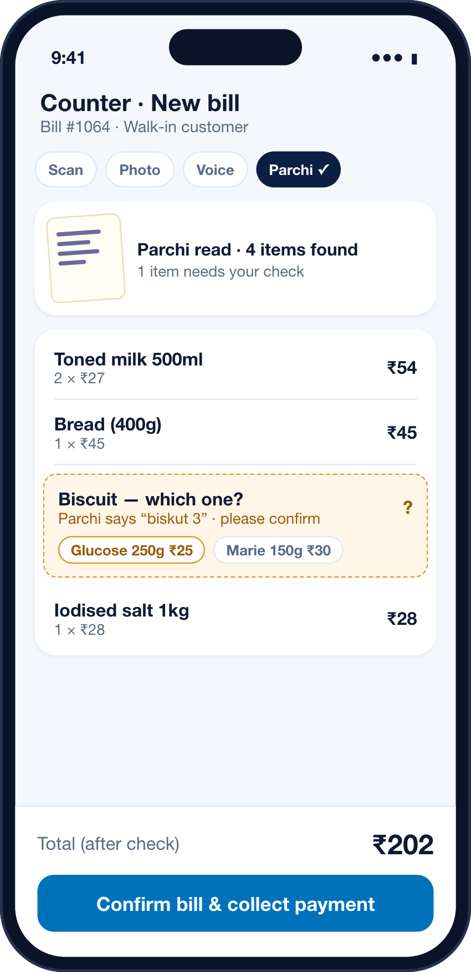







COUNTER AND SHOP
Sell at the counter. Sell from the QR. Same catalogue.
COUNTER · one bill, four ways in
SHOP · one QR, one storefront
Customer scans the shop’s QR or a shared link
Barcode
Photo
Scan the pack
Point the camera
Browses live prices and stock, from the counter’s catalogue
Voice
Parchi
Pays through Paytm checkout
“2 doodh, 1 bread”
Snap the written list
Tracks the order: received → preparing → ready
Human in the loop
AI proposes the bill; the shopkeeper confirms. Any line it isn’t sure about stays editable before payment.
A new sales channel without a separate e-commerce setup.
CONCEPT SCREENS · DEMO STORE & DATA
Kirana Shop AI
05 / 10
Notes:
Counter: four input modes create one invoice. Barcode = product lookup. Photo = visual match to the catalogue, merchant confirms if unsure. Voice = speech-to-text, intent extraction, catalogue lookup. Parchi = OCR plus structured extraction plus merchant confirmation.
Product rule: AI assists the bill; it never silently decides the final amount. Every uncertain line is editable before payment.
Shop: every merchant gets a lightweight storefront from the same catalogue. Customer opens it from a QR or shared link, orders, and pays through the Paytm checkout flow. Payment and order records stay connected.

Slide 6
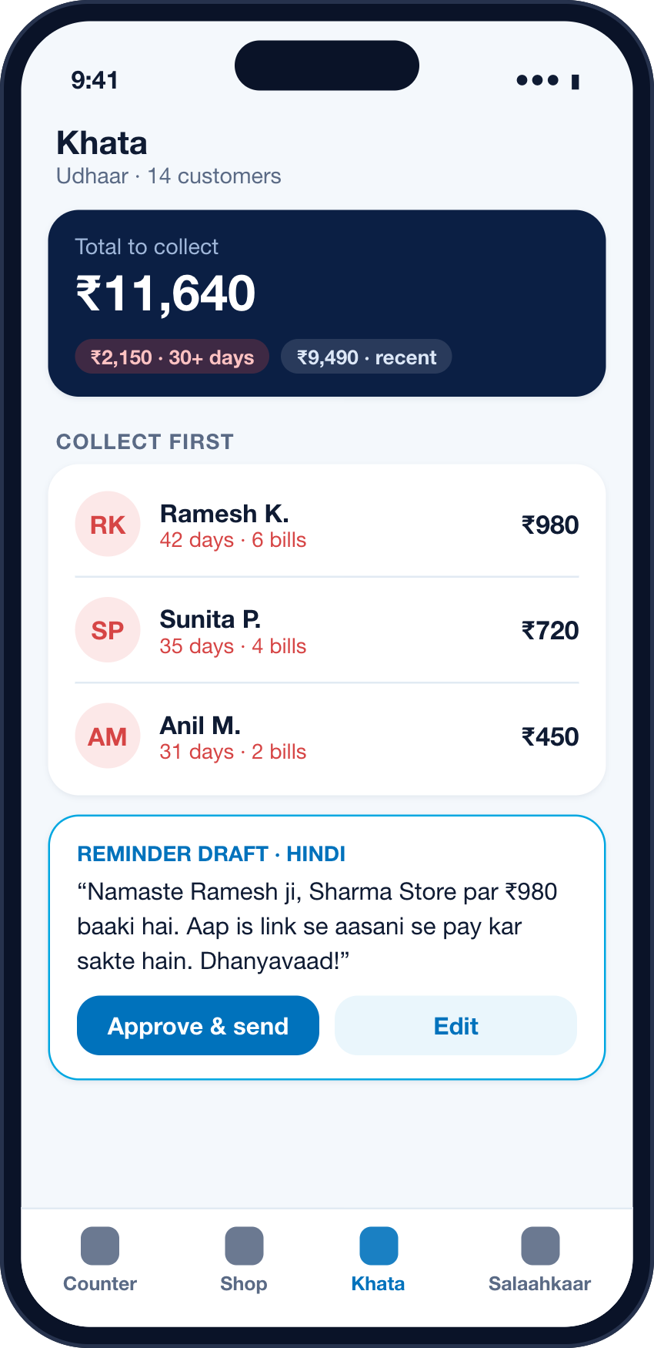



KHATA AND SALAAHKAAR
Khata tracks the dues. Salaahkaar suggests what’s next.
KHATA
Dues ranked by age. Reminders sent only after approval.
SALAAHKAAR · THE AI CORE
A voice-first adviser that speaks the shopkeeper’s language.
“Aaj kitna sale hua?”
“Kaunsa item slow chal raha hai?”
“Kis customer ka paisa baaki hai?”
“Kal kya stock mangwana chahiye?”
Grounded, not guessed
Answers come from the shop’s own bills, stock and Khata through structured tools. It shows the source; it doesn’t invent numbers.
Hindi and Hinglish, spoken
Built for code-mixed speech using Indian-language speech-to-text and text-to-speech (e.g. Sarvam APIs).
Suggests, never acts alone
Reorders, reminders and anything touching money wait for the shopkeeper’s “haan”.
CONCEPT SCREENS · ILLUSTRATIVE DEMO DATA
06 / 10
Notes:
Khata is not just a ledger: it turns receivables into an action queue. Who owes, how much, since when, and what should happen next. Credit is attached to the bill automatically; a payment closes the entry and reconciles the balance. Reminders are drafted politely in the customer's language and sent only after the merchant approves.
Salaahkaar is the "why" layer above the data. Instead of dashboards, the shopkeeper asks practical questions in their own language. Query classes: sales, inventory, Khata, trends, actions. Answers are grounded in the merchant's own data via structured tools, and every action with external or money impact needs explicit approval.
Sarvam publicly documents Indian-language STT/TTS with code-mixed input support and document intelligence. That makes the voice interface technically plausible for this concept.

Slide 7



END-TO-END PRODUCT DEMO
One transaction, all the way to a decision.
1
Transaction data
2
Insight
3
Recommendation
4
Merchant approval
5
Action
Bill #1064
Salaahkaar says
Reorder note saved: 2 crates
₹202
“Doodh kal subah tak khatam ho sakta hai. 2 crate mangwa lein?”
Toned milk is likely to run out before tomorrow morning.
“Haan, bhej do.”
Supplier message drafted
✓ Paid · webhook verified
Approve
Edit
Toned milk 500ml
Stock −2 → 6 left
Khata: no credit on this bill
Follow-up set for 8 pm
6 packets left vs. a typical evening of 14 sold (last 7 days).
Nothing is sent or paid without the shopkeeper’s explicit yes.
Spoken in Hinglish; the numbers it used are shown on screen.
Logged, so the next suggestion knows what was accepted.
UNDER THE HOOD: THE GOLDEN PATH WE BUILD ON HACKATHON DAY
Parchi photo
OCR + confirm
Invoice
Paytm checkout (staging)
Server-side verification
Stock + Khata update
Salaahkaar insight
DEMO STORE · ILLUSTRATIVE NUMBERS
Kirana Shop AI
07 / 10
Notes:
Walk through one journey. A customer hands over a handwritten parchi. The merchant photographs it; AI extracts line items and asks for confirmation on the uncertain one. The bill is created and stock is checked. The customer pays through Paytm checkout (staging in the hackathon). The server receives and verifies the payment result, then marks the order paid, decrements inventory and updates the Khata where applicable.
Then the merchant asks Salaahkaar: "Aaj ka sale kitna hua aur kya low stock hai?" The assistant answers from the shop's actual data and proposes an action (a reorder). The merchant approves; the action is logged.
All numbers on this slide are demo-store data for illustration. Barcode and photo recognition are alternate input modes, not separate demos.

Slide 8




WHY THIS MATTERS TO PAYTM
Payments bring merchants in. Daily value keeps them.
1
Faster billing
5 crore+
merchants & businesses Paytm says it powers to accept digital payments
Source: paytm.com/about-us, reviewed 25 Sep 2026
WHAT PAYTM COULD GAIN · HYPOTHESES TO TEST IN PILOT
5
Daily habit
2
More digital orders
More daily touchpoints
Billing, Khata, Shop and advice every day, not only a payment alert.
Every payment creates data.
Data creates an action.
Action creates value.
More payment-linked activity
Eligible digital orders can use Paytm checkout, keeping payment and order records connected.
A stickier merchant relationship
The more of the shop runs here, the harder it is to replace.
4
Better advice
3
Better data
Relevant, consented cross-sell
Devices and financial products shown only with eligibility and consent.
Not “Soundbox 2.0”. Soundbox confirms the payment. We connect it to the bill, stock, Khata and the next decision.
Kirana Shop AI
08 / 10
Notes:
Flywheel line: "Every payment creates data. Every piece of data creates an action. Every action creates more merchant value. That is how payments can become merchant growth."
Paytm is part of the operating loop, not a logo: customer payment → verified payment event → order status → invoice → inventory → merchant insight.
Soundbox positioning: do not claim a Soundbox hardware integration. The merchant experience can include software voice confirmation and, subject to Paytm integration access, extend the intelligence around the existing Soundbox ecosystem.
The gains on the right are strategic hypotheses, not guaranteed outcomes. The pilot measures activation, repeat usage and retention before any financial claims.

Slide 9



BUSINESS MODEL AND TECHNICAL ARCHITECTURE
How it earns, and how we build it.
BUSINESS MODEL · merchant value first, monetisation second
ARCHITECTURE · planned hackathon stack
Free core
Free
Inputs
barcode · photo · voice · parchi · online order
Counter billing, basic Khata, shop link. Goal: daily use.
Merchant PWA
Next.js / React PWA · all four modules
Pro · AI
₹149/mo*
Salaahkaar, automations, reminders, richer storefront.
API + orchestration
Node.js / TypeScript · business rules · tool calls
Ecosystem upside
Paytm terms
Device attach and financial-product distribution, with eligibility and consent.
Voice + documents
Reasoning
Paytm PG (staging)
Sarvam STT / TTS, Document AI (parchi OCR)
LLM with structured tools, grounded on shop data
Checkout · transaction status · callback / webhook
ILLUSTRATIVE SCENARIOS AT ₹149/MONTH
₹1.79 Cr
₹25.03 Cr
66%
Data + automation
PostgreSQL / Supabase · n8n workflows
ARR
ARR
margin*
10,000 paid merchants
1,40,000 = 1% of 1.4 Cr kiranas
₹99 contribution / merchant / month
AI assists; verified payment systems decide. An order is marked paid only after a verified server-side event, never a browser message.
ASSUMPTION
*Proposed pilot price, not market-researched. Assumes ₹50/month variable cost. A pitch model, not a forecast.
Kirana Shop AI
09 / 10
Notes:
Business model: free core for daily usage; a paid Pro/AI tier for Salaahkaar and automation; optional commerce and analytics plans; device attach and financial-product distribution only where Paytm's commercial terms, merchant eligibility and consent allow. We do not assume any revenue share from Paytm.
₹149/month is a proposed pilot price, not researched market pricing. Scenarios: 10,000 paid merchants = ₹14.9 lakh MRR / ₹1.79 Cr ARR. 1,40,000 (1% of 1.4 Cr) = ₹2.09 Cr MRR / ₹25.03 Cr ARR. At an assumed ₹50/month variable cost, contribution is ₹99/month (66%) before fixed costs. Real AI/API, infra and support costs must be tested.
Architecture: Next.js/React PWA; Node.js/TypeScript API; PostgreSQL/Supabase; Paytm Payment Gateway staging (checkout, transaction status, callback/webhook); Sarvam STT/TTS and Document AI (or equivalent); an LLM with structured tools grounded in merchant data; n8n for event-driven workflows. Production would need normal Paytm merchant onboarding and approval.
Trust controls: merchant review before final invoice; server-side payment verification; least-privilege access and audit logs for Khata/PII; confirmation prompts for voice; explicit approval for money movement and external messages.

Slide 10
PILOT, IMPACT METRICS AND WHAT’S NEXT
Prove it in a few dozen shops, then scale.
Now
3 Oct
Pilot
Scale
Round 1 concept
Hackathon MVP
20–50 local shops
Grow with Paytm
Problem, product, model, architecture
One working golden path, live
One region, one language, narrow SKU set
More languages, multi-store, Mini Apps if approved
WHAT WE’LL MEASURE · direction, not promises
↓
↓
↑
NORTH-STAR METRIC
Bill creation time
AI bill correction rate
Auto-reconciled payments
Weekly active merchants who complete a bill or payment and take one value-added action.
Start of bill to confirmed invoice
% of AI bills edited by hand
% of paid orders matched automatically
↑
↑
↑
Payments made the kirana digital. Kirana Shop AI makes it smarter, every day.
Weekly active merchants
Khata dues collected
AI suggestions accepted
% of onboarded shops using it weekly
% of overdue balance recovered after reminders
% of Salaahkaar actions approved and done
PILOT SIZE IS OUR PLAN · TARGETS SET AFTER A BASELINE
Dhanyavaad. We’re ready to build it on 3 October.
Kirana Shop AI · Team HackHorizon
10 / 10
Notes:
Roadmap: Round 1 concept → hackathon MVP (golden path: parchi/voice billing → Paytm staging payment → reconciliation → Khata/stock update → Salaahkaar insight) → pilot with 20–50 local merchants in one region and one language with a narrow SKU set → scale with more languages, richer inventory, multi-store and Mini App / merchant integrations where Paytm approves.
We show direction, not numeric targets: we set targets after measuring a baseline in the pilot. Also track 30/60/90-day merchant retention.
North star: weekly active merchants completing at least one bill/payment workflow and one value-added action (stock, reorder, Khata or an AI query).
Close: "The business model starts with recurring merchant software revenue. The bigger Paytm opportunity is strategic: better merchant workflows can deepen engagement, retention and product adoption over time."

