Slide 1

CNN FOR
MOVIE REVIEW
CLASSIFICATION
Jay Patel (31603118)
Priyanka Jariha (31603203)

Slide 2
Agenda
Introduction
Current Methods for Classification
Convolutional Neural Network(CNN)
Implementation & Results
Conclusion
References

Slide 3
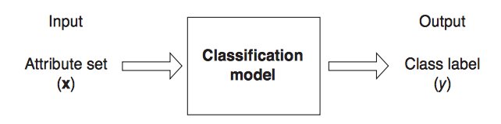
Classification
Classification is the task of learning a target function f that maps each attribute set x to one of the predefined class labels y.
It is a pervasive problem that encompasses many diverse applications. Examples include detecting spam email messages based upon the message header and content, and classifying galaxies based upon their shapes

Slide 4
Classification
Categorization
Given a set of n classes, determine which class document belongs to
Example: Deciding what the topic of a news article is, from a fixed list of topic areas such as "sports," "technology," and "politics."
Sentiment analysis
Determine if a document is positive/negative towards a specific subject
Example: Decide review of movie is positive or negative

Slide 5
Current Methods
Naive Bayes
Create probabilities of each word given a class and each class
Combine all probabilities of words in document for each class
Choose class with highest probability
Assumes all words are independent, which is rarely true
Support Vector Machine (SVM)
Finds an optimal hyper-plane to linearly separate data
Create n “1 vs All” SVMs to classify more than 2 classes, choose class with highest confidence
Can work poorly if classes are not linearly separable

Slide 6
Current Methods
Clustering with mean-NN classification
Combine features into similar clusters
Choose most popular class in the nearest cluster
Requires manually choosing cluster count
Data may be difficult to separate into distinct clusters
Recently, a new semantic sentence embedding method has emerged which models sentences as vectors. We intend to explore how a Convolutional Neural Network(CNN) can work with these embeddings to model documents for various classification tasks.

Slide 7
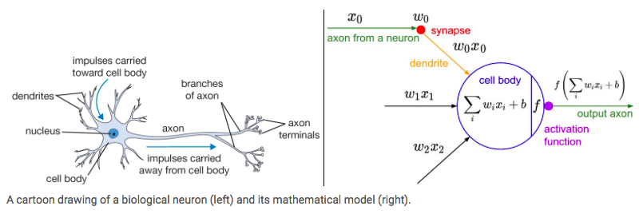
Neurons
The basic computational unit of the brain is a neuron
Each neuron receives input signals from its dendrites and produces output signals along its (single) axon.

Slide 8
Neurons
The signals that travel along the axons (e.g. x₀) interact multiplicatively (e.g. w₀x₀) with the dendrites of the other neuron based on the synaptic strength at that synapse (e.g. w₀)
The idea is that the synaptic strengths (the weights w) are learnable and control the strength of influence of one neuron on another
the dendrites carry the signal to the cell body where they all get summed. If the final sum is above a certain threshold, the neuron can fire
we model the firing rate of the neuron with an activation function f most popular right now is Rectified Linear Unit (ReLU)

Slide 9
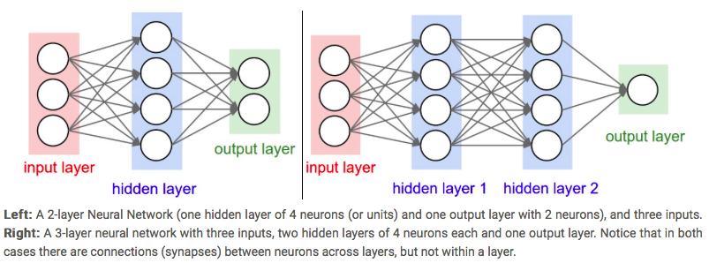
Neural Network architectures
Neural Networks are modeled as collections of neurons that are connected in an acyclic graph
The outputs of some neurons can become inputs to other neurons

Slide 10
Neural Network
Naming convention
N-layer neural network, we do not count the input layer. Therefore, a single-layer neural network describes a network with no hidden layers
Output Layer
The output layer neurons most commonly do not have an activation function because the last output layer is usually taken to represent the class scores
Sizing neural network
The first network (left) has 4 + 2 = 6 neurons (not counting the inputs), [3 x 4] + [4 x 2] = 20 weights and 4 + 2 = 6 biases, for a total of 26 learnable parameters

Slide 11
What is Convolution?
Easiest way to understand a convolution is by thinking of it as a sliding window function applied to a matrix

Slide 12
Convolution Neural Network
CNNs are basically several layers of convolutions with nonlinear activation functions like ReLU or tanh applied to the results
We use convolutions over the input layer to compute the output
During the training phase, a CNN automatically learns the values of its filters based on the task you want to perform
For example, in Image Classification a CNN may learn to detect edges from raw pixels in the first layer,
then use the edges to detect simple shapes in the second layer, and then use these shapes to determine higher-level features, such as facial shapes in higher layers.
The last layer is then a classifier that uses these high-level features.

Slide 13
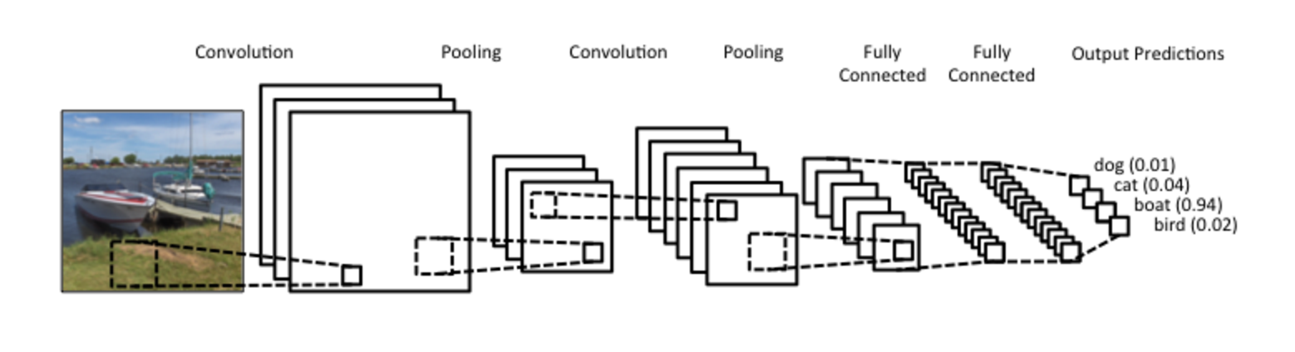
Convolution Neural Network

Slide 14
Convolution Neural Network in NLP
Instead of image pixels, the input to most NLP tasks are sentences or documents represented as a matrix
Each row of the matrix corresponds to one token, typically a word, but it could be a character
In vision, our filters slide over local patches of an image, but in NLP we typically use filters that slide over full rows of the matrix (words)

Slide 15
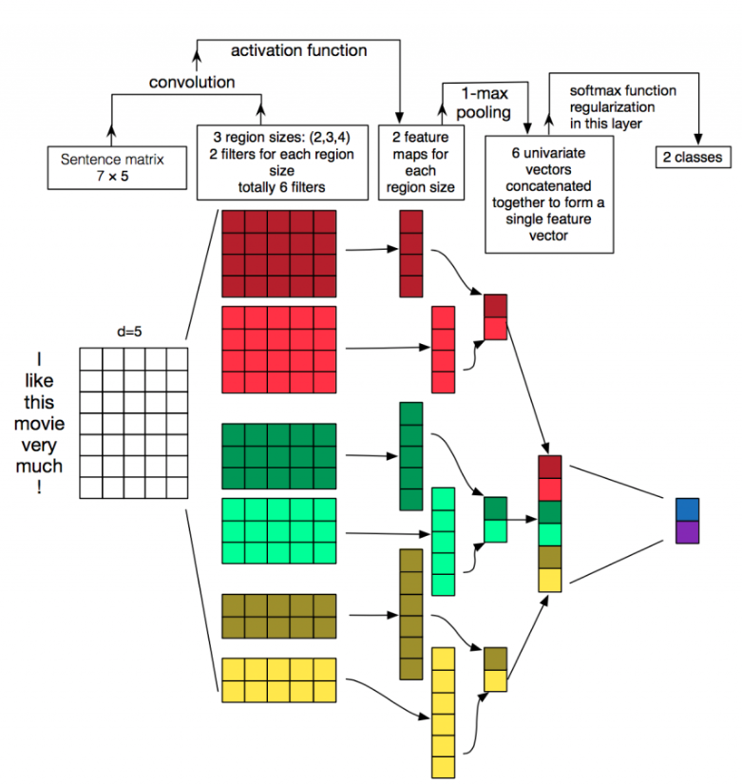
CNN architecture for sentence classification

Slide 16
The Model
Let x_{i}∈R^{k} be the k-dimensional word vector corresponding to the i-th word in the sentence
A sentence of length n is represented as
x_{1:n}=x₁⊕x₂⊕...⊕x_{n}
In general, let x_{i:i+j} refer to the concatenation of words x_{i} ,x_{i+1} ,. . . , x_{i+j}
A convolution operation involves a filter w∈R^{hk}, which is applied to a window of h words to produce a new feature.
For example, a feature c_{i} is generated from a window of words x_{i:i+h−1} by
c_{i} = f (w.x_{i:i+h−1} + b)

Slide 17
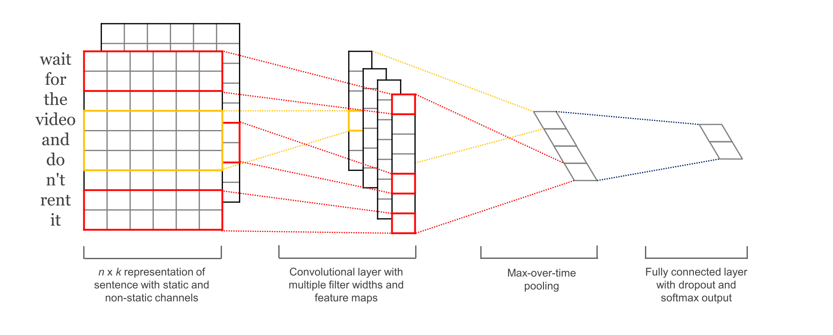
The Model
Filter is applied to each possible window of words in the sentence
{x_{1:h}, x_{2:h+1}, . . . , x_{n−h+1:n}} to produce a feature map
c = [c₁,c₂,...,c_{n−h+1}] with c∈R_{n−h+1}
Apply a max-over-time pooling operation over the feature map and take the maximum value cˆ = max{c}

Slide 18
Preprocessing
Load positive and negative sentences from the raw data files
Clean the text data
Pad each sentence to the maximum sentence length, which turns out to be 59
Append special <PAD> tokens to all other sentences to make them 59 words
Build a vocabulary index and map each word to an integer between 0 and 18,765 (the vocabulary size)

Slide 19
TensorFlow
TensorFlow is a Python library for fast numerical computing created and released by Google
The API is nominally for the Python programming language, although there is access to the underlying C++ API
It is a foundation library that can be used to create Deep Learning models directly or by using wrapper libraries that simplify the process built on top of TensorFlow
TensorFlow works with Python 2.7 and Python 3.3+. You can follow the Download and Setup instructions on the TensorFlow website

Slide 20

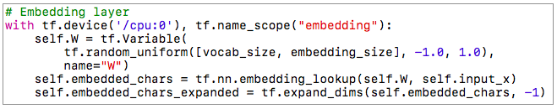
Implementation
INPUT PLACEHOLDERS
We start by defining the input data that we pass to our network
EMBEDDING LAYER
The first layer we define is the embedding layer, which maps vocabulary word indices into low-dimensional vector representations.

Slide 21
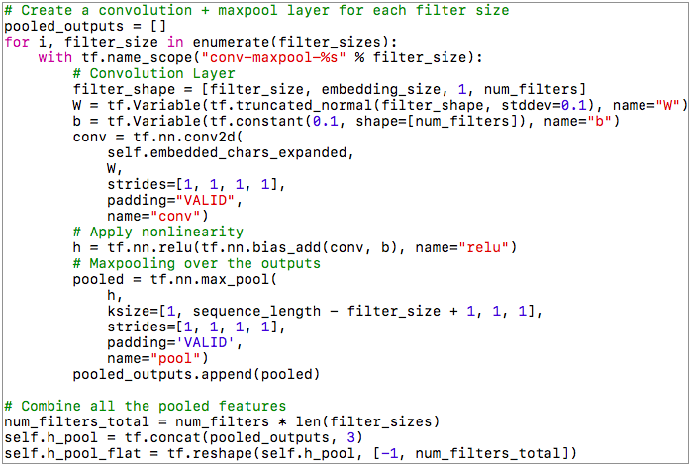
Implementation
CONVOLUTION AND MAX-POOLING LAYERS
build our convolutional layers followed by max-pooling

Slide 22
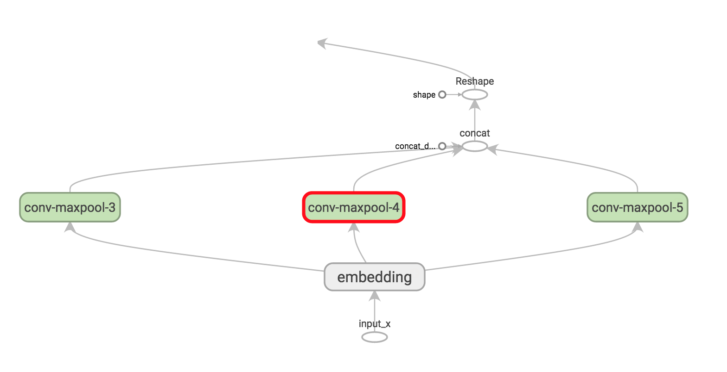
Visualize the Network

Slide 23
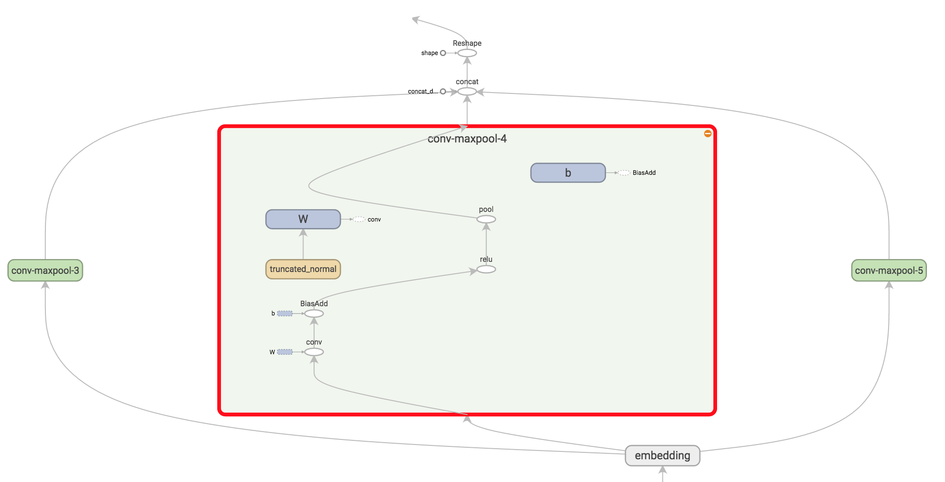
Visualize the Network

Slide 24

Implementation
DROPOUT LAYER
It is the most popular method to regularize convolutional neural networks
Dropout layer stochastically “disables” a fraction of its neurons
This prevent neurons from co-adapting and forces them to learn individually useful features

Slide 25
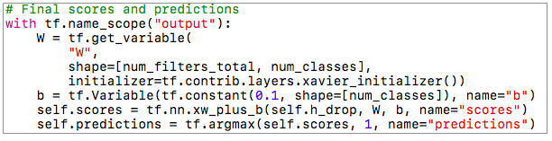
Implementation
SCORES AND PREDICTIONS
Using the feature vector from max-pooling (with dropout applied) we can generate predictions by doing a matrix multiplication and picking the class with the highest score
We could also apply a softmax function to convert raw scores into normalized probabilities

Slide 26


Implementation
LOSS AND ACCURACY
The loss is a measurement of the error our network makes, and our goal is to minimize it
The standard loss function for categorization problems it the cross-entropy loss
Accuracy = Number of correct predictions /Total number of predictions

Slide 27
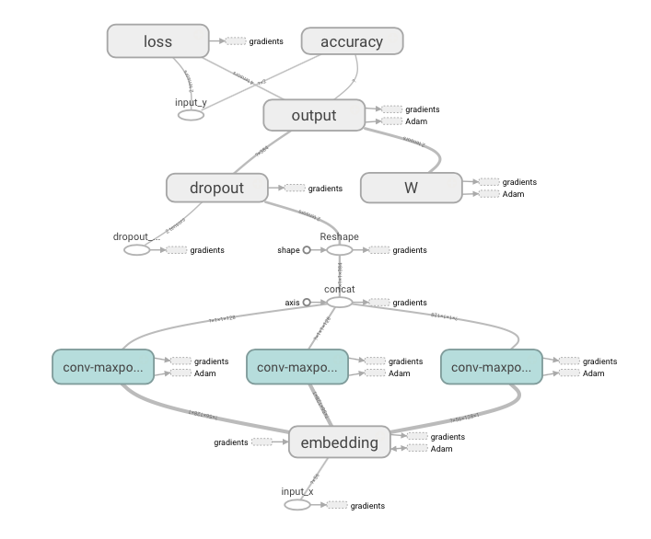
Visualize the Full Network

Slide 28
Experimental Results
Database used : Movie Review data from Rotten Tomatoes
Dataset contains 10,662 example review sentences, half positive and half negative
The dataset has a vocabulary of size around 20k
Dataset doesn’t come with an official train/test split, so we simply use 10% of the data as a dev set

Slide 29
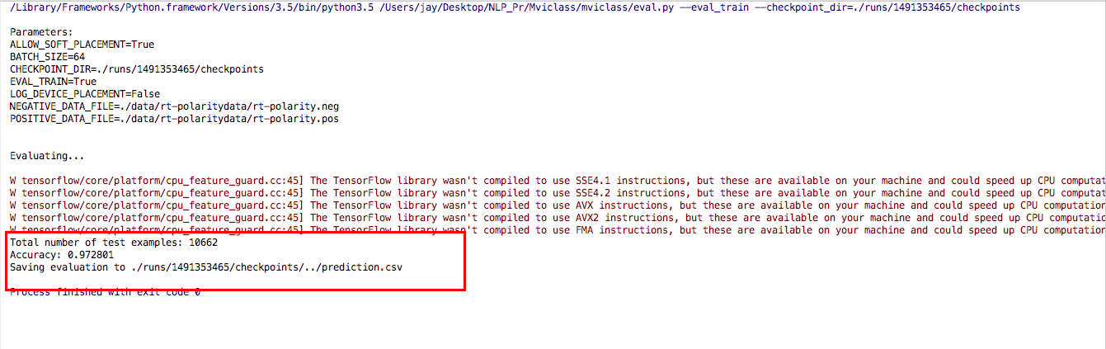
Results

Slide 30
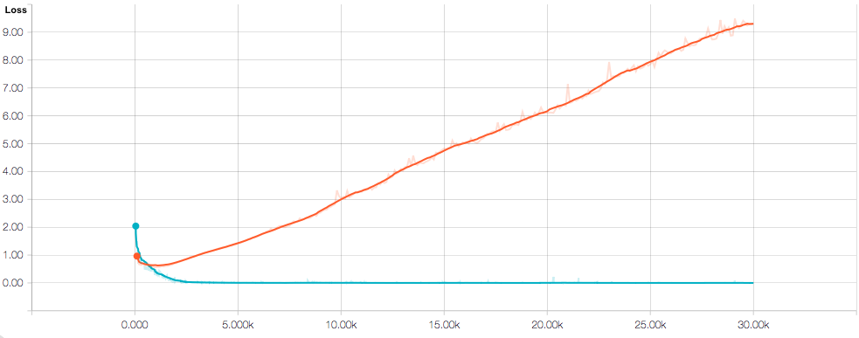
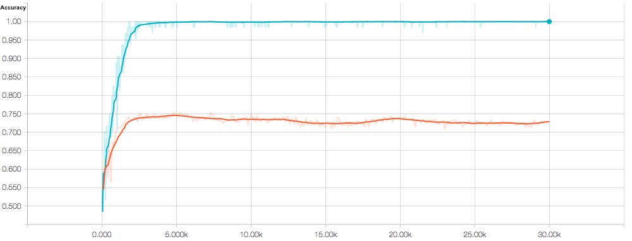
Results

Slide 31
Results
There are a couple of things that stand out :
Our training metrics are not smooth because we use small batch sizes. If we used larger batches (or evaluated on the whole training set) we would get a smoother blue line
Because dev accuracy is significantly below training accuracy it seems like our network is overfitting the training data, suggesting that we need more data (the MR dataset is very small), stronger regularization, or fewer model parameters
The training loss and accuracy starts out significantly below the dev metrics due to dropout applied to it

Slide 32
Extensions
Initialize the embeddings with pre-trained word2vec vectors. To make this work you need to use 300-dimensional embedding and initialize them with the pre-trained values
Constrain the L2 norm of the weight vectors in the last layer, You can do this by defining a new operation that updates the weight values after each training step
Add L2 regularization to the network to combat overfitting, also experiment with increasing the dropout rate.
Add histogram summaries for weight updates and layer actions and visualize them in TensorBoard

Slide 33
Conclusion
A simple convolutional neural network shows the capacity to learn good features for classification tasks in NLP
Accuracies in the testing results obtained from the simple convolutional neural network are surprisingly high. So it is highly expected that when a deeper CNN is would be trained using much bigger dataset then results will be better than we see them now
Our results add to the well established evidence that unsupervised pre-training of word vectors is an important ingredient in deep learning for NLP

Slide 34
Future Enhancement
Use this approach further for multi-class document classification task
Fine tune word vectors by training the CNN over a huge corpus to generate more semantically rich word vectors
Use this model as a feature generator to train other standard classifiers for various tasks to test the power of the CNN as a robust feature generator
Use skip-thought vectors i.e. sentence vectors instead of word vectors in this model to test multi-sentence document level classification tasks

Slide 35
Resources
Yoon Kim. Convolutional neural networks for sentence classification. EMNLP 2014, 2014.
http://www.wildml.com/2015/11/understanding-convolutional-neural-networks-for-nlp/
http://cs231n.github.io/convolutional-networks/
https://www.tensorflow.org/community/documentation
Ronan Collobert, Jason Weston, L ́eon Bottou, Michael Karlen, Koray Kavukcuoglu, and Pavel P. Kuksa. Natural language processing (almost) from scratch. CoRR, abs/1103.0398, 2011

Slide 36
Thank You!

