Slide 1
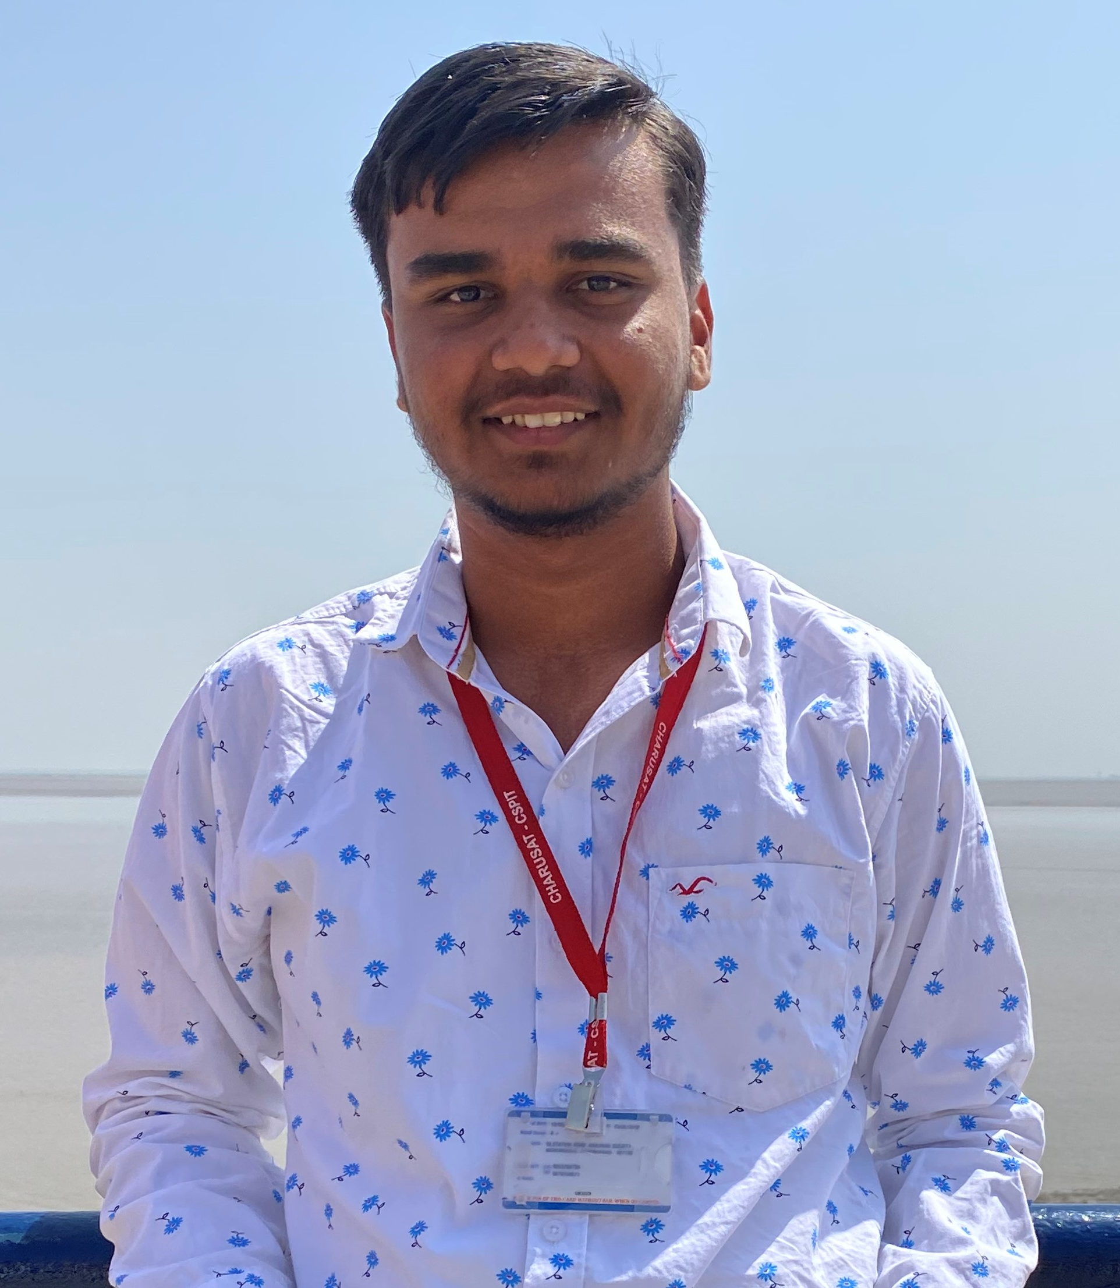
Introduction
Jaykumar Patel
Front-end Developer

Slide 2




I am…
Patience
Ambivert
Kind
Honest
2

Slide 3
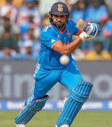

I Love…
Cricket
Food
Weekend

Slide 4


I Hate…
Being Hungry
Being compared
Overconfidence

Slide 5
SWOT
Strengths
Weaknesses
S
W
Humble
Accomodative
Self motivated
Nervousness
Hunger
O
T
Opportunities
Threats
Good position in Field
Personal growth
Shortage of food
AI

Slide 6
Belief system
“FOR EVERY ACTION, THERE IS EQUAL AND OPPOSITE REACTION ”

Slide 7
Thank YOU!!!!

