Slide 1
Jaykumar Patel
Presentation on
Full stack Development

Slide 2
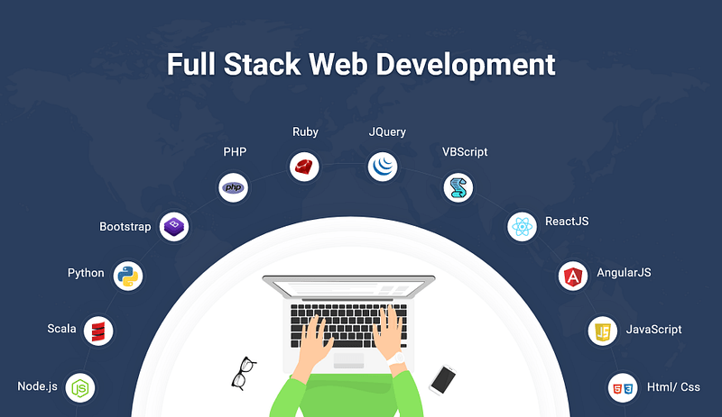
Full stack Development?
Combination of Front-end and Backend

Slide 3
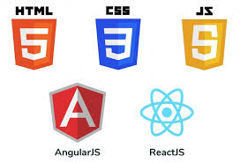
Front-end?
A front-end developer builds the front-end portion of websites and web applications—the part users see and interact with.

Slide 4
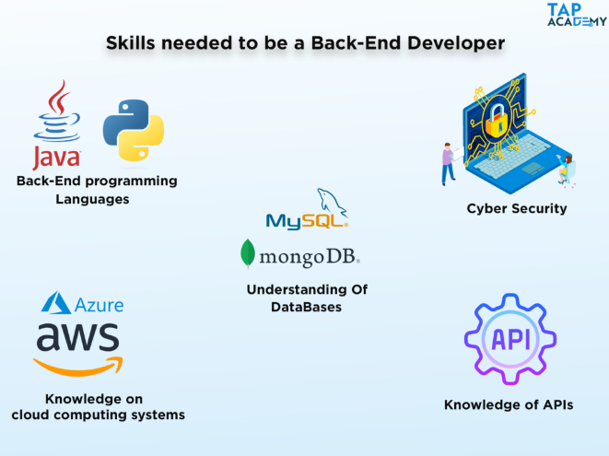
Backend?
A back-end web developer is responsible for server-side web application logic and integration of the work front-end web developers do.

Slide 5
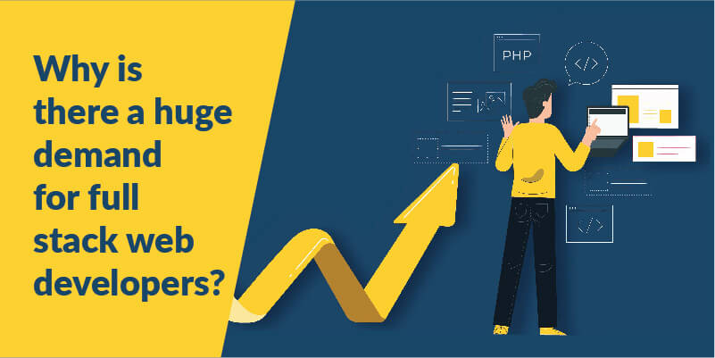
Why Full stack?
High world wide demand.
Continuously growing.
Reduces hiring

Slide 6

Trends…
Current
Upcoming
Low-code development
Progressive web apps
JavaScript
JS frameworks
Artificial intelligence
Serverless computing

Slide 7
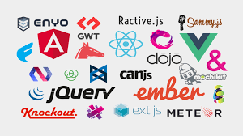
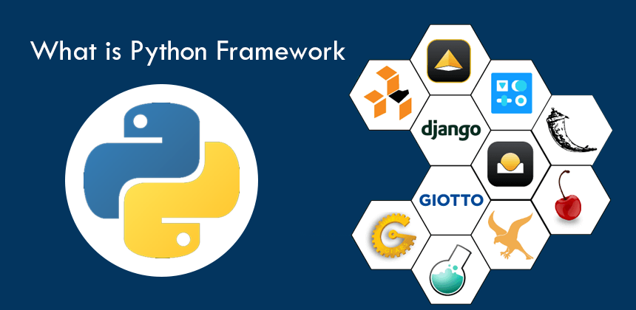
Technology upgradation
Front-end
Js frameworks like React.js ,redux
Back-end
Js frameworks like node.js

Slide 8



Why From Tops?
Proper guidance
Safe future
Personal growth

Slide 9


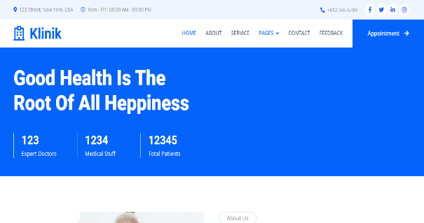

Some of my work..
Zudio clone
Dmart clone
Tops home page clone
Appointment booking system for clinic

Slide 10


