Slide 1
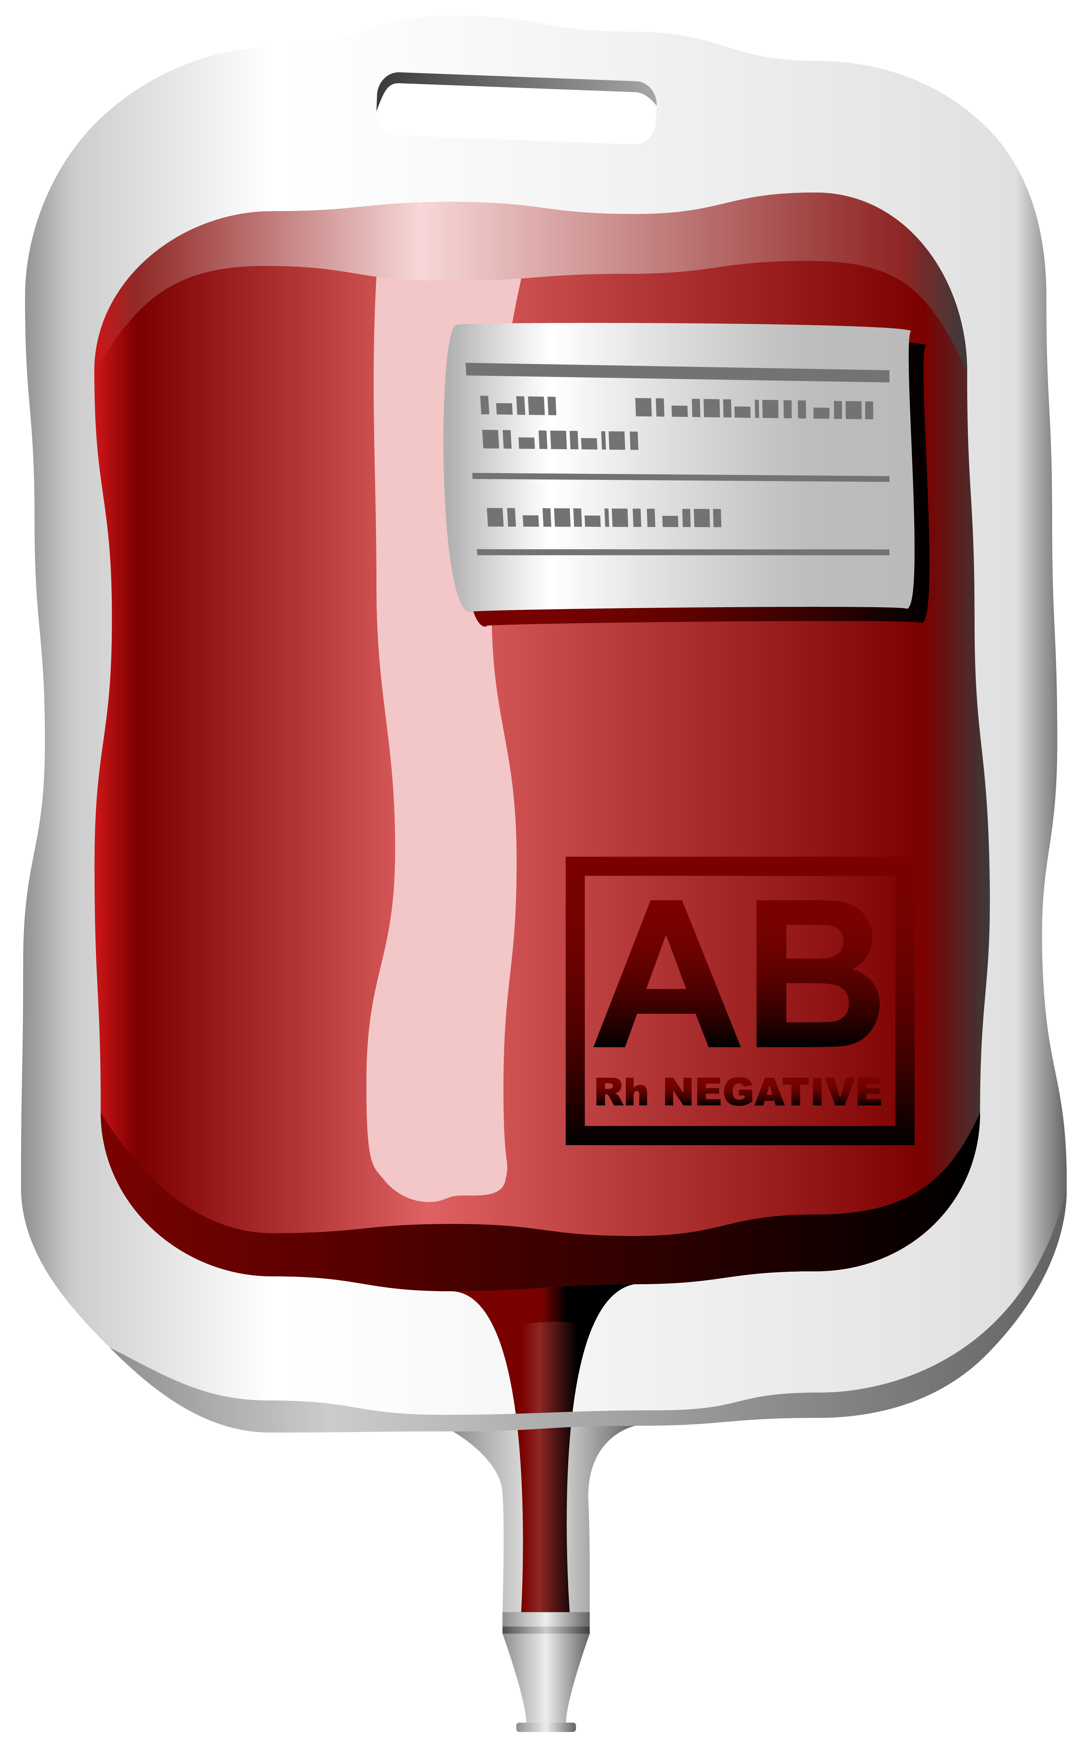
BLOODLINK
Sangani Dhruvit ( 20BEIT30116 )
Lakkad Ankit ( 20BEIT30042 )
Bodar Jay ( 20BEIT30015 )
Golakiya Shrenil ( 20BEIT30032 )
G.No:G-93

Slide 2
INTRODUCTION
At BloodLink, we are dedicated to saving lives through the collection, processing, and distribution of safe and quality blood and blood products. Our mission is to ensure a reliable and readily available supply of blood for patients in need, and we invite you to be a crucial part of this life-saving endeavor.

Slide 3
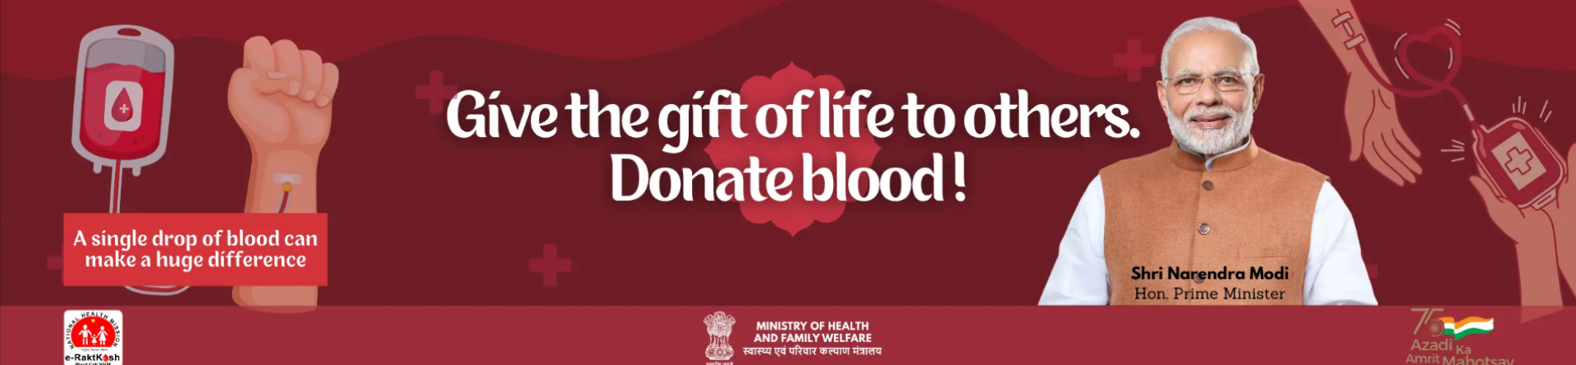
SERVICES
1
2
DONATIONS
REQUEST FOR BLOOD
3
4
BLOOD BANKS
VARIOUS CAMPS

Slide 4



SOFTWARE REQUIREMENTS (DEVELOPERS)
Front end
HTML
CSS
React.js
Back end
Node JS
Express Js
Database
MongoDB(Mongoose)
Software
Vs code
chrome

Slide 5
HARDWARE REQUIREMENTS (DEVELOPERS)
Processor
Recommended: Windows/ Intel i5
Minimum: Intel i5
System type
64 bit
CPU
8-core/4- core
GPU
Minimum : Intel UHD
Recommended: Nvidia 2 GB
RAM
Minimum:4GB
Recommended: 8GB
STORAGE
256 GB SSD

Slide 6
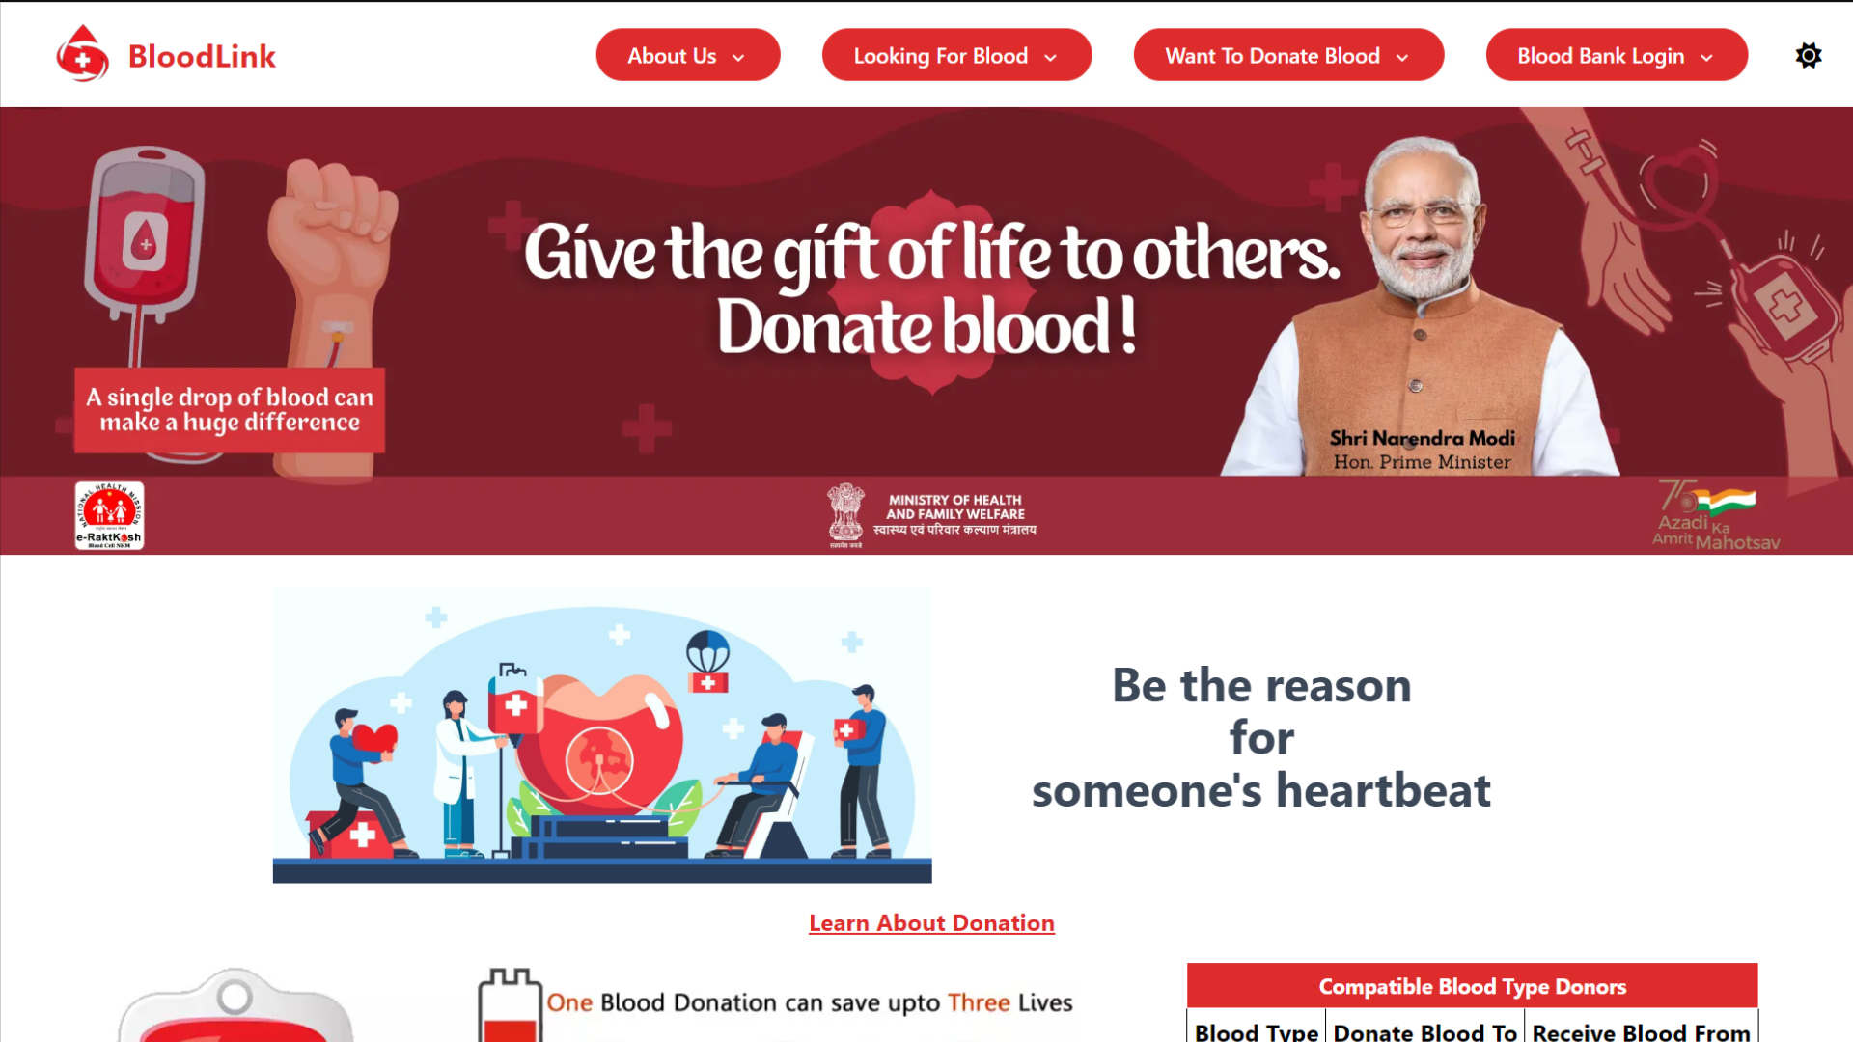
LANDING PAGE

Slide 7
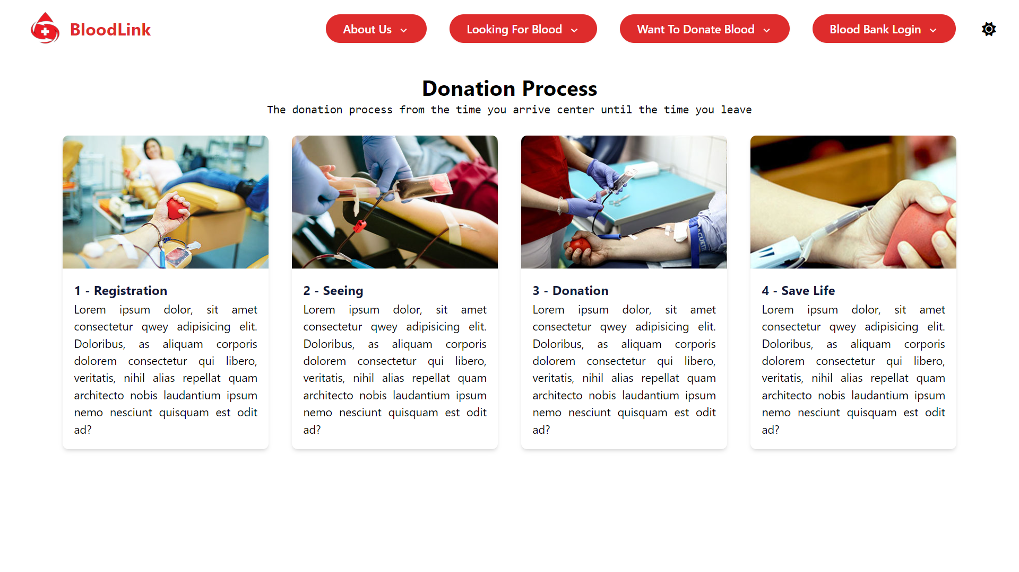
DONATION PROCESS

Slide 8
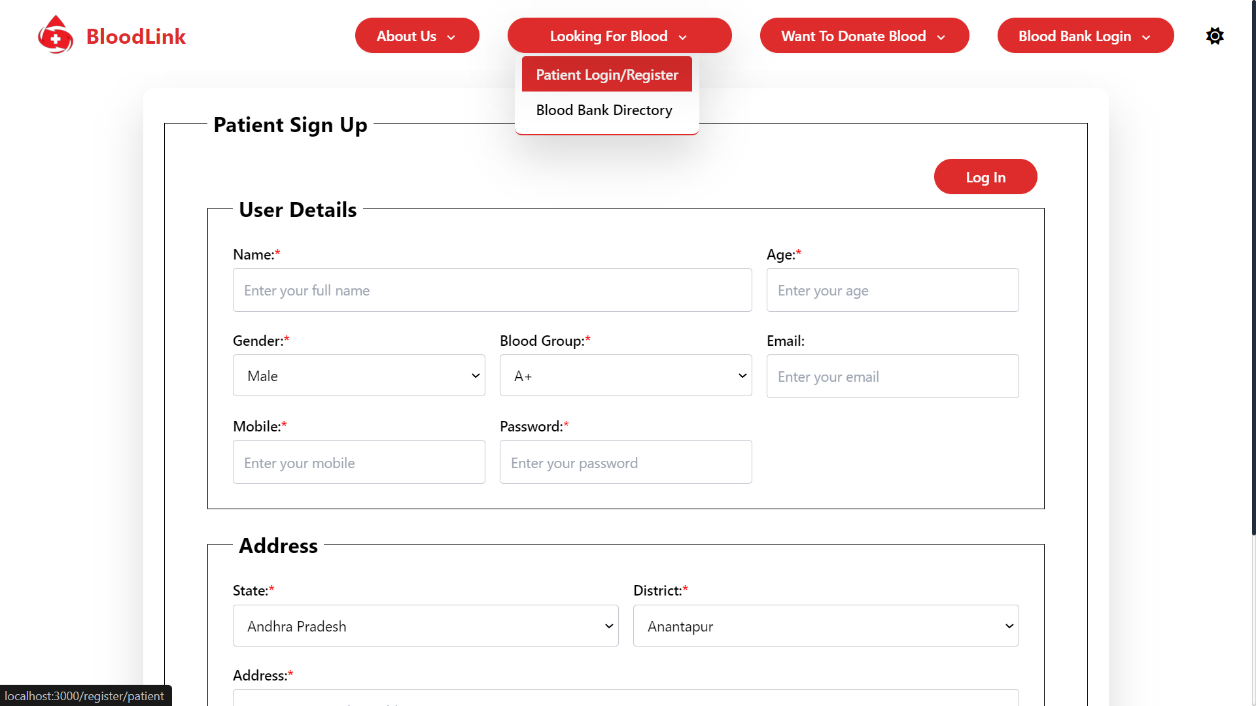
REGISTER FOR PATIENT

Slide 9
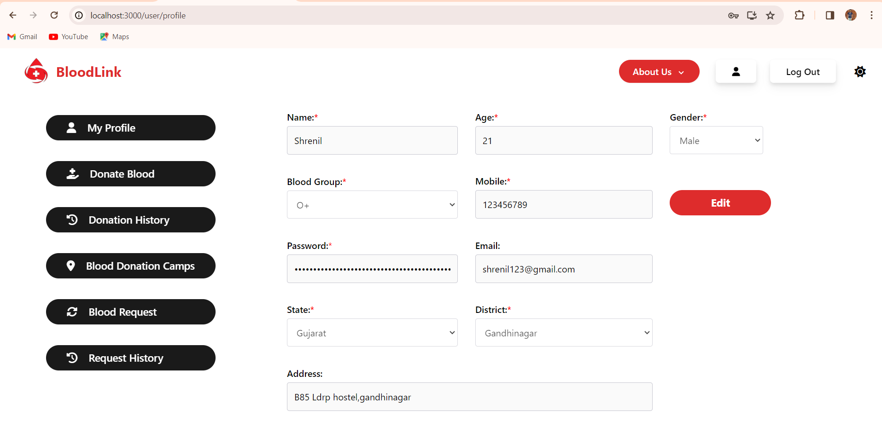
PATIENT DETAILS

Slide 10
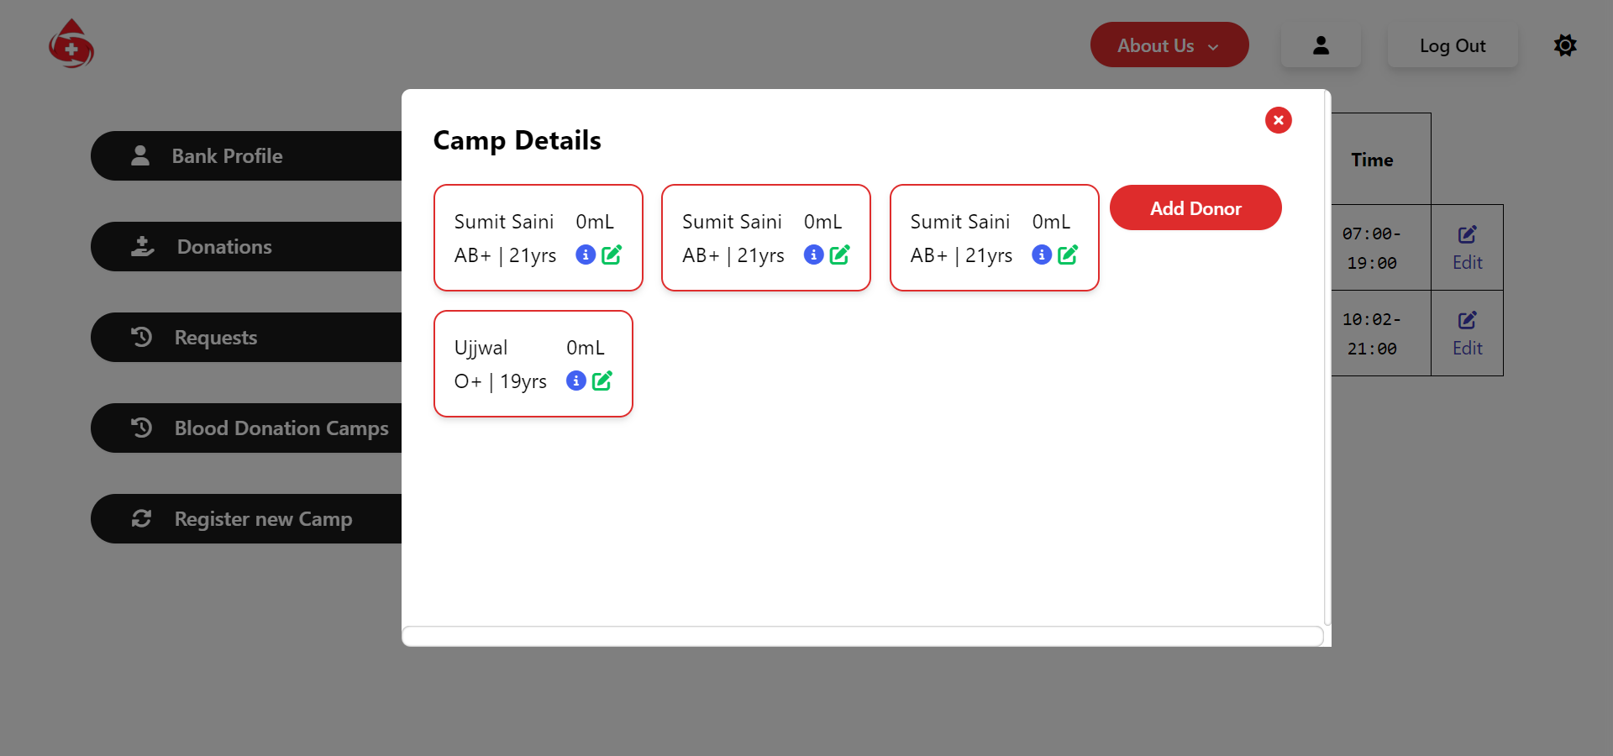
CAMP DETIALS

Slide 11
BASIC PURPOSE
Efficient Donor Management: Simplify the donor registration process, allowing individuals to create profiles and manage their donation history.
Streamlined Blood Donation Process:Enable donors to easily locate nearby blood drives and donation centers through an intuitive interface.

Slide 12
ADVANTAGES OF BLOODLINK
Patient friendly.
Various Camps which helps to Blood banks.
Understanding of Blood Groups.
Blood Stock (Avalibility).

Slide 13
FUTURE SCOPE
To provide more and more satisfaction is the future scope of our website.
To minimize the website load while more patient occur in website.
Try to Connect more Blood Camps and Frequently organized.

Slide 14
CONCLUSION
The development and implementation of a blood bank website represent a significant step toward achieving the goals of efficient blood management, increased donor engagement, and community awareness. The website serves as a dynamic platform that not only facilitates the blood donation process but also educates, engages, and connects donors with the life-saving mission of the blood bank.

Slide 15
Thank you

