Slide 1

Music Store Data Analysis
SQL Driven Business Intelligence on a Relational Music Retail Database
Jay Patwa | B.Tech Computer Engineering | Innomatics Research Labs

Slide 2
About Me
Jay Patwa | Aspiring Data Analyst
Jay Patwa
BACKGROUND
KEY SKILLS
Computer Engineering student with a strong interest in Data Analytics, Data Science and Artificial Intelligence.
SQL, Python, Power BI, Microsoft Excel, Data Visualization, Statistics and Machine Learning fundamentals.
WHY DATA SCIENCE
CAREER GOAL
I enjoy working with data — uncovering patterns and turning raw information into insights that help drive better decisions.
Start my journey as a Data Analyst and grow steadily into a skilled Data Scientist.
CURRENTLY LEARNING
STRENGTHS
SQL, Python, Statistics, Power BI and Machine Learning through hands-on projects at Innomatics Research Labs.
Analytical thinking, problem solving, quick learning ability, adaptability and team collaboration.
LinkedIn: linkedin.com/in/jay-patwa-b625031b2
GitHub: github.com/jaypatwa21

Slide 3
Agenda
What this presentation covers
01
Project Objective
04
Key Findings
02
Database Schema Overview
05
Challenges & Learnings
03
11 Analysis Questions (Q1 – Q11)
06
Q & A

Slide 4
Project Objective
Why we built this analysis
• Analyse a real-world digital music store database using SQL.
• Answer 11 business questions that a music store would actually ask.
• Practise joins, aggregations, sub-queries, CTEs and window functions.
• Generate insights about customers, sales, geography and music preferences.
• Present findings the way a junior data analyst would on the job.

Slide 5
Problem Statement
The business questions we want SQL to answer
BUSINESS PROBLEM
OBJECTIVES OF ANALYSIS
A digital music store has data scattered across customers, invoices, tracks, artists and genres. Leadership cannot easily see who their best customers are, which markets perform well, or which music genres drive revenue.
Use SQL to extract clear, accurate answers to 11 business questions that cover sales, customers, geography and music preferences — without exporting data to any other tool.
WHY IT MATTERS
DATASET & DATABASE
These insights guide real decisions — where to host the next festival, which artists to invite, which customers deserve loyalty perks, and which markets need more marketing investment.
Real-world music store schema with 11 relational tables. Implemented in MySQL using MySQL Workbench. Data imported from 11 CSV files provided by Innomatics Research Labs.
Goal: Turn 11 raw CSVs into 11 actionable business answers — using only SQL.

Slide 6
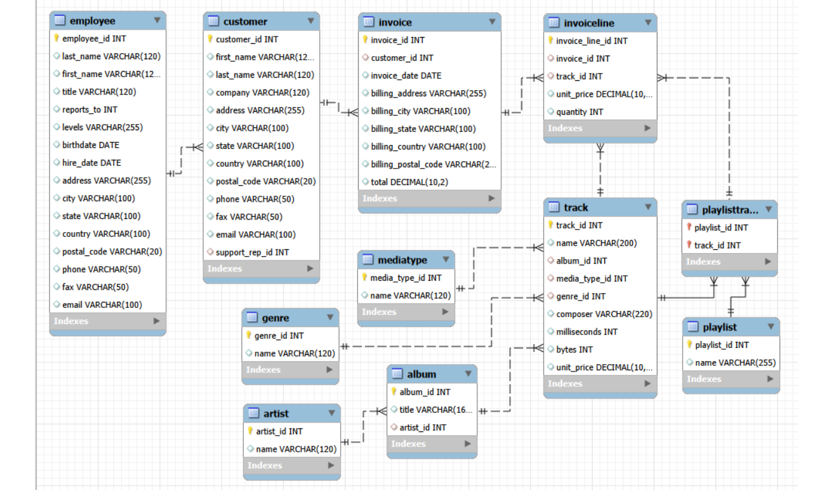
Database Schema
Entity Relationship Model — MUSICSTORE database (11 tables)

Slide 7
Data Cleaning & Validation
How we made the raw CSVs ready for analysis
CSV IMPORT ORDER
FK CONSTRAINT ISSUE
Tables were imported in the right order to respect foreign keys — Genre, MediaType, Employee, Customer, Artist, Album, Track, Invoice, InvoiceLine, Playlist, PlaylistTrack.
employee.reports_to is a self-referencing FK. CSV import failed at first. Solved by dropping the constraint, importing, then re-adding it — a common production-style workaround.
NULL VALUES
DUPLICATE CHECK
Checked customer.company, employee.fax and employee.reports_to (top boss) for legitimate NULLs. Used IS NULL / COALESCE during analysis where needed — no synthetic filling.
Ran COUNT(*) vs COUNT(DISTINCT pk) on every table. No duplicate primary keys found — data is clean at the row level.
COLUMN-NAME VALIDATION
ROW-COUNT SANITY
Confirmed every CSV column maps to its table column (snake_case). Caught early issues like BillingCity vs billing_city before queries broke.
Verified 8 employees + 1 manual insert (Mohan Madan), ~59 customers, ~412 invoices, ~2240 invoice_line rows, ~3500 tracks — matches expected dataset volume.
Clean data in → reliable insights out. Validation done before any analysis query was run.

Slide 8
Q1. Senior most employee (by job title level)
SQL QUERY
SELECT *
FROM employee
ORDER BY levels DESC
LIMIT 1;
OUTPUT
Result: Mohan Madan — Senior General Manager (Level L7)

Slide 9
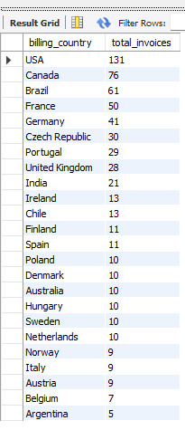
Q2. Countries with the most invoices
SQL QUERY
OUTPUT
SELECT billing_country, COUNT(*) AS total_invoices
FROM invoice
GROUP BY billing_country
ORDER BY total_invoices DESC;
Result: USA leads with the highest number of invoices.

Slide 10

Q3. Top 3 values of total invoice
SQL QUERY
OUTPUT
SELECT total
FROM invoice
ORDER BY total DESC
LIMIT 3;
Result: Top 3 invoice totals: 23.76, 19.80, 19.80

Slide 11

Q4. Best city for a music festival (highest invoice total)
SQL QUERY
OUTPUT
SELECT billing_city, SUM(total) AS total_revenue
FROM invoice
GROUP BY billing_city
ORDER BY total_revenue DESC
LIMIT 1;
Result: Prague — highest total invoice revenue.

Slide 12

Q5. Best customer (who has spent the most money)
SQL QUERY
OUTPUT
SELECT c.customer_id, c.first_name, c.last_name,
SUM(i.total) AS total_spent
FROM customer c
JOIN invoice i ON c.customer_id = i.customer_id
GROUP BY c.customer_id, c.first_name, c.last_name
ORDER BY total_spent DESC
LIMIT 1;
Result: Top customer identified — highest lifetime spend.

Slide 13
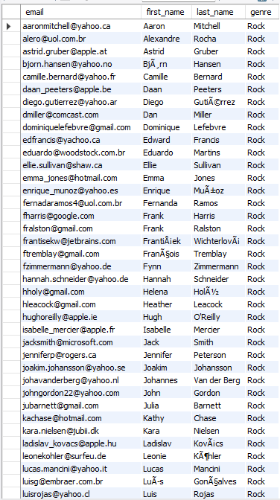
Q6. Email, first name, last name & genre of all Rock listeners
SQL QUERY
OUTPUT
SELECT DISTINCT c.email, c.first_name, c.last_name, g.name
AS genre
FROM customer c
JOIN invoice i ON c.customer_id = i.customer_id
JOIN invoice_line il ON i.invoice_id = il.invoice_id
JOIN track t ON il.track_id = t.track_id
JOIN genre g ON t.genre_id = g.genre_id
WHERE g.name = 'Rock'
ORDER BY c.email;
Result: All Rock-genre listeners listed, sorted by email.

Slide 14
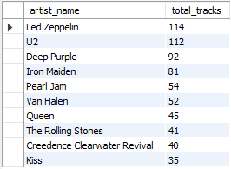
Q7. Top 10 Rock artists by number of tracks
SQL QUERY
OUTPUT
SELECT a.name AS artist_name,
COUNT(t.track_id) AS total_tracks
FROM artist a
JOIN album al ON a.artist_id = al.artist_id
JOIN track t ON al.album_id = t.album_id
JOIN genre g ON t.genre_id = g.genre_id
WHERE g.name = 'Rock'
GROUP BY a.artist_id, a.name
ORDER BY total_tracks DESC
LIMIT 10;
Result: Led Zeppelin, U2, Deep Purple dominate the Rock catalog.

Slide 15
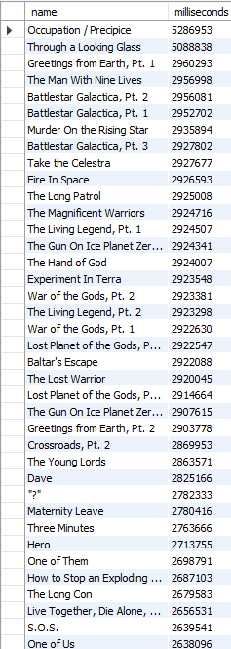
Q8. Tracks longer than the average song length
SQL QUERY
OUTPUT
SELECT name, milliseconds
FROM track
WHERE milliseconds > (
SELECT AVG(milliseconds) FROM track
)
ORDER BY milliseconds DESC;
Result: Longest tracks surfaced — classical & live recordings.

Slide 16
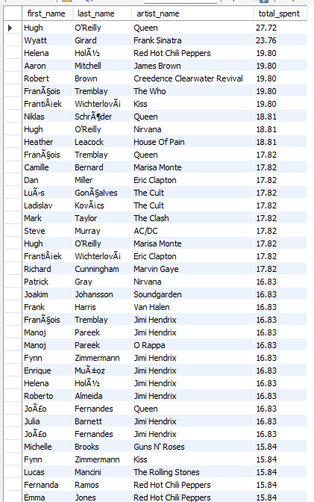
Q9. Amount spent by each customer on each artist
SQL QUERY
OUTPUT
SELECT c.first_name, c.last_name, a.name AS artist_name,
SUM(il.unit_price * il.quantity) AS total_spent
FROM customer c
JOIN invoice i ON c.customer_id = i.customer_id
JOIN invoice_line il ON i.invoice_id = il.invoice_id
JOIN track t ON il.track_id = t.track_id
JOIN album al ON t.album_id = al.album_id
JOIN artist a ON al.artist_id = a.artist_id
GROUP BY c.customer_id, c.first_name, c.last_name,
a.artist_id, a.name
ORDER BY total_spent DESC;
Result: Customer–artist spend matrix produced.

Slide 17
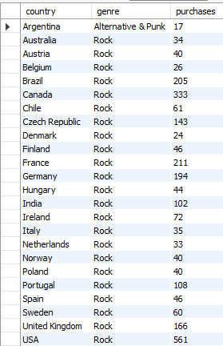
Q10. Most popular genre for each country (with ties)
SQL QUERY
OUTPUT
WITH country_genre AS (
SELECT i.billing_country AS country, g.name AS genre,
COUNT(*) AS purchases
FROM invoice i
JOIN invoice_line il ON i.invoice_id = il.invoice_id
JOIN track t ON il.track_id = t.track_id
JOIN genre g ON t.genre_id = g.genre_id
GROUP BY i.billing_country, g.name
),
ranked AS (
SELECT country, genre, purchases,
DENSE_RANK() OVER (PARTITION BY country
ORDER BY purchases DESC) AS rk
FROM country_genre
)
SELECT country, genre, purchases
FROM ranked
WHERE rk = 1
ORDER BY country;
Result: Rock dominates most countries; ties handled via DENSE_RANK.

Slide 18
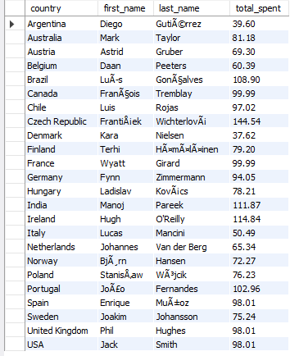
Q11. Top customer for each country (with ties)
SQL QUERY
OUTPUT
WITH country_customer AS (
SELECT i.billing_country AS country, c.customer_id,
c.first_name, c.last_name,
SUM(i.total) AS total_spent
FROM customer c
JOIN invoice i ON c.customer_id = i.customer_id
GROUP BY i.billing_country, c.customer_id,
c.first_name, c.last_name
),
ranked AS (
SELECT country, customer_id, first_name, last_name, total_spent,
DENSE_RANK() OVER (PARTITION BY country
ORDER BY total_spent DESC) AS rk
FROM country_customer
)
SELECT country, first_name, last_name, total_spent
FROM ranked
WHERE rk = 1
ORDER BY country;
Result: Top spender identified per country, including ties.

Slide 19
Key Findings
What the data revealed
TOP EMPLOYEE
DOMINANT GENRE
Mohan Madan (Senior GM, L7) leads the org chart.
Rock is the #1 genre across most countries.
BIGGEST MARKET
ROCK CATALOG
USA generates the highest number of invoices.
Led Zeppelin, U2 and Deep Purple top the track count.
FESTIVAL CITY
SPENDING PATTERN
Prague brings in the highest invoice revenue.
A small number of customers drive most of the revenue.

Slide 20
Challenges & Learnings
Things that taught me a lot during this project
01
Setting up MySQL Workbench and importing 11 CSVs in the right order.
02
Self-referencing foreign key on employee.reports_to blocked the import — had to drop and re-add.
03
Writing multi-table joins for Q6, Q7 and Q9 without losing the schema in my head.
04
Wrapping my head around CTEs + DENSE_RANK() for Q10 and Q11.
05
Debugging tiny issues like ASC vs DESC, snake_case column names and safe-update mode.

Slide 21
Conclusion
What we delivered and where this can go next
SUMMARY
KEY LEARNINGS
All 11 business questions answered using SQL — covering filtering, sorting, aggregations, multi-table joins, subqueries, CTEs and window functions like DENSE_RANK.
Strengthened understanding of relational design, joins, GROUP BY vs window functions, and the discipline of writing readable, reusable SQL.
BUSINESS VALUE DELIVERED
FUTURE IMPROVEMENTS
Identified top market (USA), best festival city (Prague), dominant genre (Rock), top spending customers, and most popular artists — directly usable by management.
Build a Power BI dashboard on these results, add date-based trend analysis, run cohort retention, and explore CASE-based customer segmentation (VIP / regular / churn-risk).
From raw CSVs to business decisions — SQL was the only tool we needed.

Slide 22
Q & A
I'd love to hear your questions.

Slide 23

THANK YOU

