Slide 1
CAPSTONE PROJECT
RECOMMENDATION TO IMPROVE SLEEP QUALITY SCORE

Slide 2
Executive Summary
The motivation of this project is to determine the top factors that impact Sleep Quality
This is an important subject since good sleep improves both Physical and Mental health
Not getting enough quality sleep regularly raises the risk of many disorders. These range from heart disease and stroke to obesity and dementia.
Exploring datasets, I realized several inputs are considered in determining Sleep Quality.
One of my goal using ML techniques was to determine 2 and no more than 3 factors that impact Sleep Quality.
My other goal was to ensure that the top factors are relatively easy for individuals to monitor and measure without requiring fancy gadgets. (e.g. HRV measurement would require a wearable and hence does not meet my criteria of top factor)

Slide 3
Data Pre-Processing Overview
I am using Sleep and Health Metrics data from https://www.kaggle.com/datasets/uom190346a/sleep-and-health-metrics, a fully synthetic collection with 1000 entries and 9 columns.
Using .info() method in Pandas I learnt that all of my data is numerical in float64 format
Using the Interquartile Range (IQR) method I removed outliers from the dataset.
Using pandas method drop_duplicates(), I removed duplicate frames from the data frame.
Using the pandas method dropna(), I removed the rows that contain NULL values.
Using trial and error as well as visualization techniques, I created a new data frame with only 2 input columns (sleep_duration_hours & caffeine_input_mg) and sleep_quality_score as the output column.

Slide 4
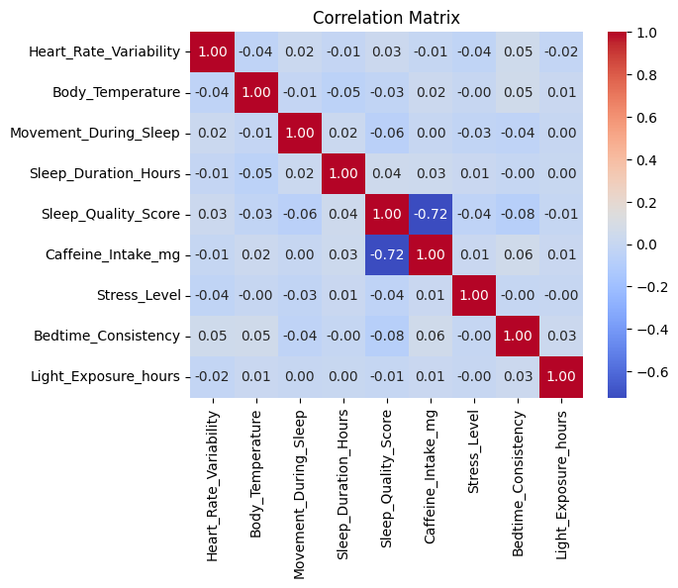
EDA Insights – Heat Map
I used Heat Map to visualize correlation of various input parameters impacting Sleep Quality Score. “Caffeine_Input_mg” has a high negative correlation with Sleep Quality Score. On the other hand, “Sleep_Duration_hours” has a positive correlation with Sleep Quality Score. This helped me identify the top factors that impact Sleep Quality Score!

Slide 5
EDA Insights – Scatter Plots
I plotted and compared 2 scatter plots (Caffeine Intake vs Sleep Quality and Sleep Duration Hours vs Sleep Quality) for both the complete data set and limited data set with only 2 input columns and 1 output column
The plots in both cases look similar as expected.
The scatter plot of Caffeine Intake clear demonstrates its negative correlation with Sleep Quality Score. To have sleep quality score 8 or better caffeine intake has to be less than 25mg!
The scatter plot of Sleep Duration is a bit hard to analyze, however, one can clearly see to have a Sleep Quality Score of 8 or better, Sleep Duration has to be 7.5 hours or higher!
I have attached the scatter plots in Appendix A.

Slide 6
EDA Insights – Histogram Plots
Appendix B contains 3 histograms (Sleep Quality Score, Caffeine Intake, and Sleep Duration Hours)
Sleep Quality Score histogram indicates majority of the samples or subjects have a low sleep score of 1. This is indicative of a widespread issue and reinforces my belief in importance of this matter.
There is another peak in Sleep Quality Score at a high value of 10. About 10% of the sample have a high score of 10. It might be interesting to understand the inputs of this group of individuals as role model values for others to adopt.
Roughly 15% of the sample size consume caffeine less than 25mg.
Sleep Duration histogram indicates that roughly half of the sample population sleeps more than 7.5hrs and other half sleeps less than that.

Slide 7
Modelling Results- Part 1
I used LinearRegression(), DecisionTreeRegressor() and RandomForestRegressor() to evaluate the models by comparing MSE, RMSE, R-Squared and MAE.
I compared the 3 models on both the original data frame as well as the reduced data frame with 2 inputs (Caffeine Intake and Sleep Duration) and one output(Sleep Quality Score)
Linear Regression model performed poorly on both data frames. Decision Tree performed better than Linear Regression but worse than Random Forest
COMPARISON OF MODELS ON 2 DATAFRAMES
 | Original Data frame |  |  | Reduced Data frame(2 inputs only)
Model Name | Linear Regression | Decision Tree Regression | Random Forest Regression | Linear Regression | Decision Tree Regression | Random Forest Regression
MSE | 4.05 | 0.14 | 0.07 | 4.08 | 0.19 | 0.09
RMSE | 2.01 | 0.37 | 0.26 | 2.02 | 0.44 | 0.31
R-Squared | 0.55 | 0.98 | 0.99 | 0.55 | 0.98 | 0.99
MAE | 1.66 | 0.16 | 0.11 | 1.66 | 0.19 | 0.13

Slide 8
Modelling Results- Part 2(Data Pre-Processing)
On the reduced data frame, I applied Data Pre-Processing as described in the earlier slide.
With Random Forest Regression model, I can see the improvement in MSE(44%), RMSE(26%), MAE(46%), however R-squared deteriorates by 10%.
In next slide I present techniques I tried to further improve the above metrics
COMPARISON OF MODELS before and after Data Pre-Processing
 | Reduced Data frame(2 inputs only) |  |  | Reduced Data frame after Data Pre-Processing
Model Name | Linear Regression | Decision Tree Regression | Random Forest Regression | Linear Regression | Decision Tree Regression | Random Forest Regression
MSE | 4.08 | 0.19 | 0.09 | 0.38 | 0.08 | 0.05
RMSE | 2.02 | 0.44 | 0.31 | 0.62 | 0.29 | 0.23
R-Squared | 0.55 | 0.98 | 0.99 | 0.18 | 0.83 | 0.89
MAE | 1.66 | 0.19 | 0.13 | 0.45 | 0.08 | 0.07

Slide 9
Modelling Results- Part 3(PCA)
First I tried Ridge, Lasso and Elastic regularization techniques but this did not improve the metrics.
I also tried logarithmic and polynomial transformation technique which also did not improve the metrics
Finally, I tried PCA technique to create uncorrelated Principal Components. VIF for Caffeine Intake was >5 and for Sleep Duration Hours was >10. This suggested high multicollinearity requiring attention. After applying PCA, I saw improvement in MSE(99%), R-Squared(11%) and MAE(90%) using the same Random Forest Regression model.
 | Data frame after cleaning without PCA | Data frame after cleaning and PCA
Metrics | Random Forest Regression | Random Forest Regression
MSE | 0.05 | 0.0006
RMSE | 0.23 | 0.23
R-Squared | 0.89 | 0.99
MAE | 0.07 | 0.007

Slide 10
CONCLUSION & NEXT STEPS
Through this project I was able to determine the top 2 factors that impact Sleep Quality Score. They happen to be Sleep Duration & Caffeine Intake.
Random Forest Regression Model gave me the best results in terms of low error and a high R-Squared value indicating model prediction closer to the actual data.
While regularization and transformation did not yield desirable outcome, PCA greatly improved my model’s performance.
After applying the model prediction, I created a filtered output for Sleep Duration and Caffeine Intake for Sleep Quality prediction greater than 8. I recommend a minimum of 4hrs and an average of 7.5hrs of sleep. I also recommend caffeine intake should not exceed 28mg and recommend an average of 5mg. (See Appendix A)
As a next step I will explore advance techniques that I learnt recently to explore CNN and LSTM to determine Sleep Apnea.

Slide 11
APPENDIX A: Sleep Duration and Caffeine Intake for predicted sleep quality score of greater than 8
index | Sleep_Duration_Hours | Caffeine_Intake_mg | Sleep_Quality_Score | forest_pred
std | 1.44 | 8.54 | 0.63 | 0.54
min | 3.91 | 0.0 | 7.12 | 8.19
25% | 6.70 | 0.0 | 9.36 | 9.48
mean | 7.57 | 5.06 | 9.61 | 9.63
50% | 7.61 | 0.0 | 10.0 | 9.95
75% | 8.64 | 9.51 | 10.0 | 9.99
max | 10.90 | 28.34 | 10.0 | 10.0
count | 121.0 | 121.0 | 121.0 | 121.0

Slide 12
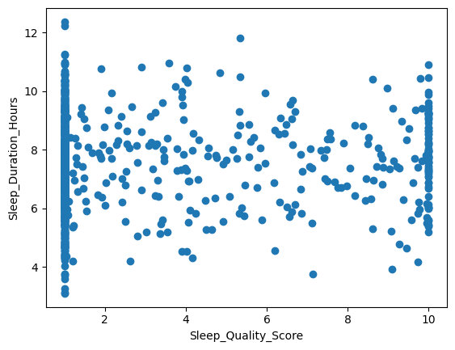
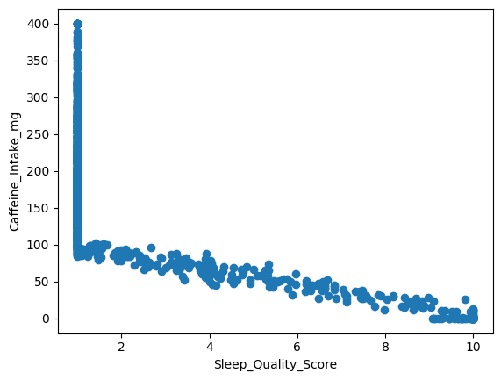
APPENDIX B: SCATTER PLOTS

Slide 13
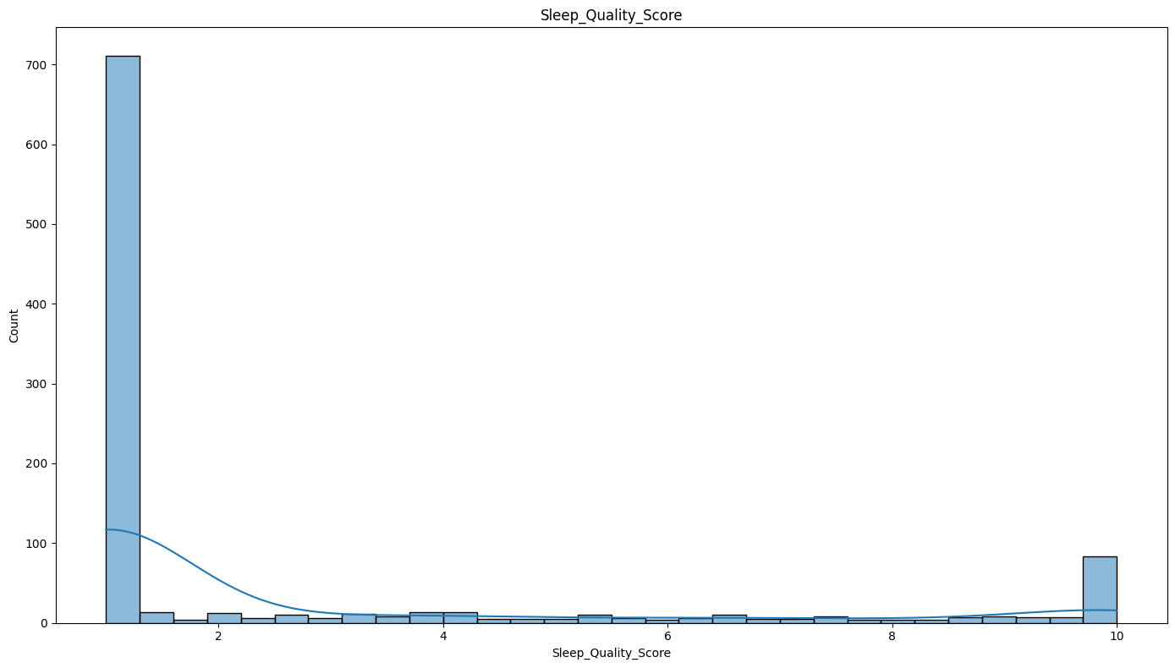
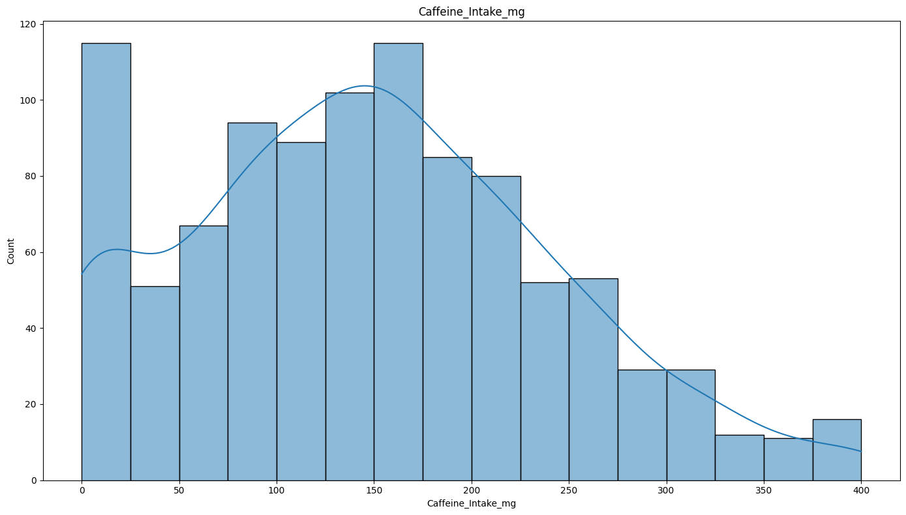
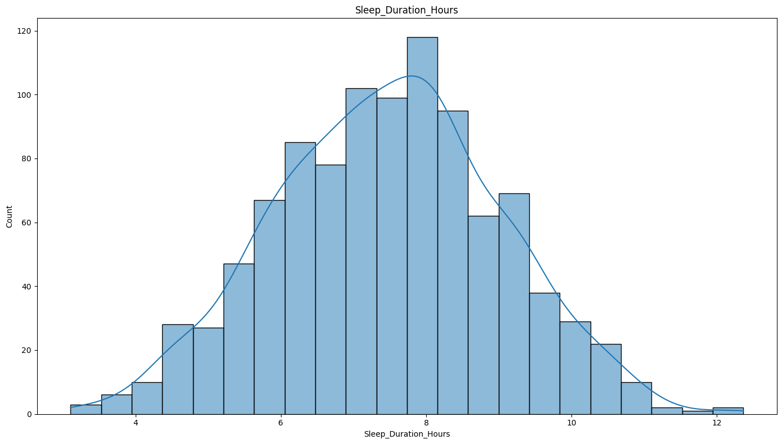
APPENDIX C: HISTOGRAM PLOTS

Slide 14
APPENDIX D: ML Glossary
Principal Component Analysis (PCA) is a dimensionality reduction technique that transforms high-dimensional data into a lower-dimensional space while preserving as much variance (spread) as possible, simplifying data for analysis and visualization.
Variance Inflation Factor (VIF) is a metric used to quantify the severity of multicollinearity in regression models, indicating how much the variance of a regression coefficient is inflated due to the correlation between predictor variables
In machine learning, logarithmic features are transformations of data using the logarithm function, often used to address skewed data distributions and improve model performance, while polynomial features are new features created by raising existing features to powers, enabling models to capture non-linear relationships.
Regularization techniques in machine learning, like L1 Lasso and L2 Ridge regularization are used to prevent overfitting and improve a model's ability to generalize to unseen data by adding a penalty term to the loss function, encouraging simpler models. Lasso adds a penalty to the loss function proportional to the absolute value of the model coefficients. Ridge adds a penalty proportional to the square of the model coefficients. Elastic Net Combines both L1 and L2 regularization penalties.

