Slide 1
MY JOURNAL TO PYTHON
Name: 菲利浦 – John Philip R. Almonia Teacher: My Great Teacher

Slide 2
AGENDA
- Python - Input and output - Data types: numerisc strings, list, disc - Operators ON data type:

Slide 3
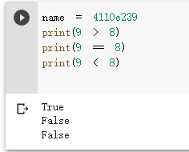
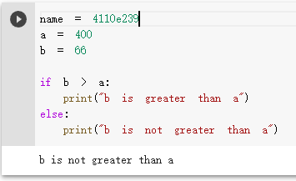
DATA TYPES: Booleans
Boolean Values
- In programming you often need to know if an expression is True or False.
- You can evaluate any expression in Python, and get one of two answers, True or False.
- When you compare two values, the expression is evaluated and Python returns the Boolean answer:
When you run a condition in an if statement, Python returns True or False:

Slide 4
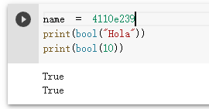
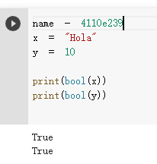
Evaluate Values and Variables
- The bool() function allows you to evaluate any value, and give you True or False in return,
Example Evaluate a string and a number:
Example
Evaluate two variables:

Slide 5
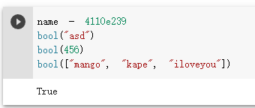
Most Values are True
- Almost any value is evaluated to True if it has some sort of content.
- Any string is True, except empty strings.
- Any number is True, except 0.
- Any list, tuple, set, and dictionary are True, except empty ones.
Example
The following will return True:

Slide 6
Some Values are False
- In fact, there are not many values that evaluate to False, except empty values, such as (), [], {}, "", the number 0, and the value None. And of course the value False evaluates to False.
Example
The following will return False:

