Slide 1
Image processing
Nubayat Ahmed and Jack Phalen

Slide 2
Introduction
This project recreates the findings from “Performance Enhancement of Image Filtering on GPU Using CUDA” by B. Ramadasu (2014), focusing on how GPU parallel processing improves the speed and efficiency of image filtering.
The main goal is to implement and compare two key image processing techniques: Gaussian blur for smoothing and Sobel edge detection for feature extraction. Both are tested on CPU and GPU architectures using CUDA.
The project measures execution-time improvements achieved through GPU acceleration and checks that the GPU-generated results remain consistent with those from the CPU.
This recreated system highlights how CUDA uses massive data parallelism, where thousands of threads handle pixels at once—cutting computation time drastically for large, high-resolution images.
All code can be found at https://github.com/jayphay/ImageProcessing.git

Slide 3
Background and Motivation
As technology continues to evolve, the speed of computation defines how efficiently we process information. Every image filter and visual algorithm depends on the ability to handle millions of pixels quickly and accurately. This project explores how GPU parallel computing with CUDA can transform image processing performance.
Traditional CPU-based methods execute tasks sequentially, while GPUs allow thousands of threads to process pixels at the same time. This shift from serial to parallel computing changes both speed and design, turning computation into a coordinated effort rather than a single task.
Building on the work of B. Ramadasu (2014), our goal was to reproduce and extend earlier findings by integrating shared-memory optimization. This improvement minimizes global memory access and increases efficiency while maintaining identical accuracy to the CPU results.
Ultimately, the motivation behind this project is to demonstrate how deeper hardware-level understanding can lead to meaningful advances in performance, showing that small architectural changes can yield significant real-world impact.

Slide 4
Design Methods
Used both CPU and GPU implementations to test accuracy and show speedup of using GPU
Blur and edge detection kernels both use a convolution matrix to process each pixel in the image
Kernels are called with block dimensions of 16x16 and grid dimensions based on the width and height of the image
  Width/16, height/16 grid size

Slide 5
Gaussian Blur
Special type of filter that gives a weighted average of a pixel's magnitude and its neighbors
Average vs weighted average
1 | 1 | 1
1 | 1 | 1
1 | 1 | 1
0 | 1 | 0
1 | 4 | 1
0 | 1 | 0

Slide 6
Gaussian Blur cont
The kernel first checks if the convolution matrix is fully in bounds
If it is, it then loops 9 times (convolution matrix is 3x3) and calculates the value each pixel will add to the magnitude
Value is found by multiplying the main pixel's neighbor's values by the specified amount in the convolution matrix
  Ex. The top left neighbor will be multiplied by the value at [0,0] in the convolution matrix
The values are added to a sum variable and then the final value is stored in the output image

Slide 7

Edge Detection
Similar process as before: 3x3 convolution mask over the pixel being processed
Slight difference: 2 masks now: one calculates changes from left to right and the other finds changes from top to bottom
These results are combined by finding the magnitude of the two values
Horizontal mask and vertical mask
-1 | 0 | 1
-2 | 0 | 2
-1 | 0 | 1
1 | 2 | 1
0 | 0 | 0
-1 | -2 | -1

Slide 8
Improvements
To enhance the original CUDA implementation, we introduced shared-memory optimization for both the Gaussian blur and Sobel edge detection kernels.Shared memory allows each block of threads to load small image tiles from global memory into a fast on-chip buffer, reducing redundant global memory accesses.
In the baseline GPU version, each thread fetched neighboring pixels directly from global memory, leading to repeated reads for overlapping convolution regions.The shared-memory version instead loads a (BLOCK_SIZE + 2) × (BLOCK_SIZE + 2) tile per block, including halo pixels, so adjacent threads can reuse data locally..
These optimizations reduced memory latency and improved cache efficiency while maintaining identical visual and numerical accuracy with the CPU and baseline GPU results.
Measured results confirmed that the shared-memory approach achieved an additional ~1.5× speedup over the standard GPU implementation, lowering total execution time from roughly 0.06 ms → 0.04 ms, and over 18,000× faster than CPU processing on the same high-resolution image.
The final system now runs and saves six outputs (CPU, GPU, and Shared GPU), providing a clear visual and quantitative comparison of how memory hierarchy optimization in CUDA can drastically improve real-world image filtering performance

Slide 9
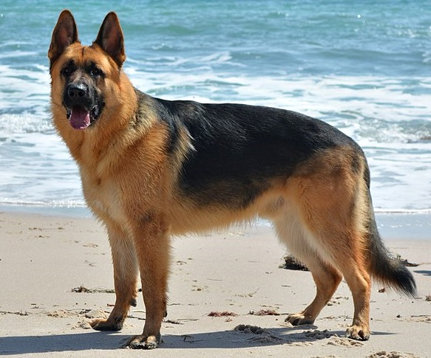
Results
Input image

Slide 10
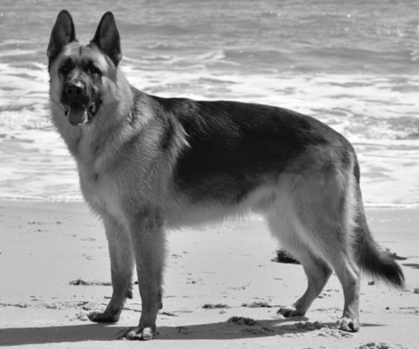
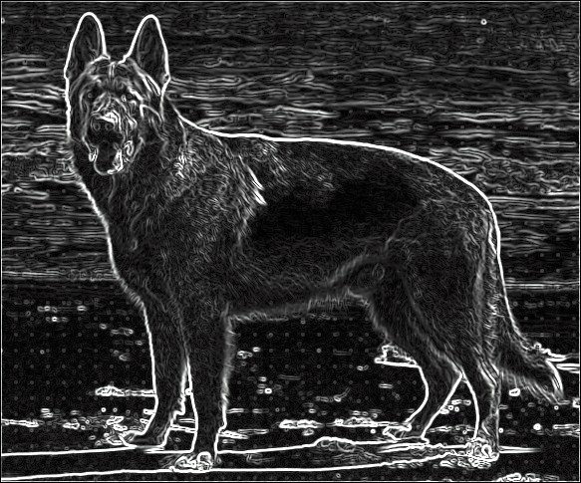
Results cont
Blur and edge detection outputs

Slide 11

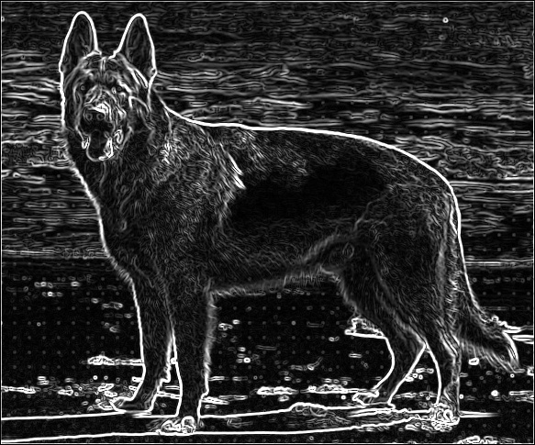
Results cont.
Shared + blur and edge detection

Slide 12
Results cont
===== RESULT COMPARISON =====
Blurred Image Mismatch: 0 / 282755 (0.0000%)
Edge Image (GPU) Mismatch: 0 / 282755 (0.0000%)
Edge Image (Shared) Mismatch: 17972 / 282755 (6.3560%)
===== PERFORMANCE SUMMARY =====
Gaussian Blur Speedup: 18056.24x
Sobel Edge Speedup: 272.77x
Overall GPU Speedup: 13466.95x
Shared GPU Speedup: 20873.78x

Slide 13
Results cont.
Saved CPU outputs:
-> blur_output_CPU.jpg
-> edge_output_CPU.jpg
Saved GPU outputs:
-> blur_output_GPU.jpg
-> edge_output_GPU.jpg
Saved Shared GPU outputs:
-> blur_output_SharedGPU.jpg
-> edge_output_SharedGPU.jpg
-> edge_output_SharedGPU.jpg
===== PROGRAM COMPLETE =====

Slide 14
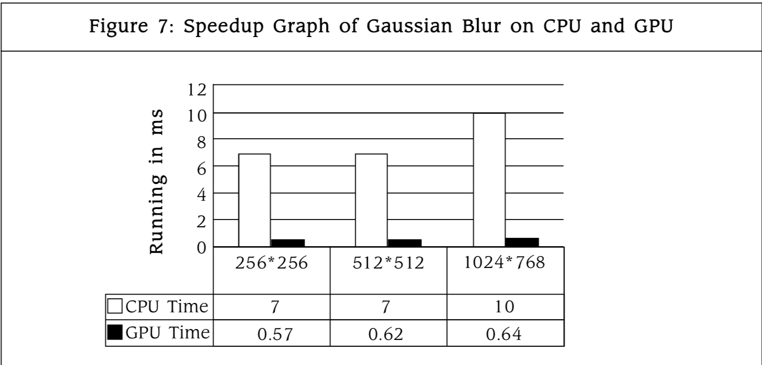
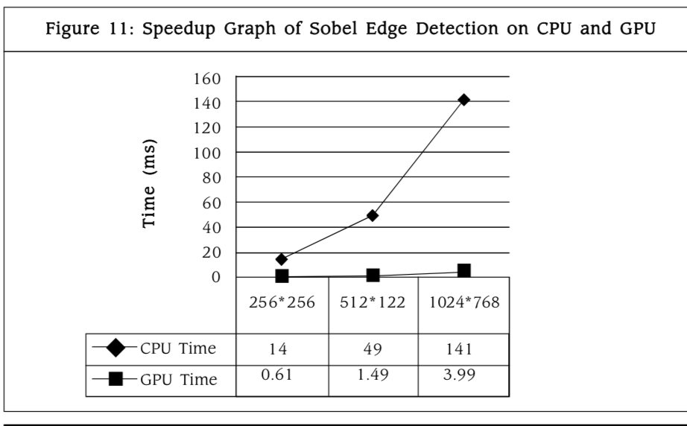
Comparison of original paper
Original paper results
Our results showed better performance gains than even the original paper got, though this is most likely due to better hardware and not necessarily better optimization
The paper shows speedup factors of 20x for the blur and we got over 10,000x speedup for the blur over many tests in our testing

Slide 15
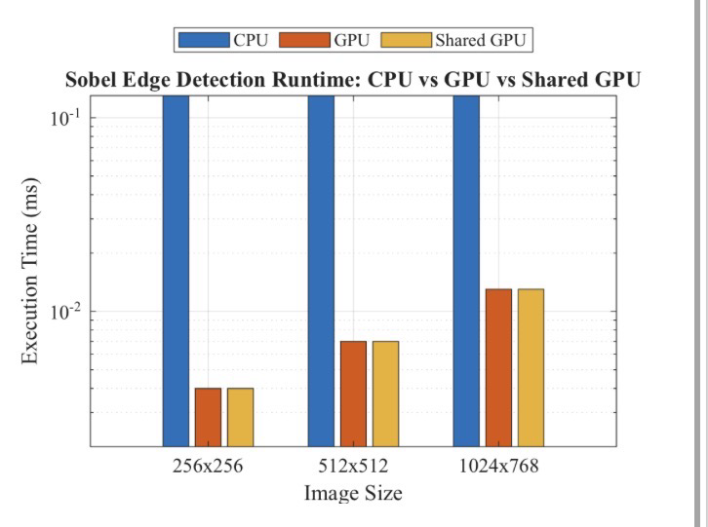
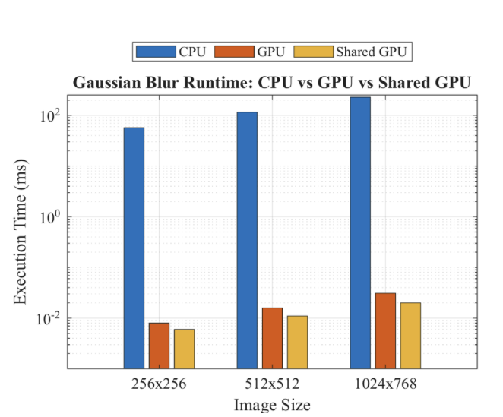
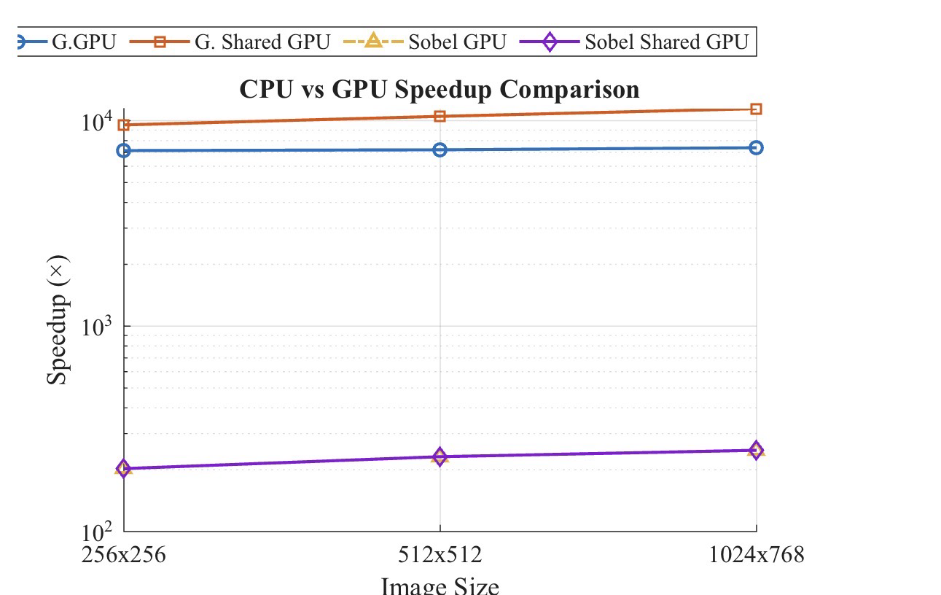
Comparison countinued
Via Matlab

Slide 16
References
Ramadasu, B. (2014). Performance Enhancement of Image Filtering on GPU Using CUDA. International Journal of Advanced Research in Computer and Communication Engineering (IJARCCE), 3(11), 8472–8476.
[Available online via ResearchGate / IJARCCE archives]
NVIDIA Corporation. (2024). CUDA C Programming Guide. NVIDIA Developer Documentation.
Retrieved from https://docs.nvidia.com/cuda/
MathWorks. (2024). MATLAB Documentation: Plot and Visualization Functions.
Retrieved from https://www.mathworks.com/help/matlab/
OpenCV Team. (2024). OpenCV 4.0+ Reference Manual.
Retrieved from https://docs.opencv.org/
GitHub Repository: Image Processing GPU Acceleration (Recreation).
Available at https://github.com/jayphay/ImageProcessing.git

