Slide 1
Autonomous Cognitive Machine (Cognix)
A Multi-Agent AI System for Intelligent Task Execution and Report Generation
Presented by:
Sikun Kumar Rout
Guided by:
Vikash Ranjan
Cognix AI Project Presentation | Slide 1

Slide 2
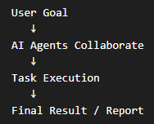
Introduction
Project Overview
Artificial Intelligence (AI) helps computers solve problems and make decisions.
Traditional systems follow fixed rules and cannot easily handle new situations.
Multi-Agent Systems use multiple AI agents that work together to complete tasks.
Cognix is an AI-based system that uses different agents to plan, execute, review, and generate results automatically.
Key Technologies :
LangGraph
LangChain
Mistral AI
Streamlit
LangSmith
Cognix AI Project Presentation | Slide 2

Slide 3
Problem Statement
Why this system is needed
Problem Statement :
Traditional AI System face the following limitations :
Provide only single-step responses.
Struggle with complex multi-step tasks.
Lack specialization for different task types.
Do not include proper validation and reporting.
Proposed Solution :
Cognix uses multiple AI agents to :
Plan tasks
Execute actions
Review outputs
Generate reports automatically
Cognix AI Project Presentation | Slide 3

Slide 4
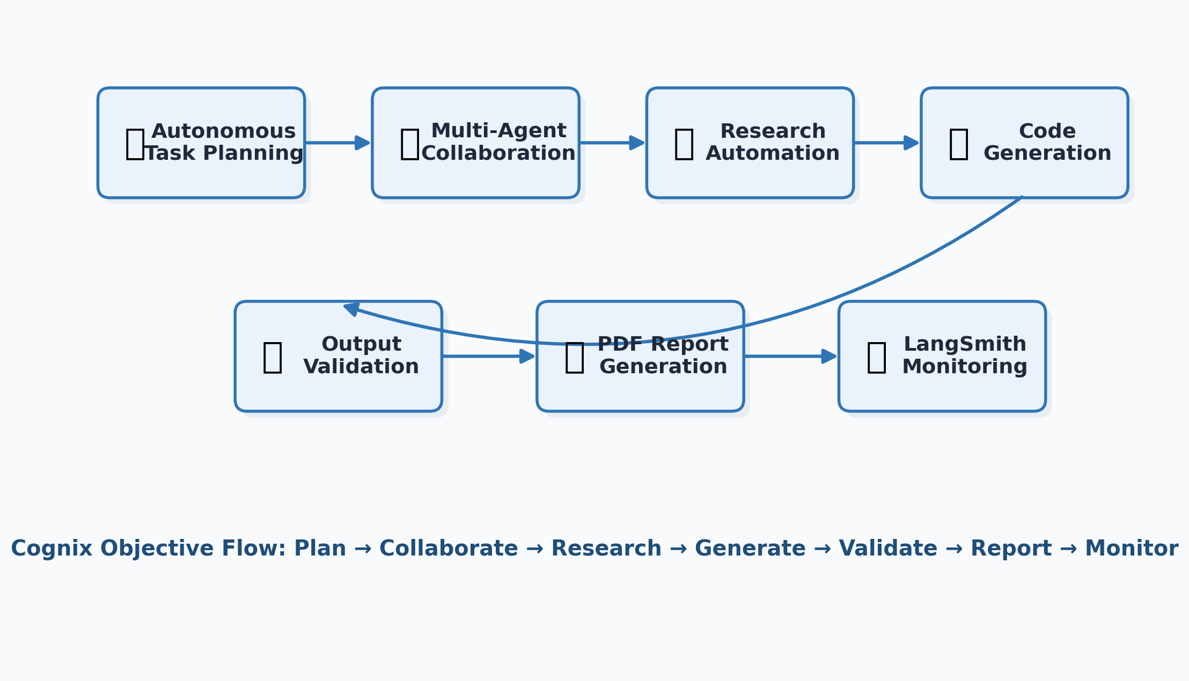
Objectives of the Project
Main goals of Cognix
Autonomous Task Planning
Multi-Agent Collaboration
Research Automation
Code Generation
Output Validation
PDF Report Generation
Workflow Monitoring using LangSmith
Cognix AI Project Presentation | Slide 4

Slide 5
Technology Stack
Core tools and frameworks
Python – Backend development and workflow logic.
Streamlit – Interactive user interface.
LangGraph – Multi-agent workflow Management.
LangChain – LLM integration and prompt handling.
LangSmith – Monitoring the Project.
Mistral AI – Language model for reasoning and generation.
Tavily API – External research and information retrieval.
ReportLab – PDF report generation.
Cognix AI Project Presentation | Slide 5

Slide 6
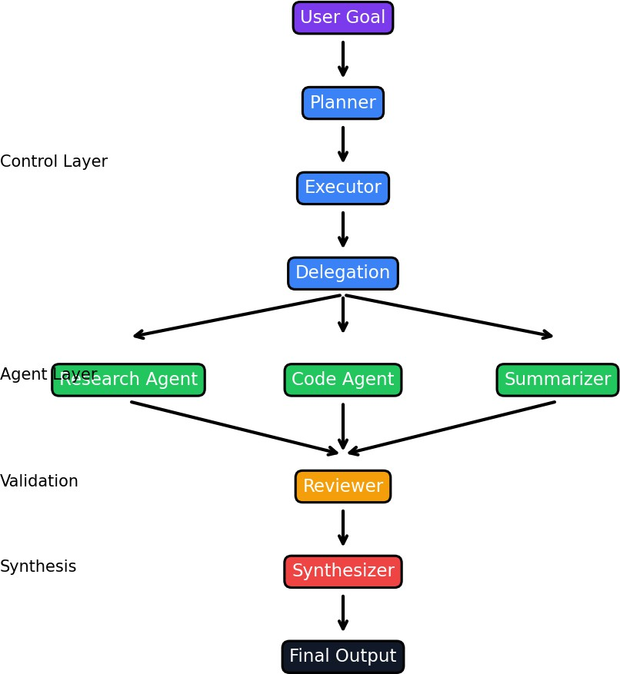
System Architecture
Main components
Planner Agent:
Generates TODO tasks from user goals.
Executor Agent:
Executes tasks sequentially.
Delegation Layer:
Routes tasks to the correct agent.
Research, Code, and Summarizer Agents:
Perform specialized work.
Reviewer Agent:
Vlidates generated outputs.
Synthesizer Agent:
Generates the final report.
Cognix AI Project Presentation | Slide 6

Slide 7
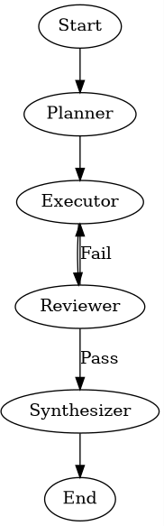
Workflow of Cognix
End-to-end execution process
1. User enters a goal in the Streamlit interface.
2. Planner Agent creates structured tasks.
3. Executor Agent processes tasks one by one.
4. Delegation Layer sends tasks to specialized agents.
5. Reviewer validates outputs.
6. Synthesizer prepares final report.
Cognix AI Project Presentation | Slide 7

Slide 8
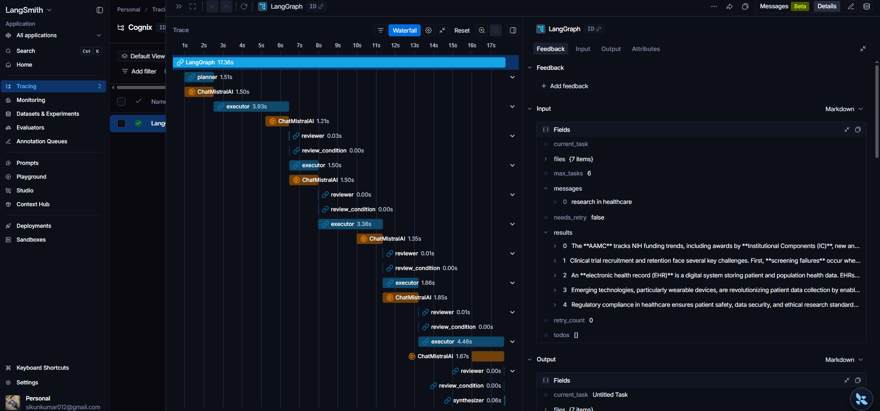
LangSmith Monitoring and Tracing
LangSmith Integration
Features :
Workflow Tracing
Agent Monitoring
Execution Tracking
Performance Analysis
Debugging Support
Benefits :
Easy monitoring
Error detection
Performance optimization
Better workflow visibility
Cognix AI Project Presentation | Slide 8

Slide 9
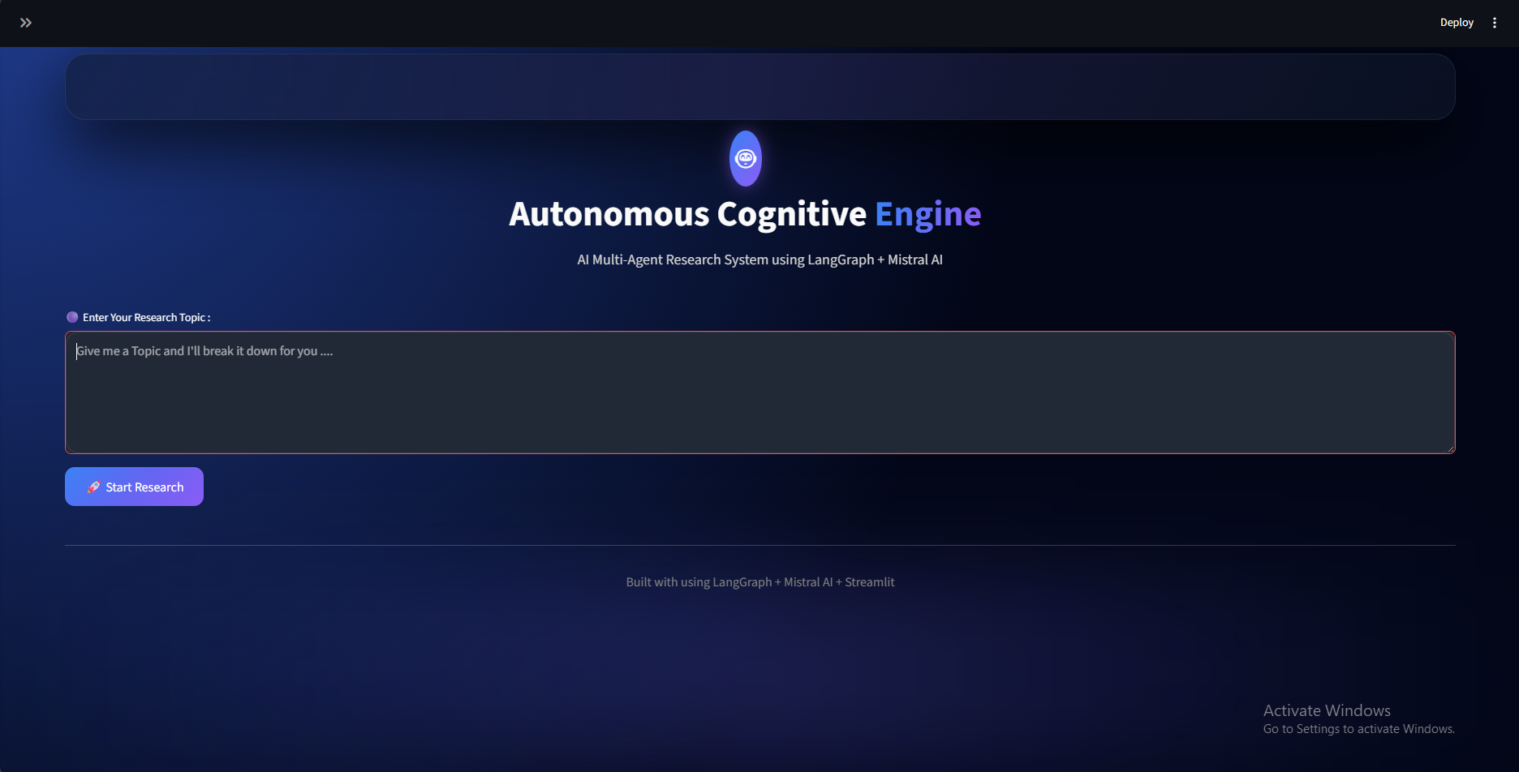
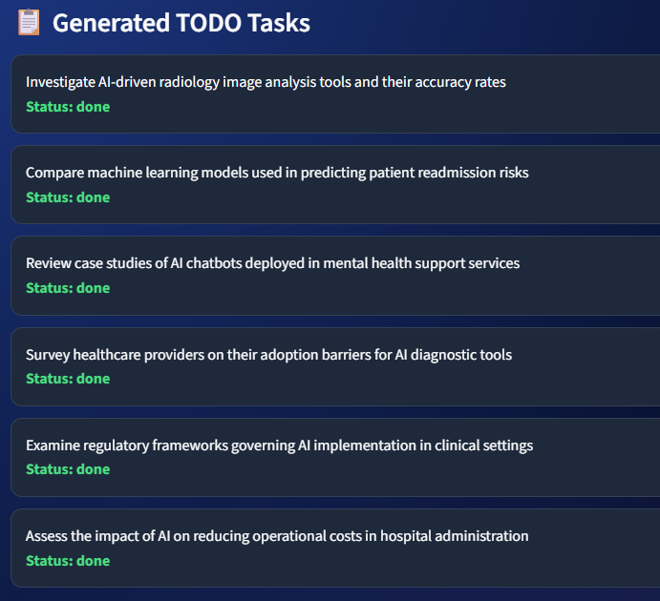
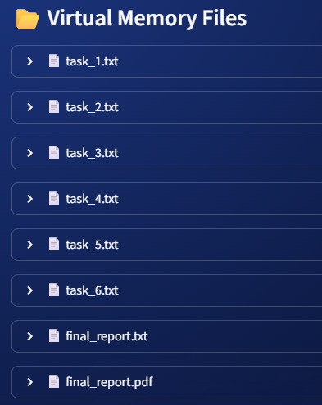
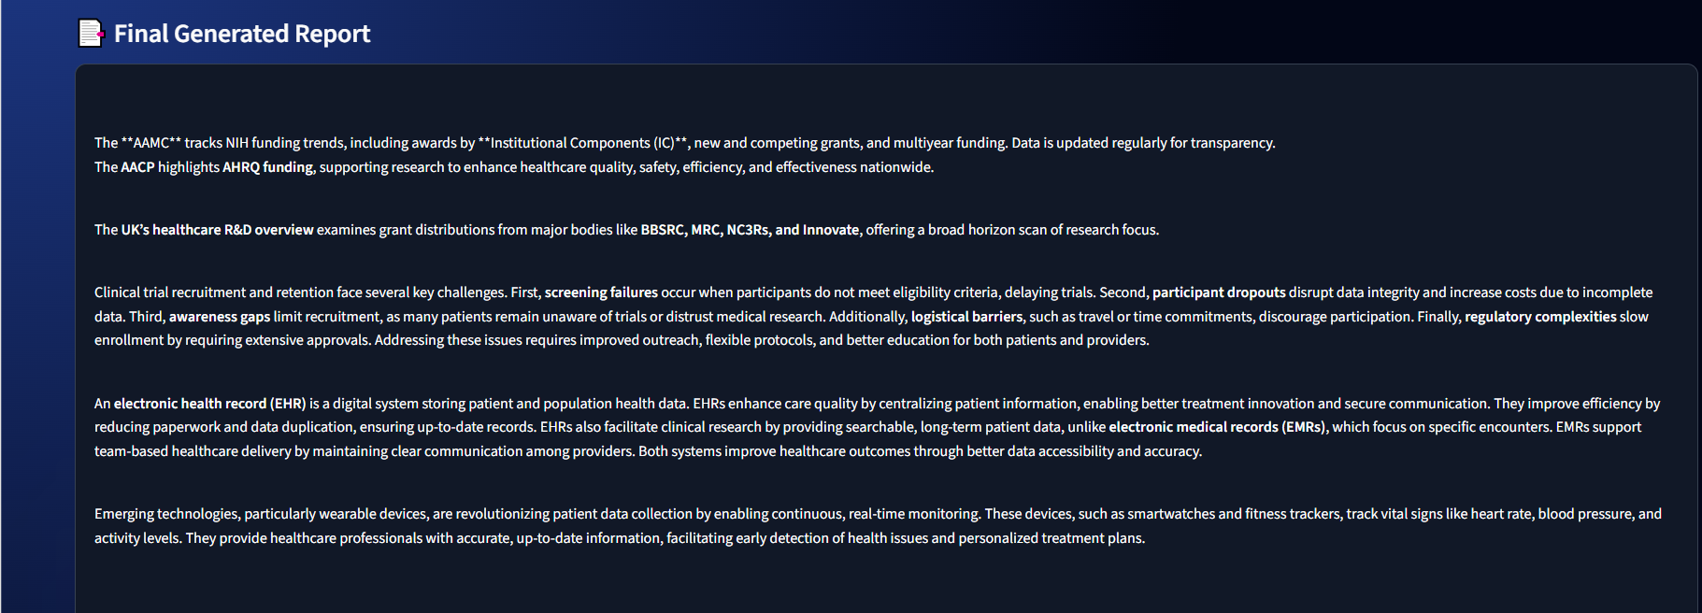
Results and Outputs
Results Obtained
Successfully Implemented :
Multi-Agent Workflow
Task Planning
Research Automation
Code Generation
Output Validation
PDF Report Generation
LangSmith Monitoring
Cognix AI Project Presentation | Slide 9

Slide 10
Advantages & Future Scope
Observed system performance
Advantages :
Reduced Manual Effort
Intelligent Task Execution
Better Workflow Management
Scalable Architecture
Improved Output Quality
Future Scope :
More Specialized Agents
Voice-Based Interaction
Cloud Deployment
Multimodal Inputs
Long-Term Memory Support
Cognix AI Project Presentation | Slide 10

Slide 11
Conclusion
Final Outcome
Cognix successfully demonstrates an Autonomous Cognitive Multi-Agent System.
Multiple agents collaborate to perform planning, execution, validation, and synthesis.
LangGraph and LangSmith enable efficient workflow orchestration and monitoring.
The project demonstrates the practical application of Agentic AI in real-world problem solving.
Cognix AI Project Presentation | Slide 11

Slide 12
Thank You
Presented by:
Sikun Kumar Rout
Cognix AI Project Presentation | Slide 12

