Slide 1
METROLINK TRANSIT SERVICES
Public Transport Insight | Business pitch | Rounds 2–4
Objective: understand passenger demand by route, stop, day and time.
Dataset: synthetic 12-week operating sample; 8 routes; fixed random seed for reproducibility.
Decision focus: align capacity with demand and address recurring reliability hotspots.

Slide 2
Executive readout
Key results from the synthetic analysis
Top route: R01 — Central Loop (188,995 passenger movements).
Peak demand period: PM Peak (510,292 movements).
Weekend average daily demand is 52.2% lower than weekday demand.
Event days show 25.6% event-weekend difference vs non-event weekends.
Highest average delay: R06 (17.8 minutes).

Slide 3
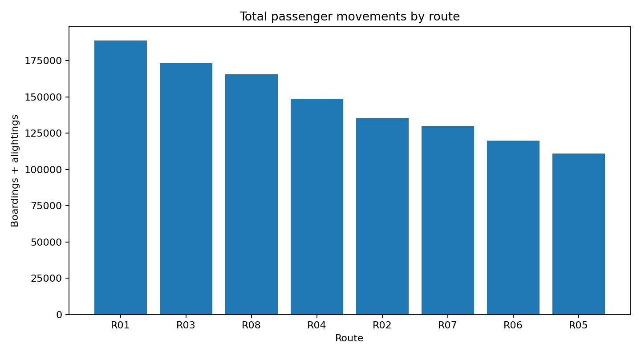
Route demand is concentrated
R01 is the highest-volume route. Protect capacity on high-demand corridors and use load monitoring to identify overcrowding.

Slide 4
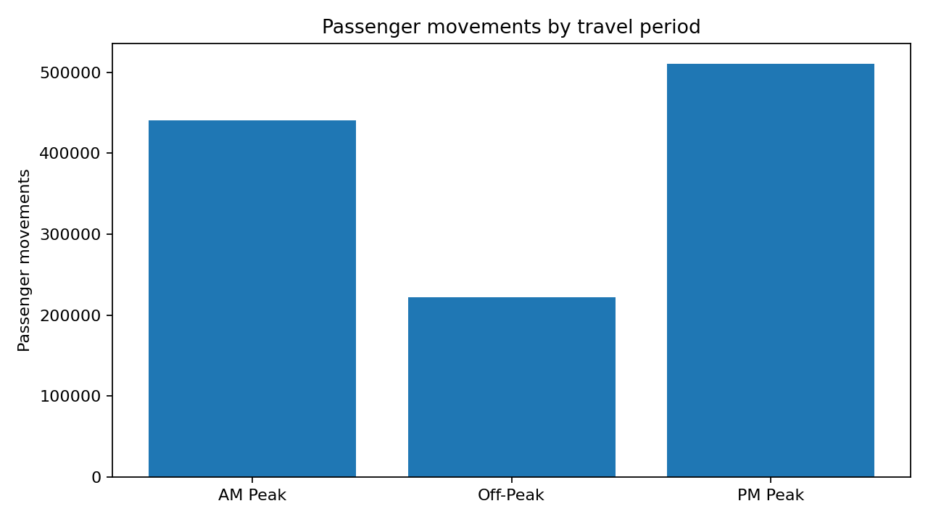
Peak periods shape the service plan
PM Peak carries the largest passenger movement volume. Match dispatch frequency and vehicle size to peak demand; avoid uniform all-day scheduling.

Slide 5
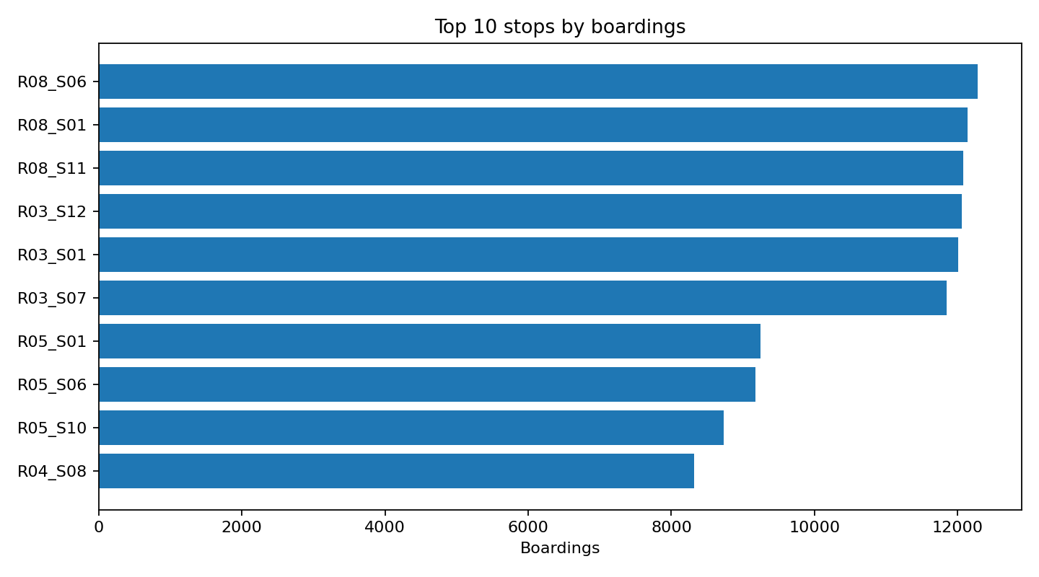
Stop-level demand points to targeted investment
R08_S06 is the leading boarding location in the prepared sample. Review queueing, shelter, accessibility and dwell time at the busiest stops.

Slide 6
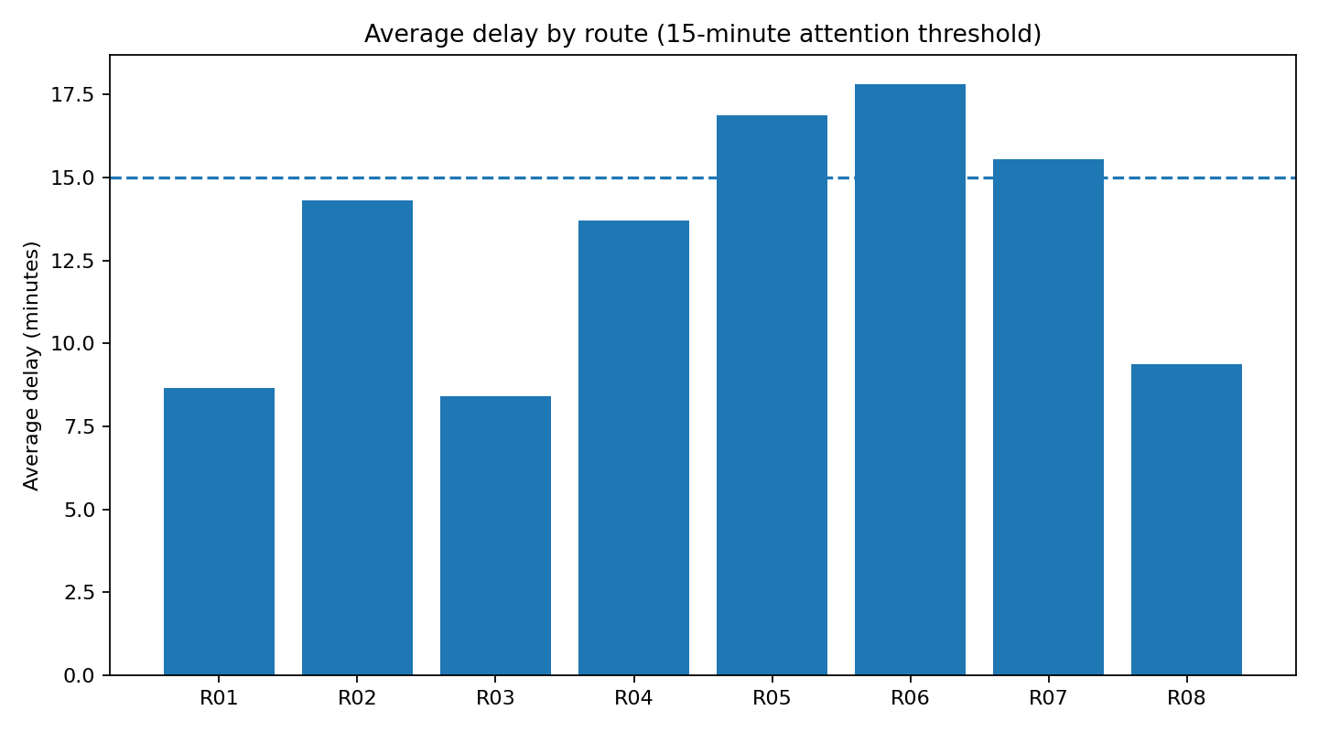
Reliability needs a route-specific response
R06 has the highest mean delay. Audit schedule padding, congestion exposure, terminal recovery time and recurring incident windows.

Slide 7
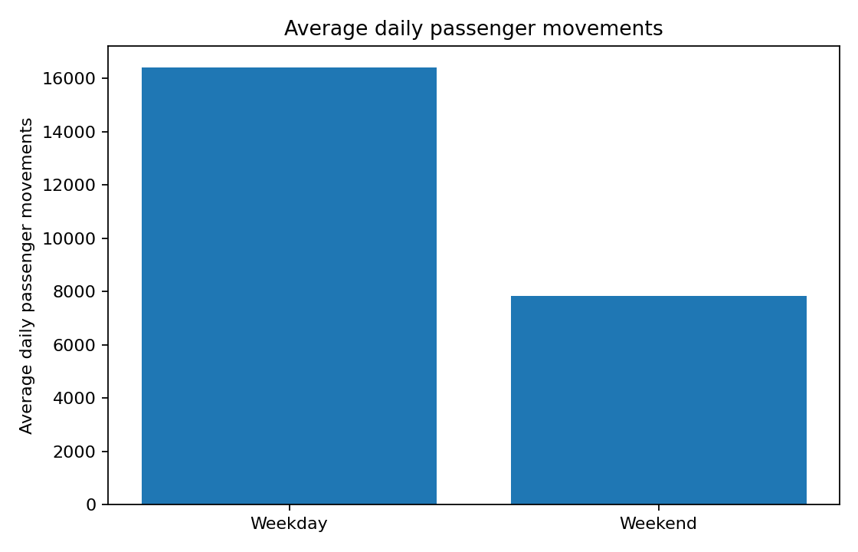
What the demand pattern means
Weekday/weekend and event-day comparison
Average weekday: 16,411 passenger movements/day.
Average weekend: 7,838 passenger movements/day.
Event weekends vs non-event weekends: 25.6% (small event sample; directional only).
Use calendar-led service overlays for major events rather than permanently increasing baseline capacity.

Slide 8
Recommended management actions
1. Demand-led scheduling: prioritize extra peak trips on the highest-volume routes; review loads by trip and direction before reallocating fleet.
2. Stop upgrades: conduct passenger counts and queue/dwell audits at the top boarding stops; prioritize shelter, signage and safe pedestrian access.
3. Reliability sprint: investigate the highest-delay routes using GPS/AVL traces, congestion hotspots and terminal recovery times; track on-time performance weekly.
4. Event operations: integrate event calendars with temporary frequency, standby vehicles and post-event dispatch plans.
5. Measurement: pilot changes for 4–6 weeks and compare boardings, crowding, completion rate and average delay against baseline.

Slide 9
Data, limitations and next steps
This is a synthetic dataset built to demonstrate the requested analytics workflow; results are not claims about an actual transit operator.
Event days are few, and event uplift is an association—not proof of causation.
The supplied Excel workbook includes cleaned data, summary tables, formulas and charts. Summary tables are pivot-style aggregations; refreshable native Excel PivotTable objects are not authored by the workbook-generation library used here.
Before deployment, replace synthetic inputs with validated ticketing, APC, AVL, route, calendar and incident data; then repeat the analysis and validate recommendations.

