Slide 1
Predicting Heart Disease
Aaron Correya, Abhishu Rawka, Austin Mooney, Jay Raavi

Slide 2
Project Overview
Using data, we will try to predict whether or not a person has heart disease.
We will use these machine learning models:
Logistic Regression
K-Nearest Neighbors
Neural Network
Visualize the data and analyze the results

Slide 3

What is Heart Disease?
Heart disease describes a range of conditions that affect the heart
Damage to the heart or blood vessels by atherosclerosis
Buildup of fatty plaques in your arteries
Caused by unhealthy living habits or heart defects
Early detection is essential to battling the disease
Machine learning can help save lives!

Slide 4
Our Data Attributes
AGE
SEX
CP: chest pain type
TRESTBPS: resting blood pressure
CHOL: serum cholesterol
FPS: fasting blood sugar
RESTECH: resting electrocardiographic results
THALACH: maximum heart rate achieved
EXANG: exercise induced pain
OLDPEAK: ST depression induced by exercise relative to rest
SLOPE: the slope of the peak exercise
CA: number of major vessels (0-3)
THAL: (3 = normal; 6 = fixed defect; 7 = reversible defect)
TARGET: (1 or 0)

Slide 5
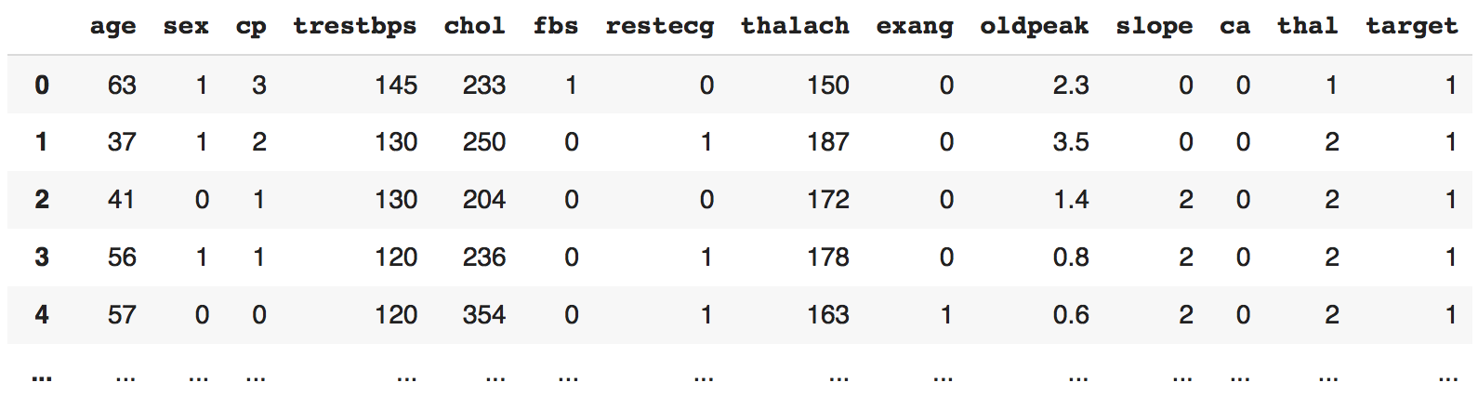

Slide 6
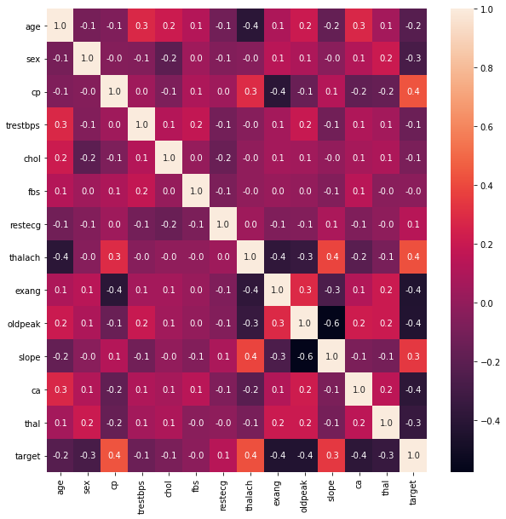
Correlation Matrix

Slide 7
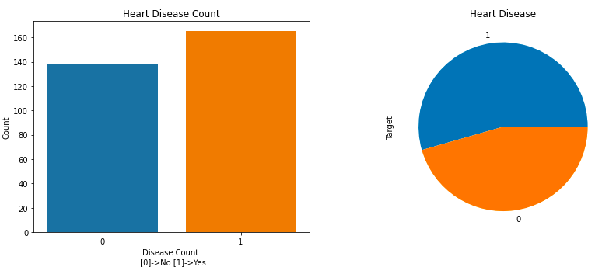
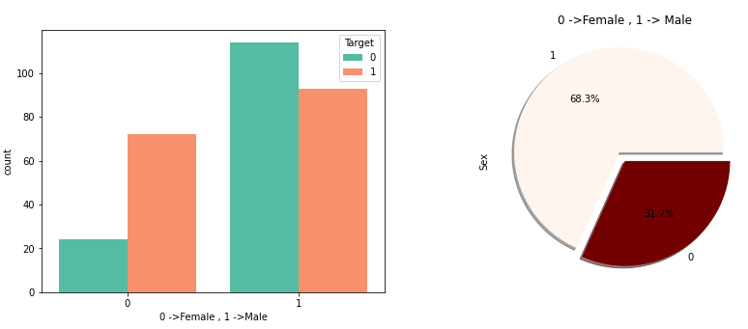

Slide 8
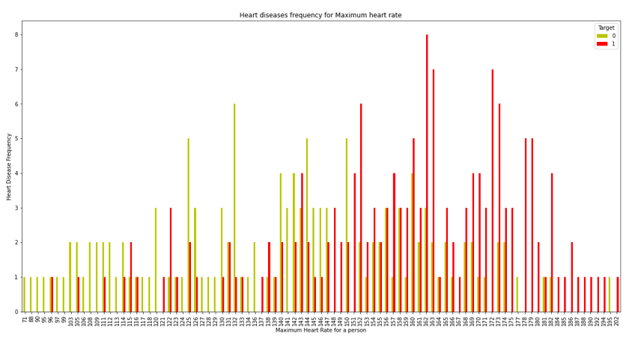
Maximum Heart Rate vs. Heart Disease Frequency

Slide 9
Data Cleanup
For the most part, the data was clean.
Removed all NaN values
Turned categorical data points into numerical (‘cp’, ‘thal’, ‘slope’).
Replaced ‘?’ with mean value.

Slide 10
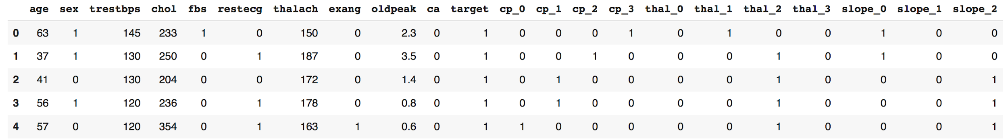
Final Data Set
Normalized the values
80% training, 20% testing, split randomly

Slide 11
Machine Learning Models

Slide 12
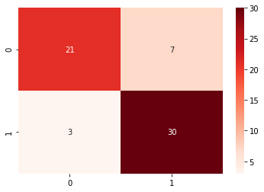
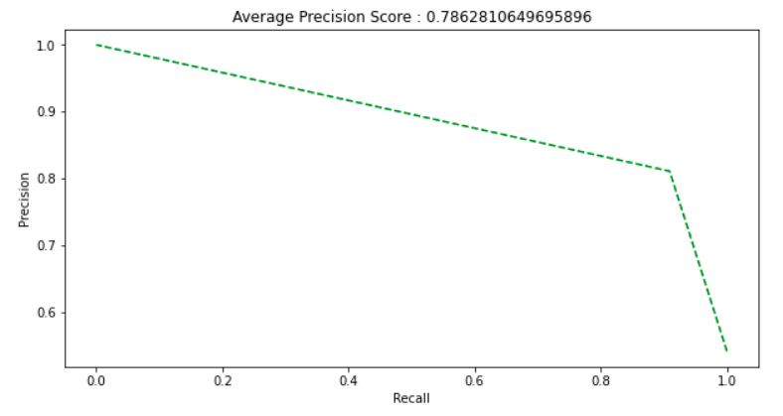
Logistic Regression
Used in place of linear regression when trying to predict categorical value instead of discrete
Similar to linear regression, but uses decision boundary and different cost function to transform discrete result into categorical
Fits well with binary data like ours

Slide 13
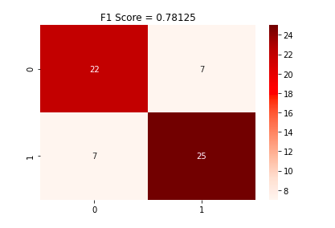
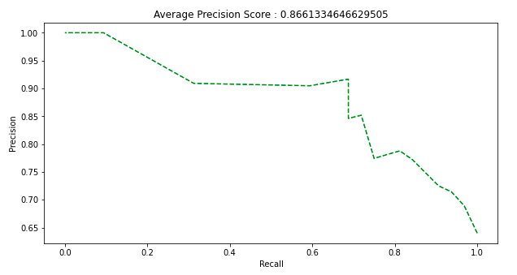
K-Nearest Neighbors
First, we have to split the data into training and testing sets.
Xtrain,Xtest,Ytrain,Ytest = train_test_split(data_scaled, data_label, test_size=0.20, random_state=217)
Then we have to pick a k value that gives us the highest accuracy. In this case, our highest accuracy k value is 17.
for i in range(1, 20):
k=KNeighborsClassifier(algorithm='auto',n_neighbors= i)
score_k=CrossVal(Xtrain, Ytrain.values.ravel(), k)
print('{} : {}'.format(i, score_k))
Next we apply our KNN using this k value, and fit the value.
k=KNeighborsClassifier(algorithm='auto',n_neighbors= 17)
k.fit(Xtrain,Ytrain)

Slide 14
Neural Network - Binary Classification
Three layers were used for the sequential model.
model = models.Sequential()
model.add(layers.Dense(16,activation='relu', input_shape=(trainAttr.shape[1],)))
model.add(layers.Dense(16,activation='relu'))
model.add(layers.Dense(1, activation='sigmoid'))
We also used binary_crossentropy, as it was ideal for binary classification.
model.compile(optimizer='rmsprop',loss='binary_crossentropy', metrics=['accuracy'])

Slide 15
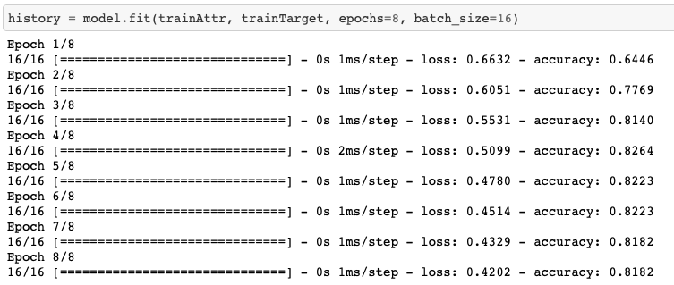
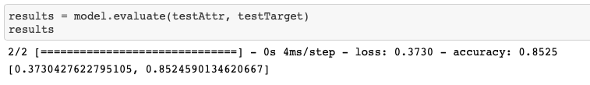
Neural Network - Binary Classification

Slide 16
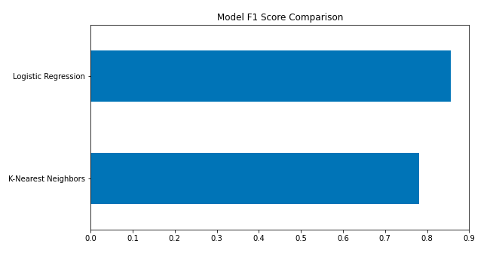
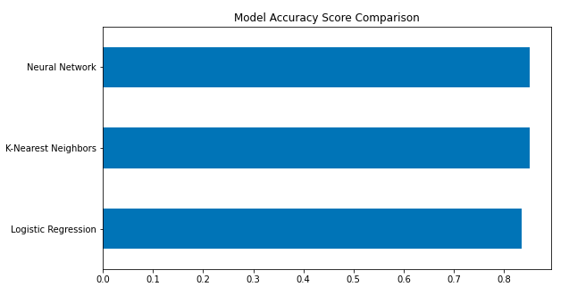
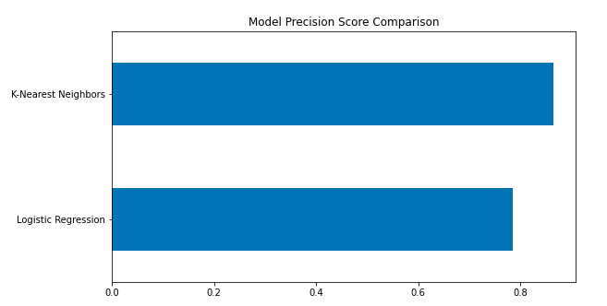
Model Analyses

Slide 17
Major Obstacles
Type of Regression
Finding a good dataset
Virtual Scheduling
We couldn’t use linear regression on binary data.
Therefore, we opted to do a logical regression instead.
We found that out after doing our linear regression, it was a minor setback.
We switched our project datasets multiple times.
Tough to find a quality dataset that had data we related to.
It was difficult to find a time that we were all free.
Working on the same coding file together caused interruptions.

Slide 18
What we learned
Our conclusions are dependant on which evaluation metric is most sought after
For accuracy, the neural network or KNN is the best
For Precision, KNN has the highest value
For F1 Score, Logical Regression is the best bet
Overall, it seems that KNN gives the best results but all three machine learning models offer benefits

