Slide 1

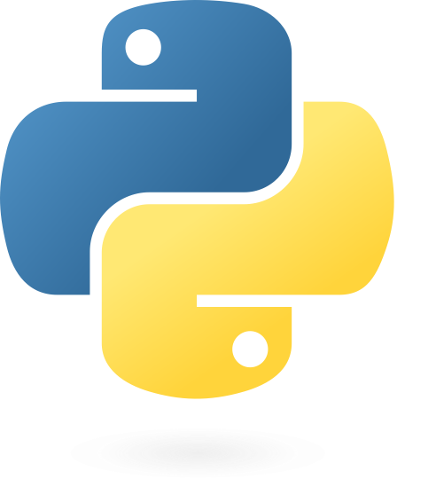




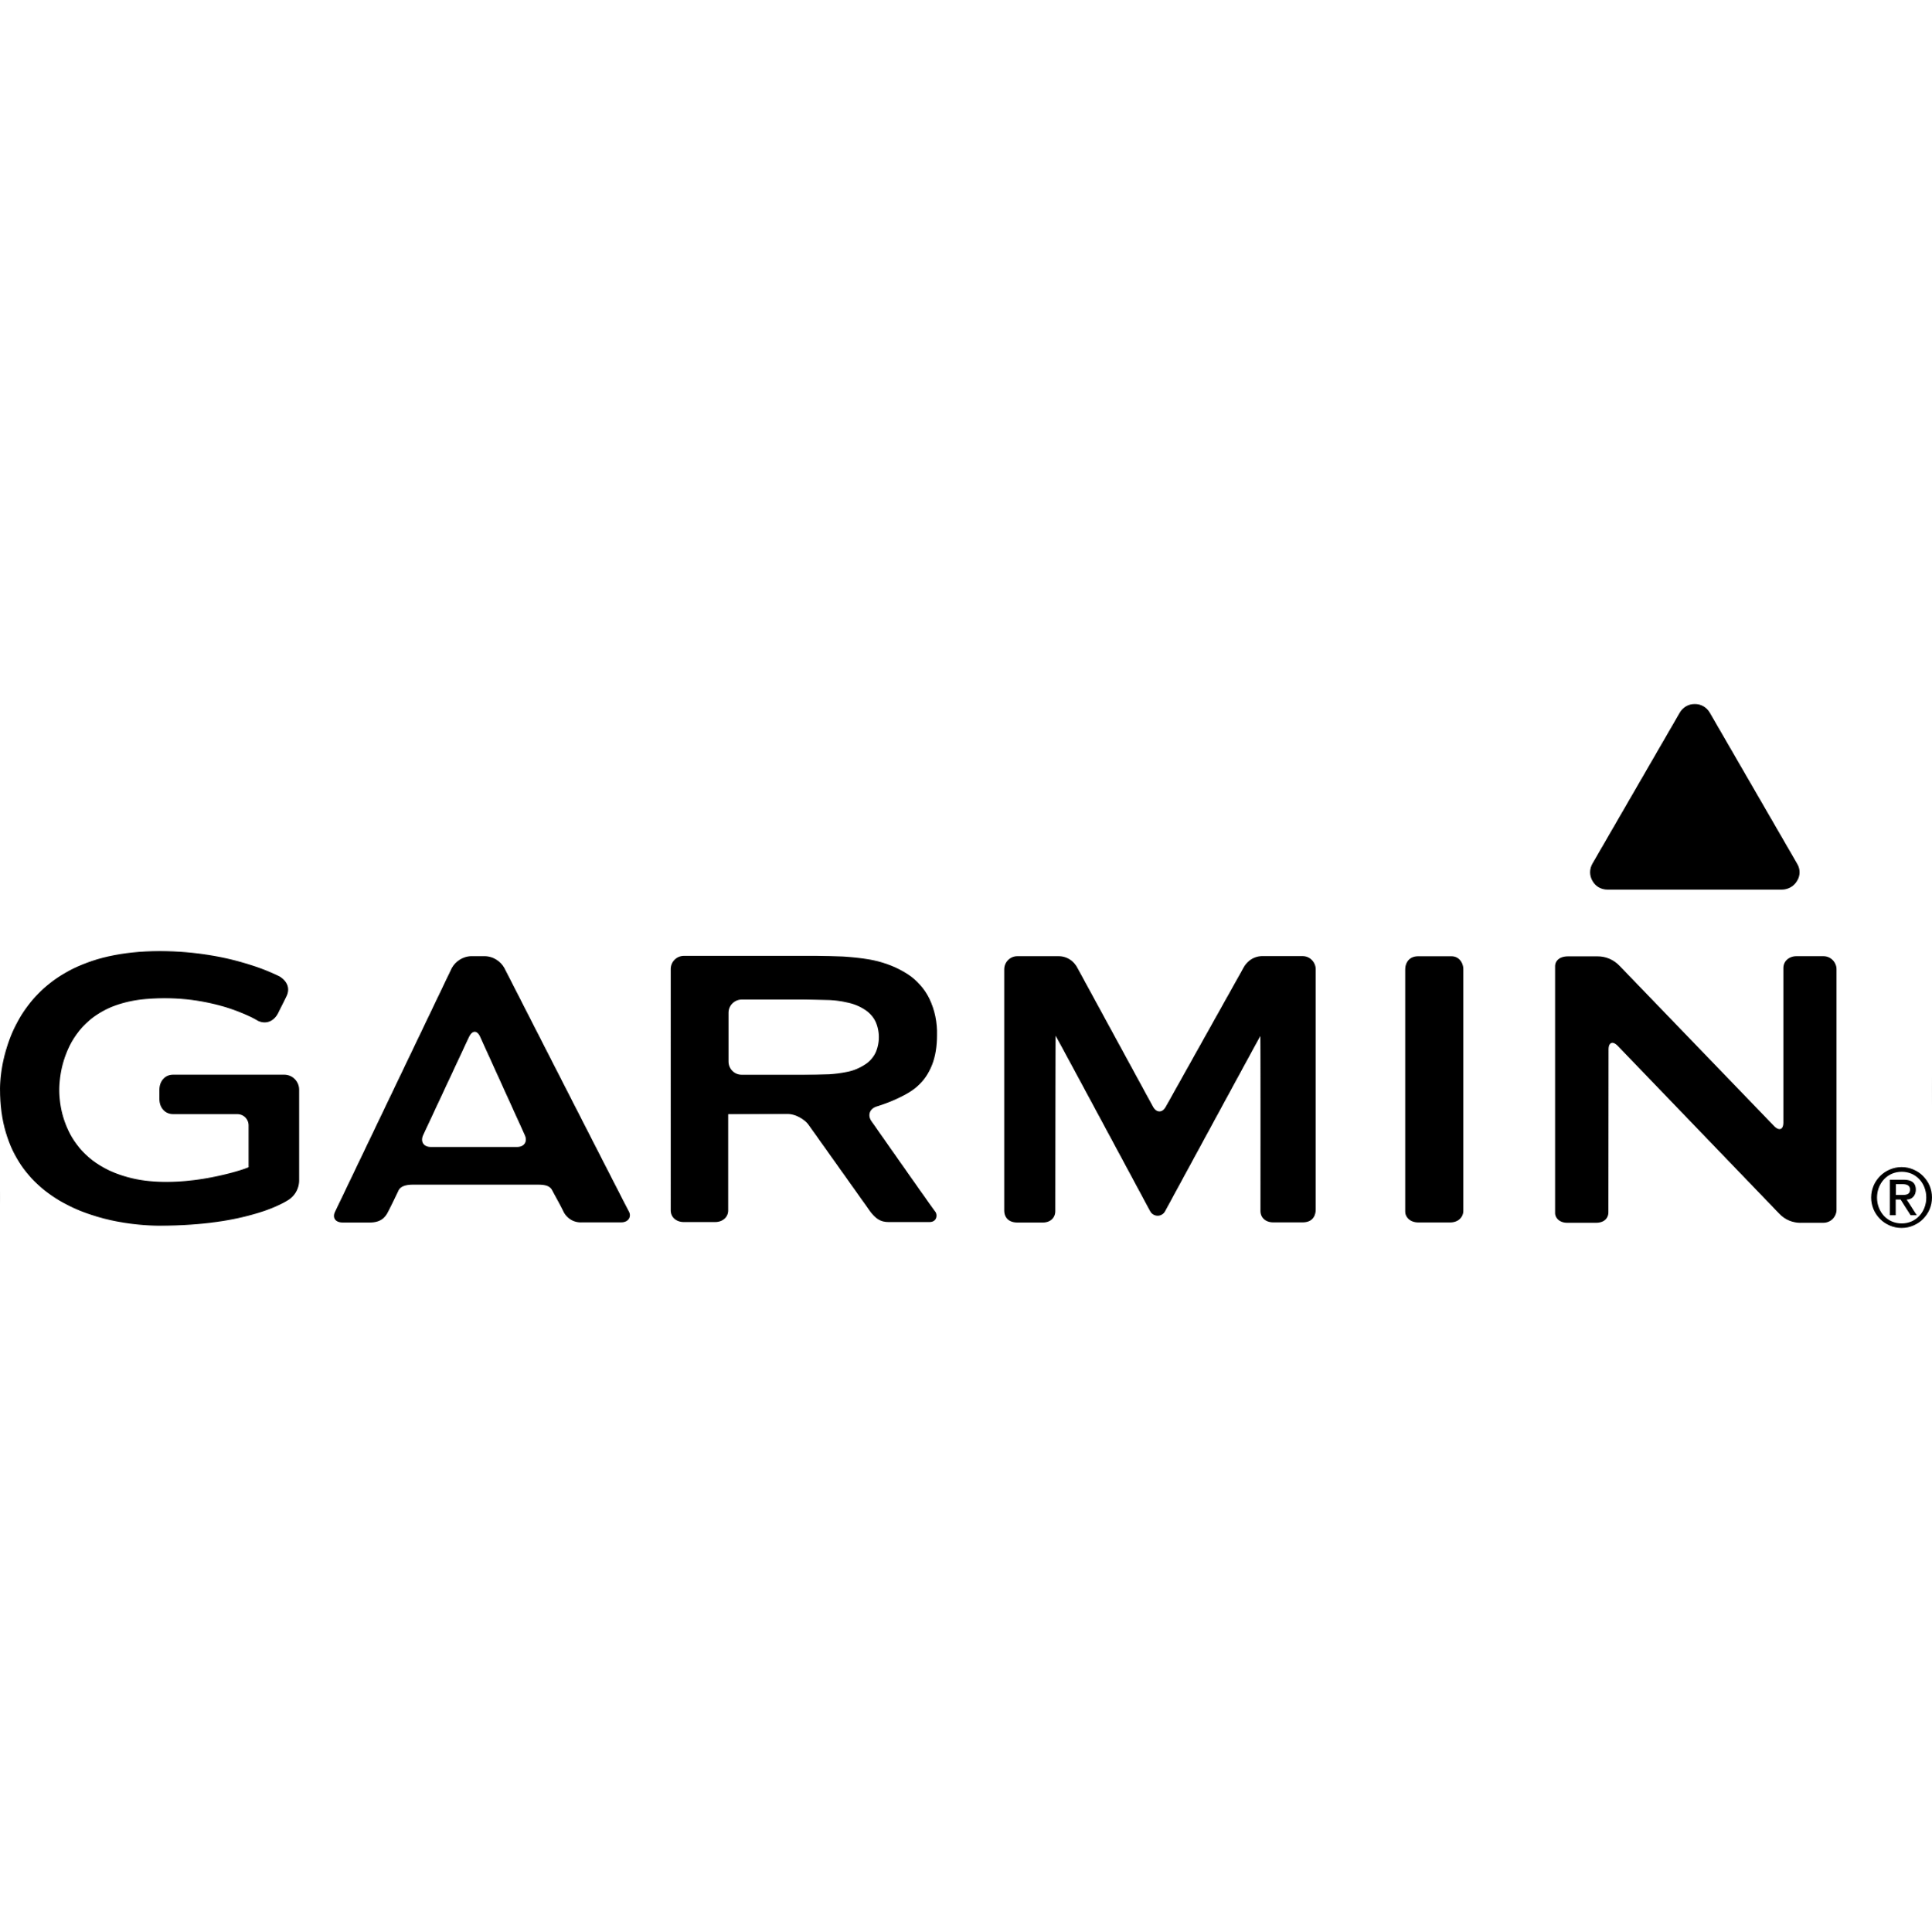

Data Ingestion
Data Manipulation
Weighing Scale
Data Storage
Data
Consumption
Python packages
Containing functions for data manipulations
Functions from packages are called in jupyter notebooks for staging data
MyFitness Pal
AWS S3
Garmin Watch
Samsung Health

