Slide 1
LoveDA Semantic Segmentation Challenge
Chavda JayrajSinh (2021CSB1078)
Imrozepal Singh (2021CSB1096)

Slide 2
Motivation
The Land-cOVEr Domain Adaptive semantic
segmentation (LoveDA) dataset was created to provide land-cover semantic segmentation
and unsupervised domain adaptation (UDA) tasks. Exploring the use of deep transfer
learning methods on this dataset will be a meaningful way to promote city-level or national-
level land-cover mapping.
The initial version of the dataset was created by Junjue Wang, Zhuo Zheng, Ailong Ma, Xiaoyan Lu, and Yanfei Zhong, most of whom were researchers at the Wuhan University.

Slide 3
Objective
Given:
A set of input images and corresponding semantic masks representing land-cover types: background – 1, building – 2, road – 3, water – 4, barren – 5,forest – 6, agriculture – 7. And the no-data regions were assigned 0.
A set of test images
Aim:
To return the set of corresponding semantic masks.

Slide 4
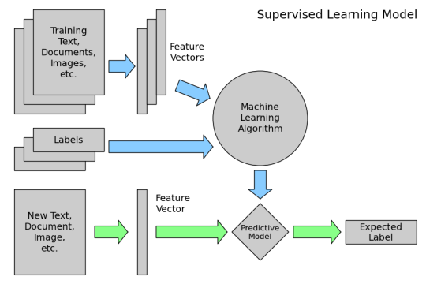
Machine Learning
Instead of relying on predefined rules, machine learning enables systems to automatically learn and improve from data.
A model is randomly initialised and trained on a dataset, which consists of input data and corresponding outputs.
The training process involves an optimization algorithm that adjusts the model's parameters to minimize a given loss function which is a measure of how poorly the model performed.

Slide 5
Usage of Machine Learning in given problem
The set of train images and corresponding masks are given as input to train the model.
After sufficiently trained, the model can be used to make predictions on test images.
In given problem, specifically, convolutional neural network (CNN) has been utilised.
A Convolutional Neural Network (CNN) is a specialized type of deep neural network designed to process and analyse visual data, such as images or videos. CNNs are particularly effective for tasks like image classification, object detection, and image segmentation.

Slide 6
CNN
CNNs incorporate convolutional layers, which perform convolution operations on the input data.
Convolution involves sliding a small filter or kernel over the input image and computing the dot product between the filter and the local receptive field at each position
The fundamental difference between a densely connected layer and a convolution layer is that dense layers learn global patterns whereas the latter learns local patterns.
Local patterns are more important in given problem, hence CNN is more appropriate.

Slide 7
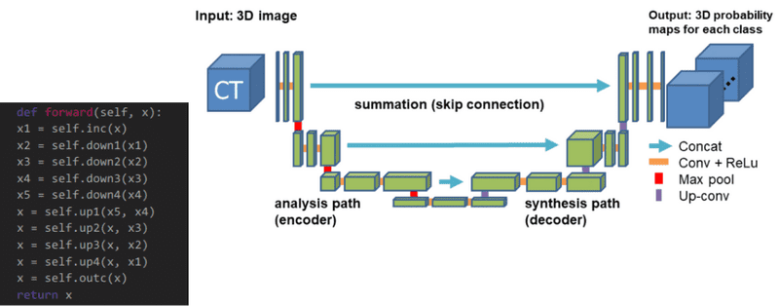
U-Net CNN
U-Net has a U-shaped architecture.
It consists of an encoder and a decoder, connected by a bottleneck layer.
The encoder captures context and extracts high-level features
The decoder generates the segmentation map.
The skip connections allow information to flow between corresponding layers of the encoder and decoder.

Slide 8
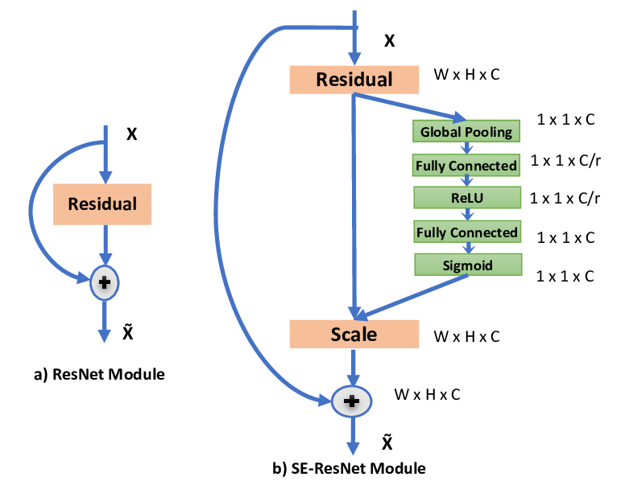
ResNet CNN
ResNet (Residual Network) is a CNN architecture designed to address the challenge of training very deep networks where adding more layers can lead to performance degradation.
It introduces residual connections, allowing information to bypass one or more layers.
Residual connections perform identity mapping, preserving important features and gradients for better information flow during training.

Slide 9
U-net model
Model-Parameters
Total params: 1,941,224
Trainable params: 1,941,224
Non-trainable params: 0
This was the initial model but was not converging quickly The reference video confirms that initial convergence is slow but later the results obtained form u-net are same as resNet
But it must be noted that unet has lesser parameters

Slide 10
ResNet
Details about Model parameters
Back-Bone: 'resnet34'
encoder_weights='imagenet'
Total params: 24,457,169
Trainable params: 24,439,819
Non-trainable params: 17,350
For Detailed Model summary refer code file

Slide 11
Pre Processing
We had a huge dataset so it was not possible to store the entire dataset on one numpy array as ram was limited.
To, Tackle this we wrote a custom ImageDataGenerator which inherits from keras sequence
The image generator loads only the images required in one batch and feed it to model.
We first get the array of file_names of images and corresponding mask and shuffle
It so that our model do not have a bias to order in which images are feed
The we can sample the dataset by slicing the file array We also have provided a argument for image augmentation to avoid “OVERFITTING”

Slide 12
Pre-Processing(contd.)
Each image is of Size 1024×1024
We make patches of the image of size 256×256
This is done to limit the GPU usage
We convert the corresponding mask into categorical(one hot encoded )

Slide 13
Training
HyperParameters:
Metrics used are accuracy and Jacard coefficient
Optimizer used for training = adam
loss= categorical_crossentropy
batch_size=64
epochs=160

Slide 14
Accuracy after 160 epochs
loss: 0.5164 - accuracy: 0.8057 - jacard_coef: 0.5690 - val_loss: 0.9820 - val_accuracy: 0.6576 - val_jacard_coef: 0.3995
Training Data
Loss on training data: 0.5164
Accuracy on training data: 0.8057
Jacard coefficient for training data: 0.5690
Validation Data
Loss on training data: 0.5164
Accuracy on training data: 0.8057
Jacard coefficient for training data: 0.5690

Slide 15
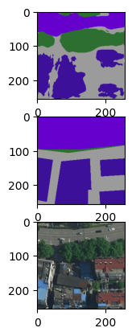
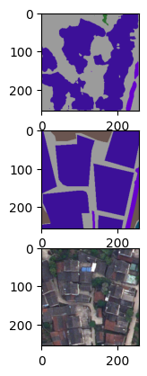
Outputs
Predicted Mask
Predicted Mask
True Mask
True Mask
Input Image
Input Image
1
2

Slide 16
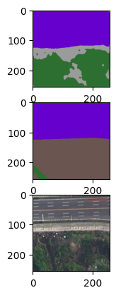
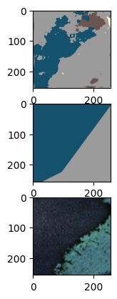
Outputs (continued..)
Predicted Mask
Predicted Mask
True Mask
True Mask
Input Image
Input Image
3
4

Slide 17
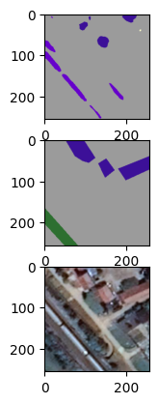
Outputs (continued..)
Predicted Mask
True Mask
Input Image
5

Slide 18
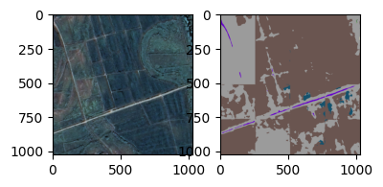
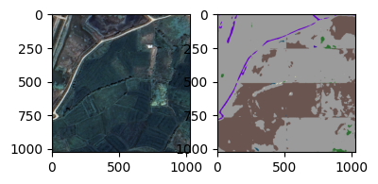
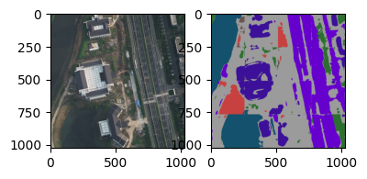
Outputs (Random Images from dataset)
f1
f2
f3
For f1 ,f2 ,f3
(Input Test Image , Output mask prediction)

