Slide 1

THESIS PROPOSAL • COMPUTER SCIENCE
MaestrAI
Vision-based Handwritten Assessment Grading and Feedback for Programming Subjects
Proponents
Jayrald B. Tajanlangit • Francis Marc Nikko Diwa • John Cale N. Nombrado
Adviser
Engr. Violdan Bayocot
Notes:
Greet the panel. State the title and that this is a proposal in Computer Science. Introduce the three proponents and the adviser, Engr. Bayocot.

Slide 2




BACKGROUND OF THE STUDY
Why this study matters
In many Computer Science classes, instructors still grade handwritten code on paper. Marking these assessments by hand takes hours every week, and feedback often reaches students only days or weeks later.
Handwritten on paper
Hours of manual work
Because grades can vary between different graders, inconsistent grading undermines student trust, late feedback weakens motivation, and learning suffers when feedback does not arrive on time.
Varies by grader
Notes:
Frame the real classroom situation: handwritten code, hours of manual grading, late and inconsistent feedback, and the effect on trust, motivation, and learning.

Slide 3





STATEMENT OF THE PROBLEM
The problems we are addressing
Instructors grade handwritten code on paper
Inconsistent grading undermines student trust
Manual grading takes hours every week
Late feedback weakens student motivation
Feedback arrives days or weeks late
Learning suffers without timely feedback
Grades vary between different graders
Notes:
Walk through each problem. Group them mentally: it is paper-based and manual, it is slow, it is inconsistent across graders, and that inconsistency and delay hurt trust, motivation, and learning.

Slide 4


SIGNIFICANCE OF THE STUDY
Who benefits and why it matters
For Teachers & Instructors
For Students
Reduces the workload and checking time spent grading handwritten programming assessments, freeing time for actual teaching and student support.
Supports faster, more consistent feedback so students can learn from their mistakes while the material is still fresh.
Notes:
Emphasise the two beneficiaries you named: instructors get reduced workload and checking time; students get more timely and consistent feedback, which is the core motivation for the system.

Slide 5
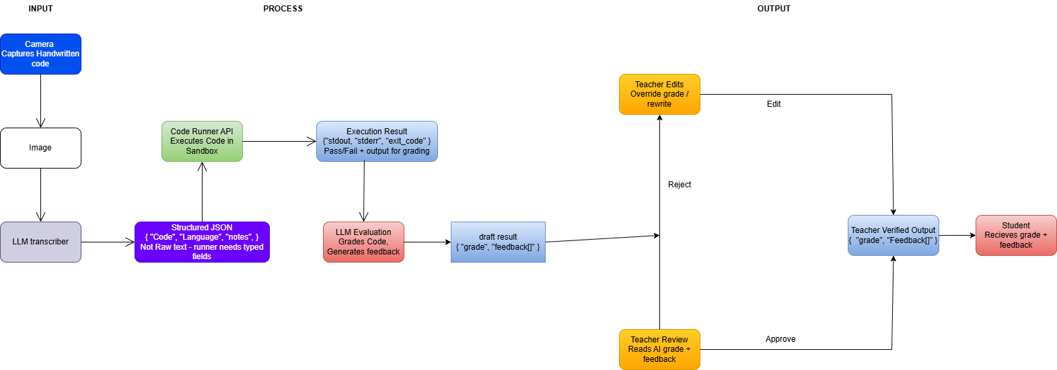
Conceptual Diagram

Slide 6
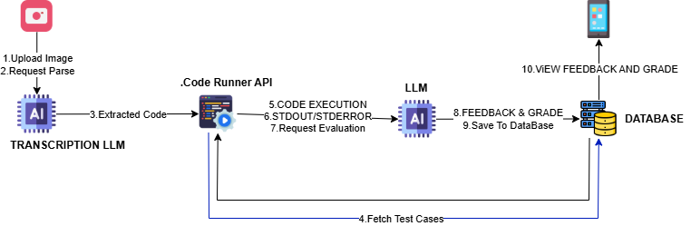
Architectural Diagram​

Slide 7


EXPECTED OUTCOMES
What we hope to achieve
Less grading time
More consistent scores
Cut the hours instructors currently spend marking handwritten programming work.
Reduce the variation that happens between different human graders.
Timelier feedback
A clear comparison
Help students receive results sooner, while the lesson is still fresh.
Evidence on whether MaestrAI or GradeChum grades programming work better.
Anticipated outcomes for a proposal — results will depend on the methodology and evaluation once carried out.
Notes:
Frame these as goals, not guarantees — this is a proposal. The headline deliverable is concrete evidence on which system grades programming assessments better.

Slide 8

Thank you
Questions & Discussion
Jayrald B. Tajanlangit • Francis Marc Nikko Diwa • John Cale N. Nombrado
Adviser: Engr. Violdan Bayocot
Notes:
Thank the panel and open the floor. Have the problem statement and the comparison rationale ready for likely questions about scope and methodology.

